Slide 1
SELF - INTRODUCTION
Hứa Ngô Đại Dương
Email: huangodaiduong@gmail.com
Phone: (+84)938585026

Slide 2
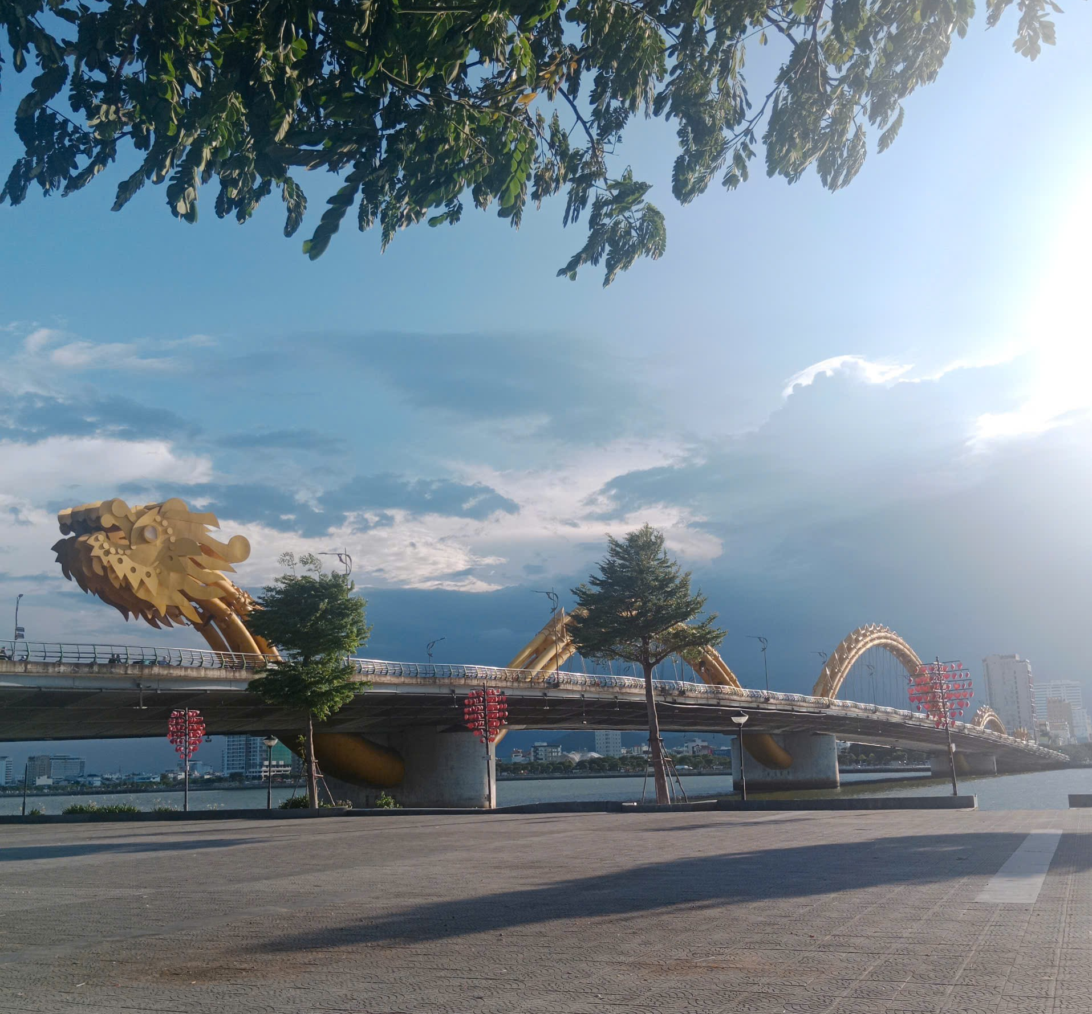

About me:
Come from Danang, the most livable city in Vietnam.
Yet, B1 student at Univ. of science and tech. Hanoi (USTH).
Major in Space science and Satellite technology.

Slide 3
My research interests:
Fascinated in every kinds of physics.
Currently interested in particle physics, and really want to pursue.

