Slide 1


Slide 2
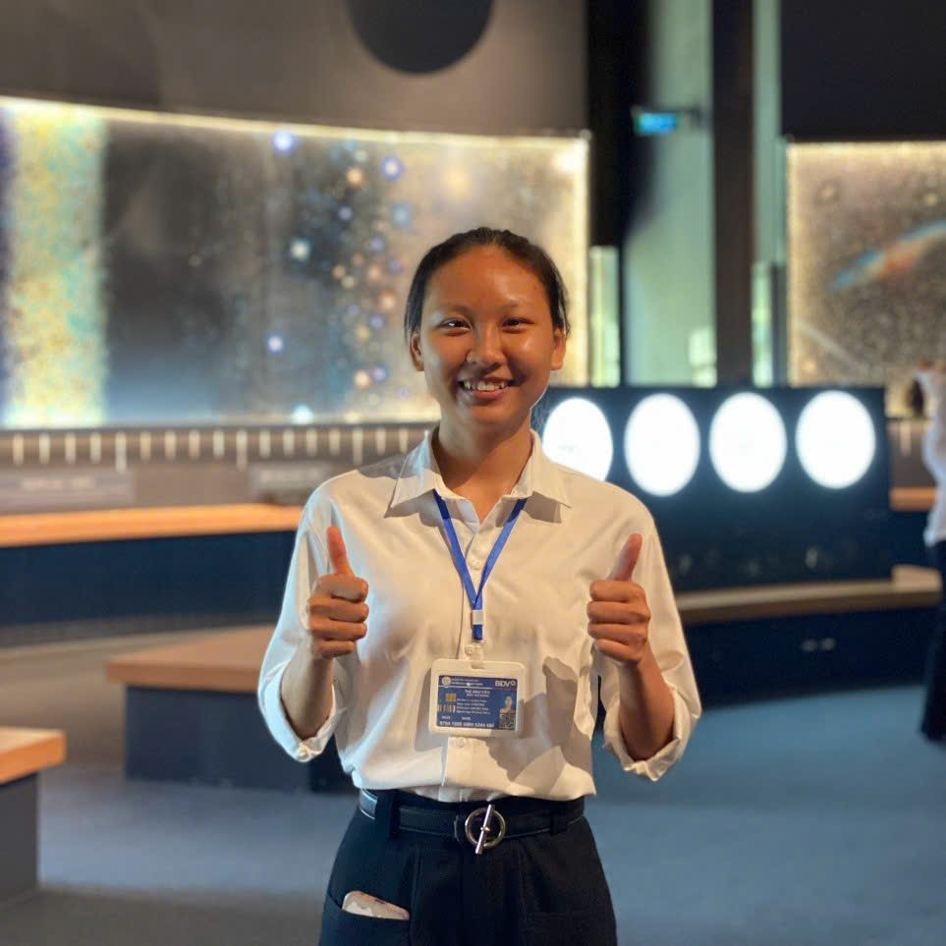
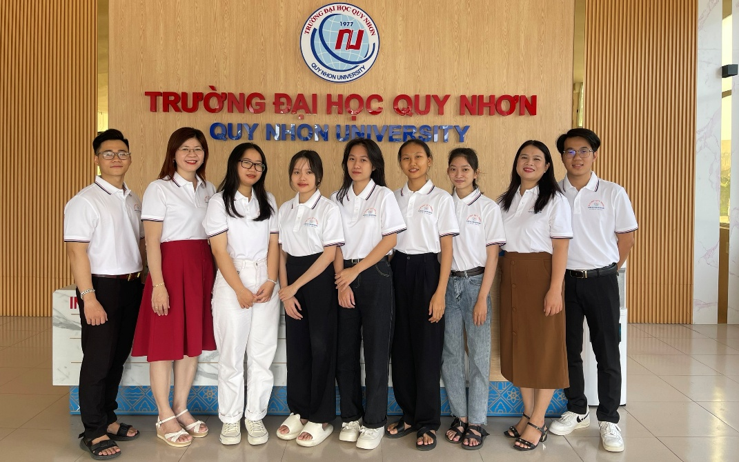
Who am I?
Name: Lê Thị Bích Tuyền
Date of birth: June 1st, 2003
Hometown: Đắk Lắk Province
Phú Yên Province (Before 07/01/2025)
Major: Physics Teacher Education
Student at Quy Nhon University

Slide 3

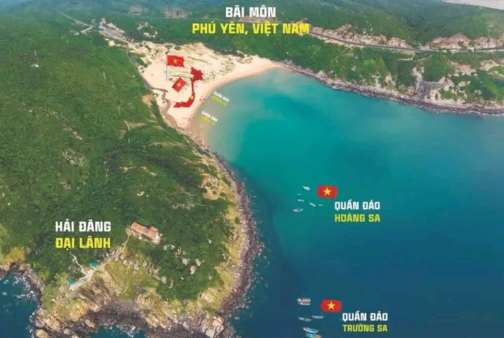
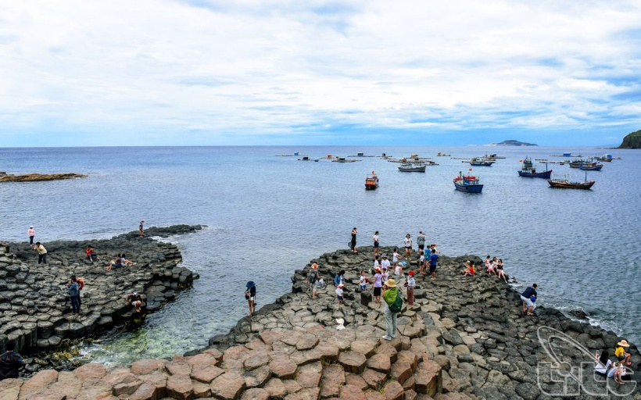
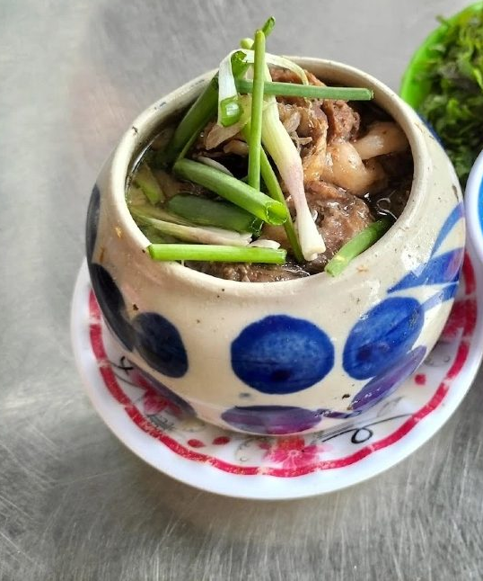
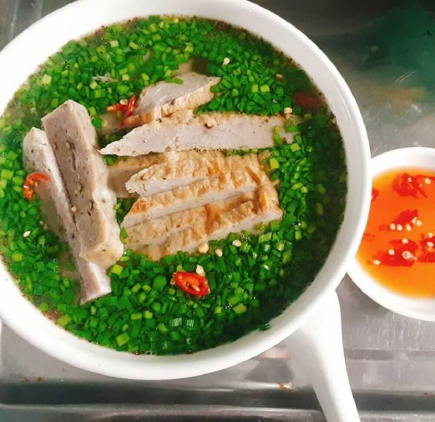
Phú Yên Province
Nghinh Phong Tower
Mui Dien (Dai Lanh Cape)
Da Dia Rapids
Phu Yen’s Specialties

Slide 4

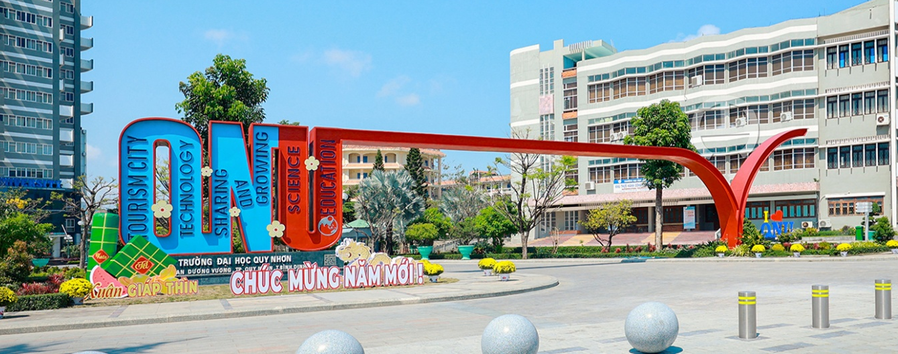


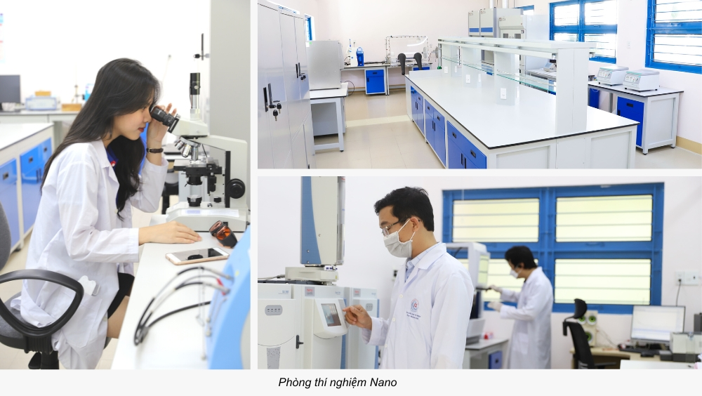
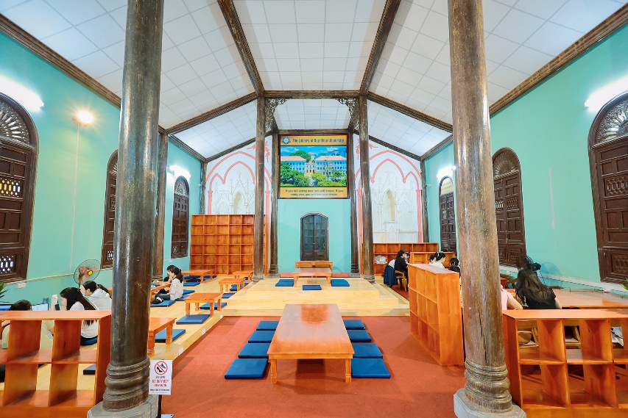
Quy Nhon University
170 An Duong Vuong Street, Quy Nhon Nam Ward

Slide 5
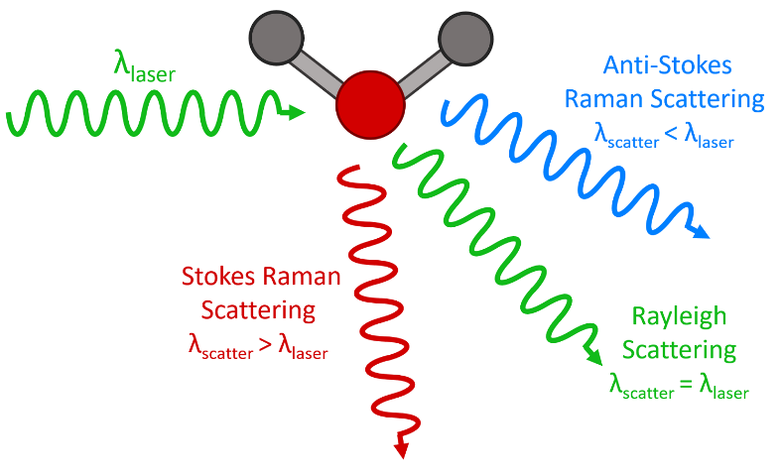

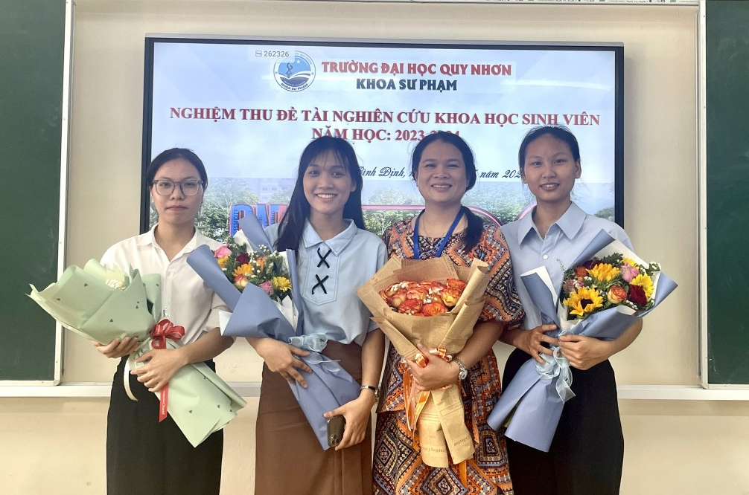
Student research:
QNU Student Scientific Research at School Level
Project:
- Raman spectroscopy.
- Hormon dopamine (DA).
My team and our supervisor Assoc. Prof. Dr. Le Thi Ngoc Loan

Slide 6






Hobies:

Slide 7
Thanks For Your Listening

