Slide 1
Self introduced
Zhenhao Liang
Westlake University, China

Slide 2
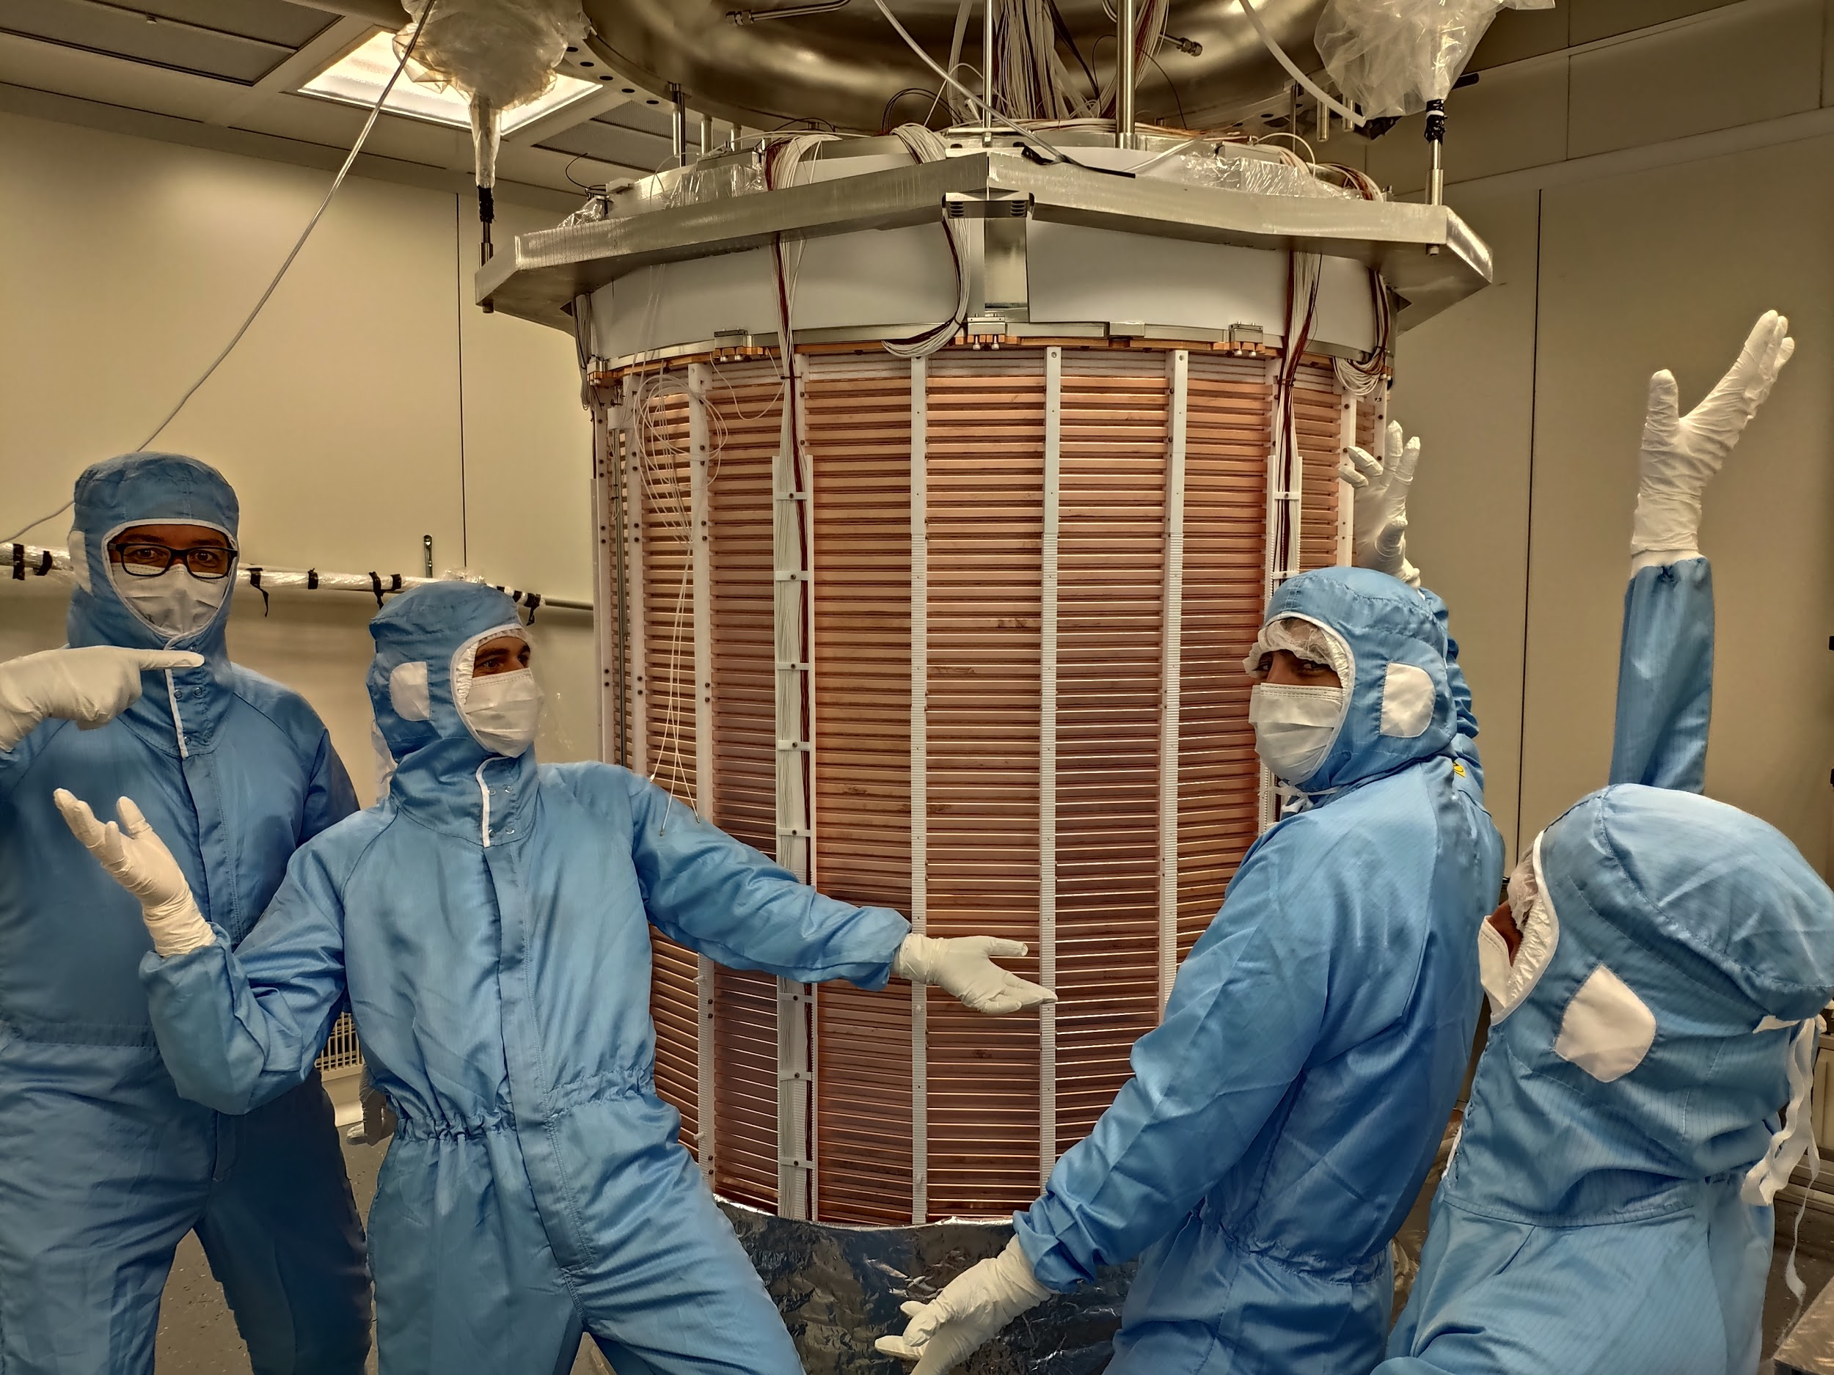
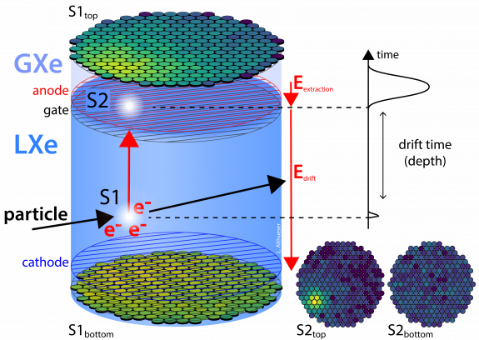
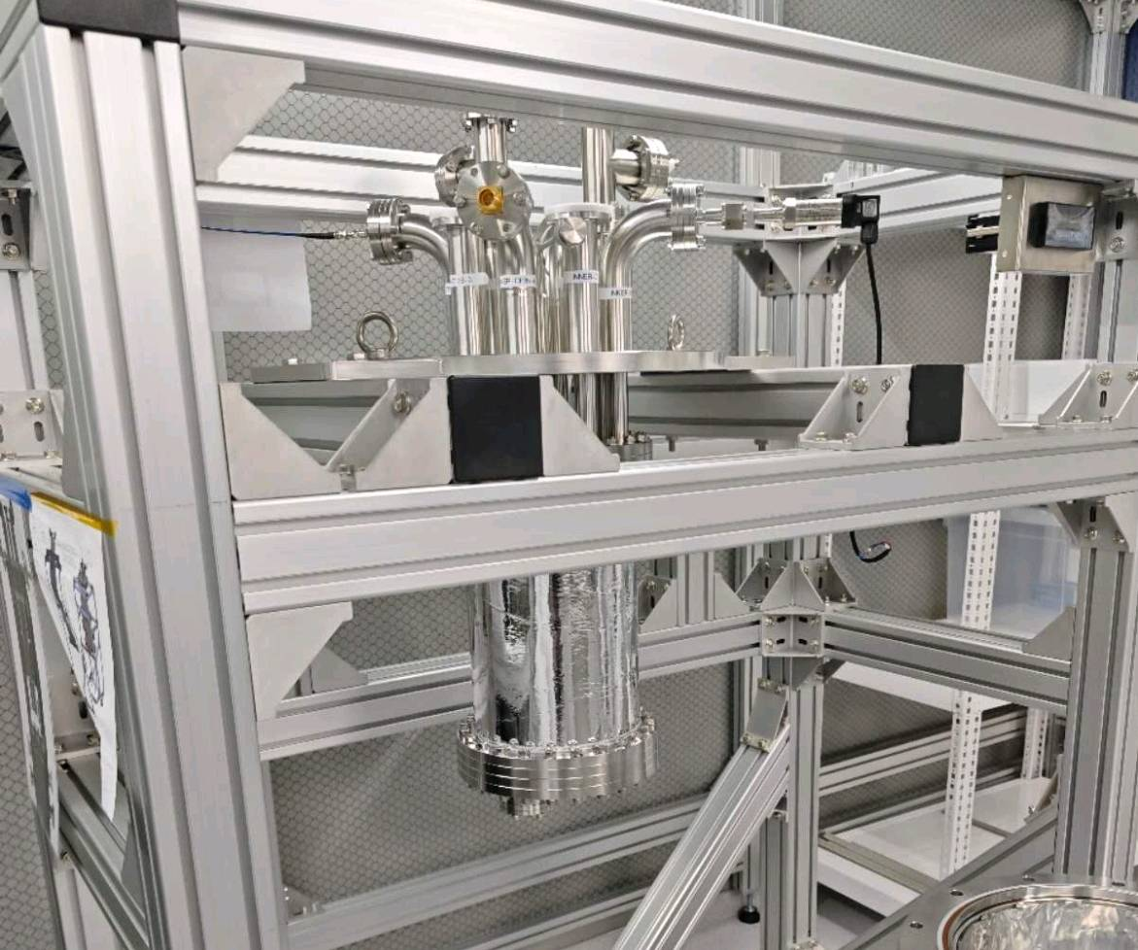
TPC detector
XENONnT Experiment TPC
Local TPC

Slide 3
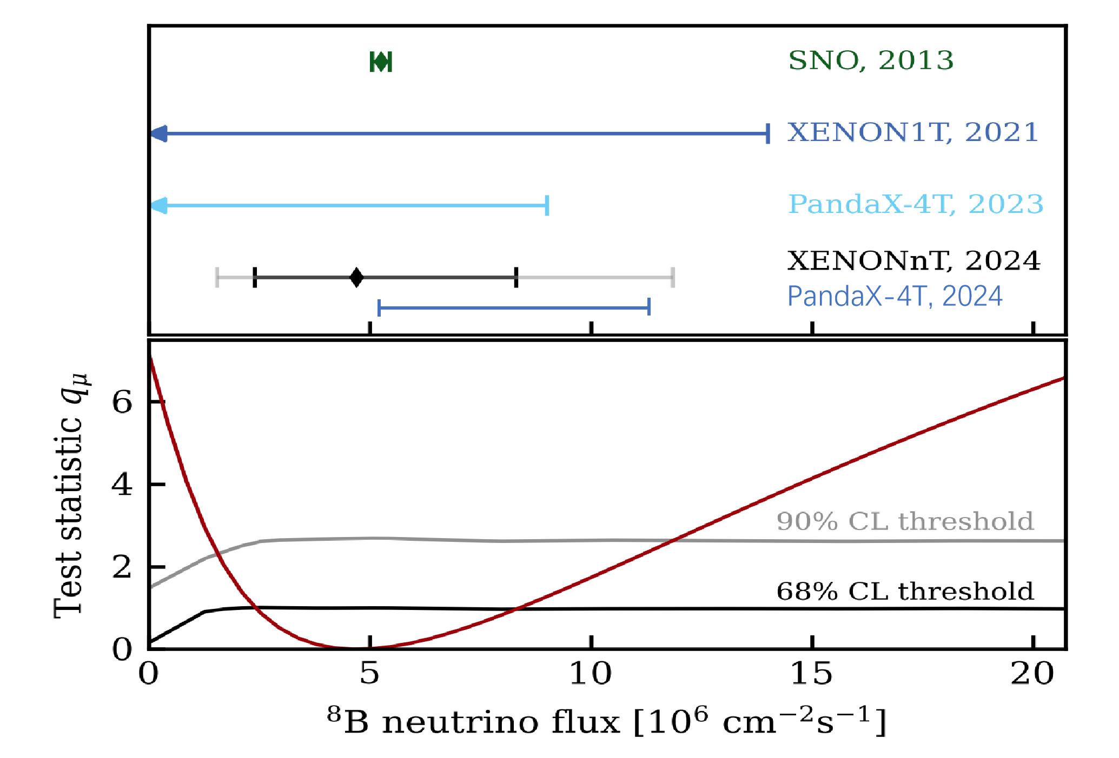
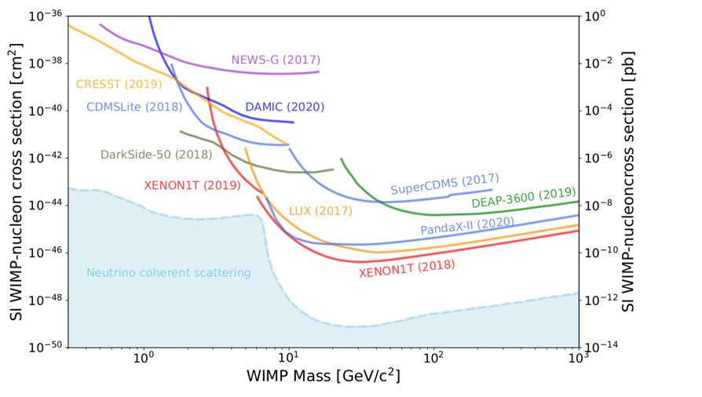
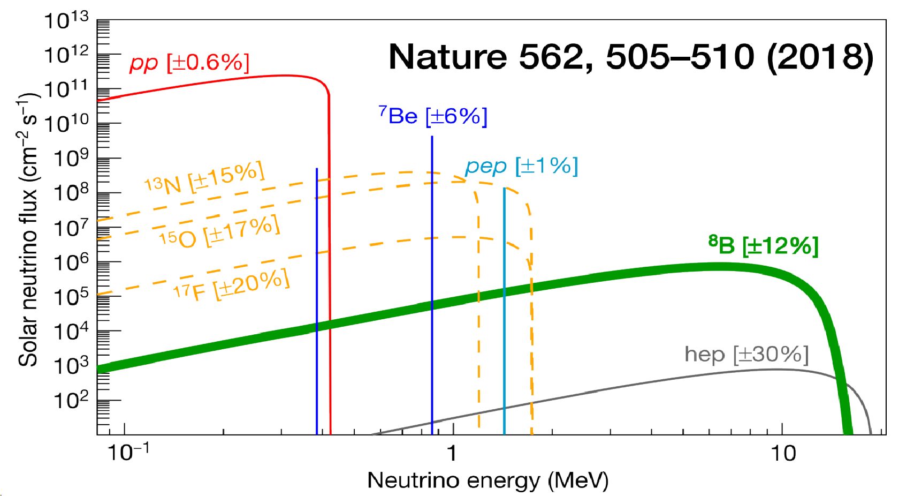
Neutrino fog
First Indication of Solar 8B Neutrinos

Slide 4
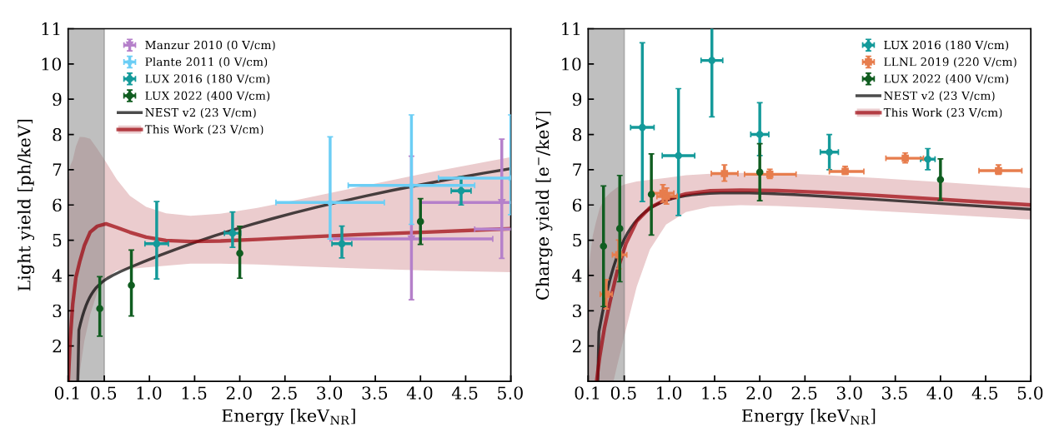
Yield model of XENONnT

Slide 5
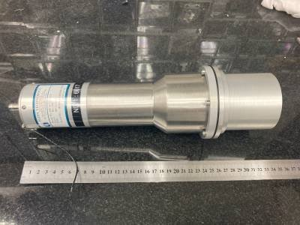
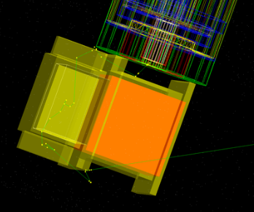
My current task
Design a new calibration plan, by using DD fusion neutron source with a backscatter scintillator. It should provide high-flux, low energy neutron with less gamma background.
Task details:
Geant4 simulation.
PMT read plan design.
Scintillator test.
Data analysis.

Slide 6
Thanks！

