Slide 1

Research and Daily life in Quy Nhon
Phan To Quyen
Vietnam neutrino group IFIRSE - ICISE
VSON9, 15 – 25 July, 2025

Slide 2


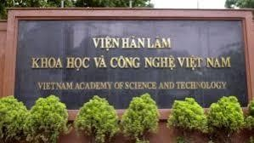

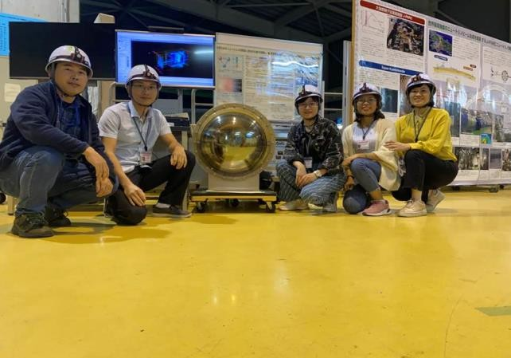
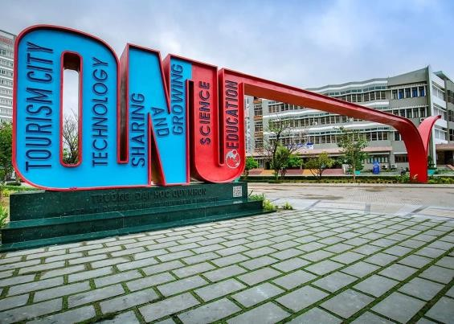
About me
Full name: Phan To Quyen
Hometown: Binh Dinh province -> Gia Lai province
^{3rd} year PhD student at GUST, VAST.
2015 - 2019 2019 - 2022
2022 - present
Bachelor: Physics Teacher
at Quy Nhon University
Master: Theoretical and Mathematical
Physics at GUST, VAST.
PhD student in Theoretical and
Mathematical Physics, at GUST, VAST
Member of VN neutrino group,
IFIRSE, ICISE.
T2K collaborator since 2019

Slide 3
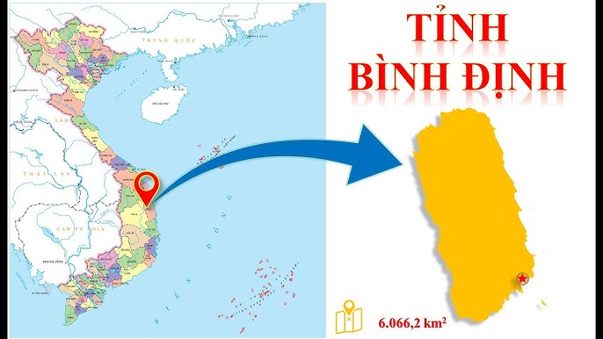
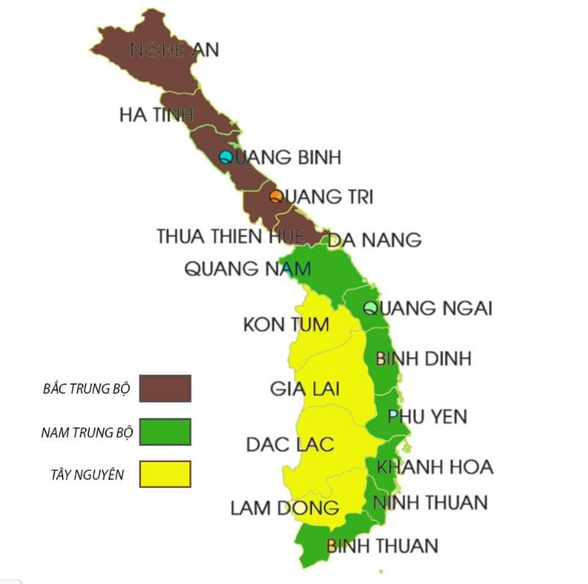
My hometown
in the South Central Coast region of Vietnam
Notes:
Bình Định is a coastal province located in the South Central Coast region of Vietnam. It borders Quang Ngai Province to the north,
Phu Yen Province to the south, Gia Lai Province to the west, and the East Sea to the east.
The provincial capital is Quy Nhon, a city known for its beaches, historical sites, and cultural heritage.

Slide 4
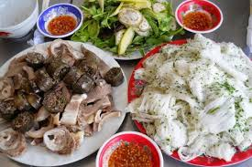
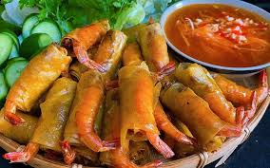
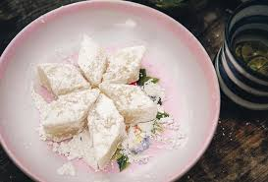
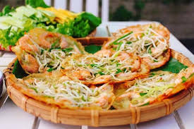
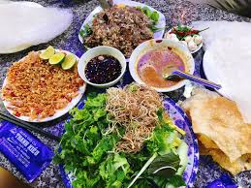

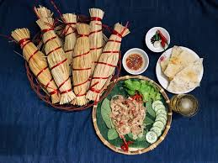
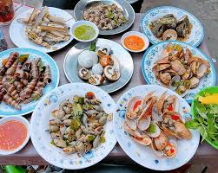
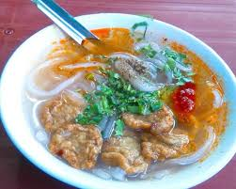
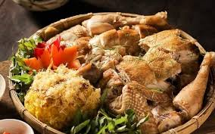
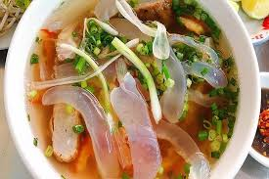
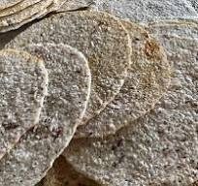

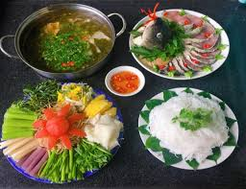
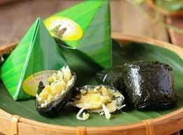

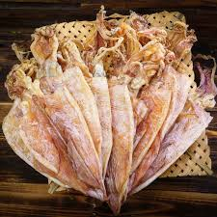
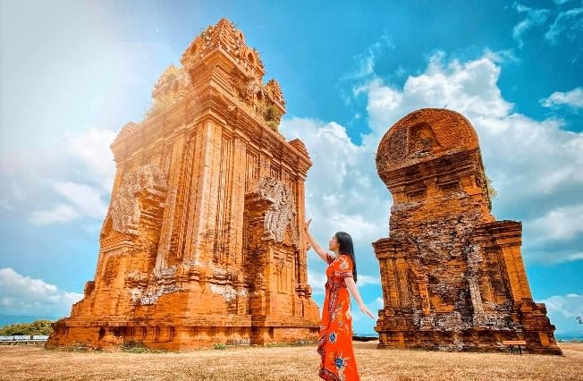
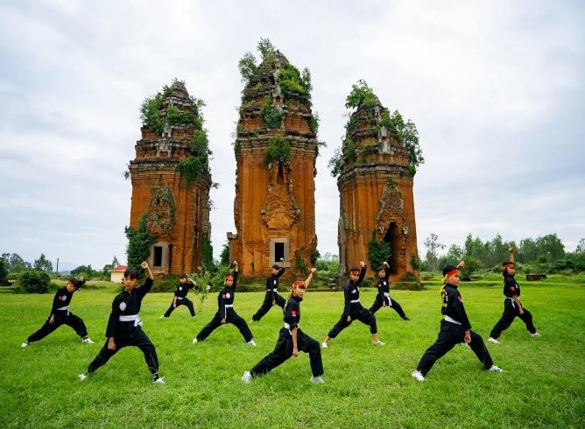
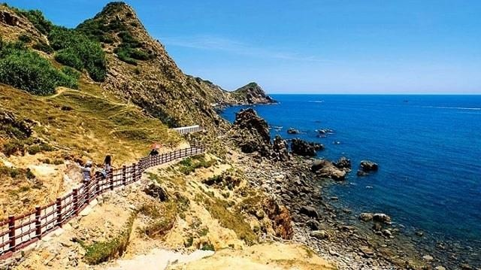
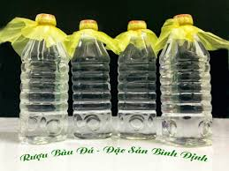
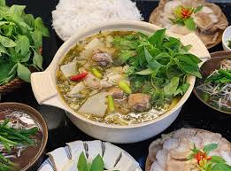

Slide 5
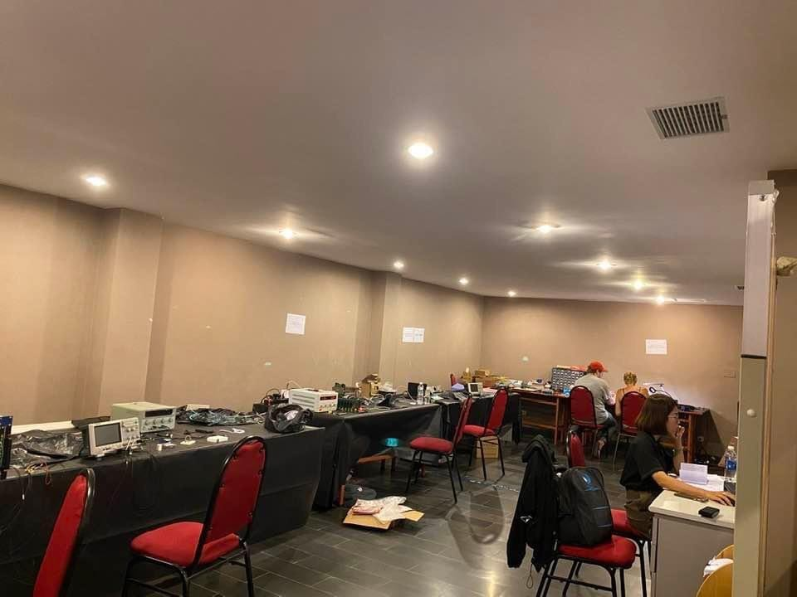
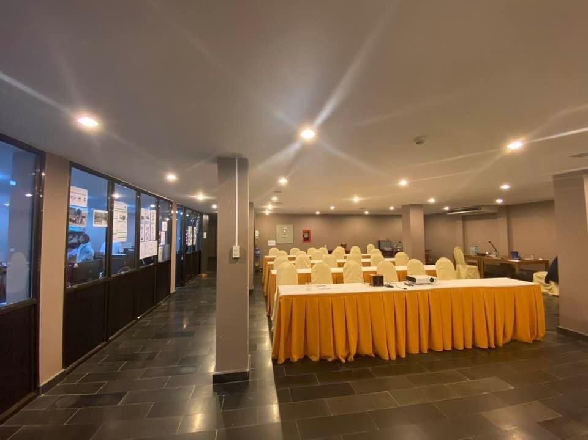
Research at IFIRSE
Neutrino physics group
Neutrino lab
Group meeting room

Slide 6
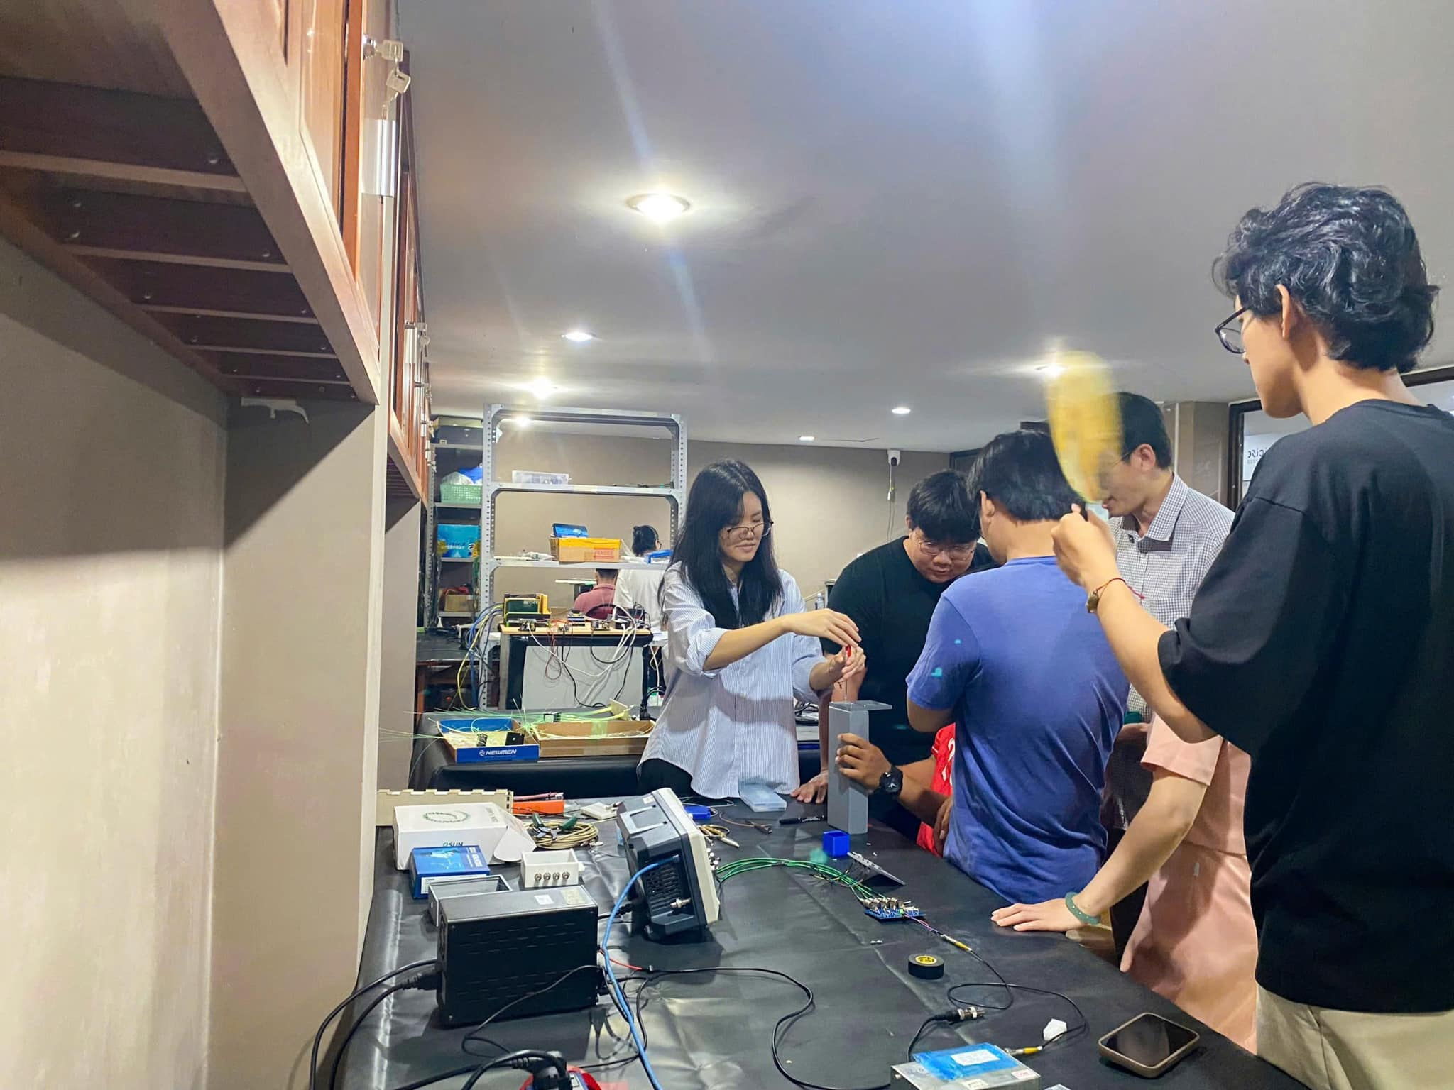
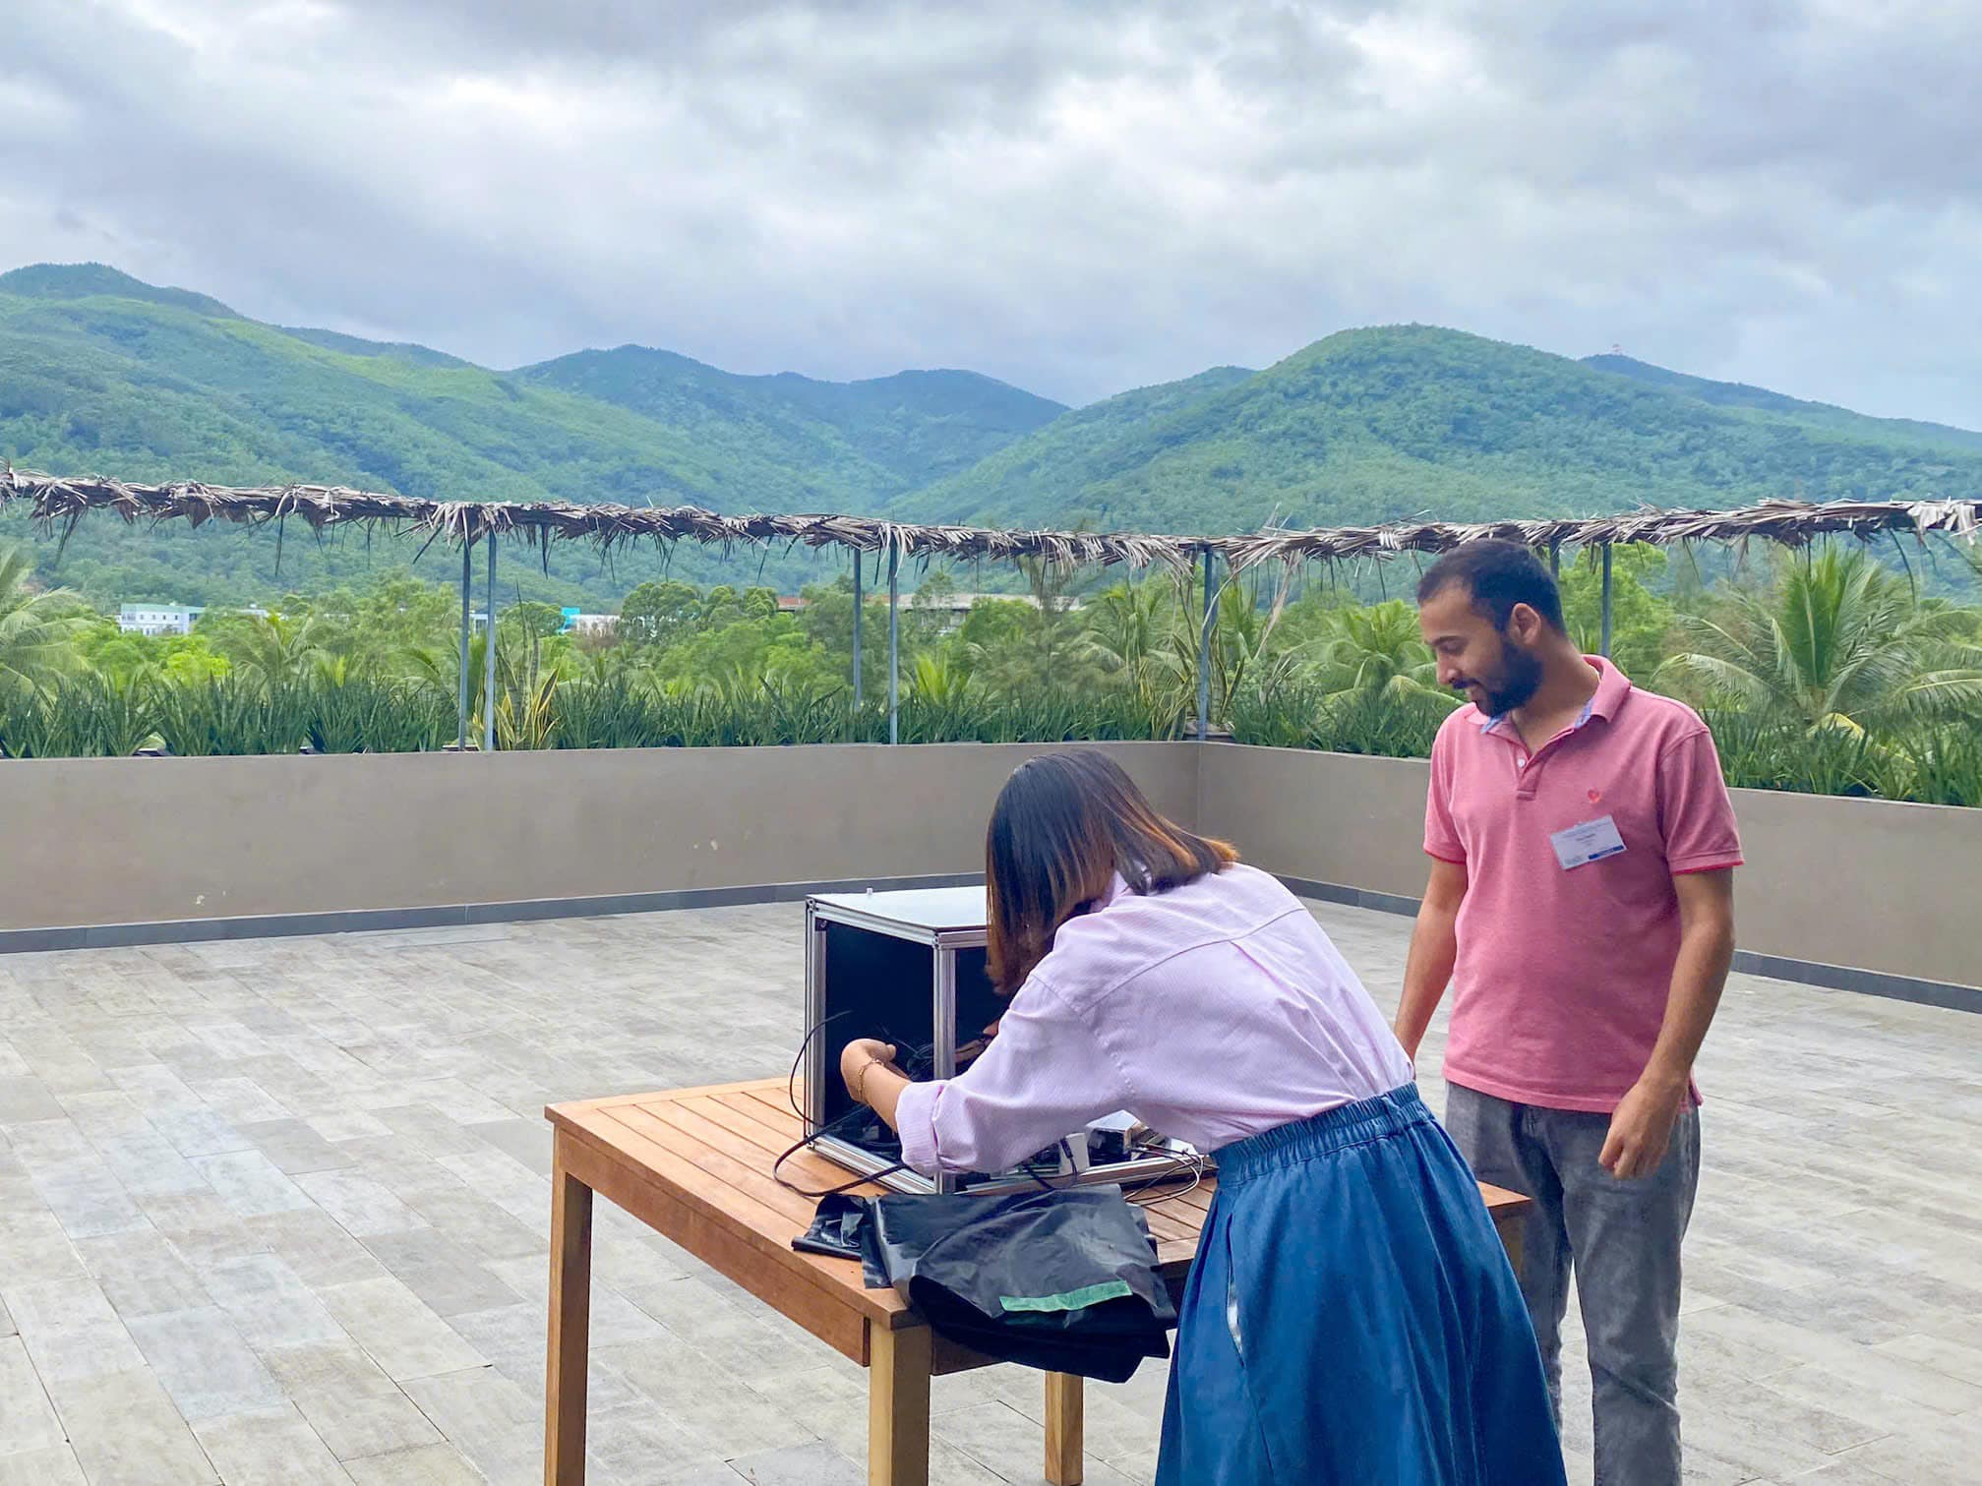
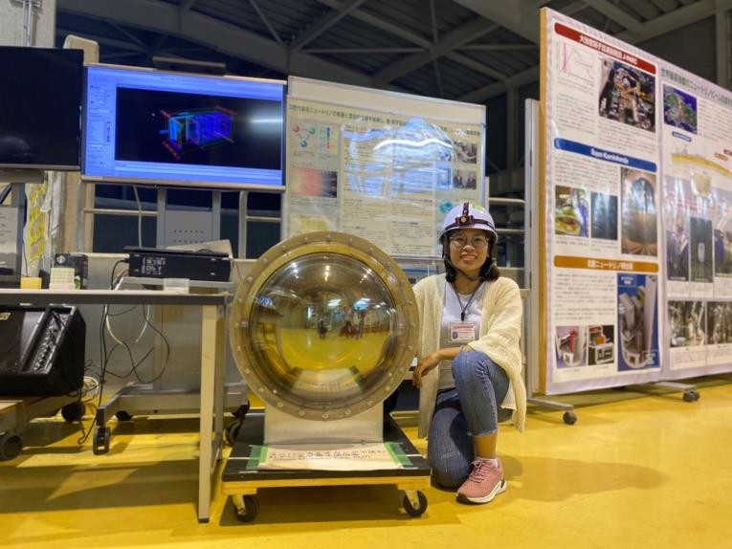
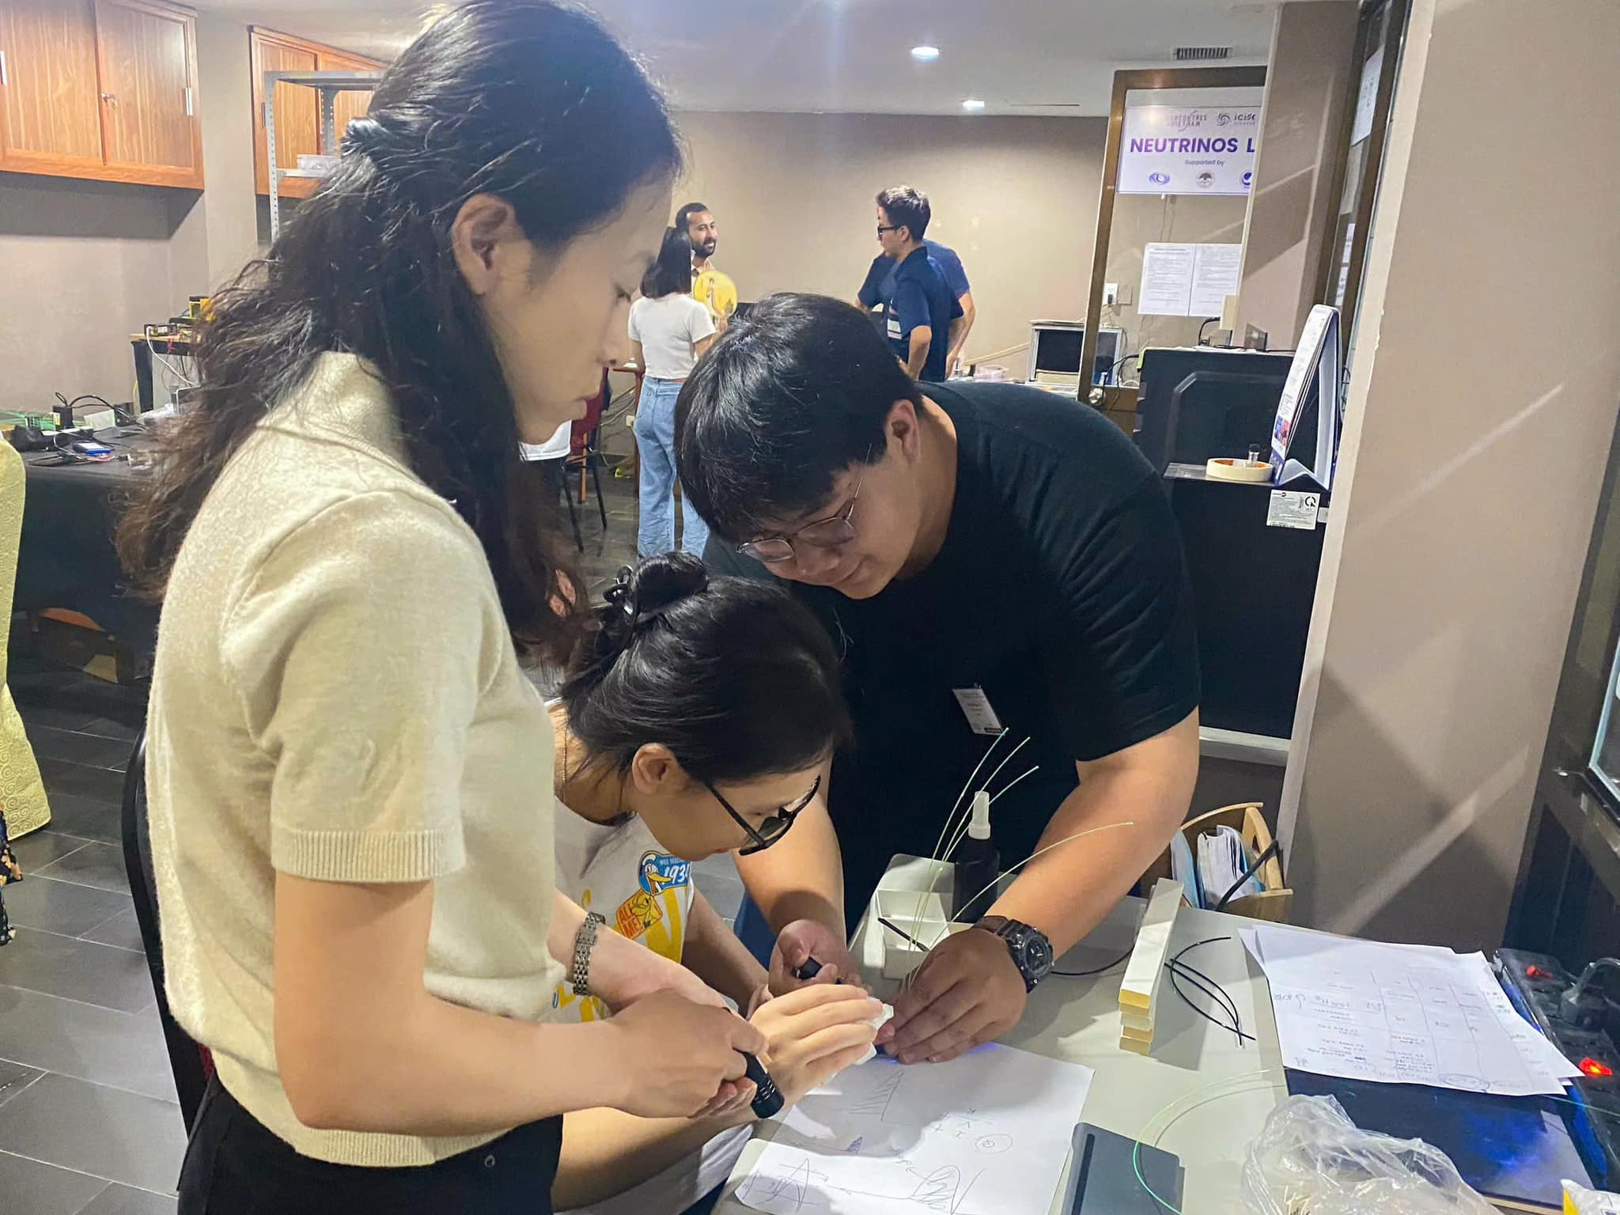
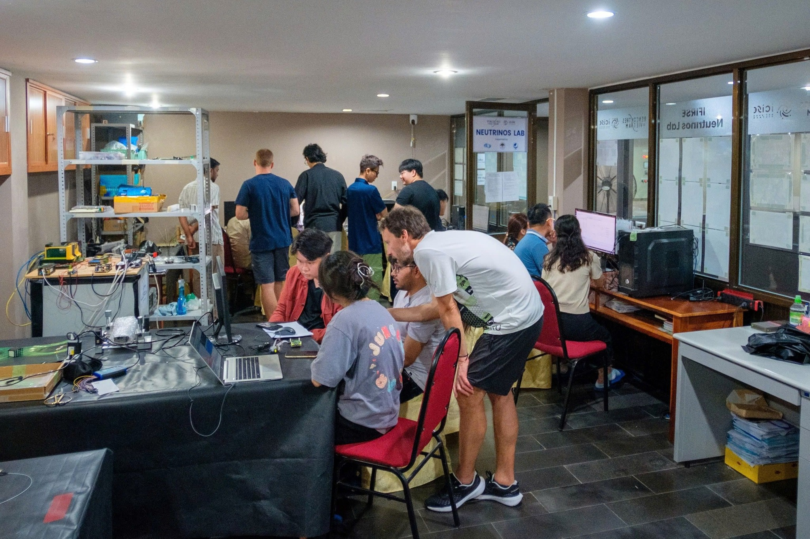

Research at IFIRSE
Hardware work at IFIRSE: MPPC, PMT, light photosensors and some equipments at the neutrino lab.
PMT
Hardware Camp: photosensor, SiPM, PMT, Cosmic-ray measurement, time-peak detector, ….
MPPC

Slide 7
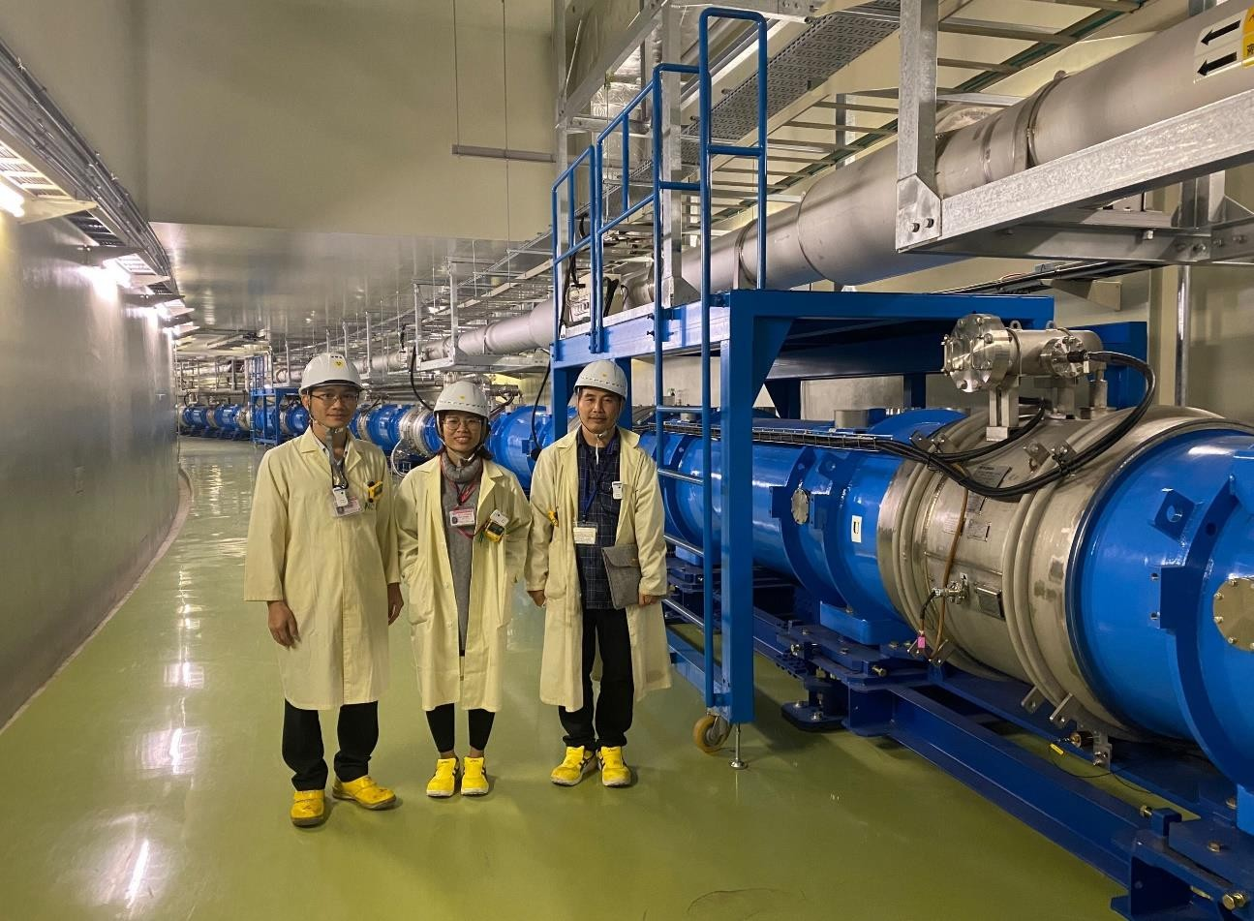
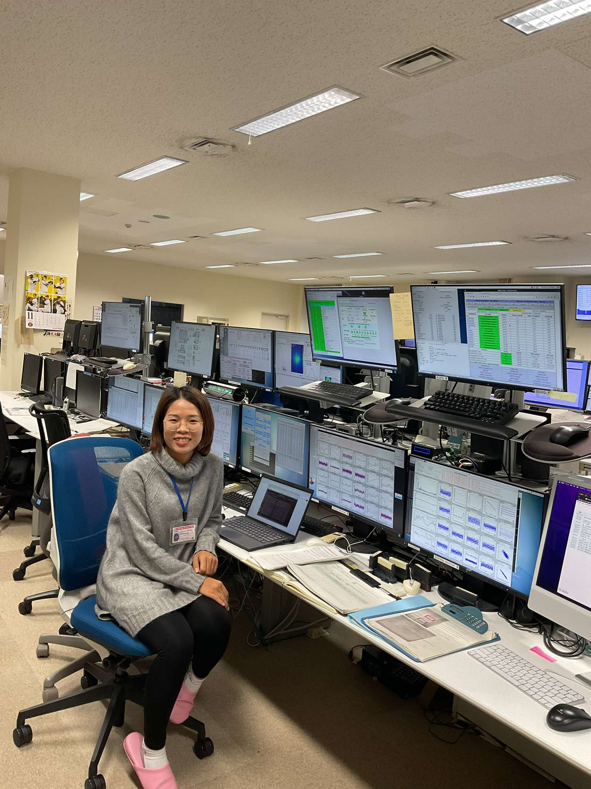
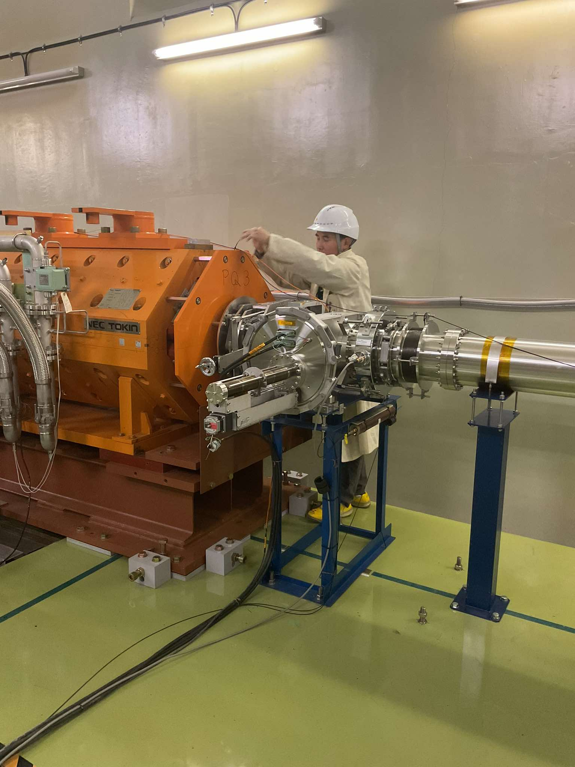
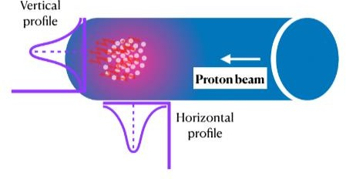
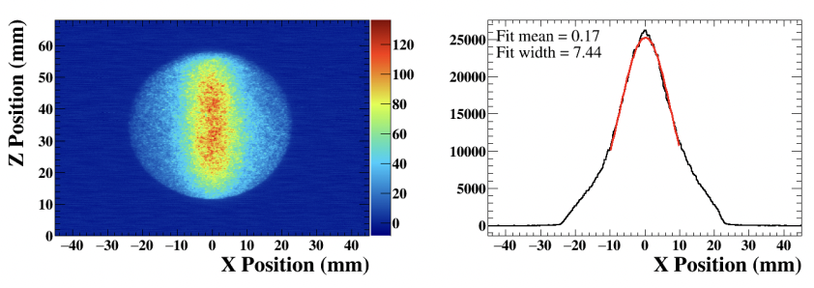
Research at IFIRSE
Hardware work at J-PARC:
Take beamshift at J-PARC.
Beamloss monitor during beamline operation.
Investigate beamline profile by beam inducing fluorescence (BIF).
VN neutrino group at J-PARC
𝐍_{𝟐}
Beam shift at CCR, J-PARC
Work in the tunnel, J-PARC
Beam profile from BIF

Slide 8
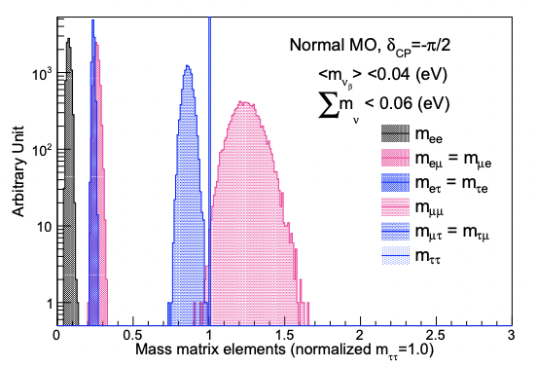
Research at IFIRSE
Software work : ROOT, GLoBES, GEANT4, NEUT,…
Neutrino phenomenology: CPviolation, Mass hierarchy, 𝜃₂₃ octant,
𝑚_{𝑣} spectrum
Master thesis:
Resolving the octant of leptonic mixing angle 𝜃₂₃
with Hyper-K experiment and the impact to the
CP violation measurement.
PhD thesis:
Neutrino mass spectrum:
hints from neutrino oscillation, cosmology, betadecay.

Slide 9
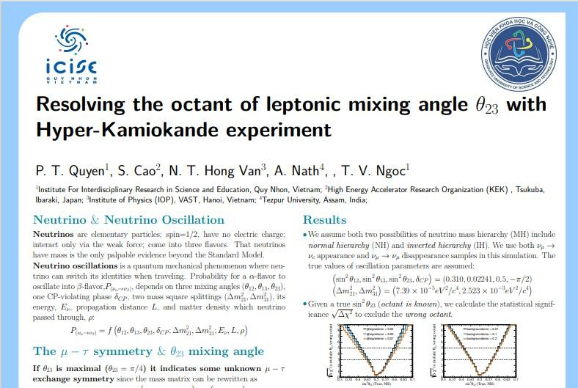
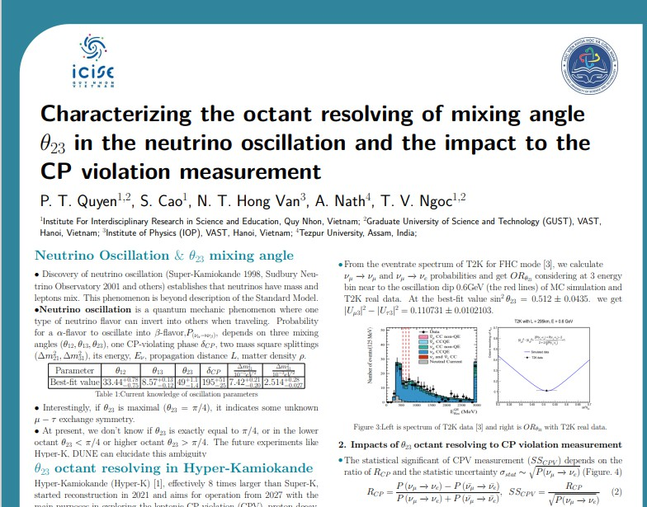
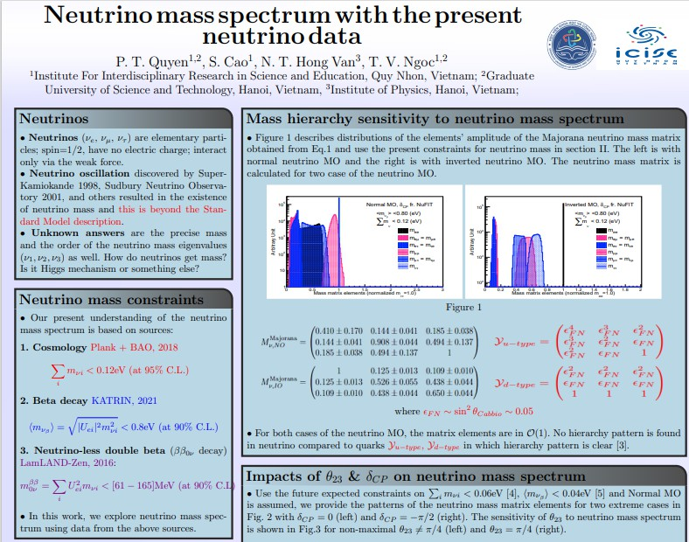
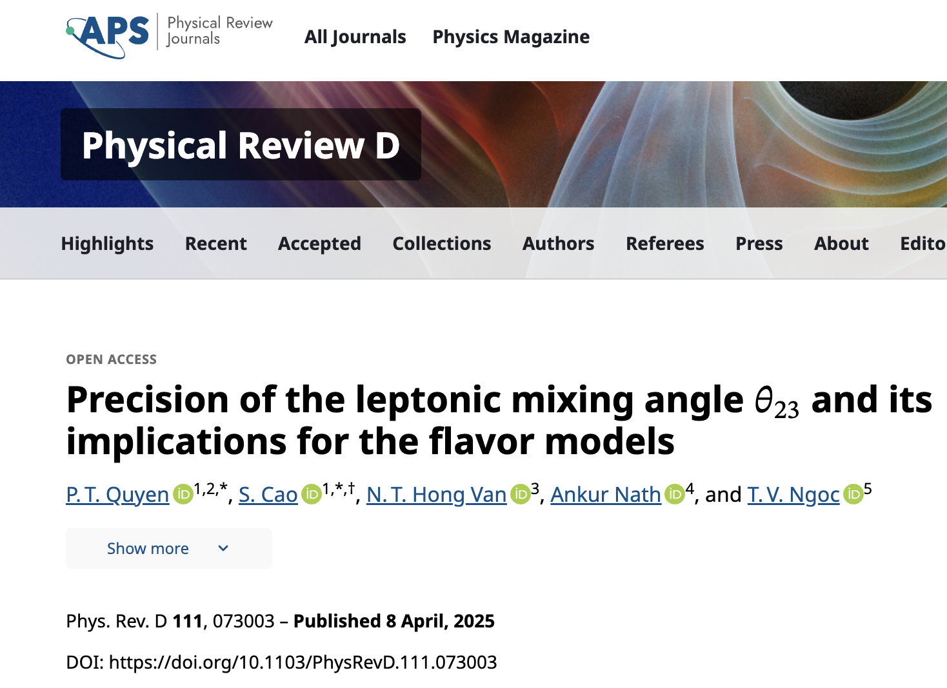
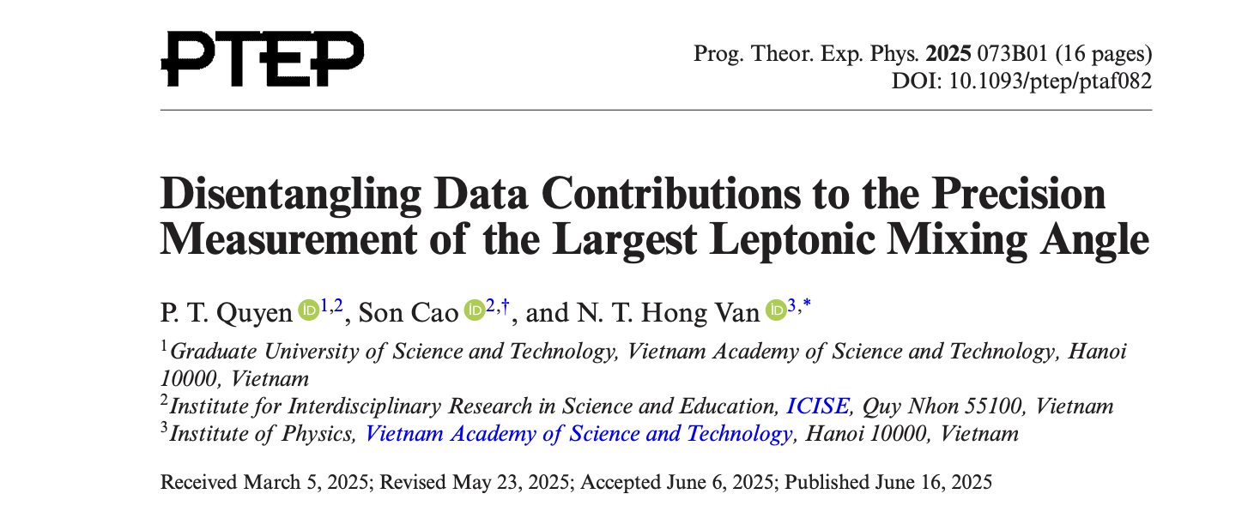
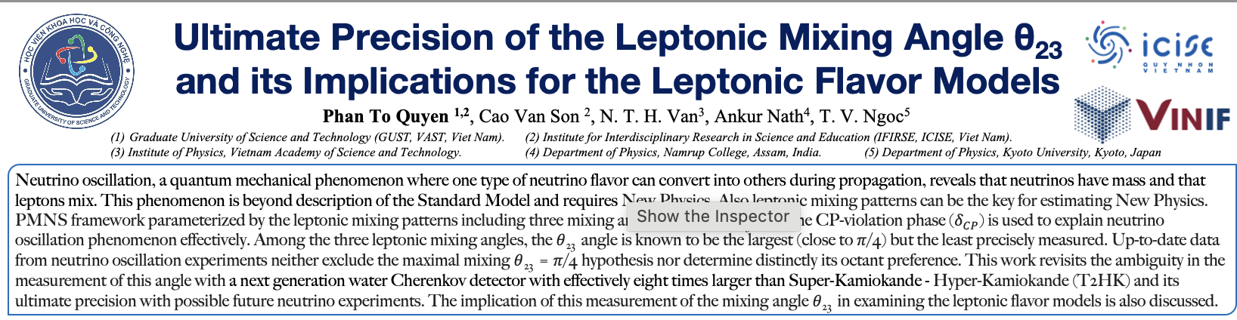
Research at IFIRSE
Software work : ROOT, GLoBES
Some topics: 𝜽_{𝟐𝟑} octant, 𝒎_{𝝂} spectrum
VCTP45
VCTP46
VCTP47
VCTP49

Slide 10
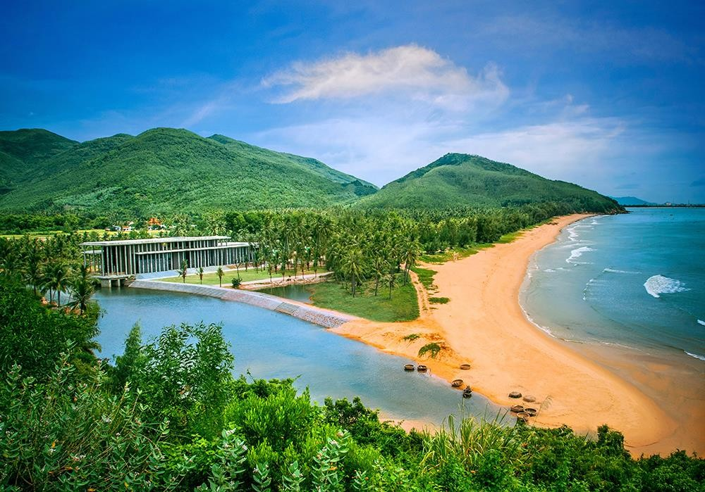
Daily life in Quy Nhon
Interfere between mountain and
sea: go swimming, hiking, fishing,….
Friendly and kindly local people
Free fresh air
Fresh and cheap sea foods

Slide 11
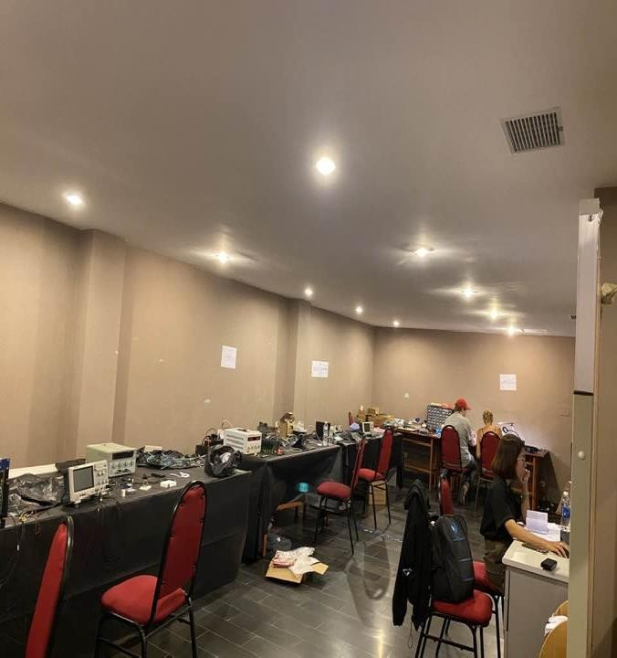
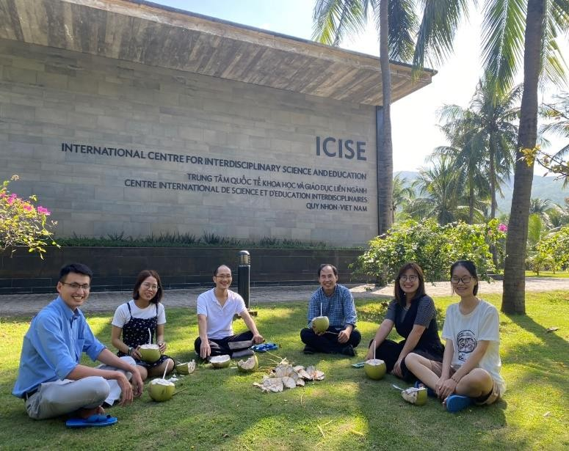
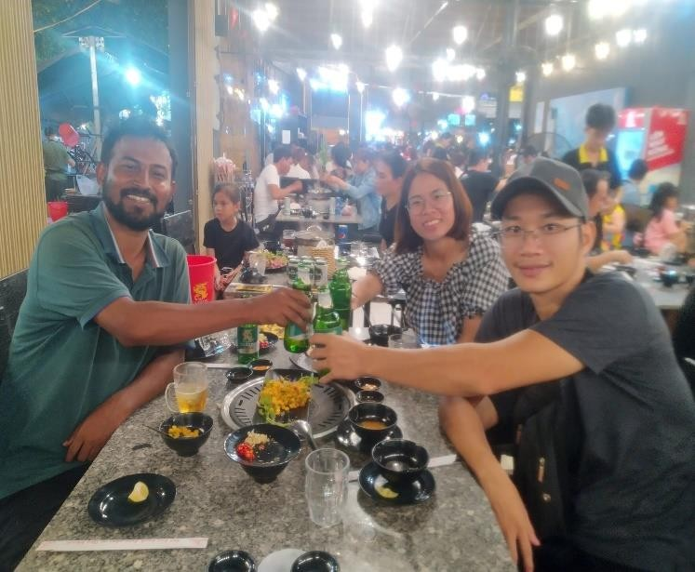
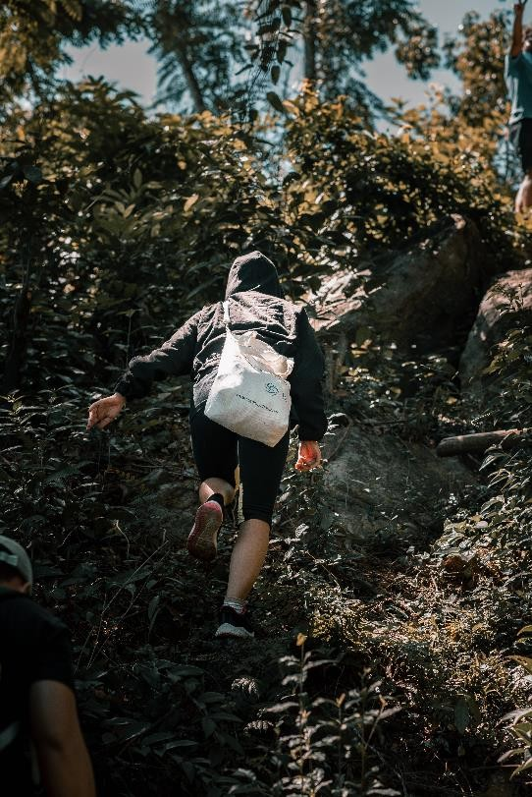
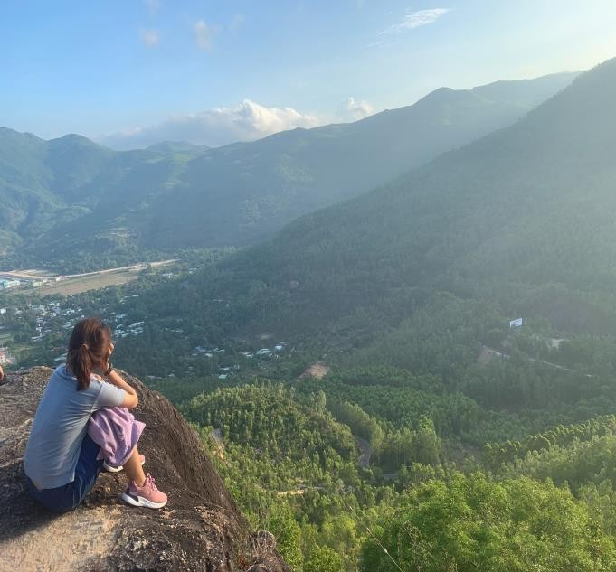
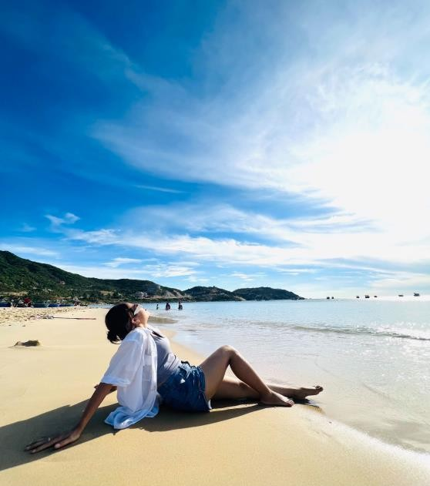

Daily life at IFIRSE
Morning
Afternoon (sometimes)
Evening (sometimes)

Slide 12




Some words to say about life of PhD student at IFIRSE????
Happy COmfortable
Peaceful
Scientific
An ideal place for living and doing research

Slide 13


If you want to enjoy neutrino physics, A fairytale life , sashimi in Japan.
Come with us, your dreams become true.

Slide 14
Thank you for your attention
Welcome to Quy Nhon

