Slide 1



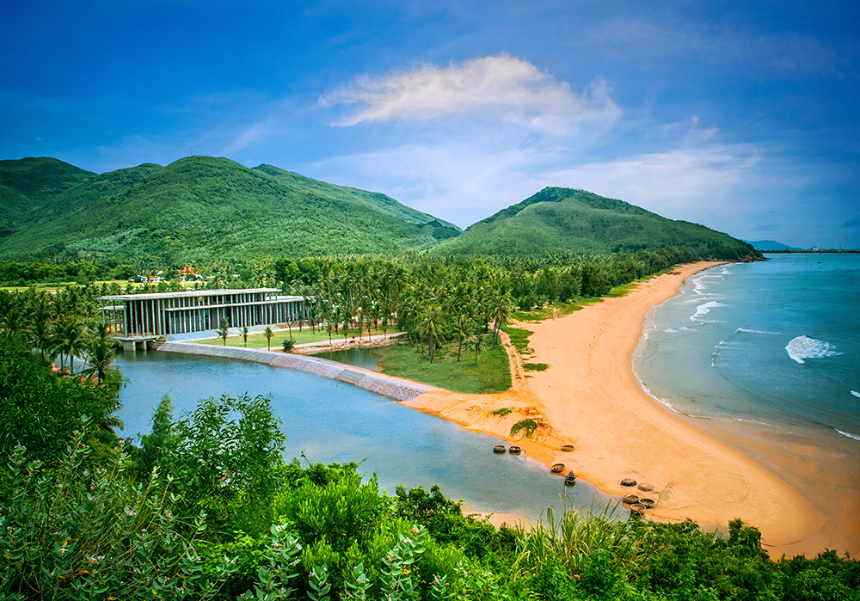








HELLO
Vietnam School on
Neutrinos 2025

Slide 2

ABOUT ME
Name: Ha Thi Thuy Linh
Birthday: 2002/09/11 (23)
Birthplace: Ha Nam province

Slide 3
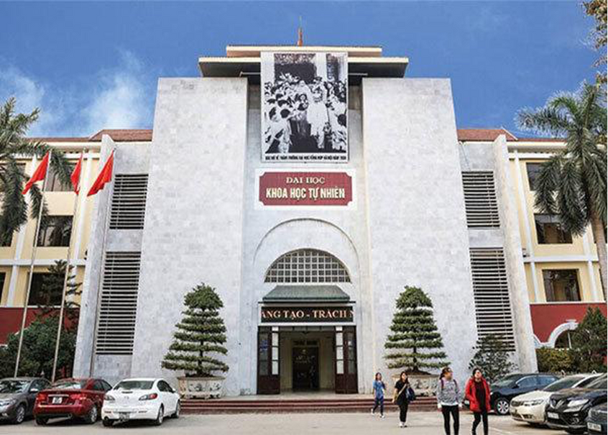

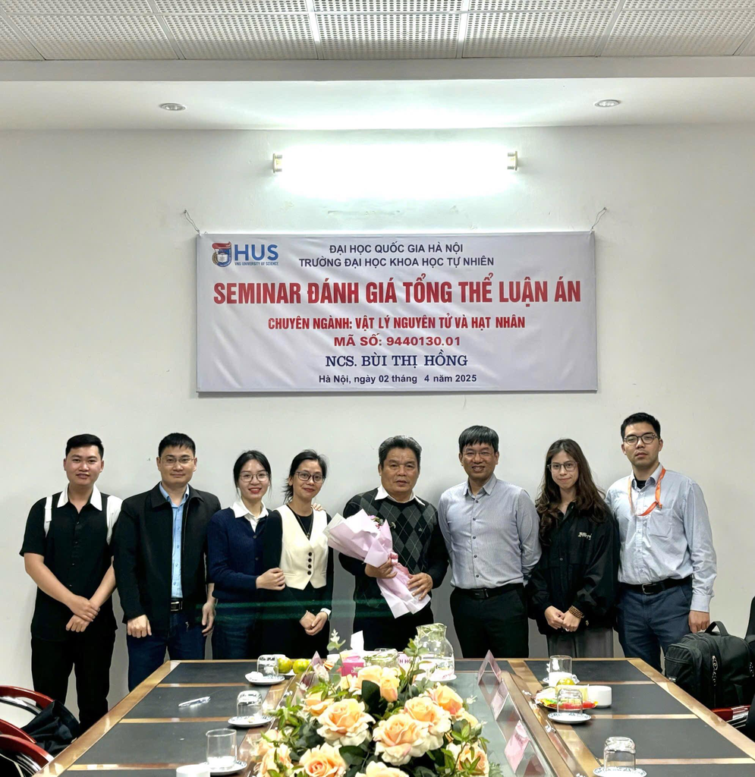
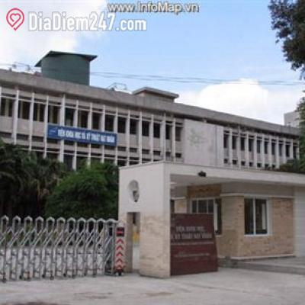

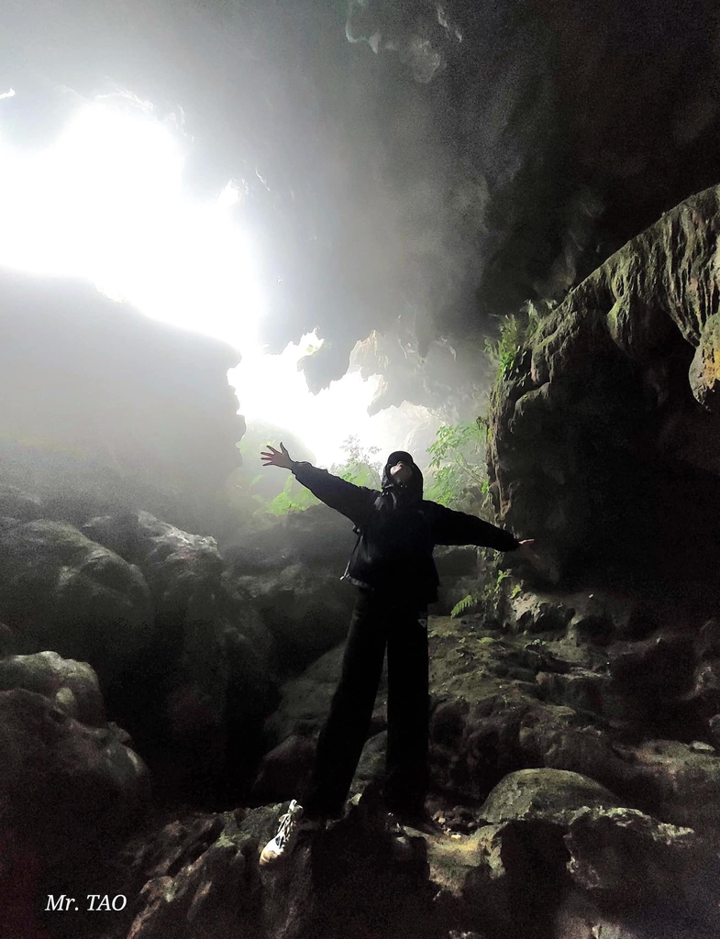
My school
My school
My usual
spot
My current workplace
My research
team

Slide 4
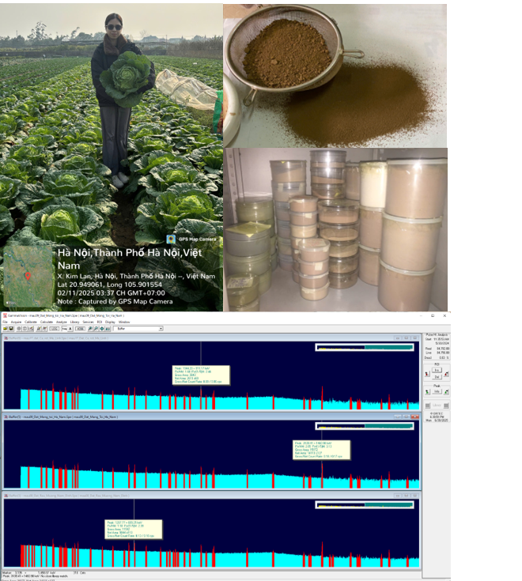


MY RESEARCH PASSIONT
Development of a radionuclide activity concentration spatial distribution map in agricultural produce (vegetables/fruits) across Northern Vietnam.

Slide 5
I APPRECIATE YOUR TIME AND ATTENTION.

