Slide 1
Self-Introduction @VSoN_2025
Ayana Asai

Slide 2


Homeland Japan 🇯🇵
Position Master’s student (1st year)
Affiliation Particle Physics Lab of Okayama University
Experiment NA61/SHINE experiment
Hobbies Watching anime, singing, playing games
Ayana Asai
Feel free to follow!!

Slide 3
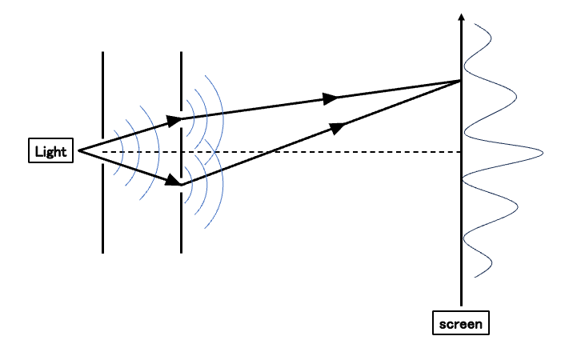
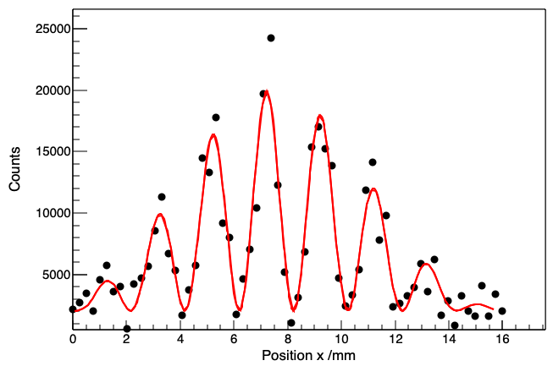
Undergraduate thesis
Measure single photon interference
- observe with a MPPC array and the corresponding readout circuit, EASIROC
light
Screen
Current study
Detector development for the new beam line of NA61/SHINE experiment

Slide 4
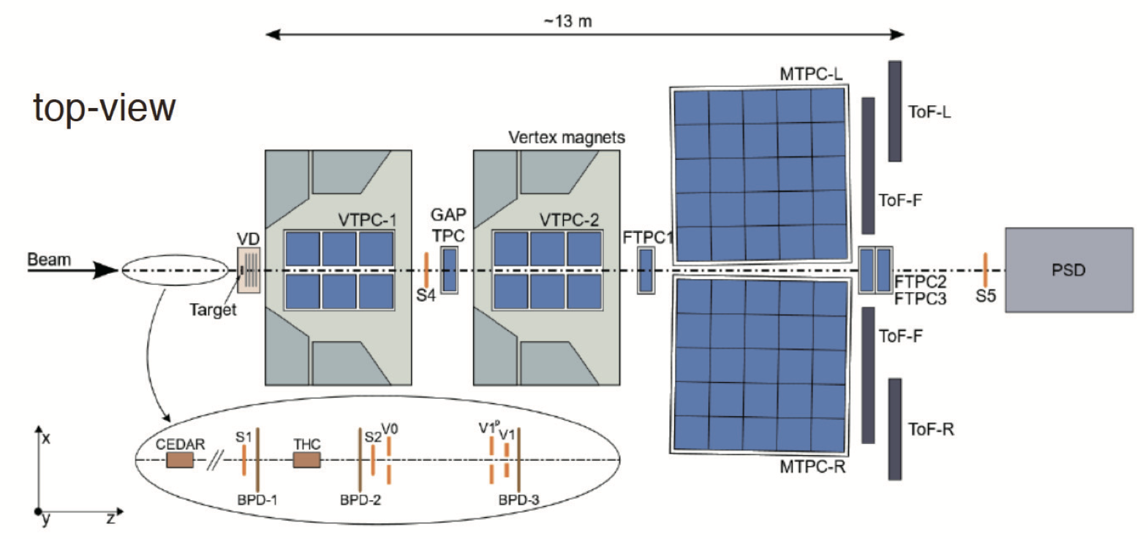
New Low-Momentum Hadron Beamline
・Fixed-target experiment at CERN SPS: NA61/SHINE
・Planning construction of a 2−13 GeV/c low-momentum hadron beam line
・Aims to improve flux uncertainty for various neutrino experiments
My future work: Detector development
・Scintillation counter
- PID of the secontdry hadron beam
・Silicon strip detector
- a beam monitor

