Slide 1

Hello everyone
My name is
Pham Hoang Nam

Slide 2
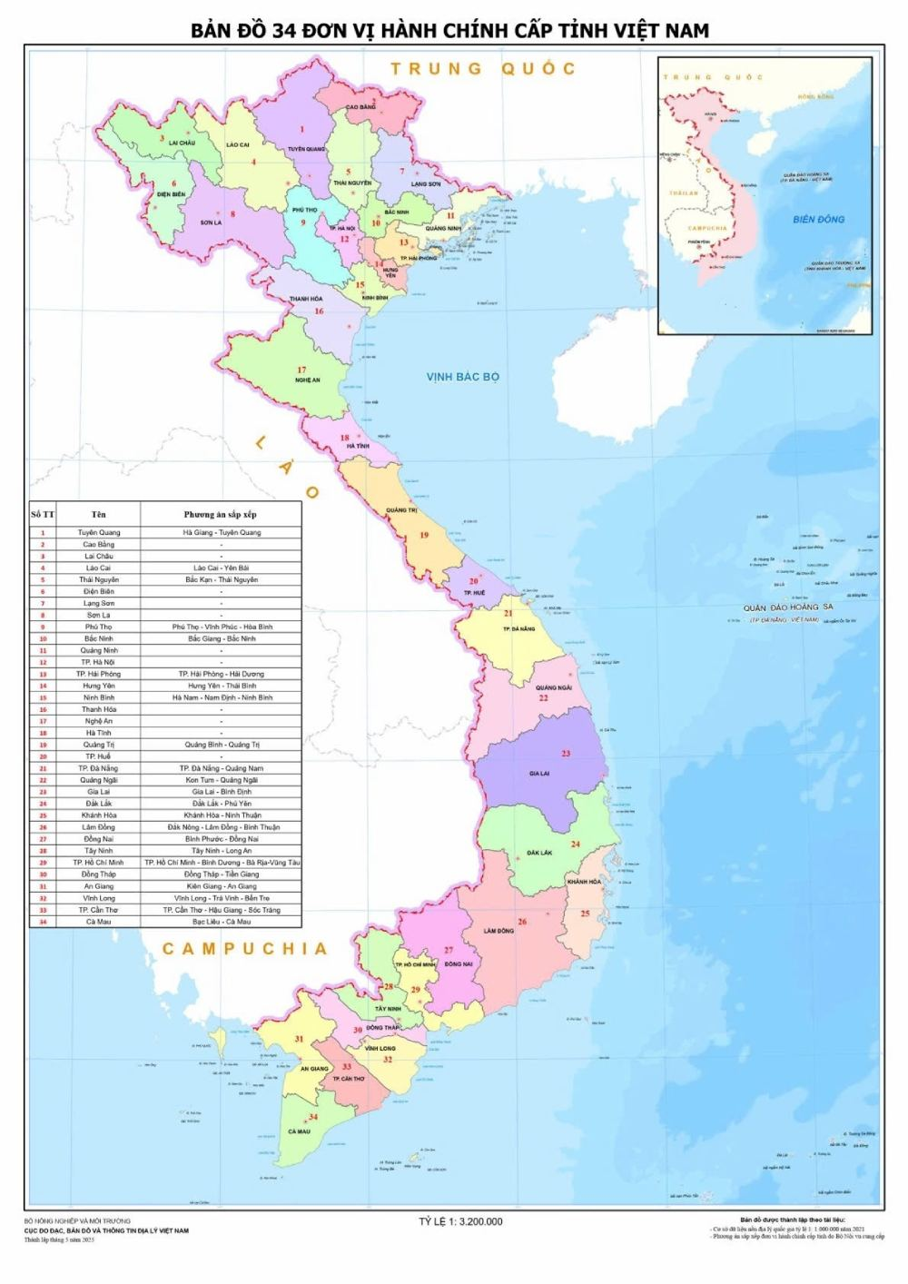
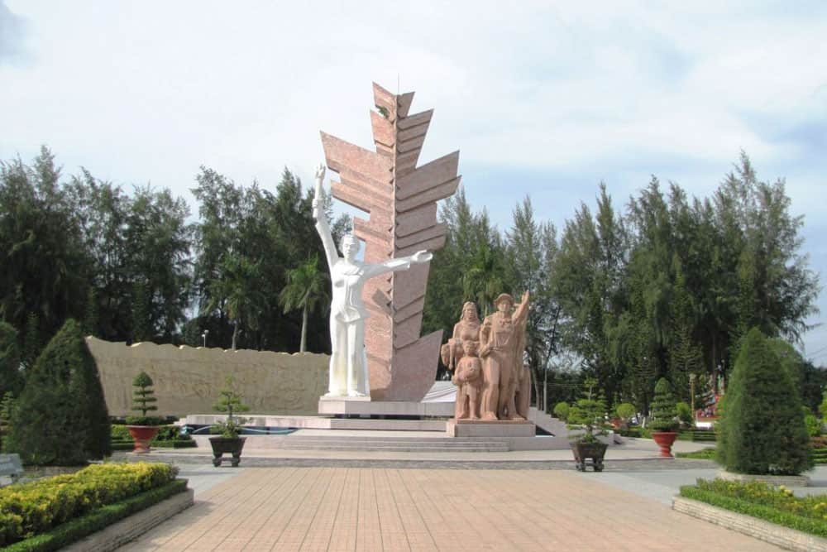
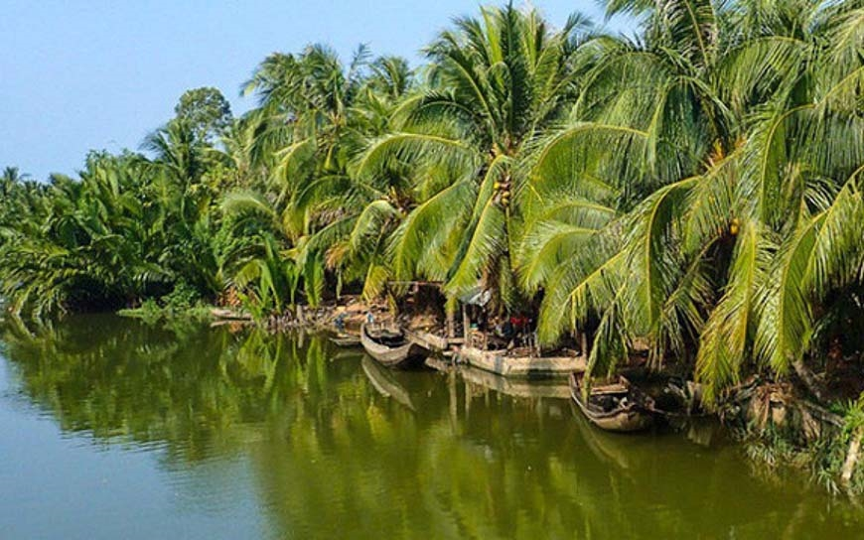
HOMETOWN
I’m from Vinh Long (formerly Ben Tre), a province located in the southern part of Vietnam

Slide 3
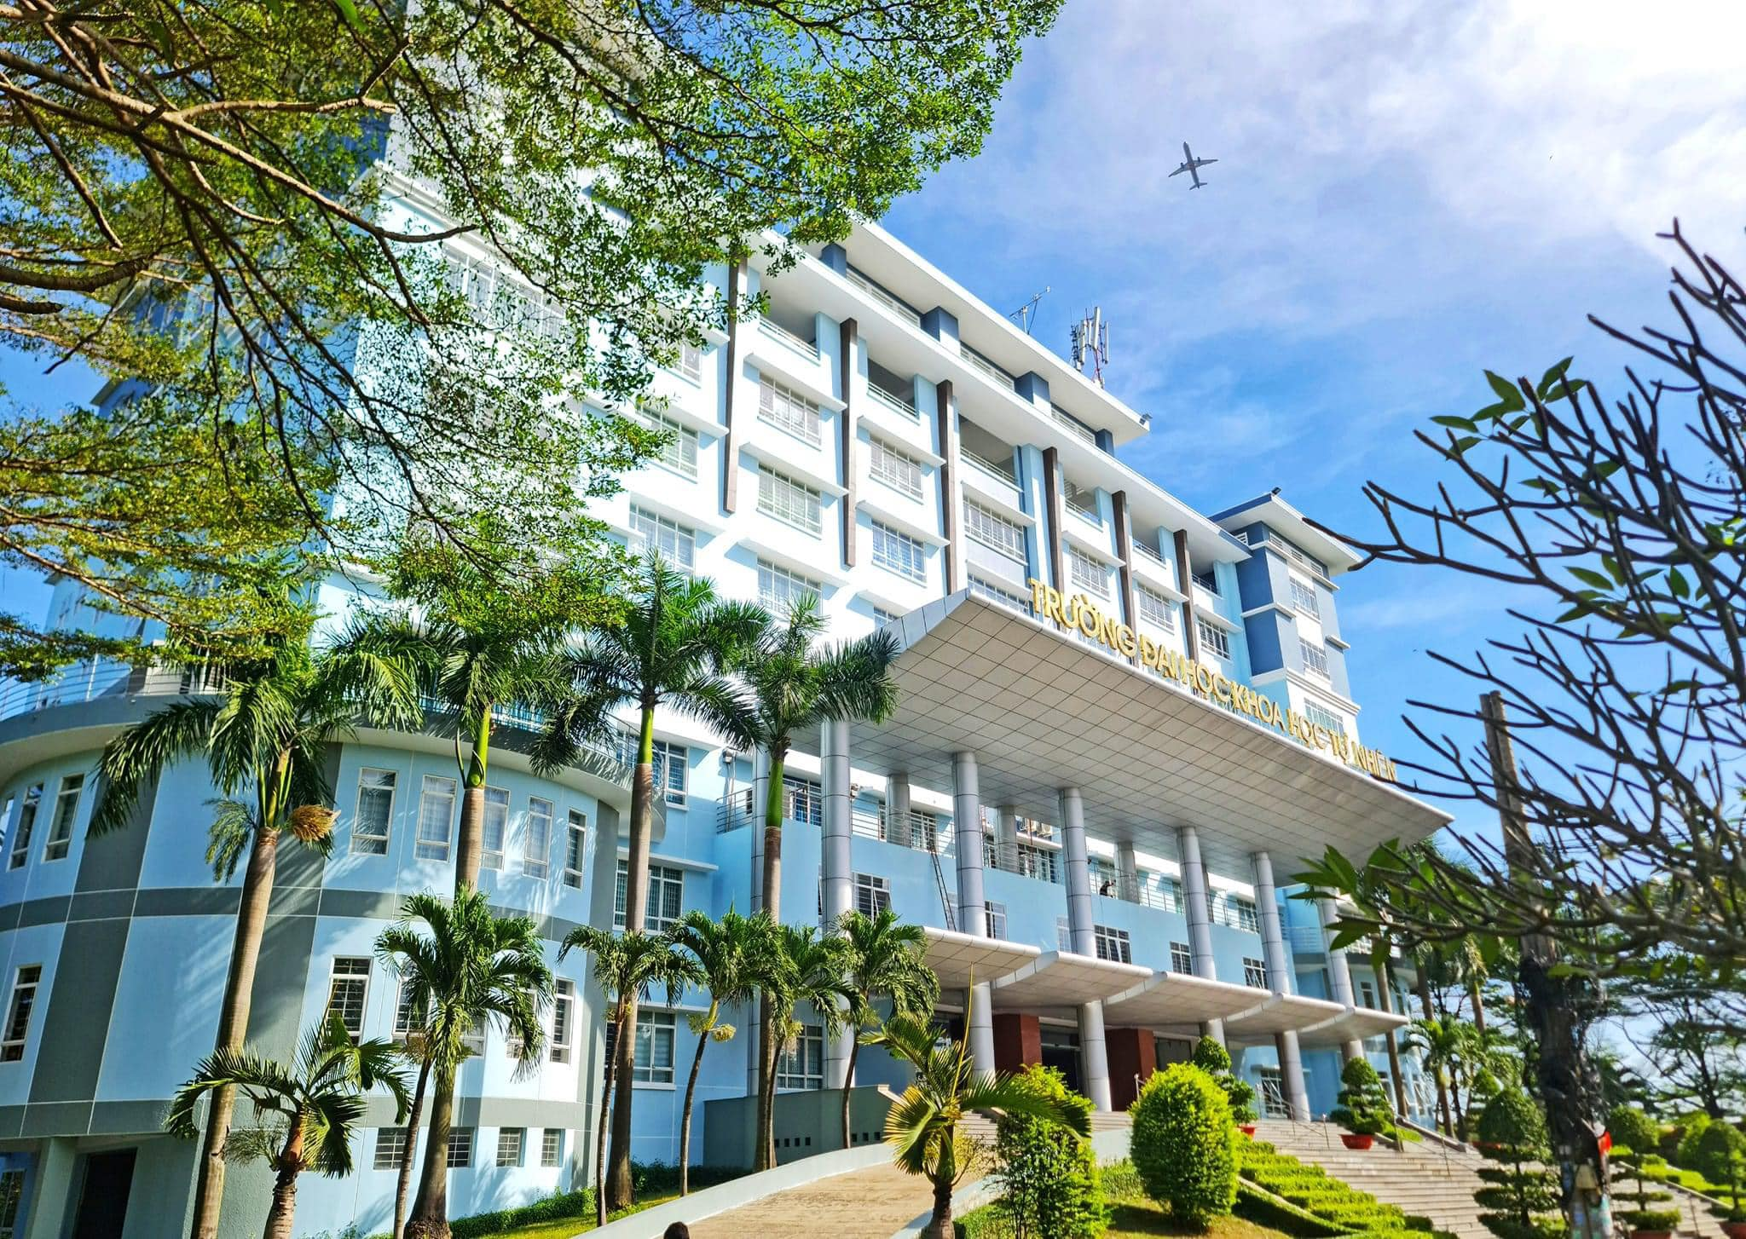


UNIVERSITY
I’m about to become a second-year student at University of Science, VNU-HCM (HCMUS)
Major: Physics (Cosmology)

Slide 4



AFTER SCHOOL

Slide 5
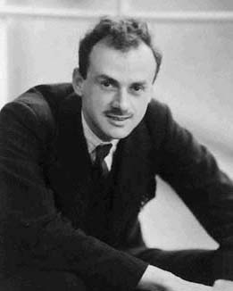
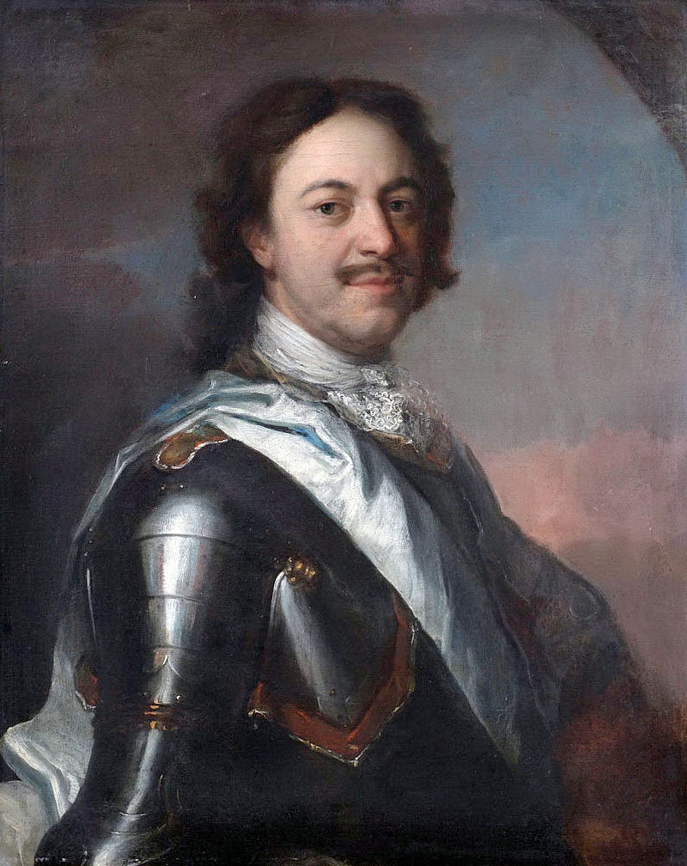
MORE ABOUT ME
The person who inspires me the most is Paul Dirac
Favorite quote:
“I have conquered an empire but I have not been able to conquer myself.” – Peter the Great

Slide 6
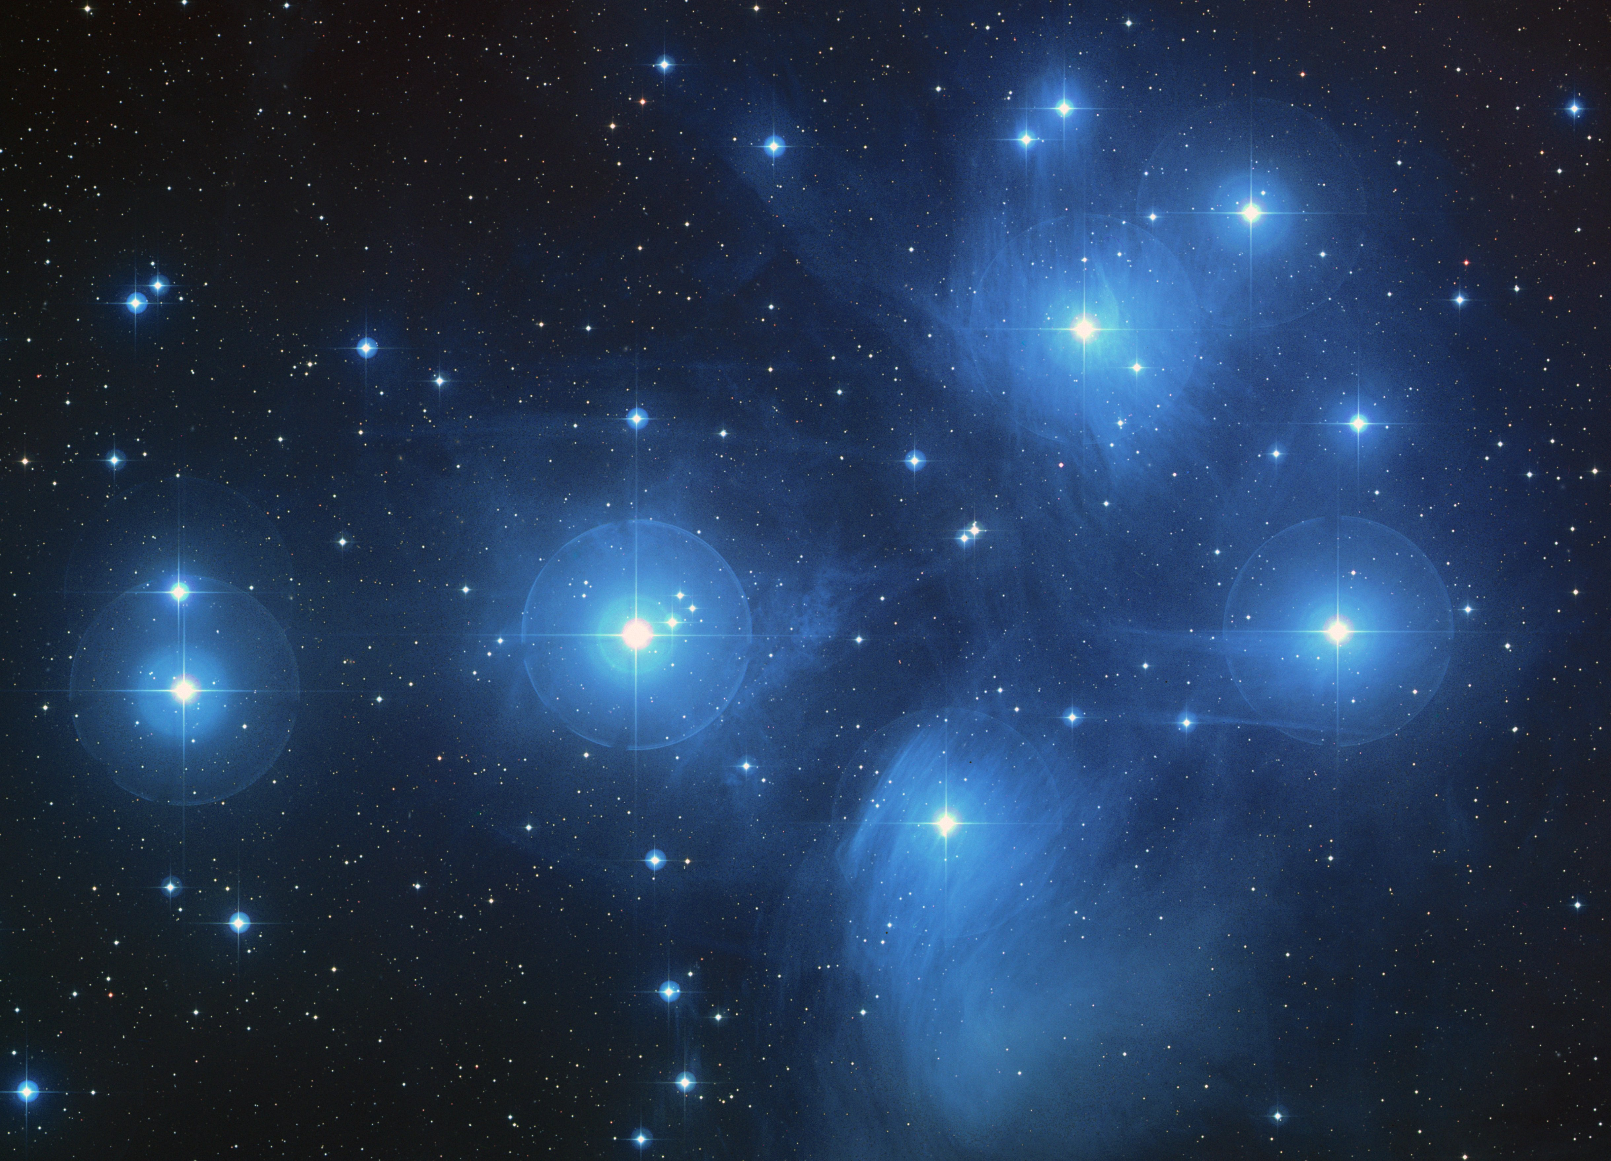
THANK YOU!

