Slide 1
WHO AM I?
INTRODUCING MYSELF
SELF - INTRODUCTION
…
…

Slide 2
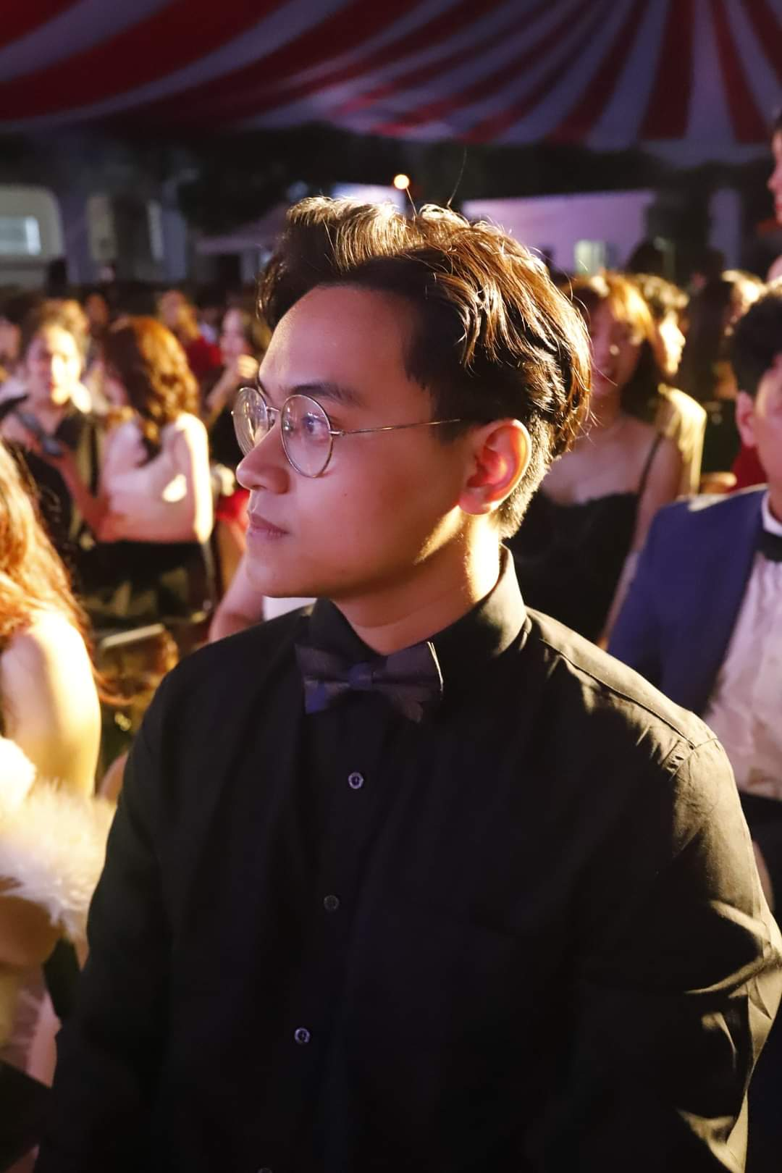
HA NGUYEN
…
…
Email: habuikhoinguyen2004@gmail.com
Phone: (+84) 0834583049
FB: Ha Nguyen
…

Slide 3
ABOUT ME
HANOI
PARTICLE
COSMOLOGY
USTH
GAMES
MOVIES

Slide 4
01
HANOI
I was born and raised in Hanoi. I also live there as well

Slide 5
USTH
02
…
USTH in fact stands for the University of Science and Technology. I am currently a second-year student at the faculty of Space Science and Satellite Technology

Slide 6
03
COSMOLOGY
PARTICLE
I have a special interest for cosmology and particle physics since I was in highschool

Slide 7
04
GAMES
MOVIES
In my leisure hours, I typically indulge in playing video games and watching movies. I like to explore a diverse array of genres in both games and movies

Slide 8
—By ME
“The reason for me to be here is to gain experience and insights and make new friends.”

Slide 9
THANK FOR LISTENING!
…

