Slide 1
Self-introduction
Hayashi Koki

Slide 2
about me
I’m from Japan.
I study in Kyoto University.
I joined T2K experiment.

Slide 3
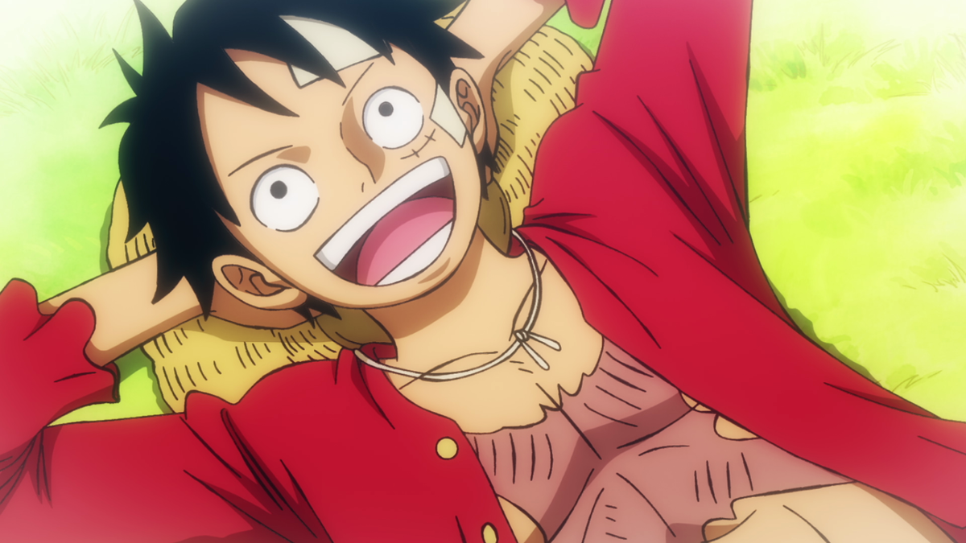
hobby
E-sports
Ramen
Manga, Anime..

Slide 4
physics
I’m interested in particle physics, especially around the Standard Model.
I tried to measure neutrino mass for my graduation research.
Neutrino is mysterious and interesting.

Slide 5
Thank you for listening.

