Slide 1
HELLO EVERYONE!
Tạ Văn Minh
Birthday: 13/07/2003
Nam Dinh province

Slide 2
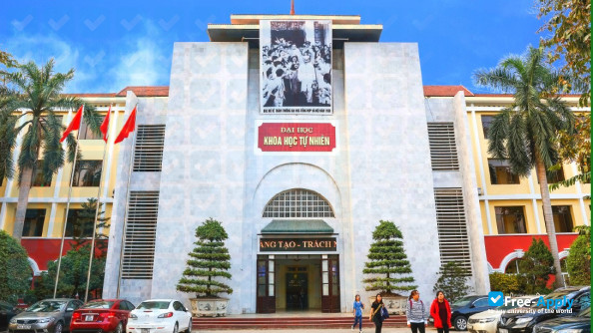
University:
VNU University of Science

Slide 3
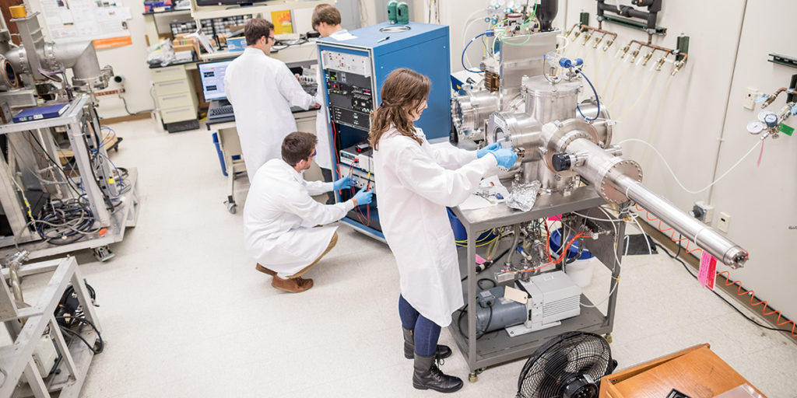
Major:
Nuclear engineering technology

Slide 4
Farvorite:
- learning about new things
- listening to music
- relaxing

Slide 5
Thank you!

