Slide 1
Self Introduction
Sasaki Hayato

Slide 2
Hello! I’m Hayato Sasaki.
Nice to meet you!
I am a first year student of master course in
High Energy Physics Laboratory, Kyoto University.
This is my first visit to Vietnam.
I want to enjoy life and people here!

Slide 3
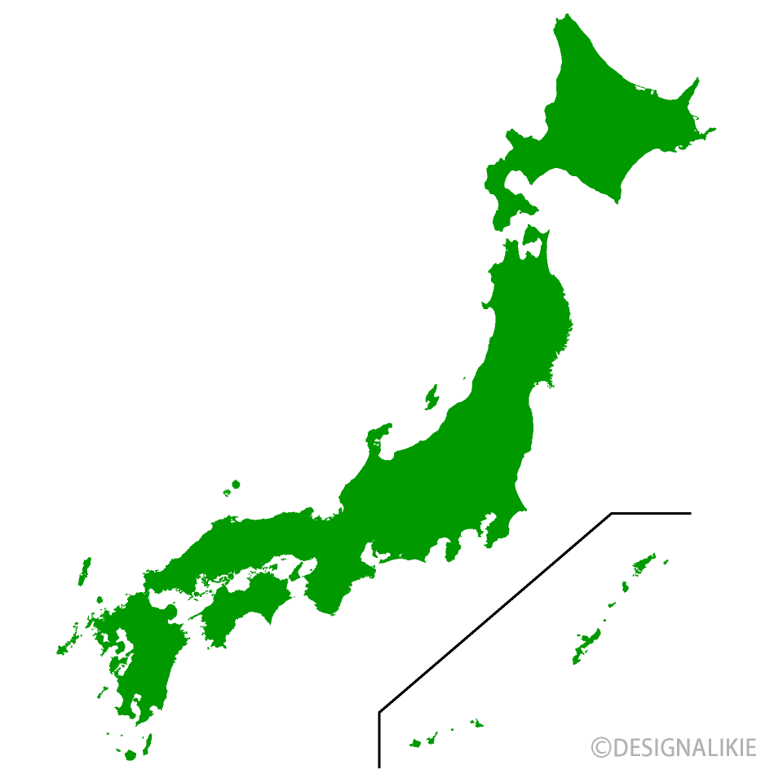
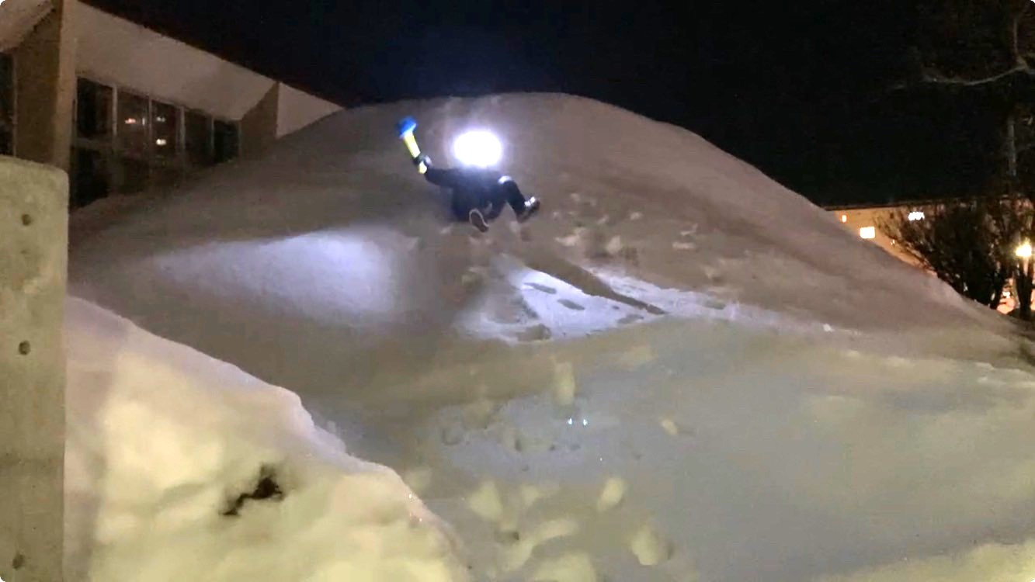
My hometown
I’m from Hokkaido, the most northern
prefecture in Japan.
It gets cold in winter such that
-10℃~-5℃.
Also, there is a lot of snow
in the season!
It’s near my parents’ house!

Slide 4
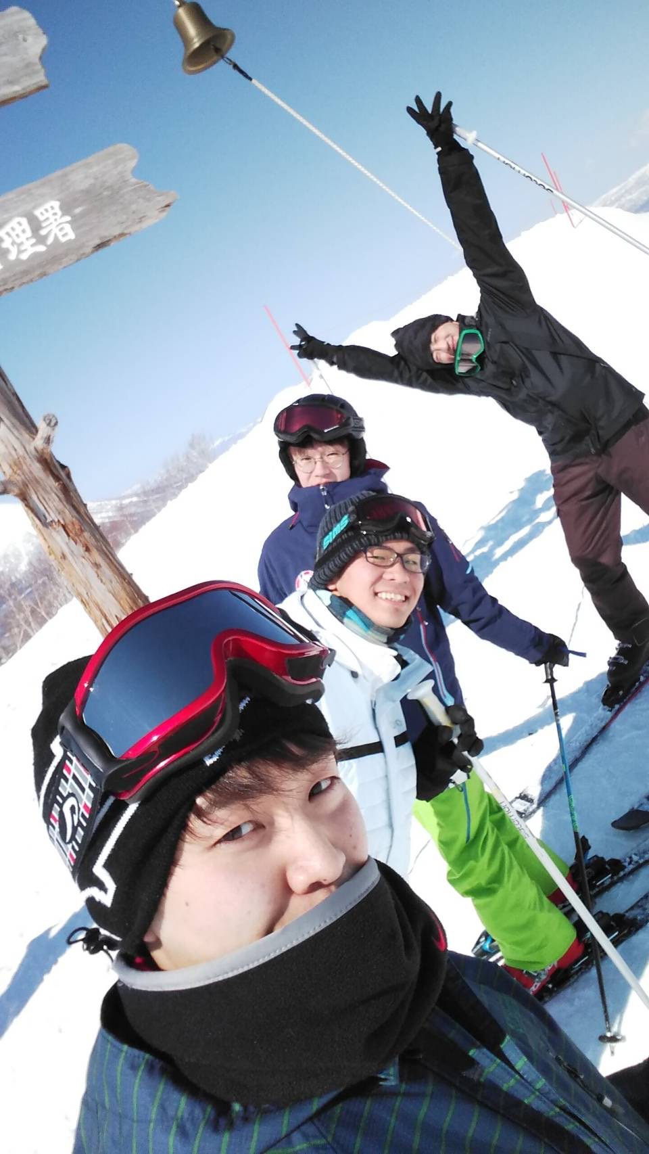
My hobby
I like reading! Haruki Murakami is my favorite author.
Please tell me your favorite books!
Do you know him?
I also like video game, cycling, and traveling.
And in winter, I enjoy skiing!
This is me!

Slide 5
Physics interests
I’m in AXEL project, which is searching for
neutrino less double beta decay (0ν2β).
I decided to specialize in physics
when I was in high school.
Now I am also interested in supersymmetry, lattice QCD,
primordial gravitational waves, etc…
I hope to get fruitful knowledge about neutrino in this school!

Slide 6
Thank you in advance!!

