Slide 1
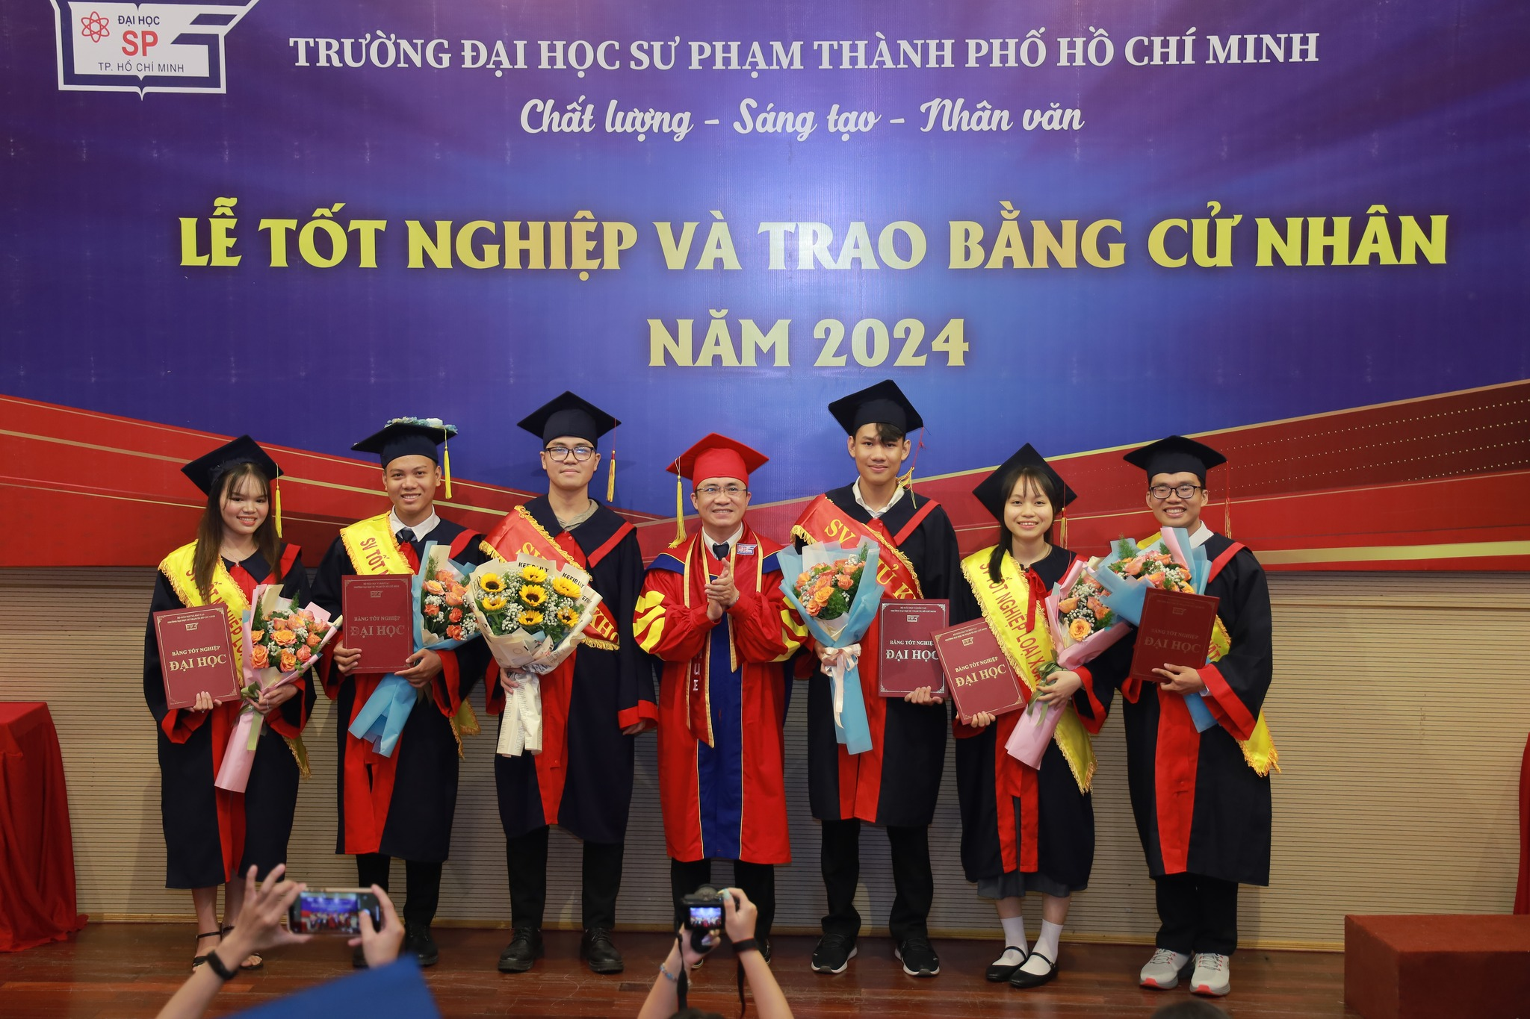
Myself information
- Name: Le Minh Khang
- Hometown: Nha Trang City ($\sim$200km from Quy Nhon City)
- Student at Ho Chi Minh University of Education (HCMUE)
- Major: Physics teacher
Graduated in the early of July, 2024

Slide 2
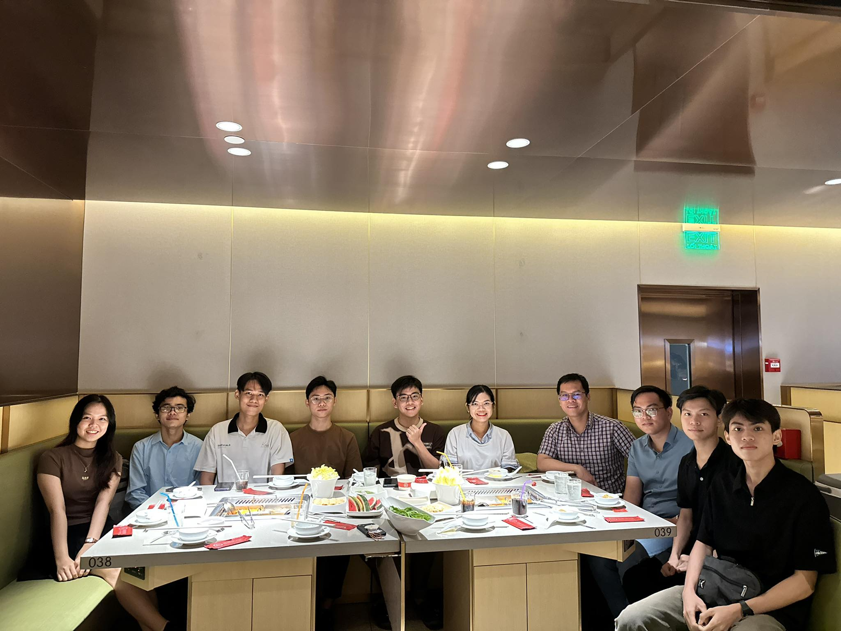
AMO Lab at HCMUE
- Leader:
Assoc. Prof. Pham Nguyen Thanh Vinh (Head of Postgraduate Office, HCMUE)
- Research field:
Atomic – Molecular – Optical (AMO)
- My project:
+ Numerical Calculation: Using DVR method to solve TDSE.
+ Ultracold quantum gases: Two components few-body ultracold Bosonic system in external trapping potential.

