Slide 1
Welcome to “Vietnam School on Neutrino”!
Jul-11-2022
Yuichi Oyama (KEK/J-PARC)
Makoto Miura (Kamioka Observatory, ICRR, Univ. of Tokyo)
Atsumu Suzuki (Kobe Univ.)
Tsuyoshi Nakaya (Kyoto Univ.)
Son Cao (IFIRSE)
Nguyen Thi Hong Van (IFIRSE & IOP, Hanoi)
Jean Tran Thanh Van (Rencontres du Vietnam)
Presented by Yuichi Oyama
Let me present the background and the program of this neutrino school.
1

Slide 2
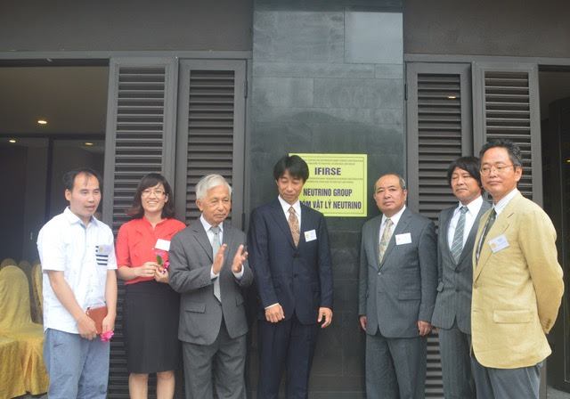
Background of this Neutrino School
An experimental neutrino group was created in Quy Nhon on July 17, 2017.
The project was proceeded with a strong leadership of Prof. Jean Tran Thanh Van, who is the president of Rencontres du Vietnam.
Since no high energy experimental group existed in Vietnam at that time, Japanese physicists working in Super-Kamiokande and T2K helped the formation of the group.
The Vietnam neutrino group successfully joined in the T2K collaboration in October 2017.
July 17, 2017 Opening Ceremony of the Vietnam neutrino group
2

Slide 3
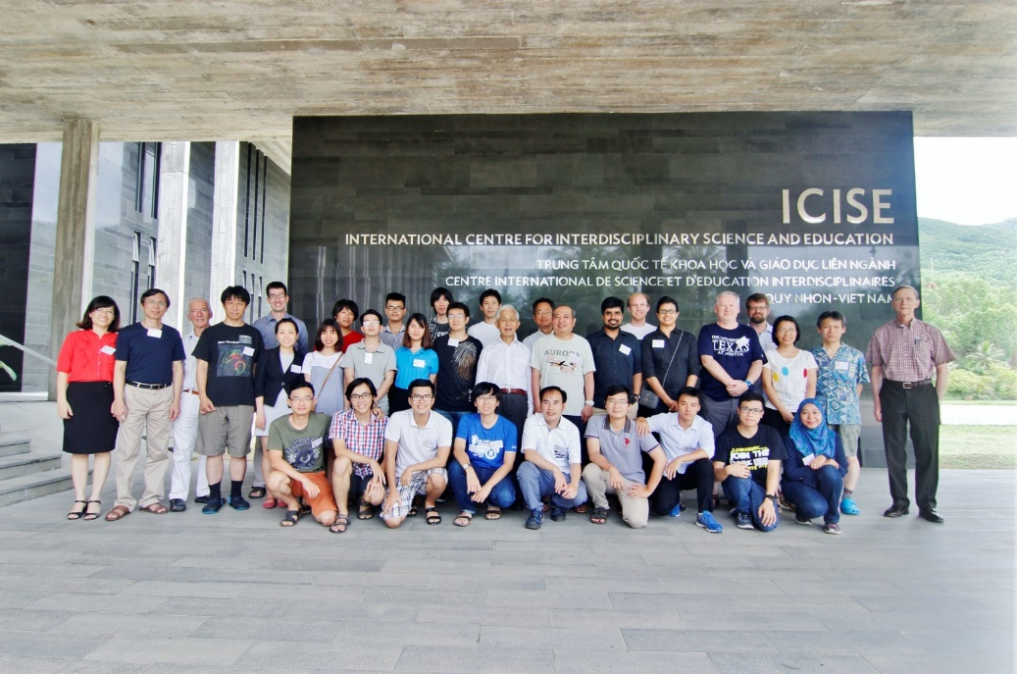
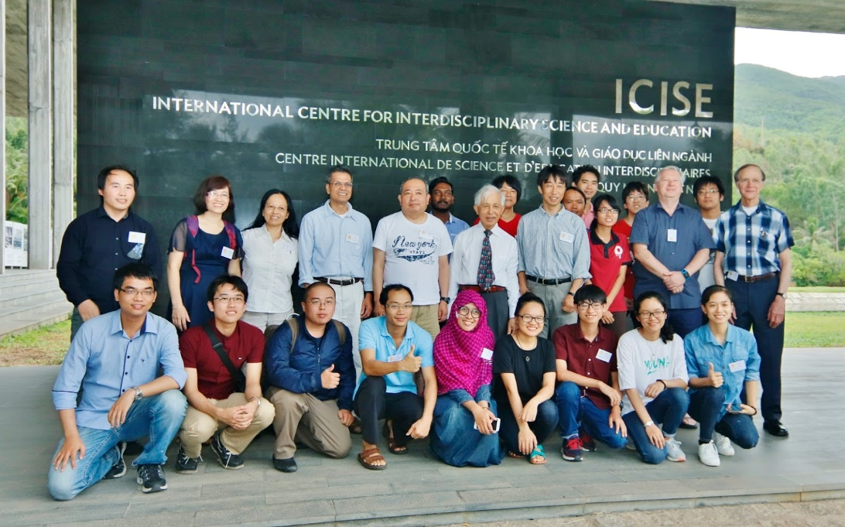
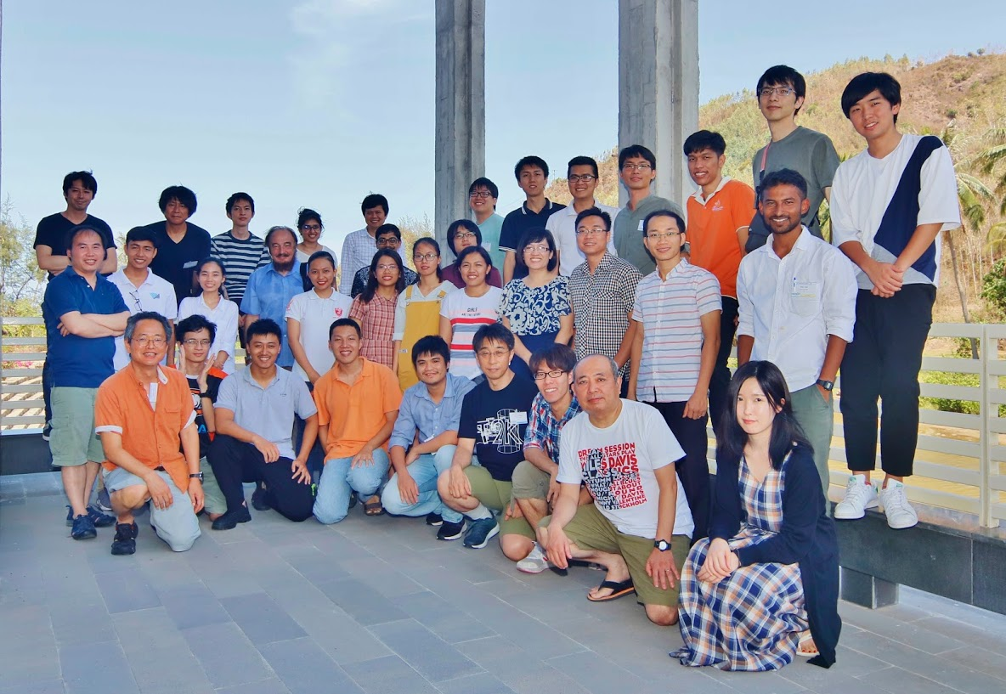
The Vietnam School on Neutrino (VSoN)
VSoN started with the formation of the neutrino group in 2017. It has been held every year.
Japanese physicists who contributed the Vietnam neutrino group also organize the school.
Unfortunately, VSoN2020 and VSoN2021 were held by online because of coronavirus.
VSoN2017
VSoN2018
VSoN2019
3

Slide 4
VSoN2022 in face-to-face!!
We are very happy to resume our face-to-face school after twice of online schools.
The school program mainly focus on experimental neutrino physics. About 2/3 lectures are given by experimental physicists.
We have 18 x 90 minutes lectures, and 9 x 60 minutes lectures. Some of the 60 minutes lectures will be given by guest lecturers, who attend "Neutrino Conference" held in the second week. The other 60 minutes lectures will be given remotely.
In addition to lectures, we have 2 software trainings, hardware training and group works.
4

Slide 5
Students
We have 20 onsite students. They are 14 from Vietnam, 4 from India, 1 from Malaysia and 1 from Japan.
In addition, some students could not come to Quy Nhon because of the travel restriction by the coronavirus problem, and hoped to join remotely. They can attend any lectures they like. There is no restriction about their attendance.
In every year, most of the students are studying theoretical particle physics. Therefore, one of the school purpose is Invitation to experimental neutrino physics.
We hope that some of them will change their research field from theory to experiment, and will join the Vietnam neutrino group and participate in Japanese neutrino experiments.
We hope that they will become a pioneer of the Vietnamese high energy experiment in future.
5

Slide 6
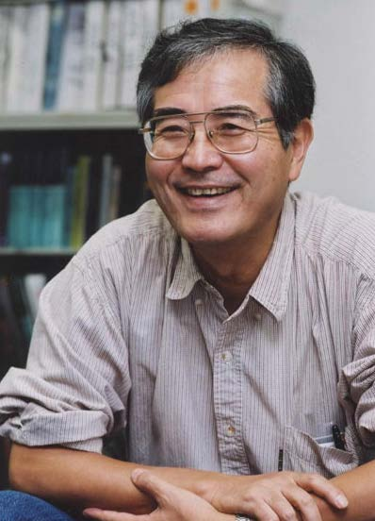
Experiments are important!
To invite students to experiments, let me introduce some words from Prof. Totsuka who was the first spokesperson of the Super-Kamiokande experiment.
Prof. Yoji Totsuka
(1942-2008)
Even though a great theorist propose a fantastic and beautiful theoretical model, we can easily reject it, saying “No! it does not agree with our experiment!”. In physics, the experimental result is everything.
Straightforwardly speaking, I am a detector physicist. I can make the best detector in the world, and I can explore the most advanced physics in the world.
6

Slide 7
Welcome to the world of neutrino experiments !
at least, for 2 weeks,
hopefully,
for the rest of your research life.
Enjoy !
7

