Slide 1
Mini-Project Group v2
Naoto Onda
Phu Nguyen Phu
Binh Nguyen Thi Yen
Notes:
Hello everyone, welcome to Mini-project presentation by group neutrino 2, The presenter are me - Binh, Phu and Naoto. Our selected topic is about calculate CP violation effect in T2K, NOva and Hyper-K if second-tank proposed to put in Korea….. Before, going into the topic, we would talk about the motivation, why we have to study the CP violation.

Slide 2
Scientists think that matter and antimatter should have been created in equal proportions at the birth of the universe…
BIG BANG
Notes:
Scientists think that matter and antimatter should have been created in equal proportions at the birth of the universe, we are confident because base on our understanding about matter and antimatter, the only difference between them is charge.

Slide 3
Our universe is matter dominated !
Notes:
However the world we know today is fill with the domination of matter, so it’s a matter-antimatter asymmetry problem that we are try solve nowaday.

Slide 4
THE POTENTIAL ANSWER
Neutrino scientists are looking for something called “charge-parity violation,” often shortened to CP violation.
Scientists know neutrinos change flavors as they travel, a phenomenon known as oscillation. If the oscillations of neutrinos are fundamentally different from the oscillations of antineutrinos, then CP is broken.
CP VIOLATION
Notes:
So the solution we are looking for this problems is CP Violation, and we will investigate that by the neutrino oscillation experiments.

Slide 5
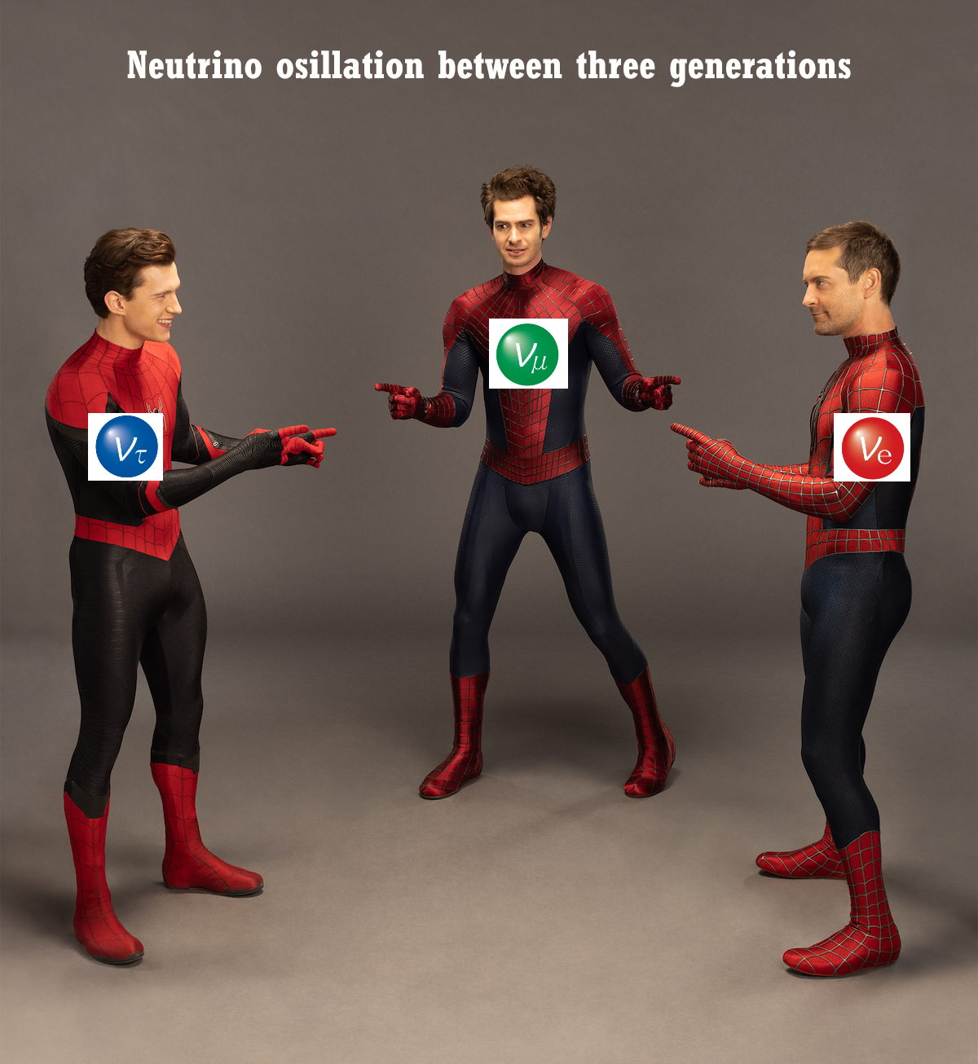
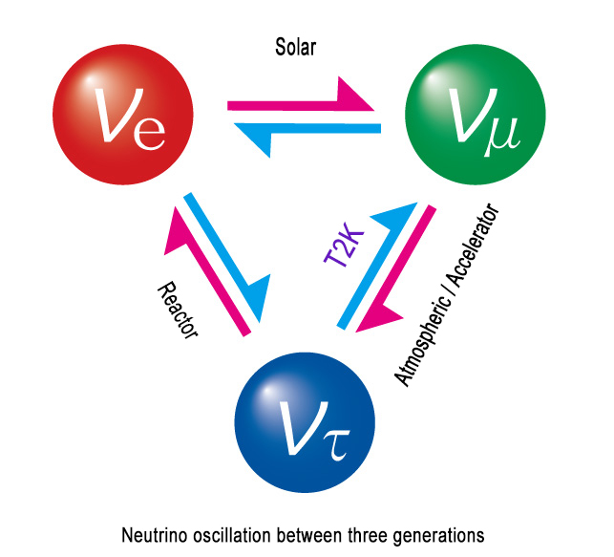
Neutrino Oscillation
Neutrinos change flavor as they travel. A neutrino born as one flavor (electron, muon, or tau neutrino) will change into the other flavor —and the probability of appearing as a different flavor depends on how far it has gone
Notes:
So before diving into the answer, we need to recall some of basic concepts. First, it’s about the neutrino oscillations. Neutrinos comes in three flavor: electron, muon or tau neutrino which respectively associated with three different charged leptons electron, muon and tau.For example, the Beta-decay will produce electron and electron neutrino while pion decay will produce muon and muon neutrino. Neutrino Oscillation is that neutrinos will change flavor as they propagate through a large distance. It’s a little weird thing about neutrinos cause you know that electron will always be electron no matter how far it’s travel. So how can this happens?

Slide 6
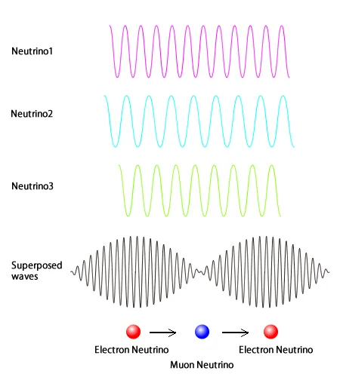
Neutrino Oscillation
mass eigenstates
flavor
eigenstates
Pontecorvo-Maki-Nakagawa-Sakata matrix (PMNS matrix)
Notes:
Those neutrinos on the right are electron, muon and tau neutrinos which are characterized by their flavors, and on the left that’s the neutrinos when they travel through space time characterized by their mass. And in fact the flavor eigenstates is not decided by one of the mass eigenstates, but instead it’s the mix of there mass eigenstates or what we call the superposition, which is related by the PMNS matrix. That’s the reason why the neutrino can change its flavor after traveling a distance.

Slide 7
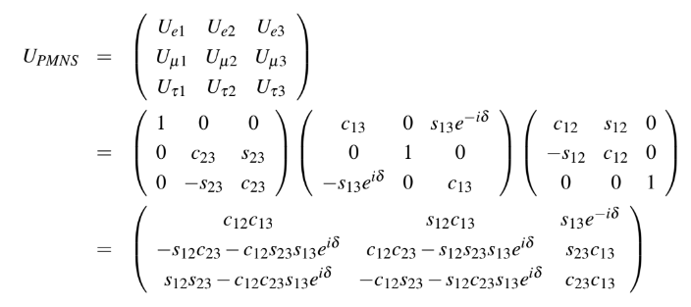
Neutrino Oscillation
The PMNS Matrix depends on four parameters:
Three mixing angles: θ12, θ13, θ23
A Dirac phase represents CP violation: δ
Notes:
PMNS matrix is a 3x3 unitary matrix consists of the fundamental parameters of the lepton flavors sector in the standard model. It can be represented by orthogonal rotation matrix with a complex part. The total degree of freedom of this matrix is four.

Slide 8
Neutrino Oscillation
The oscillation probability between neutrinos in general form:
mass-squared differences between mass eigenstate
Baseline
The oscillation probability between
antineutrinos in general form:
*just the complex conjugation of neutrino oscillation probability
Neutrino Energy
Notes:
We can calculate the oscillation probability between any type of neutrino. And the neutrino oscillation probability is not only depend on four parameters that we talked about in the slide before, but also depends on the mass-squared differences between mass eigenstate, neutrino energy and the distance neutrino travels. We can also deduce the antineutrino oscillation probability just by taking the complex conjugation of the neutrino oscillation probability

Slide 9
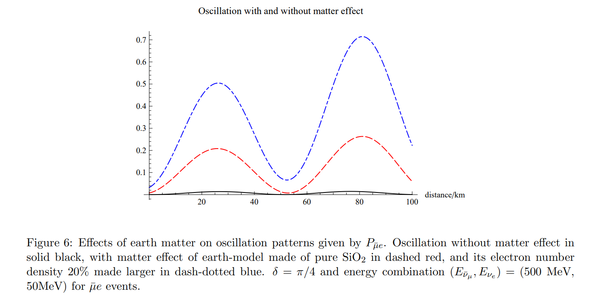
Matter effect of neutrinos oscillation
Neutrino oscillations change when in media in comparison to vacuum oscillations due to the scattering of neutrinos on matter constituents

Slide 10
CP VIOLATION
*but, what is Symmetry ?
Notes:
They observe one phenomena in neutrino oscillation which called CP VIOLATION

Slide 11
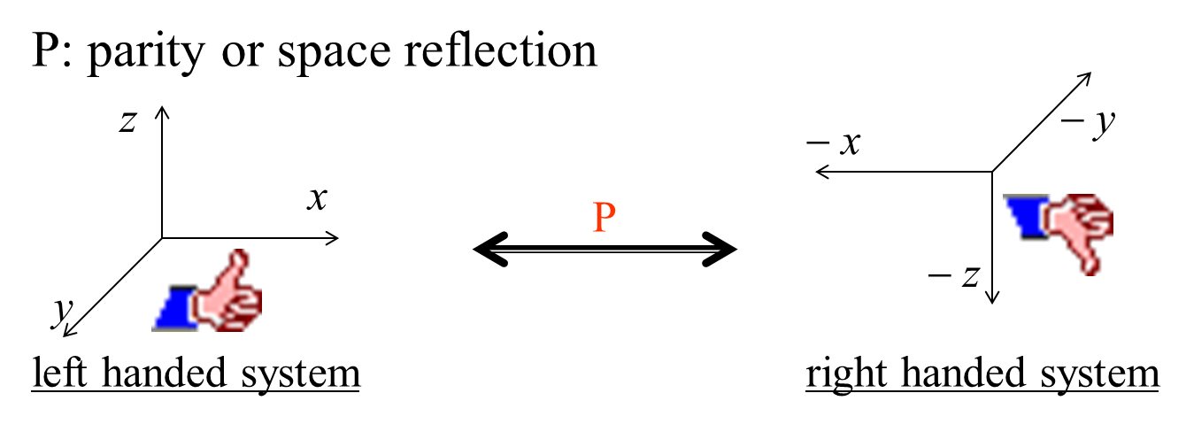
Time Reversal, for example, the direction of motion of particles
Parity reflects a system through the origin. Converts right-handed coordinate systems to left-handed ones
Charge conjugation turns a particle into its antiparticle
Notes:
In physics everything is invariant under charge, parity, and time; this is called the CPT theorem. This means if you were to change all of these things together, the universe would still react exactly the same.CP-symmetry states that the laws of physics should be the same if a particle is interchanged with its antiparticle (C-symmetry) while its spatial coordinates are inverted ("mirror" or P-symmetry). P -

Slide 12
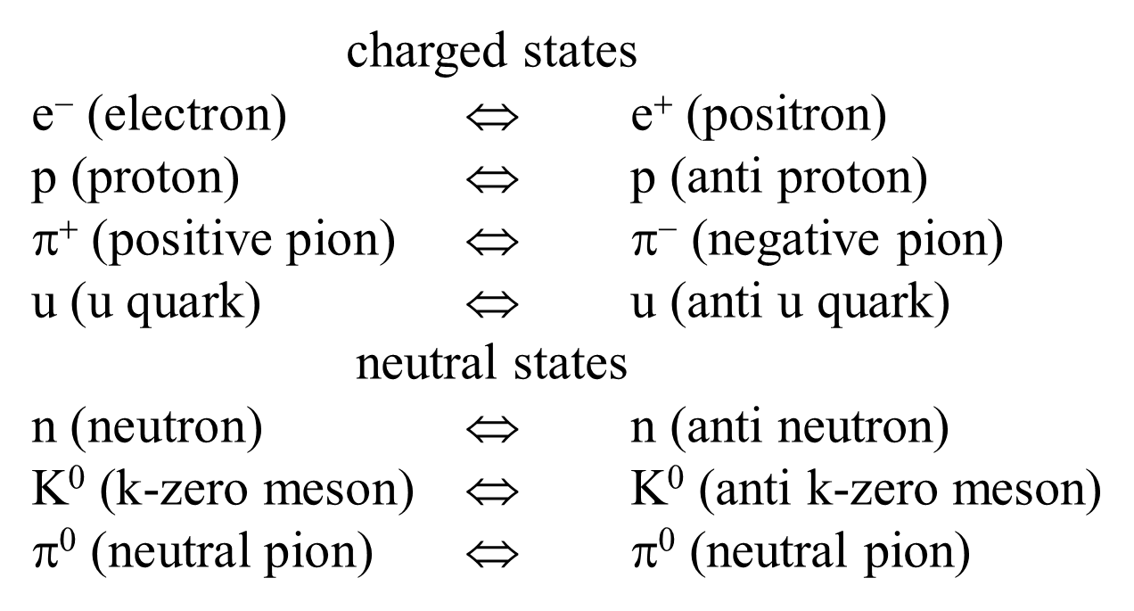
paritcle = anti-particle
Notes:
Therefore, for every process that produces a particle, there is a mirror process that produces an antiparticle. So during the Big Bang, we would have expected that the universe was formed with equal amounts of particles and antiparticles that would then annihilate with each other into pure energy.

Slide 13
CP Violation
CP violation is the difference between the neutrino and antineutrino oscillation probability
*This formula consider CP violation in vacuum
CP Asymmetry

Slide 14
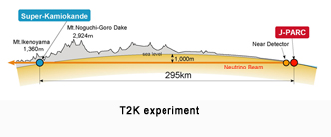
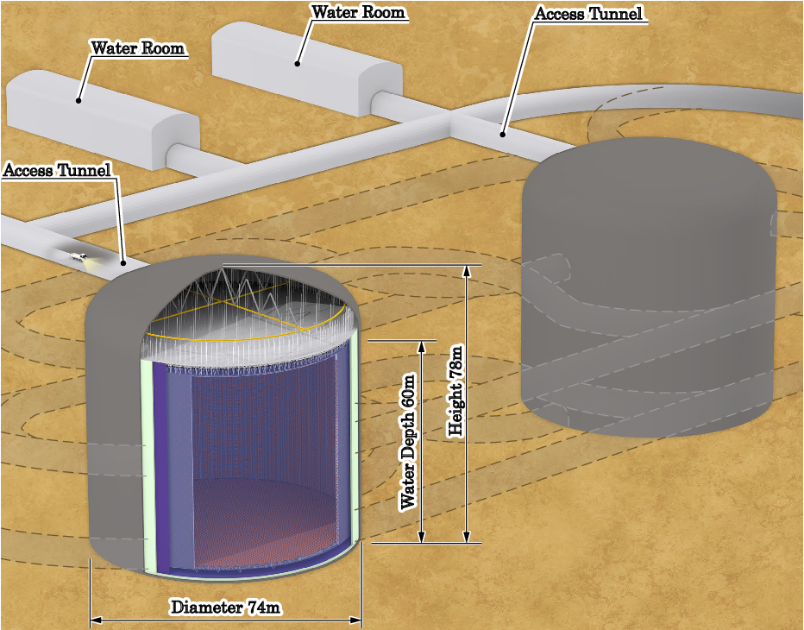
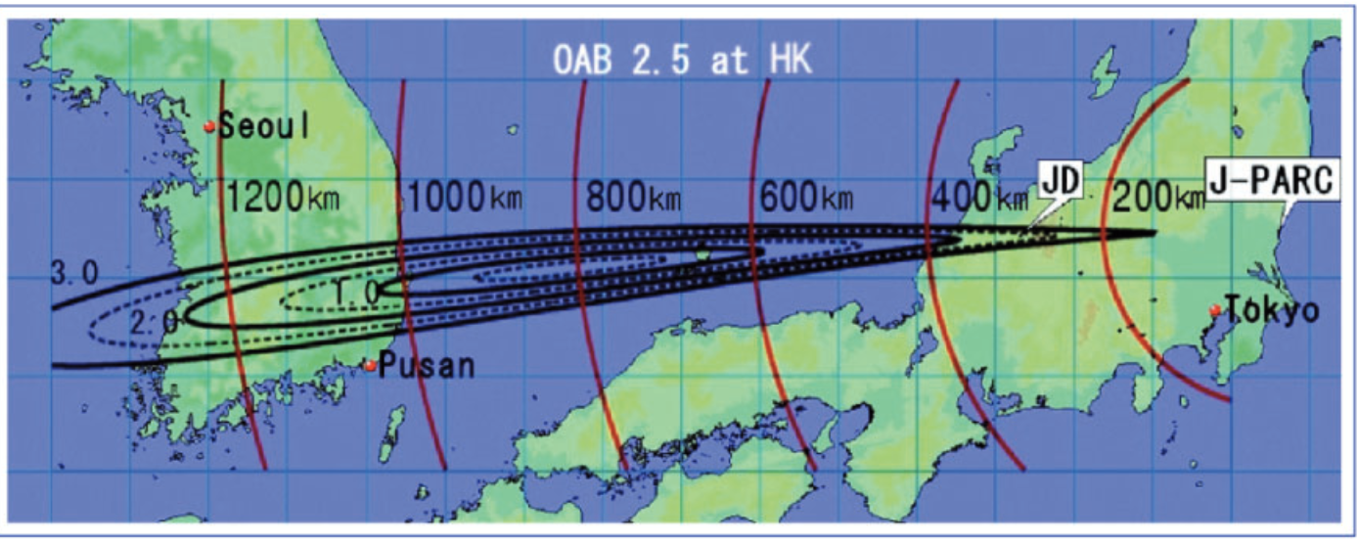
T2K, NOvA, Hyper Kamiokande
baseline L
peak energy E
T2K
295km
0.6GeV
NOvA
810km
2GeV
?
Hyper K
(second detector in Korea)
1100km
0.7GeV
Notes:
At this time, T2K experiment and Nova experiment are leading accelerator-based long baseline neutrino experiments in the world. In addition to those ongoing experiments, today, we consider the proposal to install HK's second detector in Korea.
T2K experiment uses the intense beam of muon neutrinos generated by Jpark and usesSuper-Kamiokande as the far detector to measure neutrino rates at a distance of 295 km, and near detectors to sample the beam just after production.
T2K’s physics goals include the measurement of the neutrino oscillation parameters through νµ disappearance studies and νµ→νe appearance..
T2K adopts the off-axis method with 2.5° off-axis angle to generate the narrowband neutrino beam and the peak energy of neutrino beam is about 0.6GeV.
NOνA experimen uses the upgraded Fermilab NuMI(Neutrinos at the Main Injector) beam and measures electron-neutrino appearance and muon-neutrino disappearance at its far detector in Ash Rive. The distance between the far detector to Fermilab is about 810 km.
The far detector is sited 14 mrad off-axis to produce a narrow-band beam around the energy of 2GeV.
Hyper-Kamiokande (Hyper-K) is a next generation water Cherenkov detector consisting with 260 kton purified water.
The baseline from J-PARC to Kamioka is ,as same as T2K, 295 km with 2.5 ◦ off-axis angle (OAA).
The neutrino beam produced at J-PARC currently reaches Korea with 1◦ ∼ 3 ◦ off-axis angle from 1,000 km to 1,260 km baselines. This gives an opportunity to locate the 2nd detector in Korea since the longer baseline would benefit various physics potentials such as precise measurement of CP violation phase and neutrino mass ordering determination. today, we assume that we put the second detector with the 1100km of baseline and peak energy of neutrino beam is set to 0.7GeV to compare the matter effect in CP violation in three experiments.

Slide 15
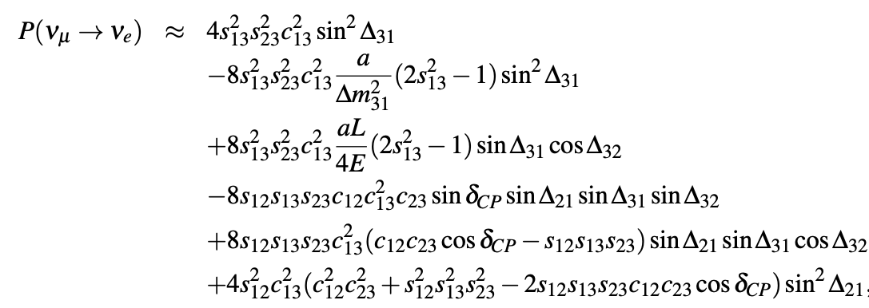
Oscillation Probability
In anti-neutrino case, the sign of and are inverted.
Notes:
as i said, two experiment that nu-mu disappearance experiment and nu-mu to nu-e appearance experimen are considerable.Now we consider the nu-mu to nu-e appearance probability because there no cp violation in mu disappearance probability as phu say. this formula shows the transition probability from muon-neutrino to electron-neutrino using some approximations. This formula takes into account Earth matter effects. L shows the travel distance of neutrio which corresponds to baseline in oscillation experiment and E is the energy of neutrino. this a represents the earth matter effect, so second term and third term contains the matter effect.
In anti-neutrino case, the oscillation probability from anti-muon-neutrino to anti-electron-neutrino is the formula that the sign of a and sin(delatacp) in this formula are inverted. so if we consider the earth matter effect, the oscillation probability nu-mu to nu-e minus the oscillation probability anti-nu-mu to anti-nu-e has not only a term depend on the sin(deltacp) but also a teram depend on a.

Slide 16
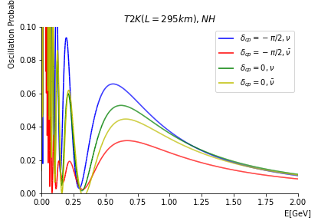
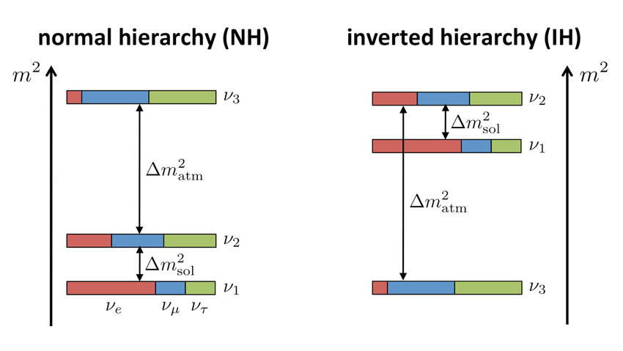
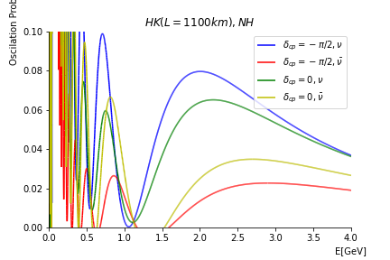
Even if =0, there are significant difference between oscillation probability of particles to that of anti particles
mass hierarchy problem
Notes:
this three figure show the plot of this formula of three experiment in the case deltacp is -pi/2 or 0 and Normal Hierarchy is assumed. this mass hierarchy problem is whether the m3 is heavier or lighter than the m1 and m2, and normal hierarchy means this side.horizontal axis shows the neutrino energy and vertical one show the oscillation probability nu-mu to nu-e or anti-nu-mu to anti-nu-e. top shows the T2K, center shows the NovA, bottom shows the HK 2nd detector result. dotted line shows the peak neutrino energy of each experiment. T2K has the 0.6GeV peak energy…
these figure shows that even if deltacp is equals to 0, which means CP is conserved in neutrino oscillation, the oscillation probability of nu-mu to nu-e is different from oscillation probability of anti-nu-mu to anti-nu-e.
and T2K and Nova set the peak energy around the oscillation maximum region, on the other hand, HS 2nd Detector set the peak energy at the second oscillation maximum.

Slide 17
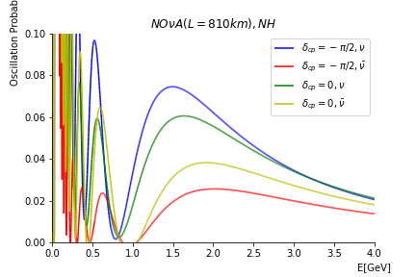

Slide 18
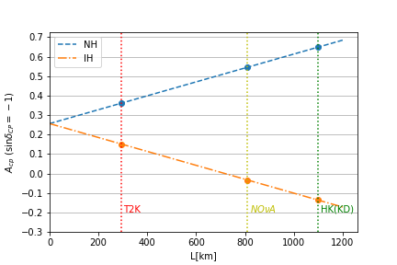
L = 0 shows vacuum value
Earth matter effect have opposite effects on CP symmetry for Normal hierarchy and Inverted hierarchy
Notes:
next we show the baseline dependence of earth matter effect in the CP asymmetry. CP asymmetry is defined that like (~) this.
this figure shows the above CP asymmetry when L/E satisfies this condition, of course this condition is not completely satisfied with the experiment especially in HK(2nd detector), but for simplicity, we use this formula to compare these experiments.
horizontal axis shows the baseline .
L=0 values shows the vacuum value of CP Asymmetry when sin(deltacp) is -1. this figure shows that Earth matter effect have opposite effects on CP symmetry for Normal hierarchy and Inverted hierarchy, and earth matter effect is proportional to baseline. so it can be said that long-baseline experiment has a high sensitivity to the mass hierarchy problem

Slide 19
Conclusion
Observing CP violation in lepton sector may be important to solve the mystery of our universe
CP violation can be observed as the difference between the neutrino and antineutrino oscillation probability
matter effect have a no small effect on the measurement of CP violation.
matter effect can be used to measure the mass hierarchy

Slide 21
References
https://vjst.net/index.php/cip/article/view/12930
https://doi.org/10.1093/ptep/pty044
https://pdg.lbl.gov/2022/tables/rpp2022-sum-leptons.pdf

