Slide 2
Supervisor: Makoto Miura Sensei
Bachelor student, USTH, HN
Bachelor student, HCMUS
PhD Student, Universiti Malaya, KL

Slide 5
I. Why measuring neutrino mass is so challenging ?
How small is neutrino ?
Why measure neutrino ?
Constraint from the cosmology for neutrino mass

Slide 18
II. Methods to measure the absolute mass of neutrinos
Cosmology observation
Electron capture
Single beta decay
Neutrinoless double beta cay

Slide 19
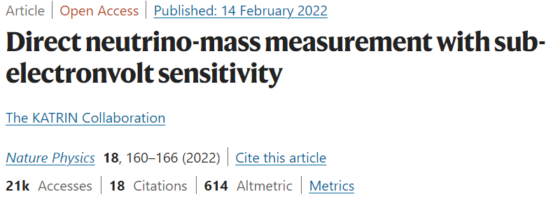
General difficulties in trying to experimentally determine the absolute mass of neutrinos
Neutrinos as far as we know can only perform “weak interaction”. Therefore, we can only measure it through indirect methods. Many of which are model dependent.
What neutrinos are we even trying to measure? Dirac or Majorana?
Background is always a huge hurdle to climb through, requiring bigger and better detectors.
Not even mentioning the math and data analysis. The physics are already hard enough, we also need data analysis to process the quite frankly huge amount of information collected through years of taking in data.
A significant portion of one of the most recent work on mass measurement is made up of data analysis.

Slide 20
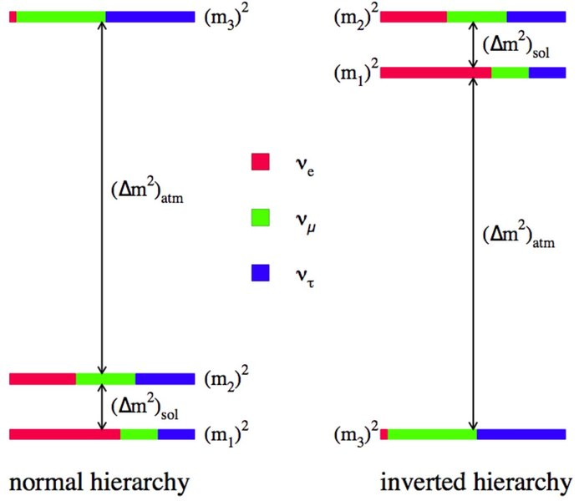
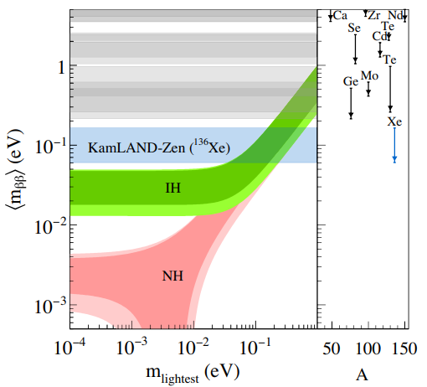
Neutrino Mass Hierarchy
In Normal Hierarchy, the two lightest eigenstates aren’t much heavier than another other, while the mass of the third eigenstate is much greater than the other aforementioned two.
In Inverted Hierarchy, it’s quite literally the reversed of Normal Hierarchy. The first eigenstate is much lighter than the other two, but the mass of the other two eigenstates only have a small difference.
The hierarchy of these eigenstates affects the limits of the absolute mass of neutrinos.
R.N.Cahn et al, arXiv:1307.5487
A.Gando et al, arXiv:1605.02889

Slide 21
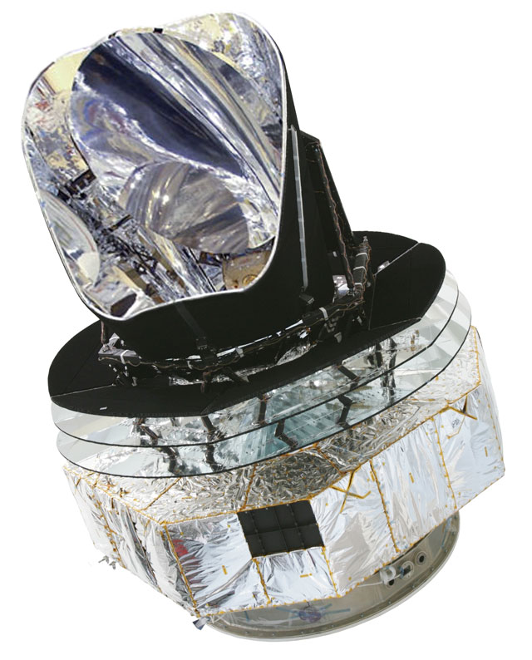
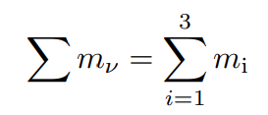
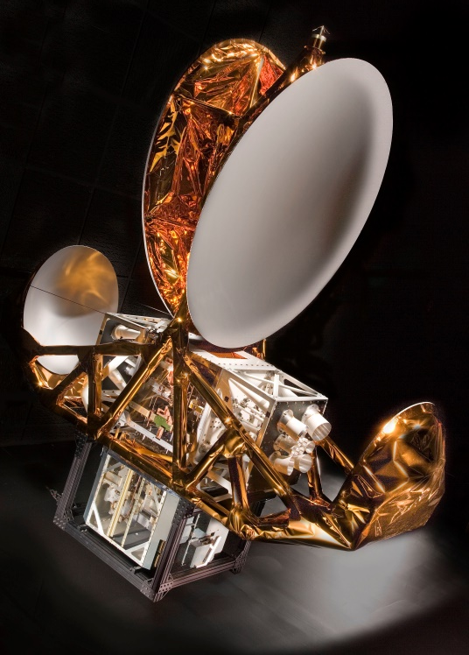
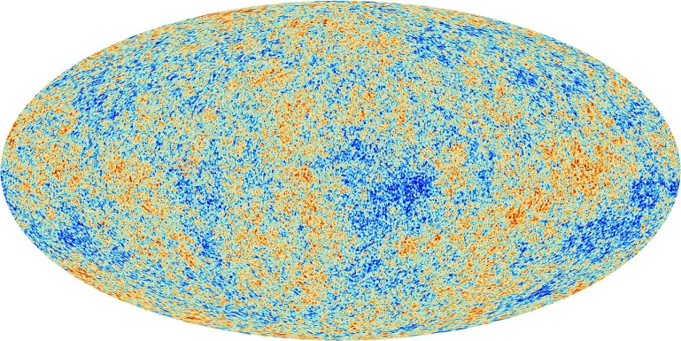
Cosmology observation
Absolute mass of neutrinos can be measured by looking at the power spectrum of cosmic microwave background measurements made by space telescopes like WMAP and Planck or SDSS-IV.
Planck
WMAP

Slide 22
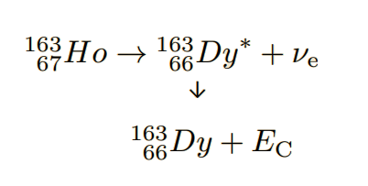
Electron capture
The nucleus of an electrically neutral atom absorbs an inner atomic electron
and causes the emission of an electron neutrino.
That sole emitted neutrino carries the entire decay energy, so we try to
measure that energy and attempt to work backwards into the absolute neutrino mass.
Physics Letters B, 118B, p. 429, 1982

Slide 23
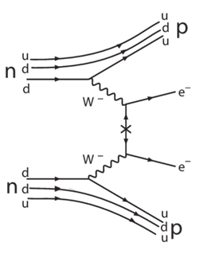
Neutrinoless Double Beta Decay (0vββ)
2vββ is allowed by the Standard Model, but can the same be said for 0vββ?
If it does, by identifying the energy peak coming from the hypothesized neutrinoless double beta decay, we can from then infer neutrino absolute mass.
It would also confirm that neutrino is a Majorana particle and indicate that right-handed neutrinos also exist.

Slide 24
0vββ Experiments
There are nine candidates nuclei considered for these experiments: Calcium-48, Germanium-76, Selenium-82, Zirconium-96, Molybdenum-100, Cadmium-116, Tellurium-130, Xenon-136 and Neodymium-150.
We are not trying to measure the neutrino itself, but rather the energy from the two electrons that would be emitted from 0vββ decay (the decay is supposed neutrinoless to begin with) amongst the immense background of 2vββ.
The measurements are done in a variety of ways:
Scintillator (KamLAND-Zen) – Detecting electron anti-neutrinos through light emitted by product positron resulting from inverse beta decay.
Bolometer (CUORE) – Measuring the temperature spikes from the electrons emitted in Te double beta decays.
Time-projection chamber (EXO) – Tracking the trajectory of the particles and the subsequent avalanches created by primary ionizations.
Some experiments use multiple types of detector (NEMO-3).

Slide 25
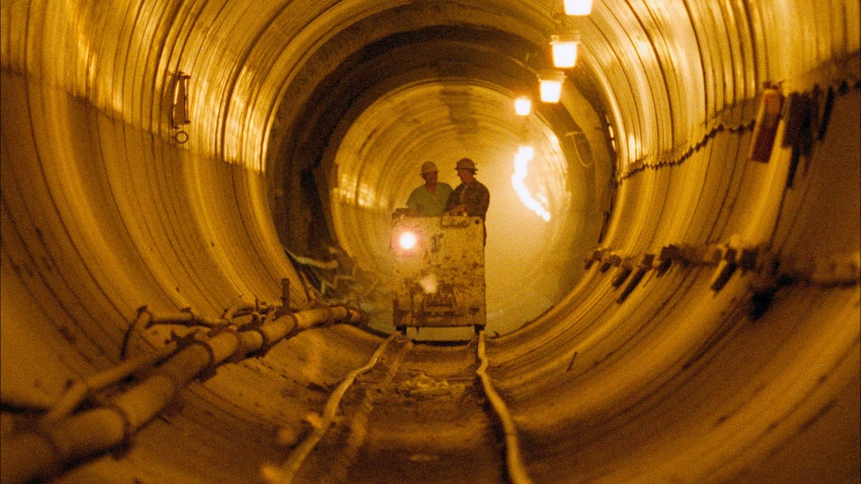
years
Problems with 0vββ
W.Tornow. arXiv:1412.0734
The probability of the decay
If this decay exists, it’s realistically too rare to be observed.
Other missing piece of the puzzle
Even if we can find the decay, we still need to calculate the nuclear matrix element (with massive uncertainty and being model dependent) in order to then find the neutrino mass.
The slippery slope of funding politics(?)
To increase the chance of finding this decay, we need bigger detectors, which means more funding (don’t forget about the demise of the SSC).

Slide 26
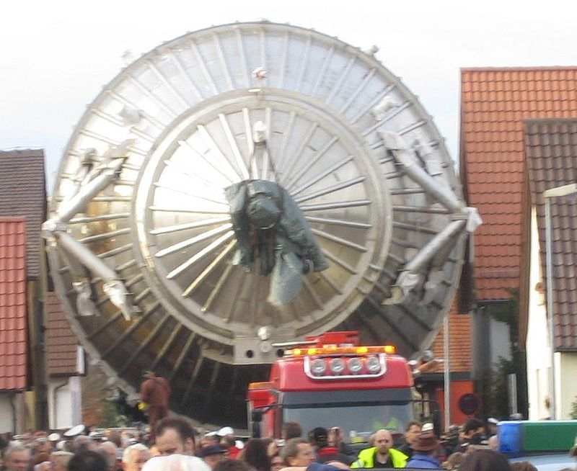
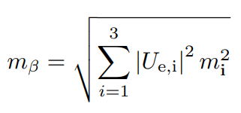
Single Beta Decay
The absolute mass of neutrinos can be obtained from analyzing kinetic energy data of the electrons emitted from the beta decay of tritium.
Examples of experiments employing this method is Mainz, Troitsk and KATRIN.
A feature from the three experiments mentioned above is the MAC-E Filter (Magnetic Adiabatic Collimation combined with an Electrostatic Filter).

Slide 27
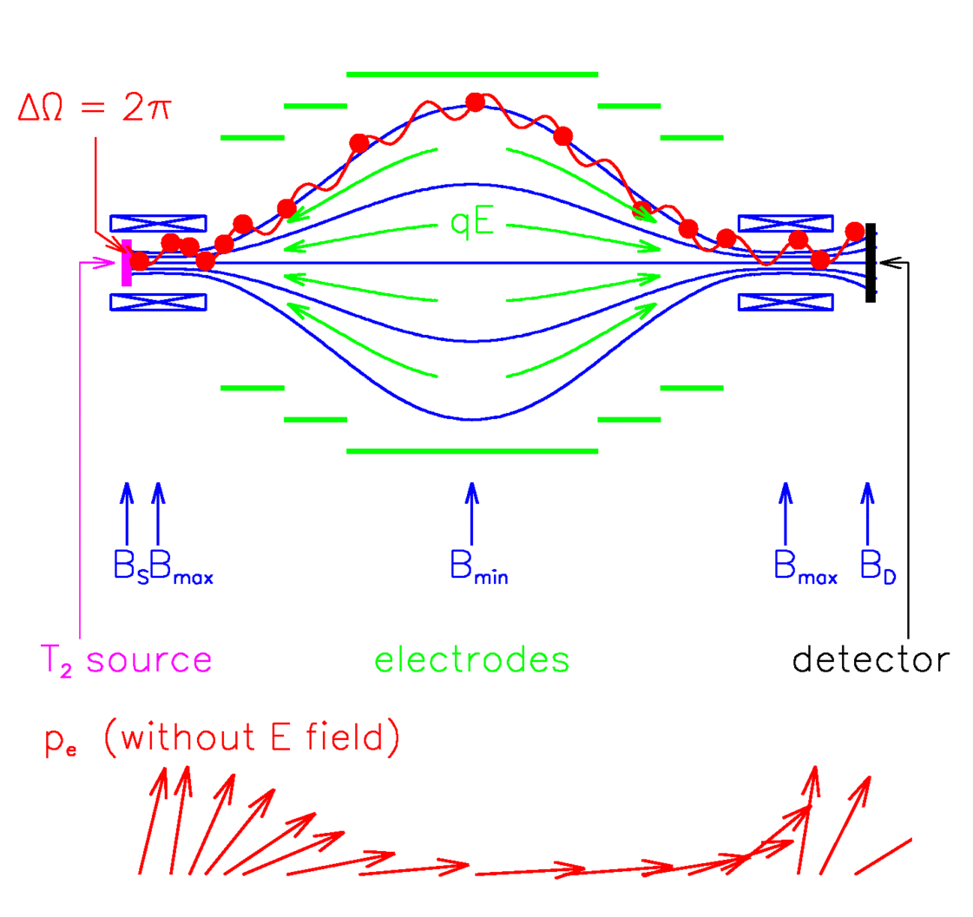
MAC-E Filter
The beta electrons are created through single beta decay of tritium and sent into the filter in a beam of electrons.
Inside the filter, there’s an electrostatic barrier created by a system of cylindrical electrodes which acts a high-energy pass filter and reflect electrons with insufficient energy.
Angrik J., T. Armbrust, and A. Beglarian. KATRIN design report 2004

Slide 28
III. Recent progress on absolute neutrino mass measurements

Slide 29
Recent progress on absolute neutrino mass measurements
Evidence of Neutrino Oscillation
― Prove that neutrino has mass even though it’s small
Method we can come up with:
Cosmology observation
Electron capture
Neutrino-less double beta decay
single beta decay
Recent progress on absolute neutrino mass measurements
KATRIN: Single beta decay – Tritium
Why measuring the absolute mass of neutrino is so challenging?
No current experiment has sufficient sensitivity to measure it. The principle of the experiment is to look for a distortion near the endpoint of the electron spectrum of tritium b-decay.
Notes:
The most direct way to assess the neutrino mass is via the kinematics of single-β decays or electron capture processes.
The neutrino mass scale is accessed by studying the energy spectrum generated by the b-decay of tritium for example in the KATRIN experiment. Also promising are studies of electron capture of 163Ho with cryogenic calorimeters in the ECHo and Holmes experiments.

Slide 30
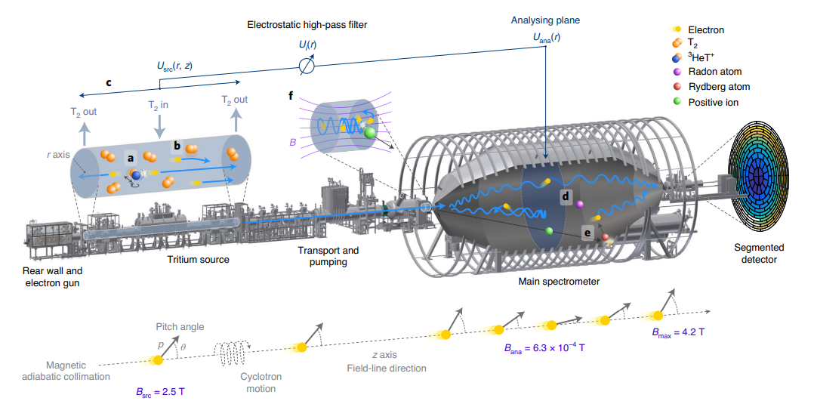
KATRIN : Single Beta decay of Tritium
KATRIN (KArlsruhe TRItium Neutrino), based in Germany at the Karlsruhe Institute of Technology. In this experiment, m_{ν} is probed via a high-precision measurement of the tritium β-decay spectrum close to its endpoint. This method is independent of any cosmological model and does not rely on assumptions whether the neutrino is a Dirac or Majorana particle.
(Illustration of the 70-m-long KATRIN beamline.)
This has been done for several decades (The Troitsk (Russia) and Mainz (Germany)) and these past experiments employed the MAC-E filter method to determine the energy of the electron. The KATRIN experiment does this on a much larger scale, and together with a high-intensity tritium β source it is hoped to achieve a mass determination down to 0.35 eV/c², or to set an upper limit of 0.2 eV/c².
The KATRIN Collaboration. Direct neutrino-mass measurement with sub-electronvolt sensitivity. Nat. Phys. 18, 160–166 (2022). https://doi.org/10.1038/s41567-021-01463-1

Slide 31
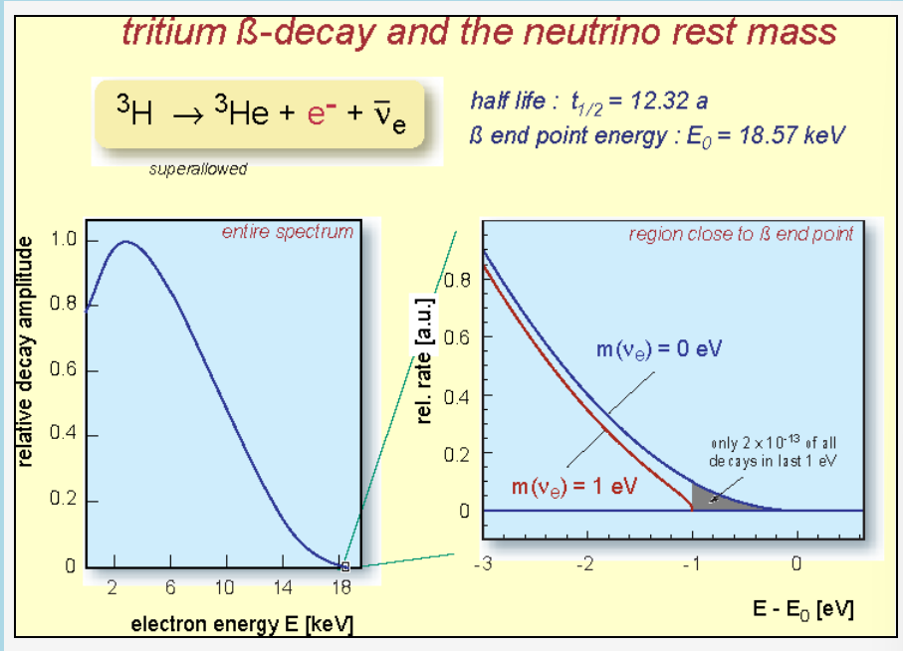
KATRIN experiment exploits the single beta decay of molecular tritium as:
And currently provides the best neutrino-mass sensitivity in the field of direct neutrino-mass measurements.
F Šimkovic 2021 Phys.-Usp. 64 1238
Notes:
$$T_{2}→ {}_{}^{3}{He}T^{+}+ \acute{e}+ {\overline{v}}_{e}$$

Slide 32
Overview of the KATRIN experiment
The electron path is from left to right.
Windowless Gaseous Tritium source
Transport Section
Pre-spectrometer
Main Spectrometer
Detector
The gaseous tritium is inserted in the middle and pumped out at both ends
é from β decay and remaining tritium molecules enter the TS which has the purpose of eliminating the tritium while guiding the é to the spectrometers. This is achieved by a combination of mechanical and cryogenic pumps and superconducting magnets.
The pre-spectrometer is in principle a smaller version of the main one. This is necessary to minimize background in the main spectrometer due to trapped electrons.
It defines the analysing potential with a precision of a few ppm. Both spectrometers operate as MAC-E-filters. The spectrometers may be operated at a temperature down to -20⁰C to reduce outgassing. To minimize background, an ultra high vacuum of better than 10-11mbar is necessary
é are guided to a detector which, from the measuring principle, needed only to be a counting device.
Notes:
KATRIN cannot detect the neutrinos directly. Instead, it measures the range of energies of the electrons that shoot around inside a 23-metre-long, blimp-shaped chamber, which is the largest ultra-high-vacuum system in the world. This measurement reveals the range of energies of the unseen neutrinos, which in turn reveals their mass. (https://www.nature.com/articles/d41586-019-02786-z)

Slide 33
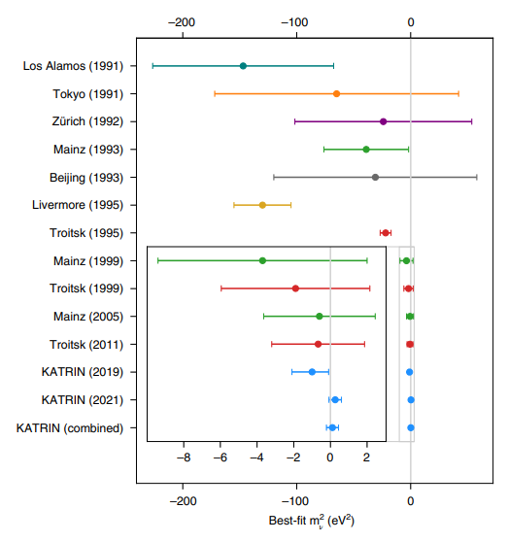
The team’s first reported measurement in 2019 cut the upper limit for m_{v} almost in half, from 2 eV/c² to about 1.1 eV/c². With the new findings reported this year, the upper limit drops below 1 eV/c² for the first time.
By increasing the source activity and reducing the background with respect to the first run of experiment, KATRIN reached a sensitivity on m_{ν} of 0.7 eV/c² at a 90% confidence level (CL). The best fit to the spectral data yields m_{ν}² = (0.26 ± 0.34) eV²/c⁴, resulting in an upper limit of m_{ν} , 0.9 eV/c² at 90% CL.
By combining this result with the first m_{v} experiment, KATRIN find an upper limit of m_{v} < 0.8 eV/c² at 90% CL.
Data taken by the experiment in 2019 and 2021 allowed KATRIN scientists to narrow the upper limit on the neutrino mass. The KATRIN experiment will continue to collect data until 2024, with the goal of reaching a sensitivity 4 times greater than what the collaboration has achieved to date.
Comparison of best-fit values and total uncertainties with previous neutrino-mass experiments
The KATRIN Collaboration. Direct neutrino-mass measurement with sub-electronvolt sensitivity. Nat. Phys. 18, 160–166 (2022). https://doi.org/10.1038/s41567-021-01463-1

Slide 34
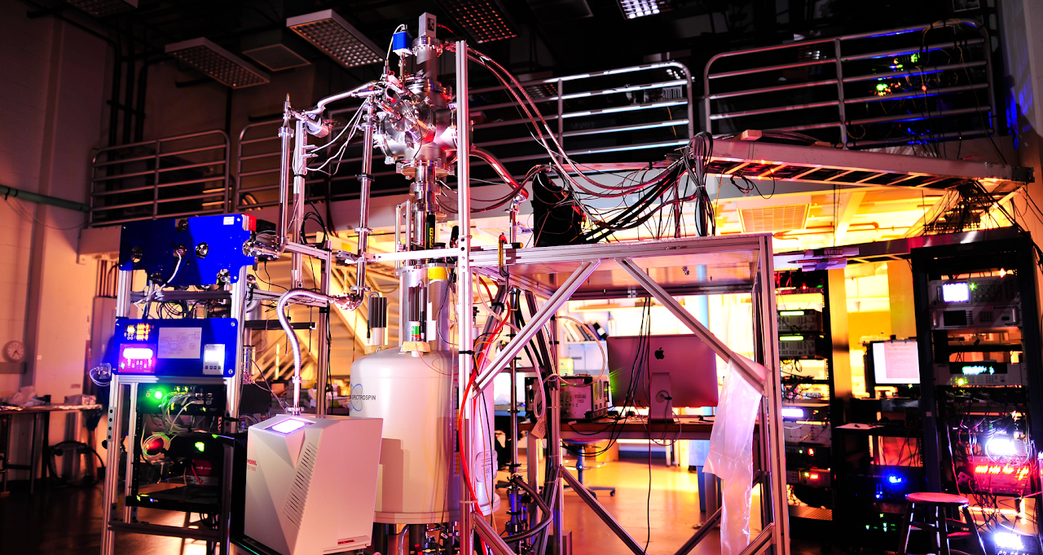
The future
But the technique employed by KATRIN cannot practically determine a mass below 0.2 eV/c². A new endeavour, Project 8, plans to reach an upper limit sensitivity of 0.04 eV/c². Project 8 will measure the neutrino’s mass by making use of an atomic tritium source — rather than molecular tritium — and will track the electron energy using a novel detection technique….
https://www.project8.org/

Slide 35
Thank you!
Cảm ơn!
Arigatou!
Terima Kasih!

