Slide 1
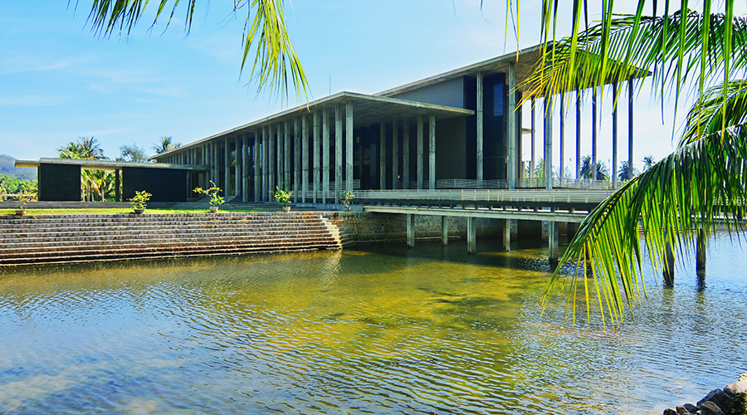
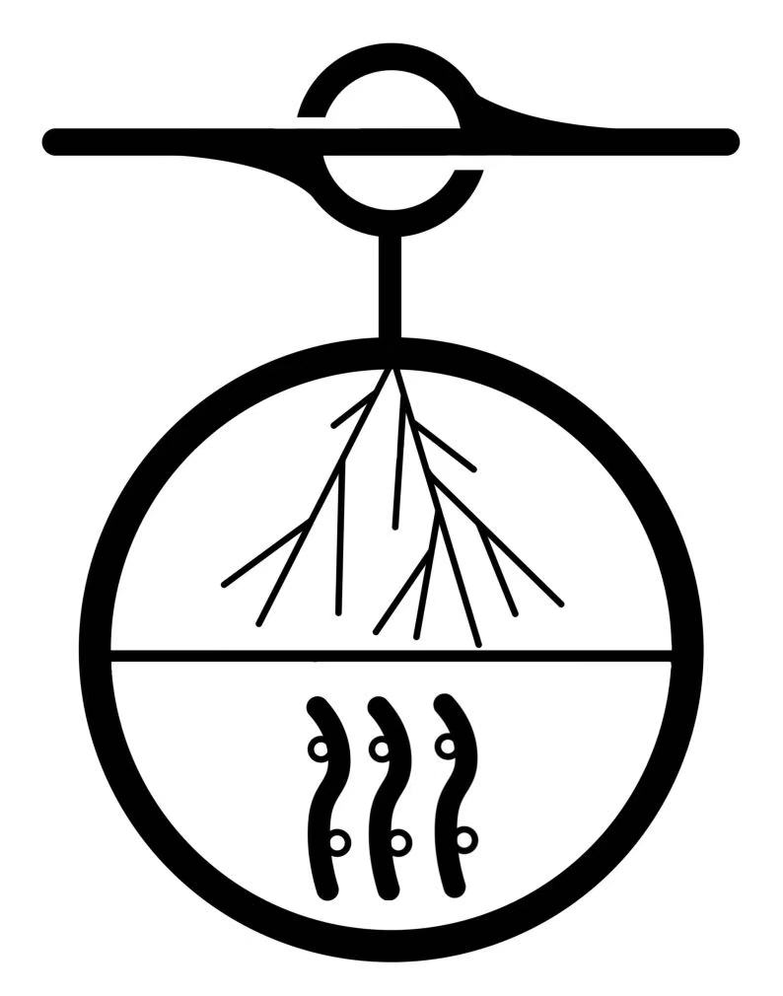
The Plan and Status of NEON
21st Rencontres du Vietnam, Neutrino Physics - Quy Nhon Nam ward
S. Lin for the NEON Collaboration
July 24th, 2025

Slide 2
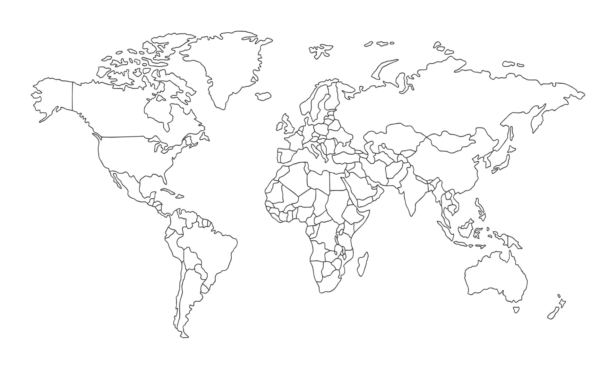
Neutrino Telescopes around the World
[Baikal-GVD]
Lake Baikal
[KM3Net]
Mediterranean Sea
(P-ONE)
East Pacific Ocean
(HUNT,TRIDENT,NEON)
South China Sea
IceCube (IceCube Gen-2)
South Pole

Slide 3
Outline
Simulation and Prospects
Experimental Progress
Summary
Conceptual design
Signal analysis
Sensitivity
PMT Test
OM status
Electronic
Trial

Slide 4
Outline
Simulation and Prospects
Experimental Progress
Summary
Conceptual design
Signal analysis
Sensitivity
PMT Test
OM status
Electronic
Trial

Slide 5
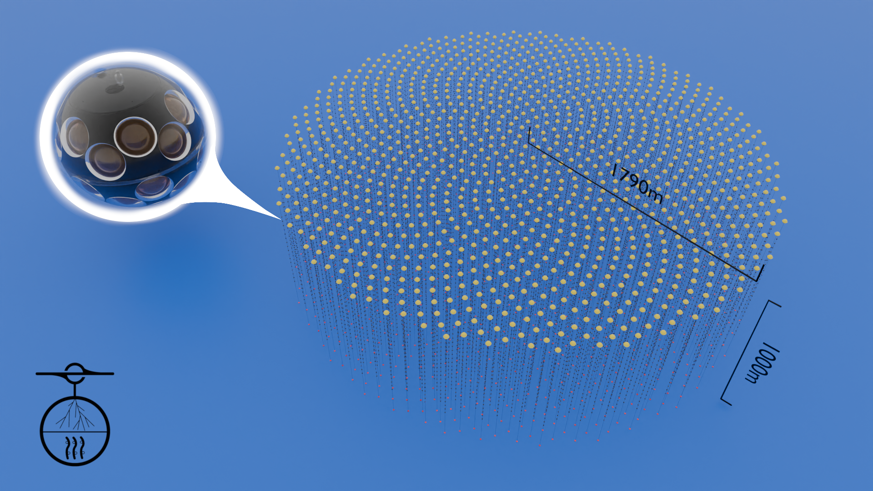
Conceptual Design
Neutrino Observatory in the Nanhai (NEON)
Depth: 1700m / 3500m
Detection Volume: ~10 km³
Number of strings: ~1000
Tiling method: Fibonacci spiral
Inter-string distance: ~100m
Inter-OM distance: 40m
31PMT / OM

Slide 6
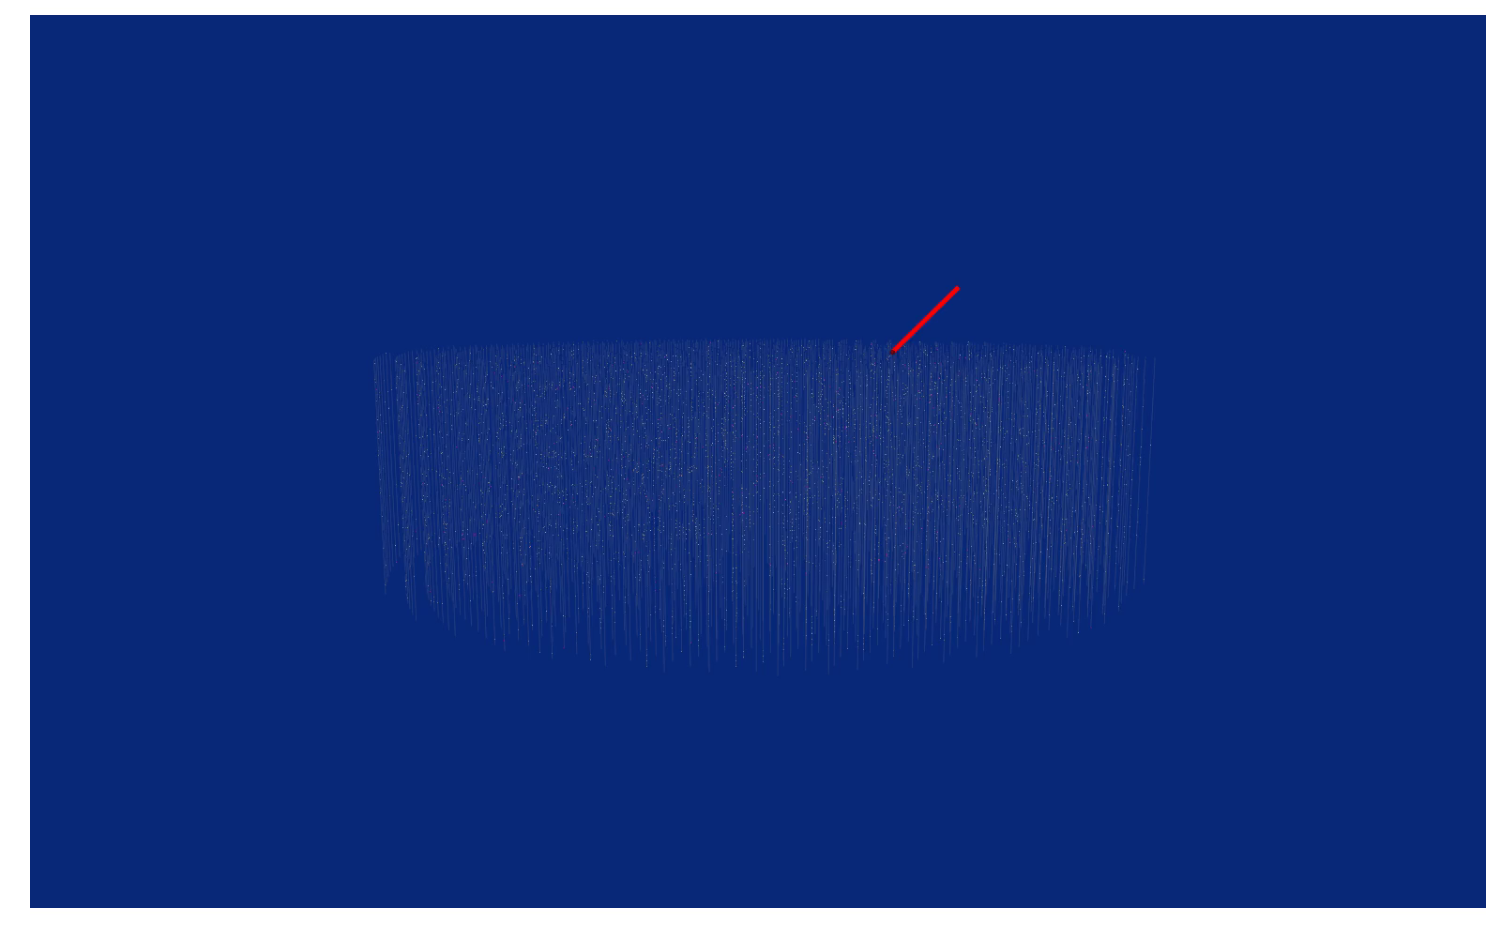
Conceptual Design
Neutrino Observatory in the Nanhai (NEON)
Depth: 1700m / 3500m
Detection Volume: ~10 km³
Number of strings: ~1000
Tiling method: Fibonacci spiral
Inter-string distance: ~100m
Inter-OM distance: 40m
31PMT / OM

Slide 7
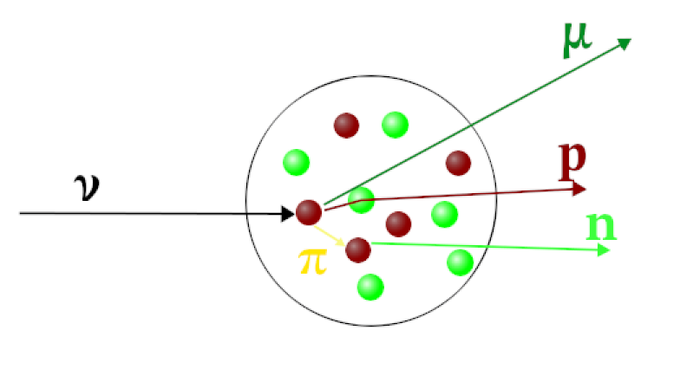
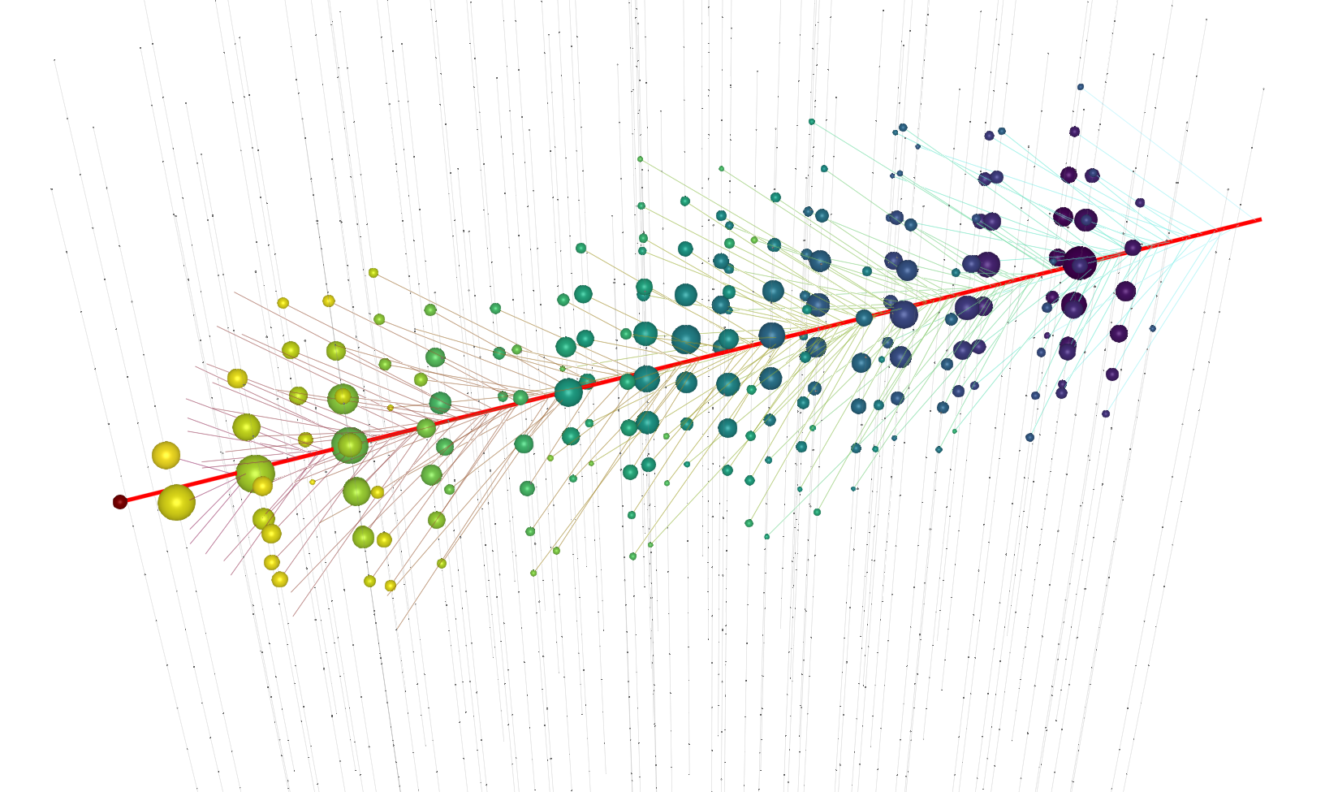
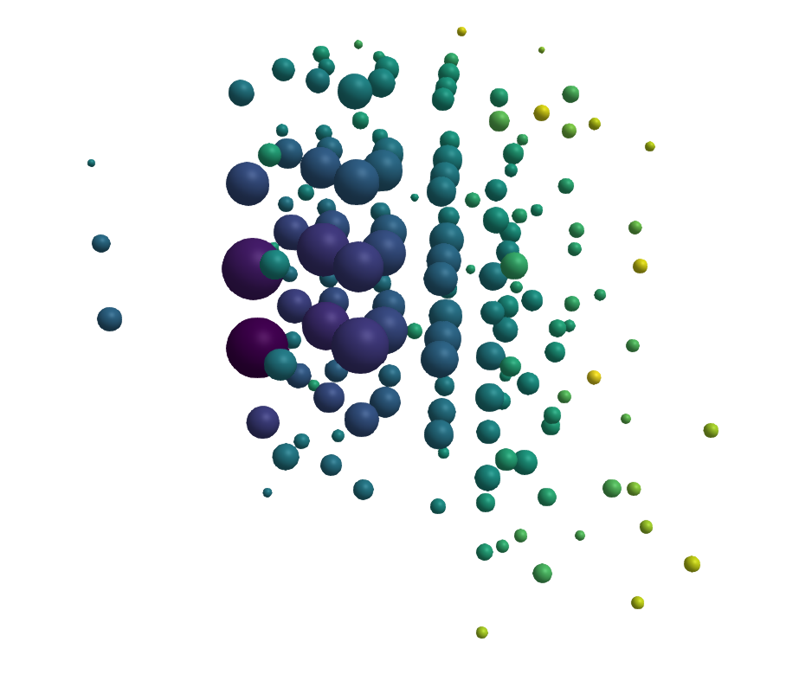
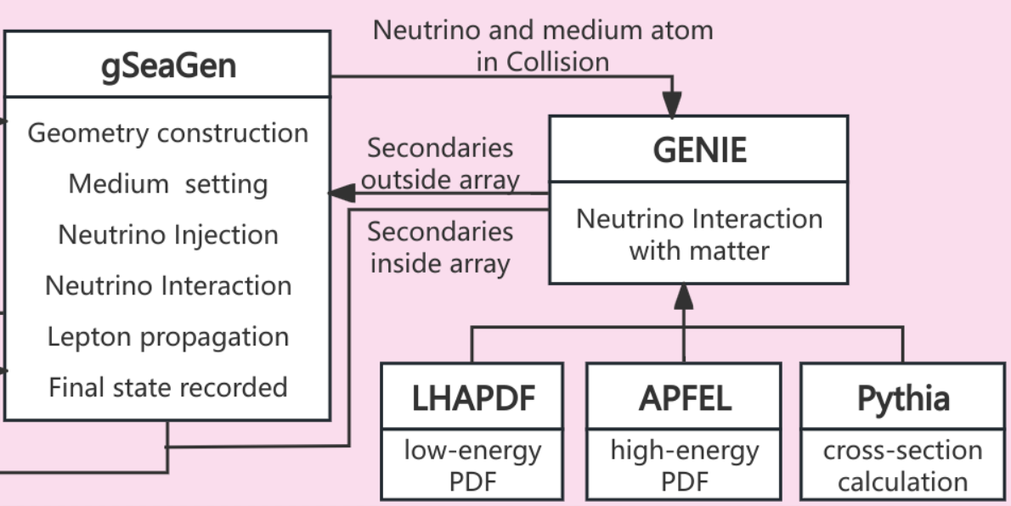
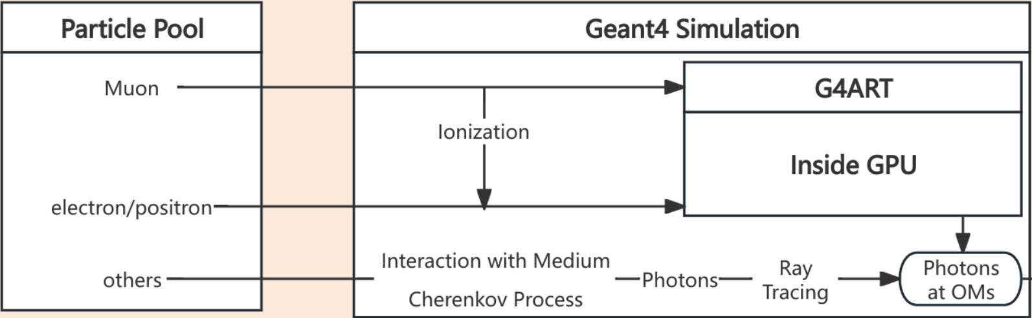
Simulation Framework
Digitalization
Neutrino interaction
Track
Cascade
GENIE for neutrino-nuclear interaction
G4ART: Adopting GPU to simulate tons of cerenkov photons

Slide 8
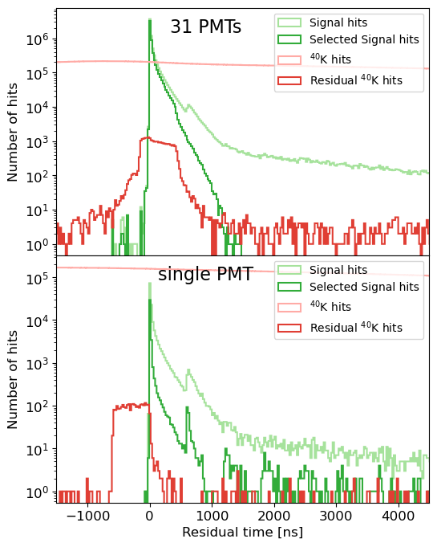
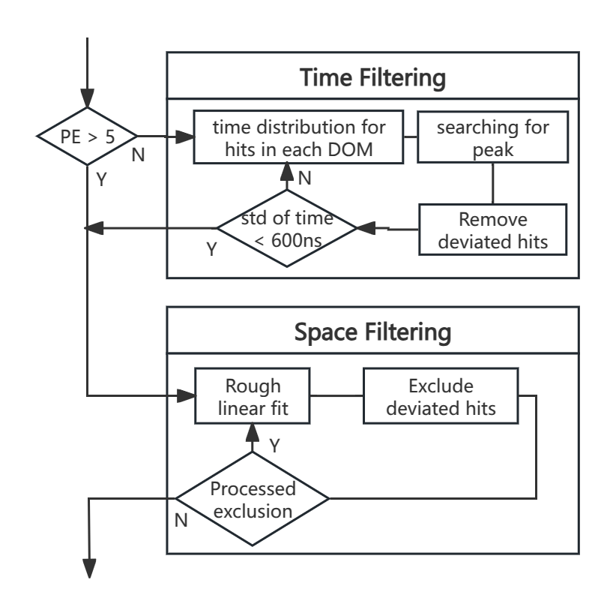
Noise filtering
The process to filter noise hits from ⁴⁰K
The 31-PMT OM retains most signals while filtering out noise hits

Slide 9
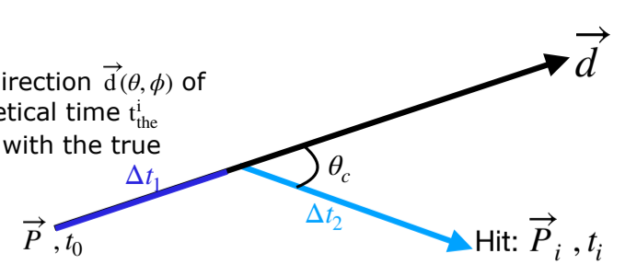
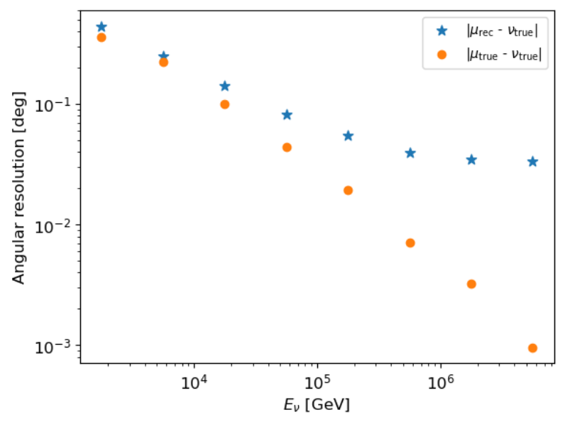
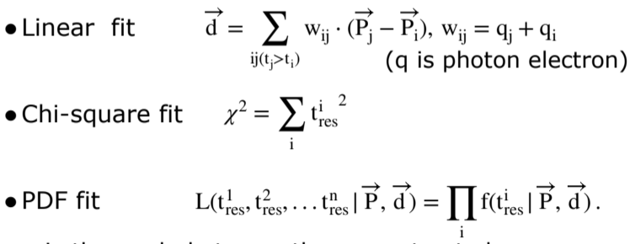
Reconstruction
ν_{µ}
µ
A GNN-based algorithm has been developed,
with performance similar to the current version
but much faster.

Slide 10
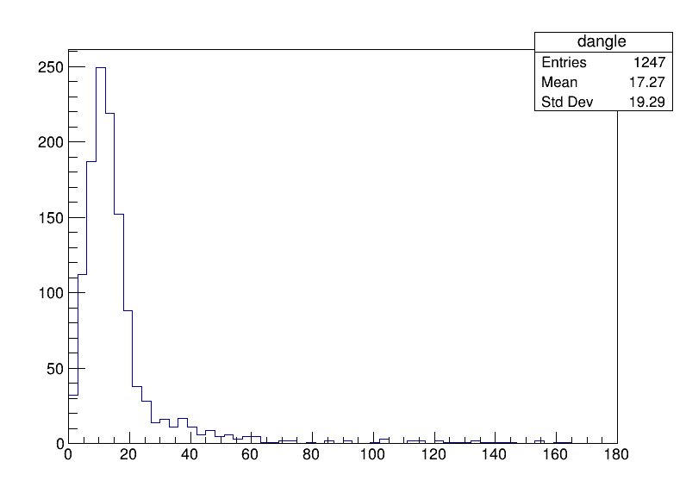
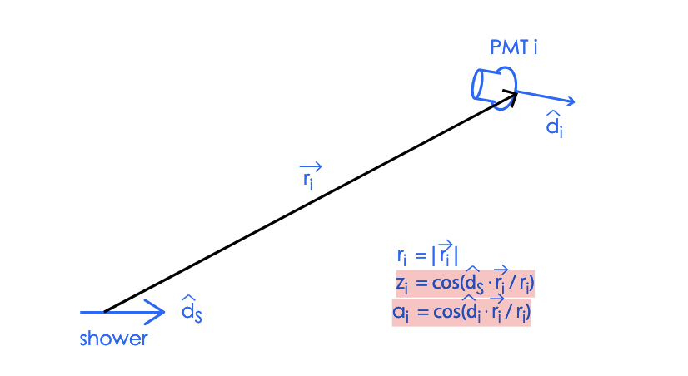
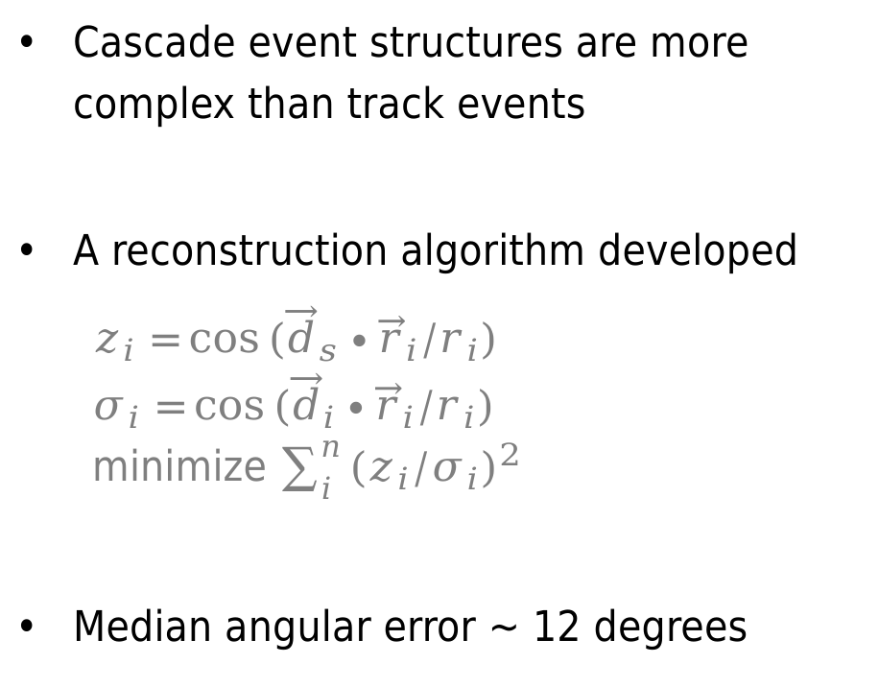
Reconstruction
Cascade event structures are more complex than track events
A reconstruction algorithm developed
  $$z_{i}=\cos{({\vec{d}}_{s}∙{\vec{r}}_{i}/r_{i})}$$
  $$σ_{i}=\cos{({\vec{d}}_{i}∙{\vec{r}}_{i}/r_{i})}$$
  minimize $\sum_{i}^{n}{{{(z}_{i}/σ_{i})}^{2}}$
Median angular error ~ 12 degrees
A GNN-based algorithm is under development

Slide 11
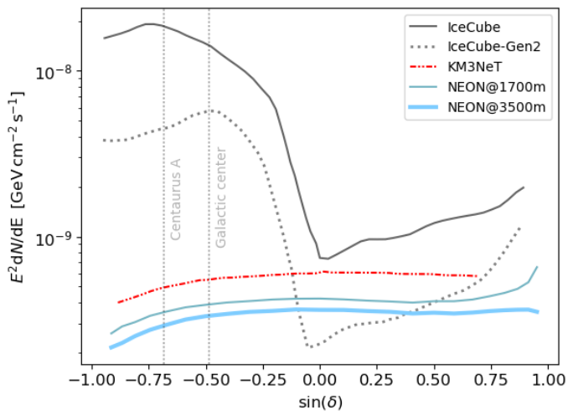
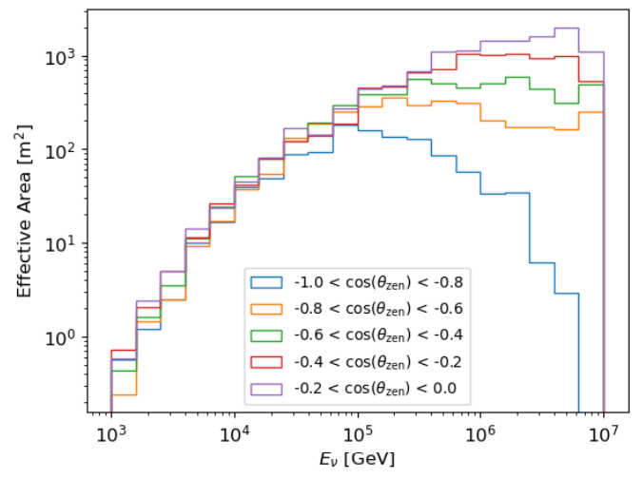
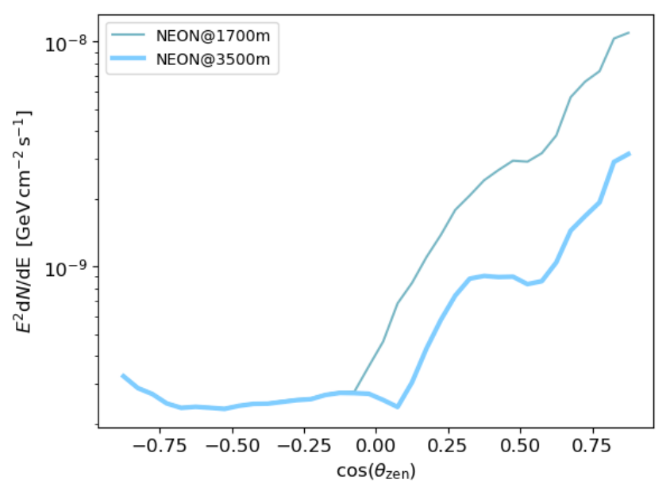
Sensitivity
arXiv:2408.05122
Similar sensitivity to steady sources at 1700 m and 3500 m
Advantage for Galactic center and Centaurus A
A 10-km³ detector achieves 5σ sensitivity of
E²Φ ∼ 3 × 10⁻¹⁰ GeV cm⁻² s⁻¹

Slide 12
Outline
Simulation and Prospects
Experimental Progress
Summary
Conceptual design
Signal analysis
Sensitivity
PMT Test
OM status
Electronic
Trial

Slide 13
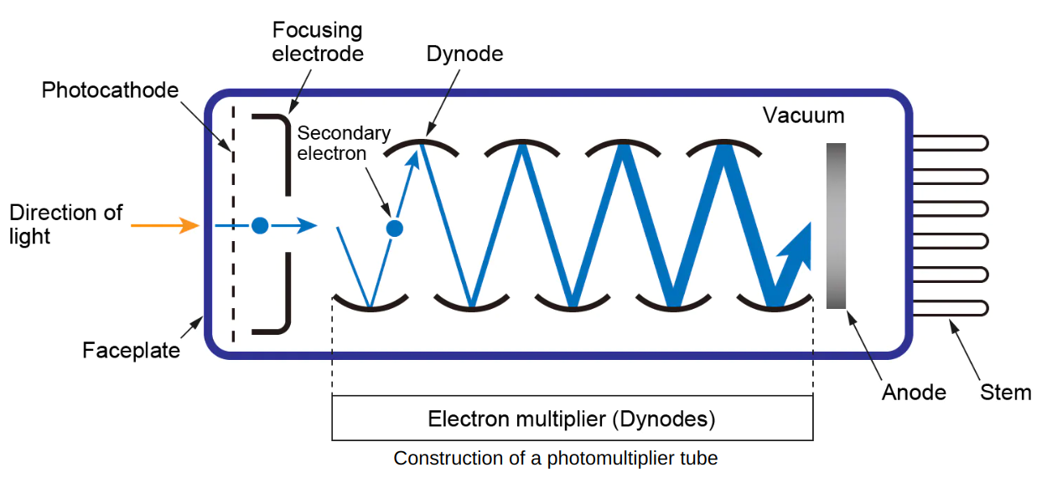
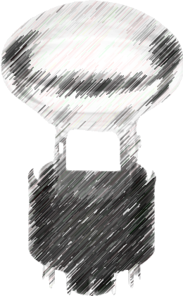
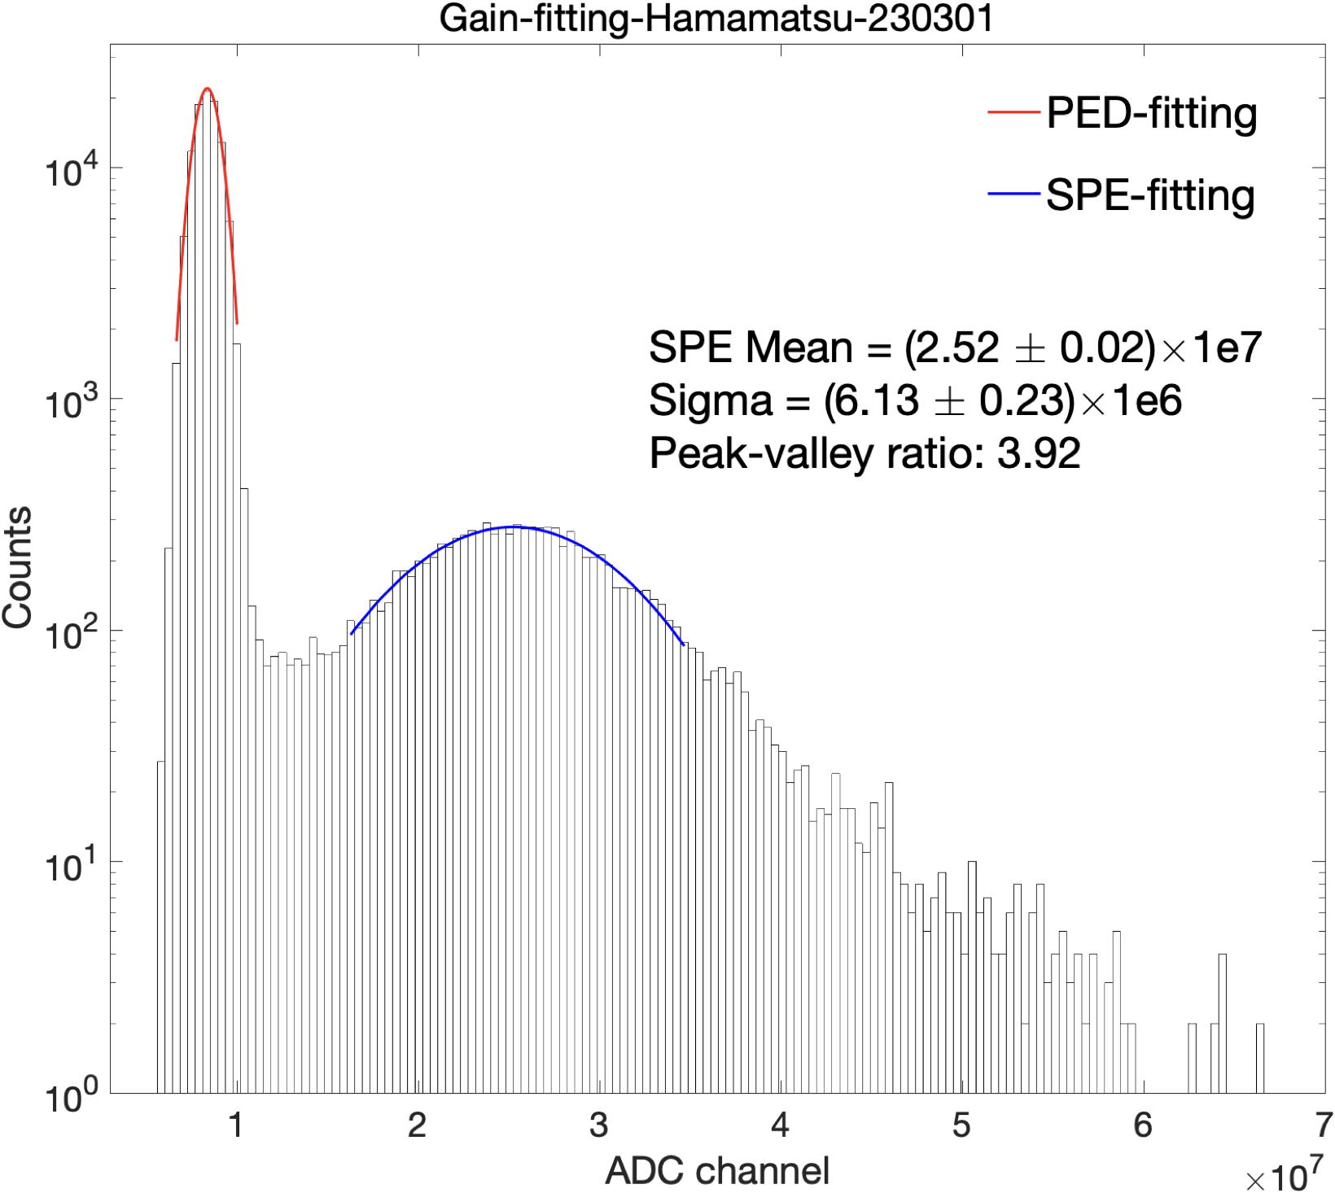
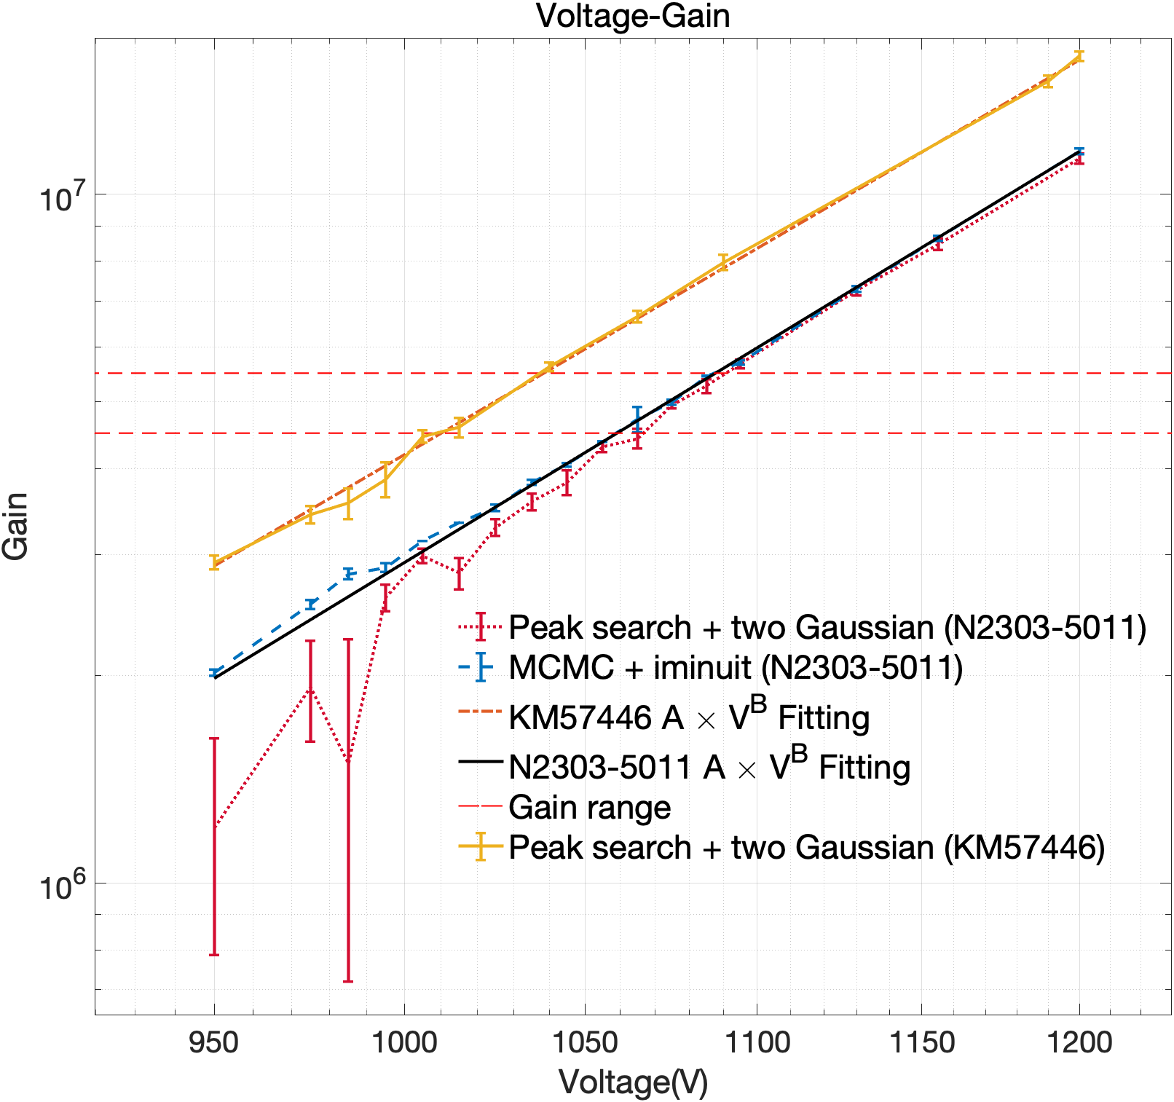
PMT Test
QE~30%
Gain~N_{sec_ele}
Batch Testing
Multi-channel power supply
Manufacturer | QE(%) | Voltage(V) | Gain | Peak/Valley ratio | Dark Current (nA) | Dark Count (Hz)
North Night Vision | 28.5 | 1005 | 5.34E+06 | 2.05 | 1.35 | 526
Hamamatsu | 27.1 | 1000 | 4.88E+06 | 2.25 | 1.23 | 1178
Multi-channel oscilloscope
Light
Valley
Peak

Slide 14
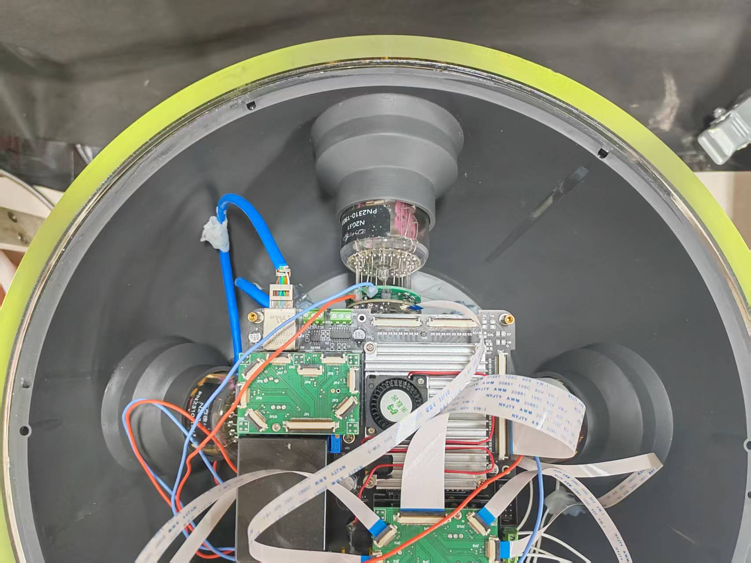
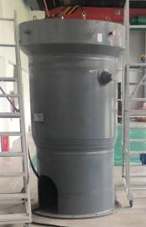
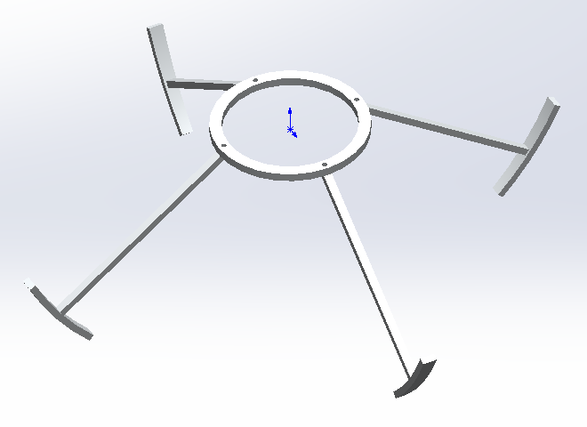
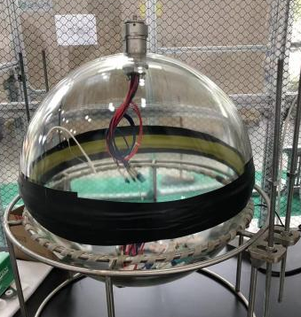
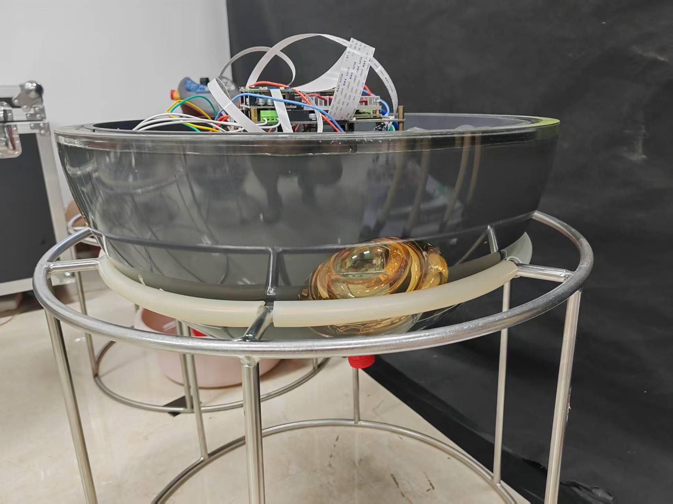
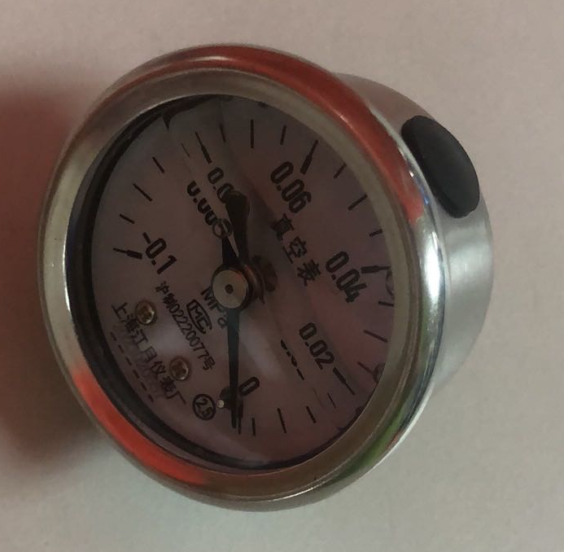
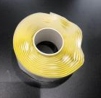
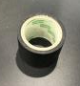
OM Status
Current Version of OM
8-PMTs / OM
support bracket
Pressure Test:
  works at 4km
Leak Test:
  ~ 0 pressure for 1 day
4km ocean depths (40Mpa)
Pressure Test Chamber
Pressure Gauge
Putty
Tape

Slide 15
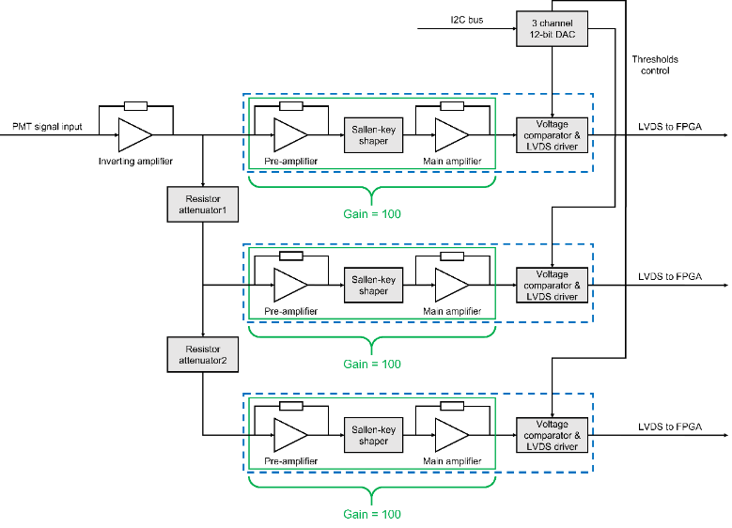
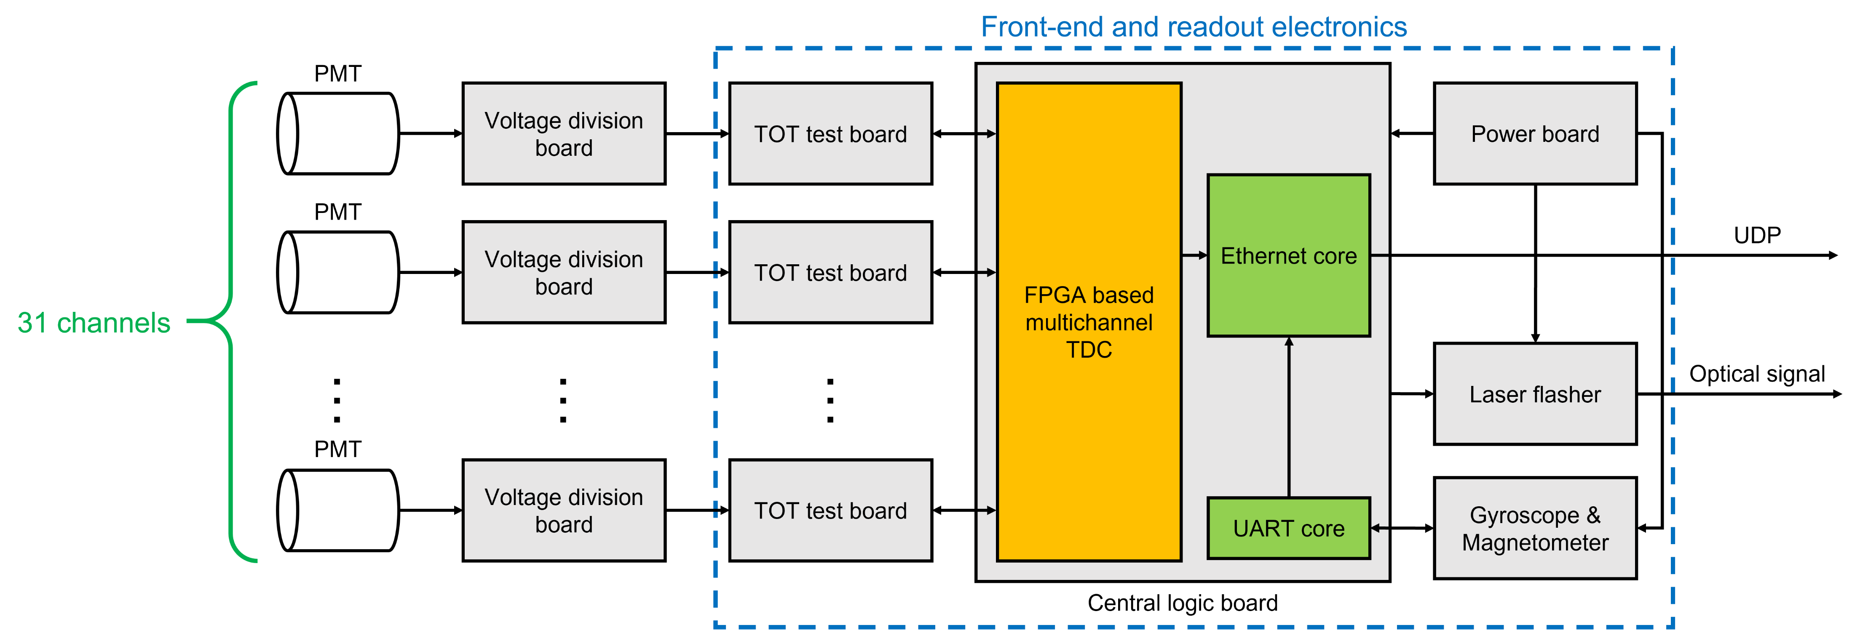
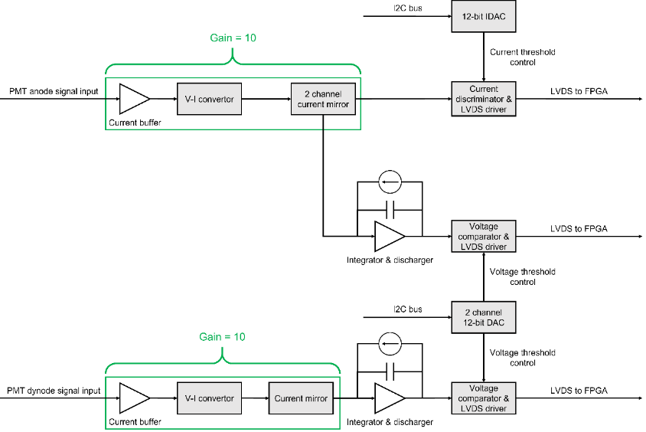
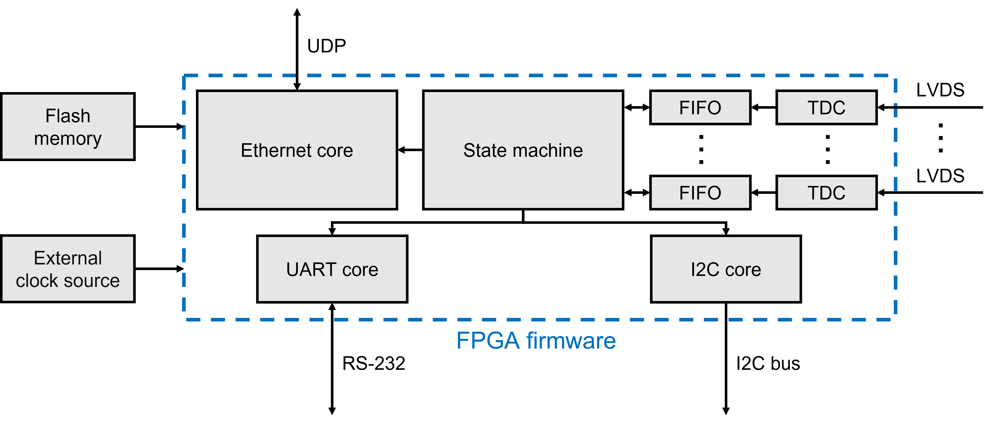
Electronic Design
Front-end and readout electronics

Slide 16
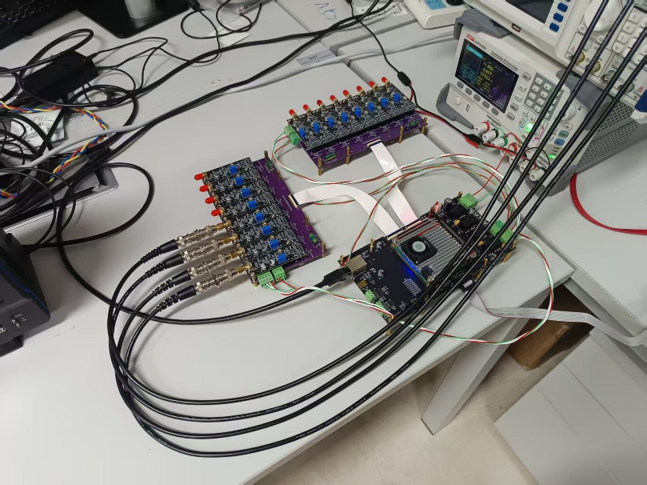
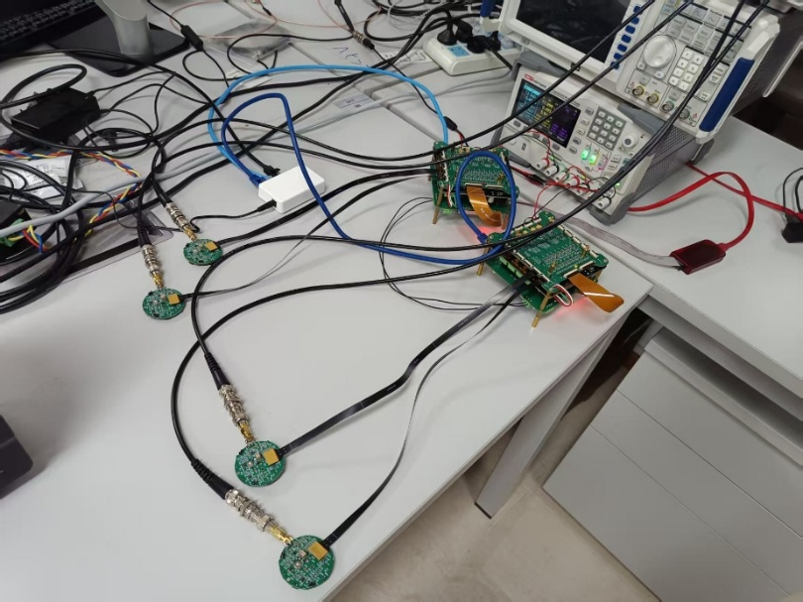
Electronic Status
Testing with 10 MHz Signals
16-Channel Electronic
Channel | σ_{Δt} / ns | σ_{TOT} / ns | Channel | σ_{Δt} / ns | σ_{TOT} / ns
shell a ch1 | 0.70 | 0.89 | shell c ch1 | 0.36 | 0.80
shell a ch2 | 0.50 | 0.68 | shell c ch2 | 0.36 | 0.53
shell a ch3 | 0.41 | 0.61 | shell c ch3 | 0.36 | 0.56
shell a ch4 | 0.41 | 0.78 | shell c ch4 | 0.41 | 0.70
shell b ch1 | 0.42 | 0.46 | shell d ch1 | 0.48 | 0.59
shell b ch2 | 0.46 | 0.66 | shell d ch2 | 0.49 | 0.61
shell b ch3 | 0.75 | 0.66 | shell d ch3 | 0.49 | 0.82
shell b ch4 | 0.72 | 0.76 | shell d ch4 | 0.72 | 0.71
Testing Version
Master
σ_{Δt} and σ_{TOT} ≤ 1 ns
Packet Loss Rate < 0.001%
Slave
For all the channels:
Integrated Version
Testing with higher signal frequency is on going...

Slide 17

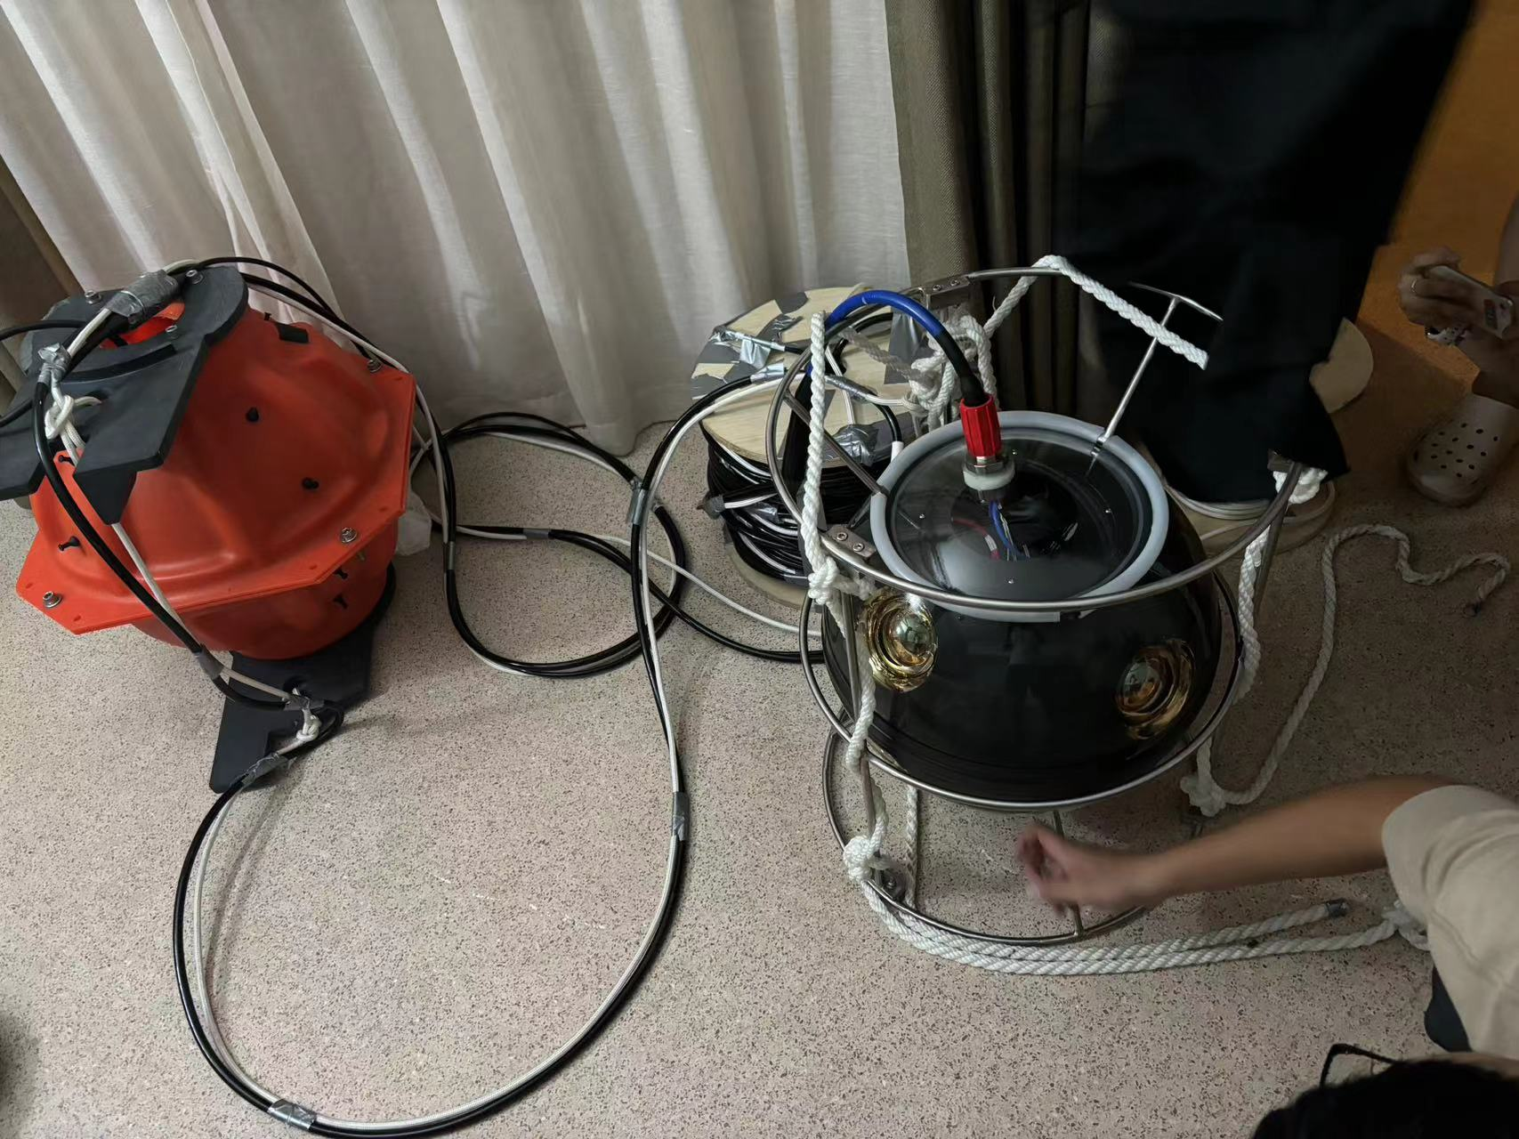
Trials
Last trial in Qiandao Lake:
Single OM works well under water
buoy
26m
OM 2
Next trial in preparation
→ Validate the time sync system
OM 1
2m
anchor

Slide 18
Summary
Proposed a deep sea Neutrino Observatory in the Nanhai (NEON)
Built a simulation and analysis framework
Evaluated sensitivity for different sites
Developing optical modules and electronics
Conducted initial underwater trials; next trial in planning
Advancing step by step with ongoing development...

Slide 19
Thank you for your attention!
21st Rencontres du Vietnam, Neutrino Physics - Quy Nhon Nam ward

Slide 20
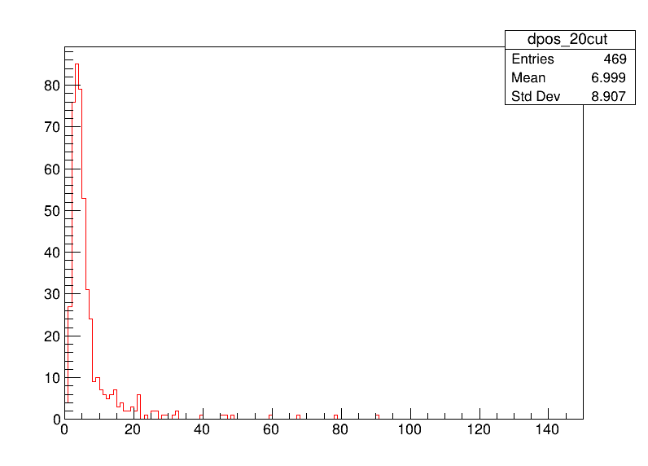
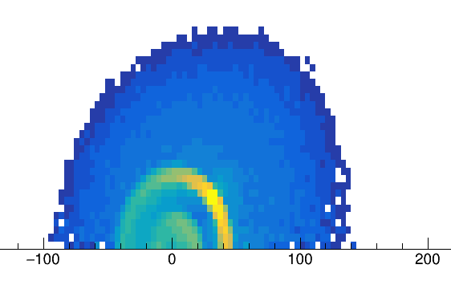


Reconstruction (Appendix)
Shower Vertex Reconstruction of Cascade
Assuming straight propagation from Vertex to hit position
M-Estimator:
$$M=\underset{hits}{∑}\sqrt{(t_{i}−t_{i}^{exp})^{2}+1}$$
Minimizing T-Res (Melis, 2017)
$$R=c_{w}(t_{i}^{exp}−t_{0})$$
Vertex
Cherenkov angle

