Slide 1
Hello everyone I’ll introduce myself!!

Slide 2
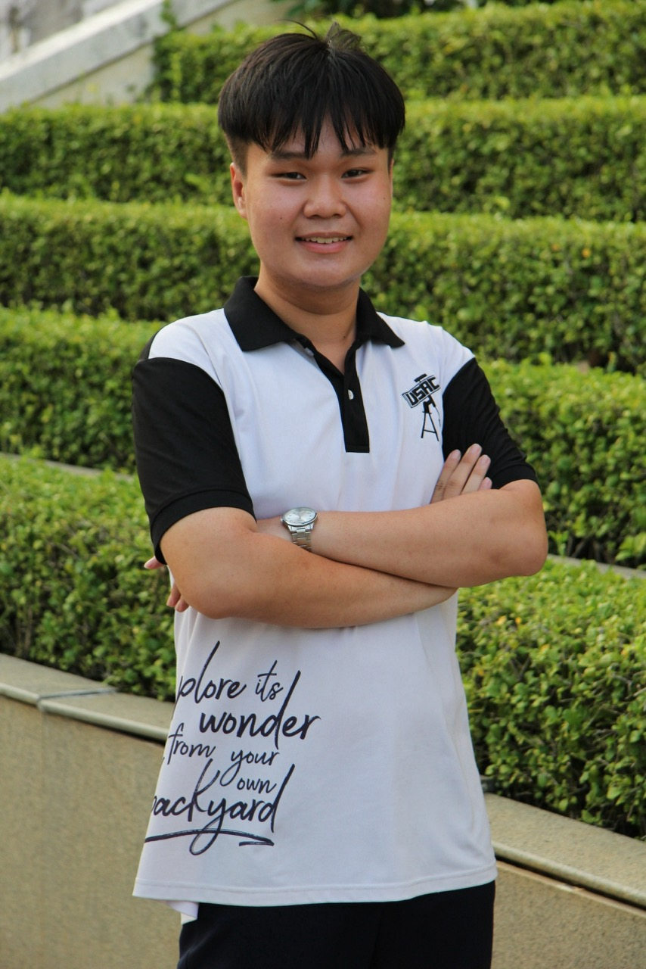
About me
Vương Uy Lực
21 (my favourite number) years old.
From China but I was born in Binh Dinh and now live in HCM city.
3rd-year student, Medical physic, VNUHCM - University of Science.

Slide 3
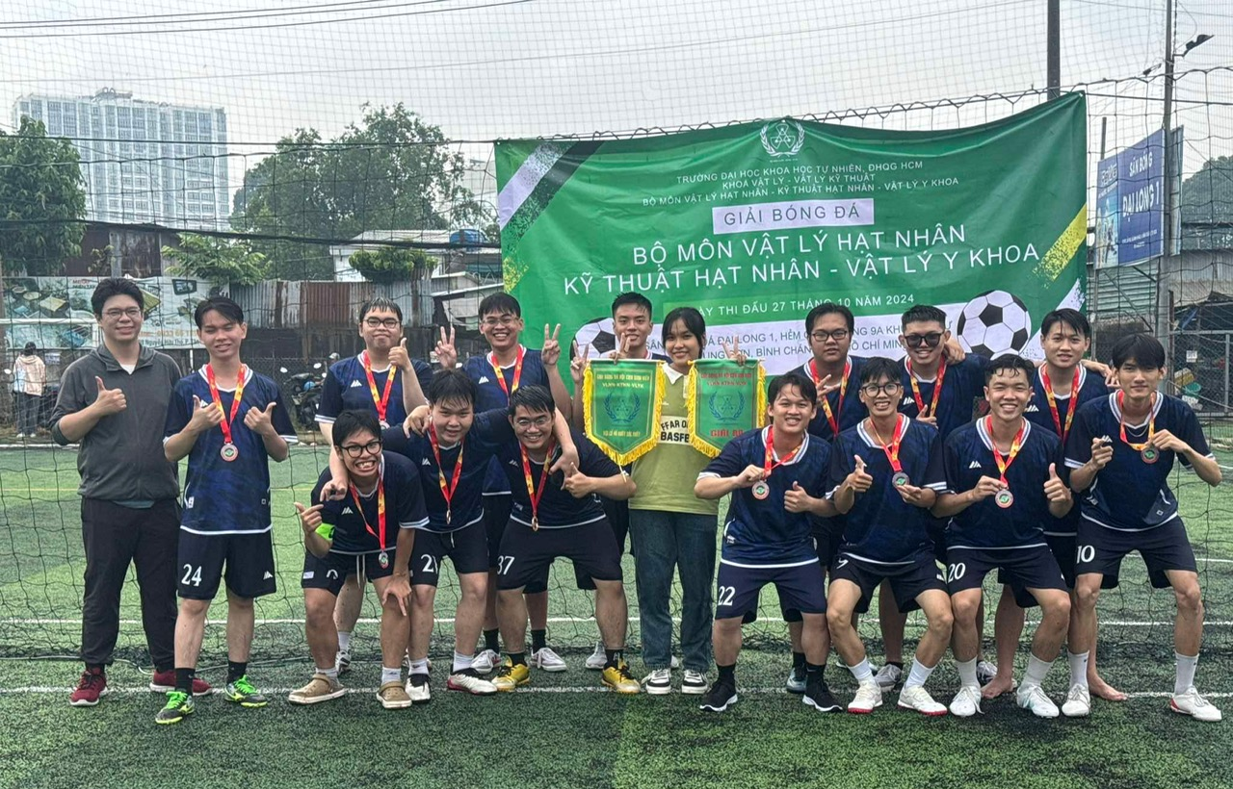
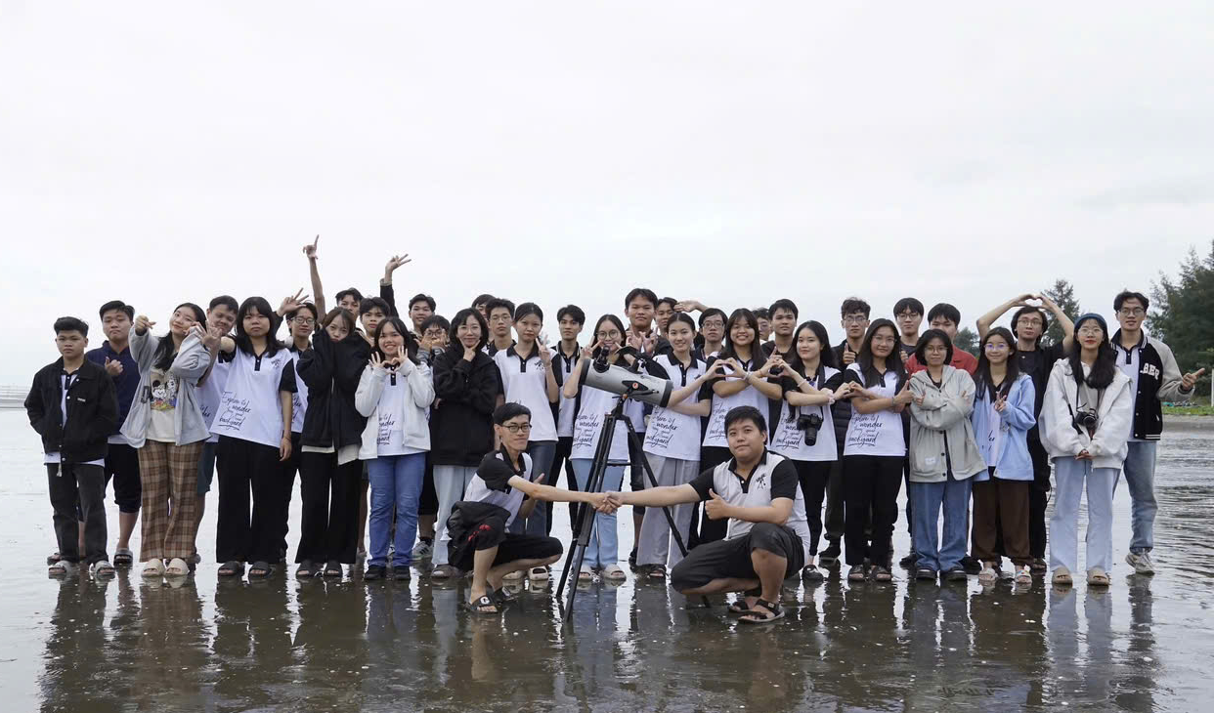
EDUCATION AND ACTIVITES
University of Science Astronomy Club (USAC)
Participate in a football tournament.

Slide 4
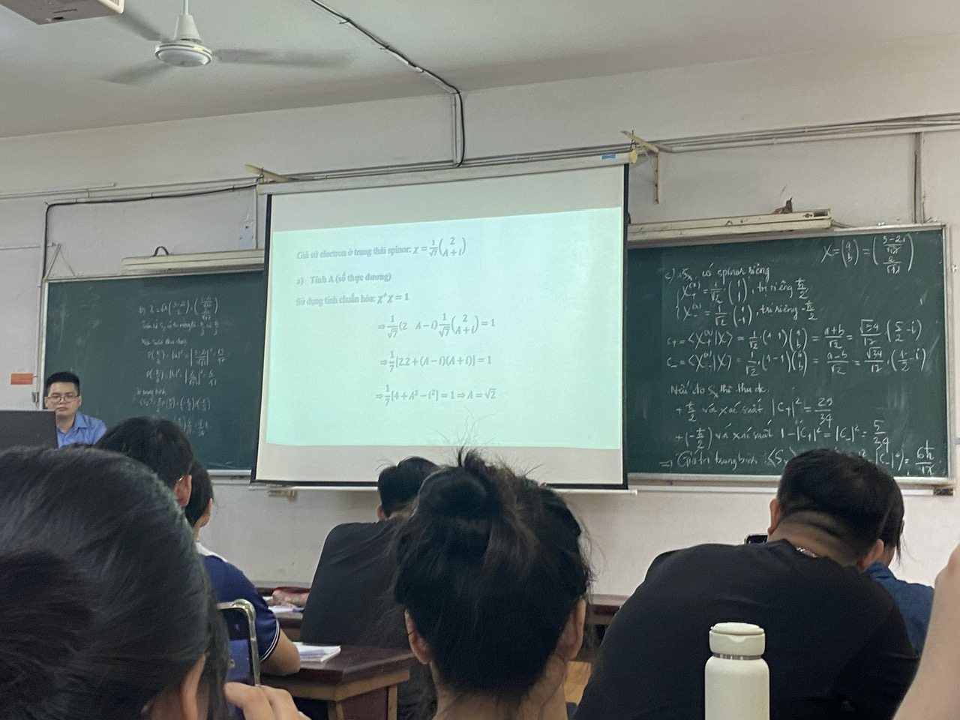
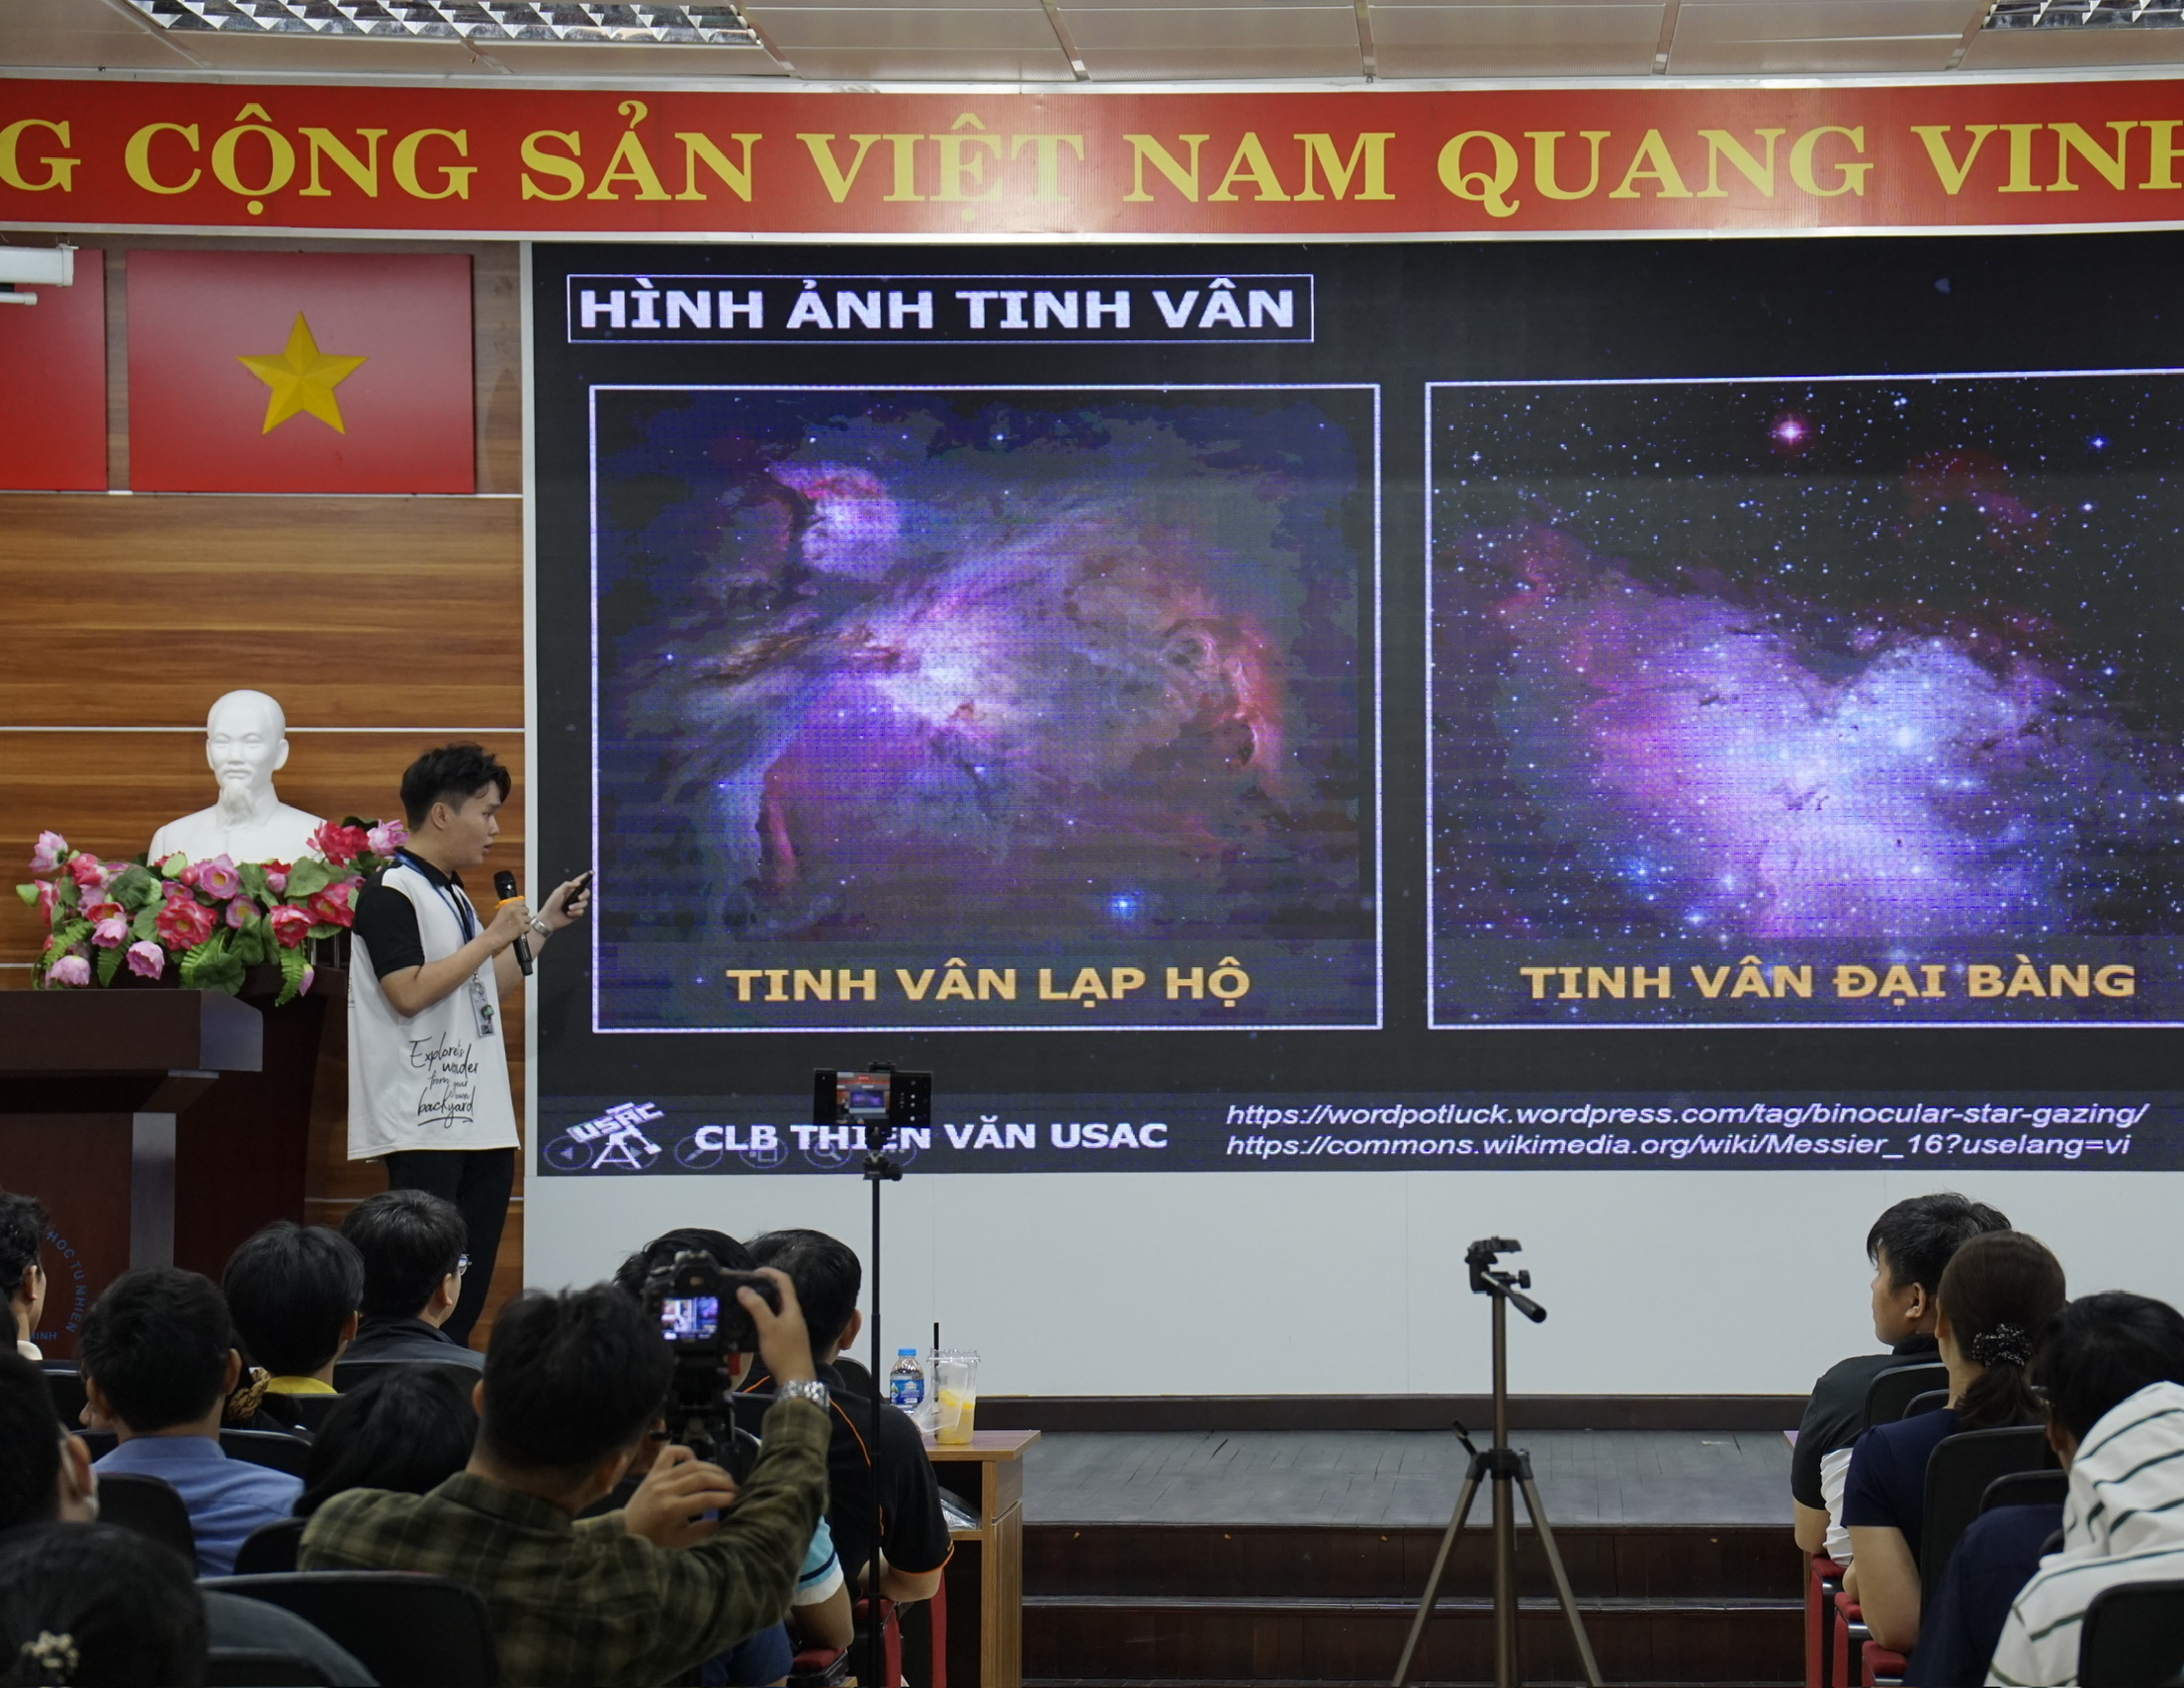
EDUCATION AND ACTIVITES
A class at the University of Science, VNU, Ho Chi Minh City
I am a speaker at the seminar

Slide 5
STRENGTH AND WEAKNESS
MY STRENGTHS
MY WEAKNESSES
apprehend knowledge really well.
self-learning.
studious and responsible
Not confident in English communication skills.
hands-on experience in physics.

Slide 6
Thank you for listening!

