Slide 1
Ho Huy
Ngoc Khue
Undergraduate student (IU-VNU HCMC)
Major: Space Engineering

Slide 2
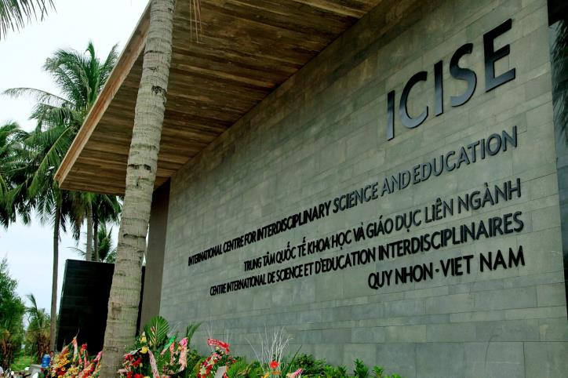
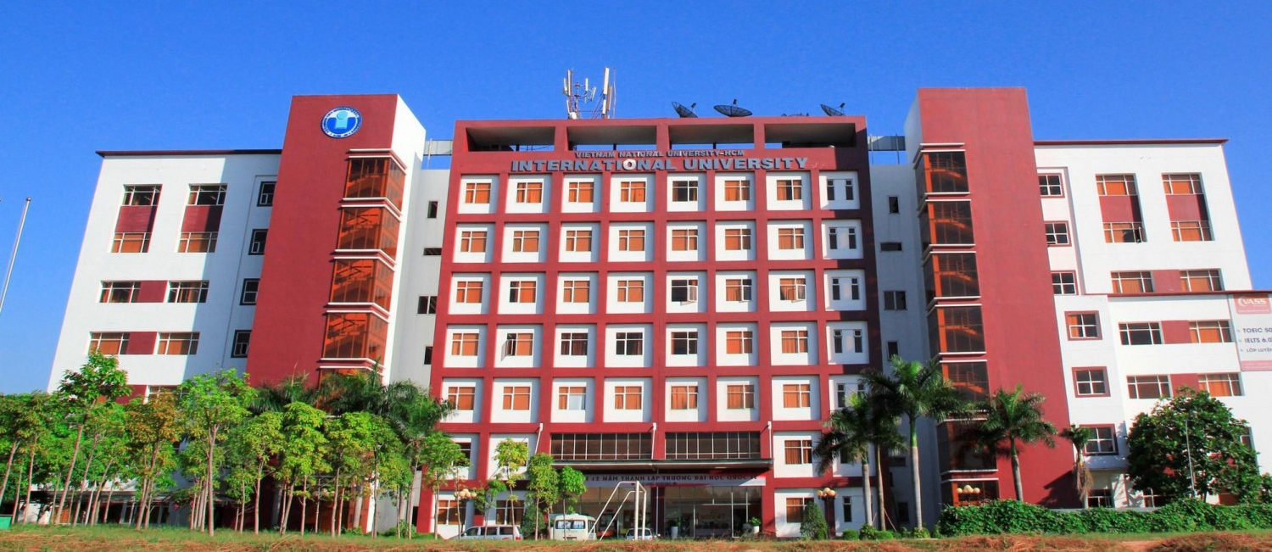
Tam Ky - Quang Nam
Quy Nhon - Binh Dinh
Ho Chi Minh City

Slide 3
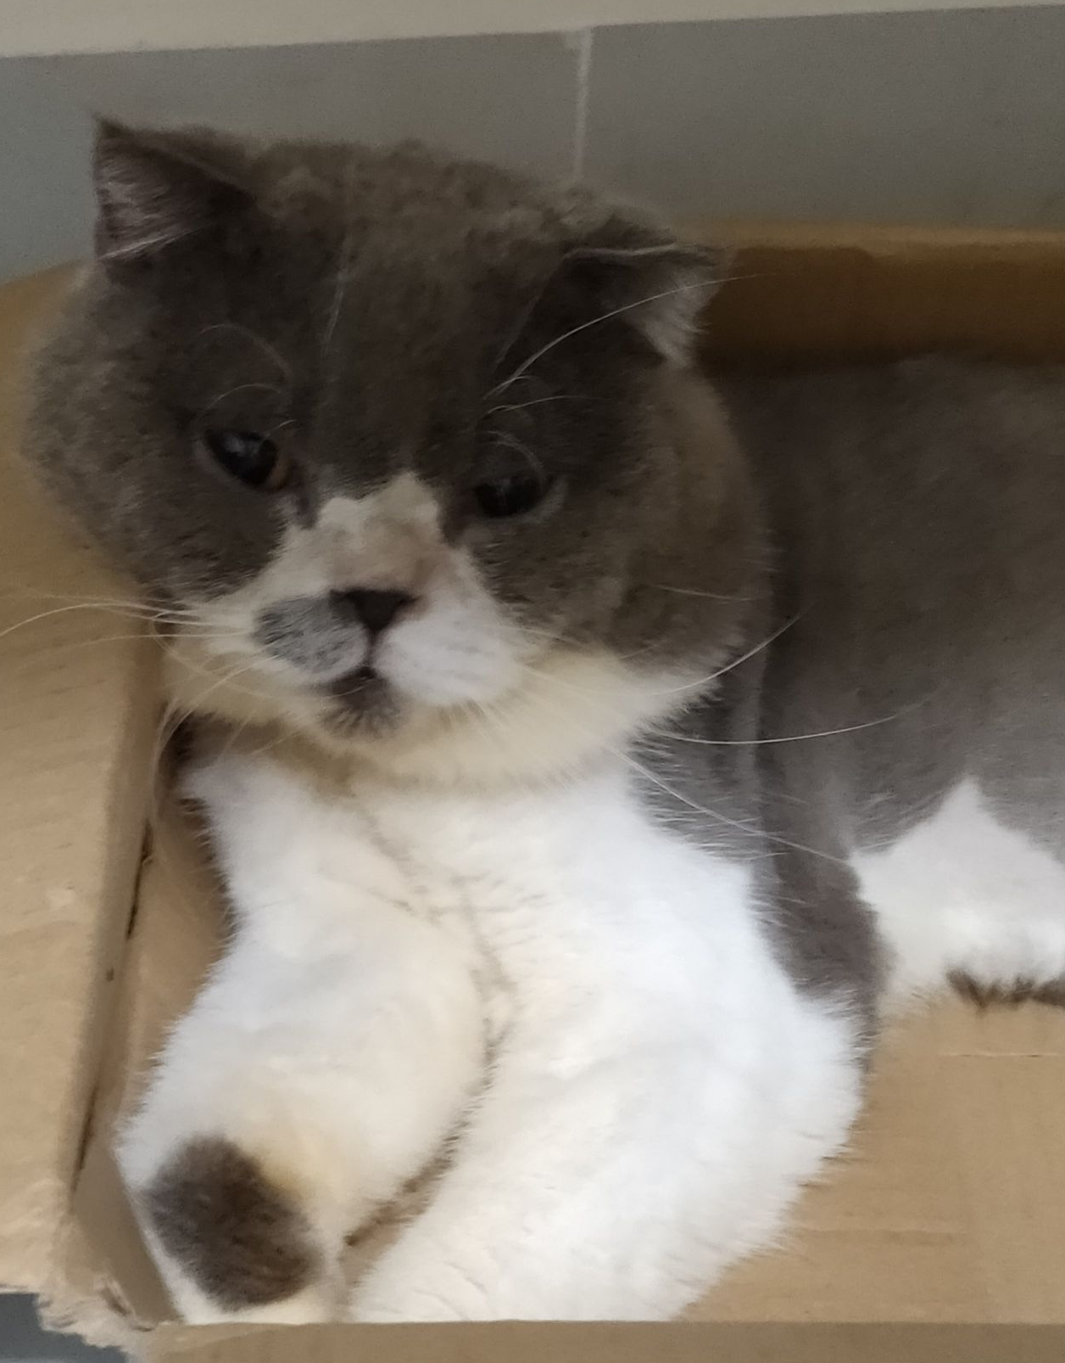
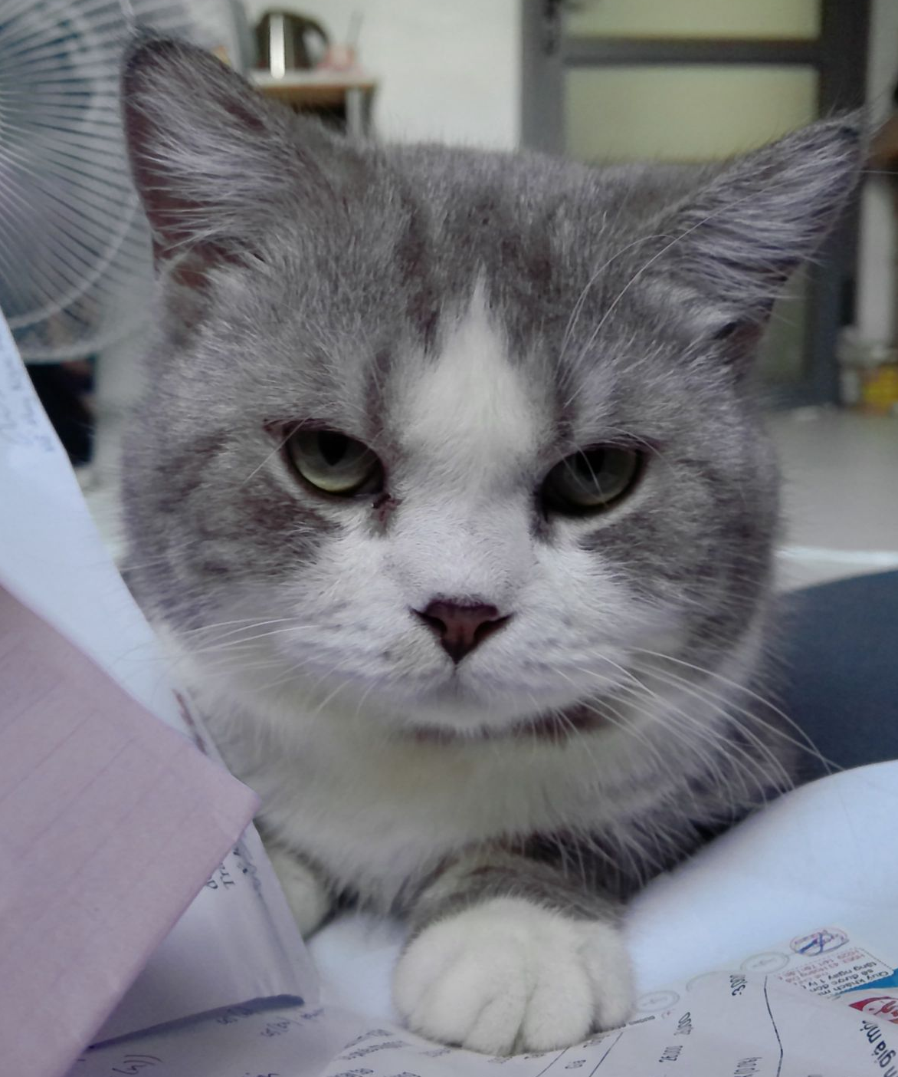
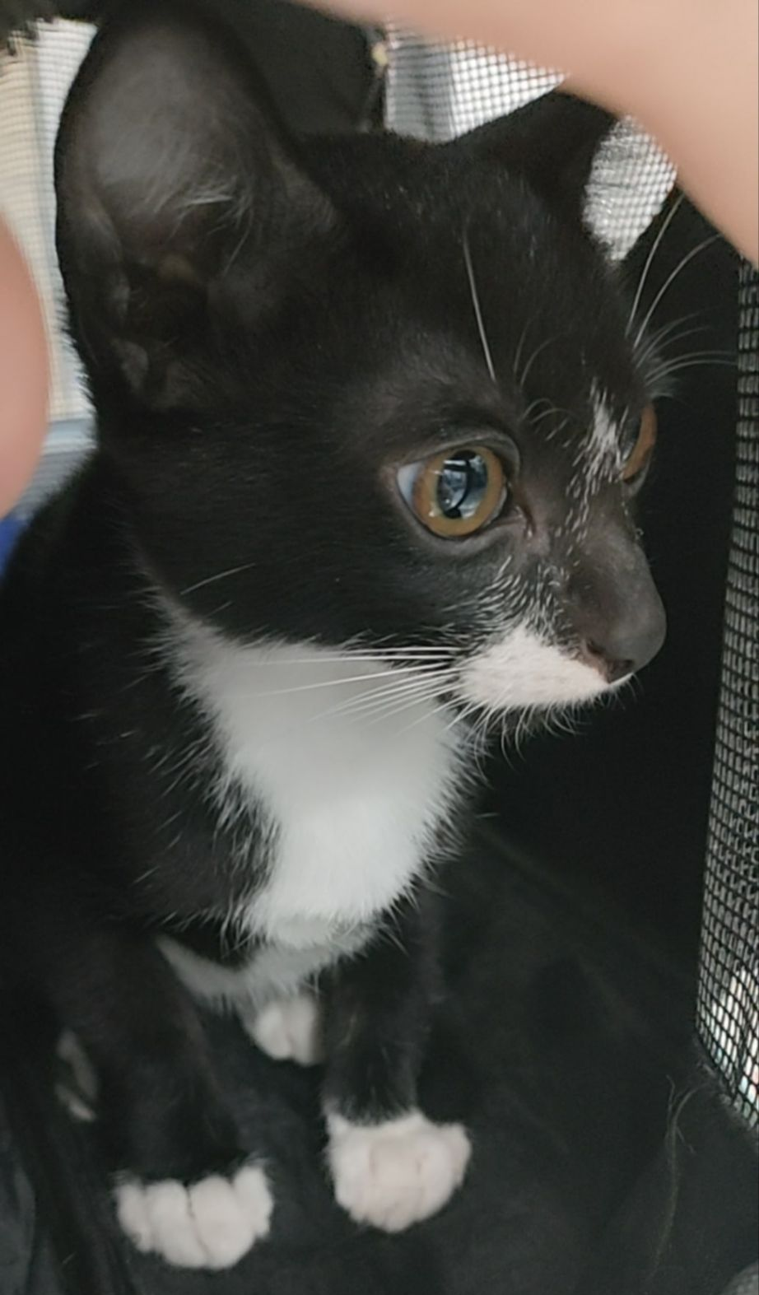
My cats
Cotton
Sugar
Cheese
3 years
2 years
2 months

Slide 4
Space Engineering
Satellite Technology

