Slide 1
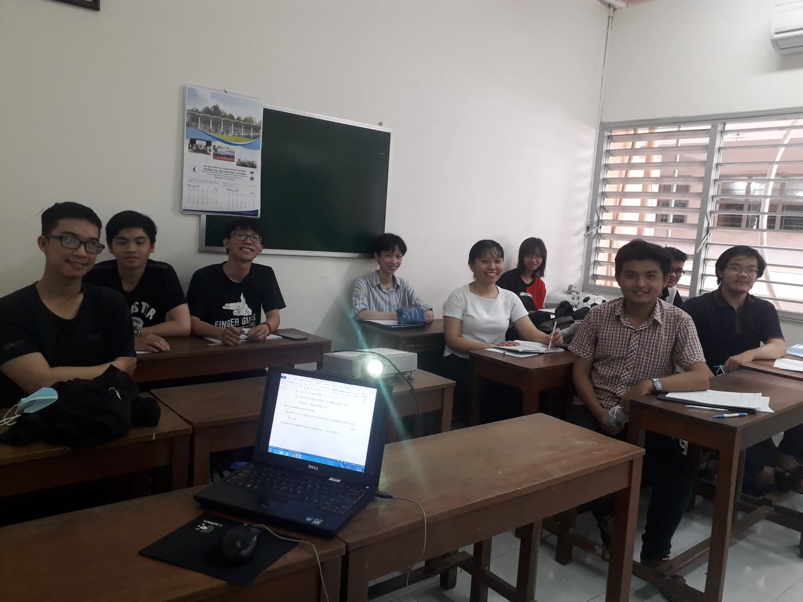
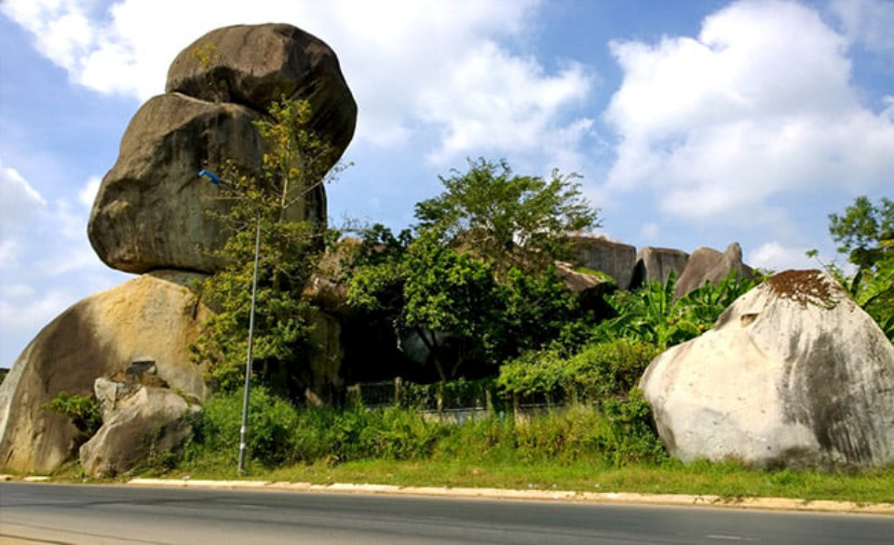
Informations
DONG NAI
Tran Thi Minh Hoan

Slide 2
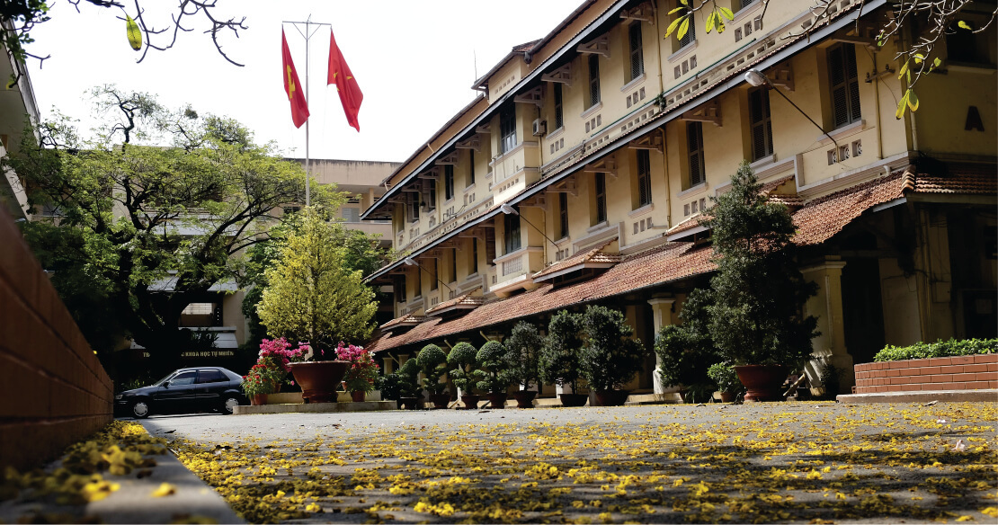
Education
University of Science

Slide 3
Education
Introduces and recalculates the basic features in describing the expansion of the universe.
Rastall gravity
Presents Rastall gravity.
Comparing: Rastall gravity and Einstein gravity.

Slide 4
Interests
Physics.
Information technology.
Purpose
Hands – on experience.
Develop more fields in physics.

