Slide 1







Hi..! Nice to meet you
I'm Nguyen Lan Anh
Hardware Camp 2025 - ICISE

Slide 2
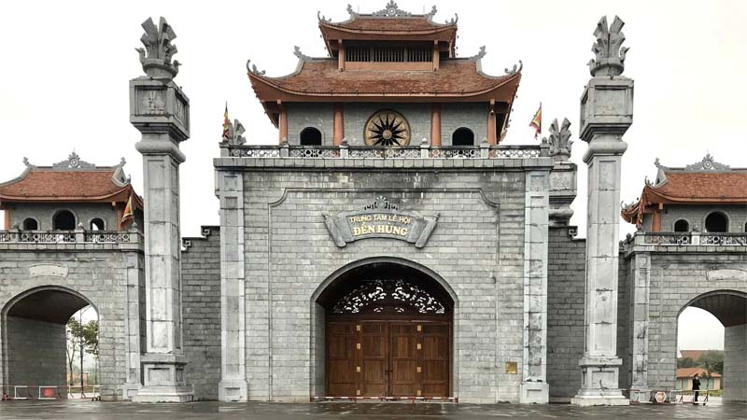
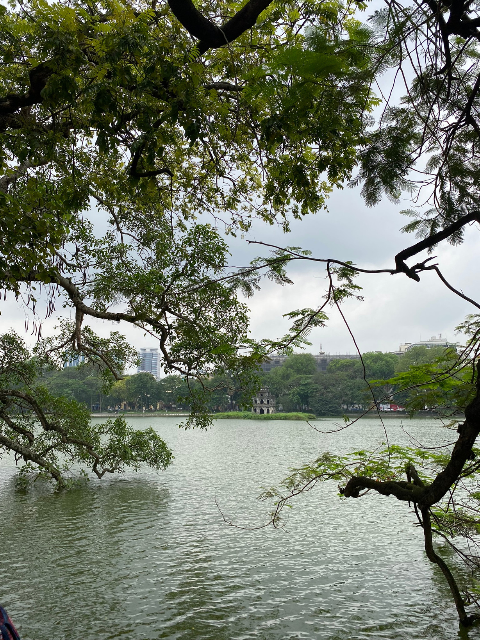
My background
I was born in 2002 in Phu Tho Province.
Moved to Hanoi in 2006

Slide 3

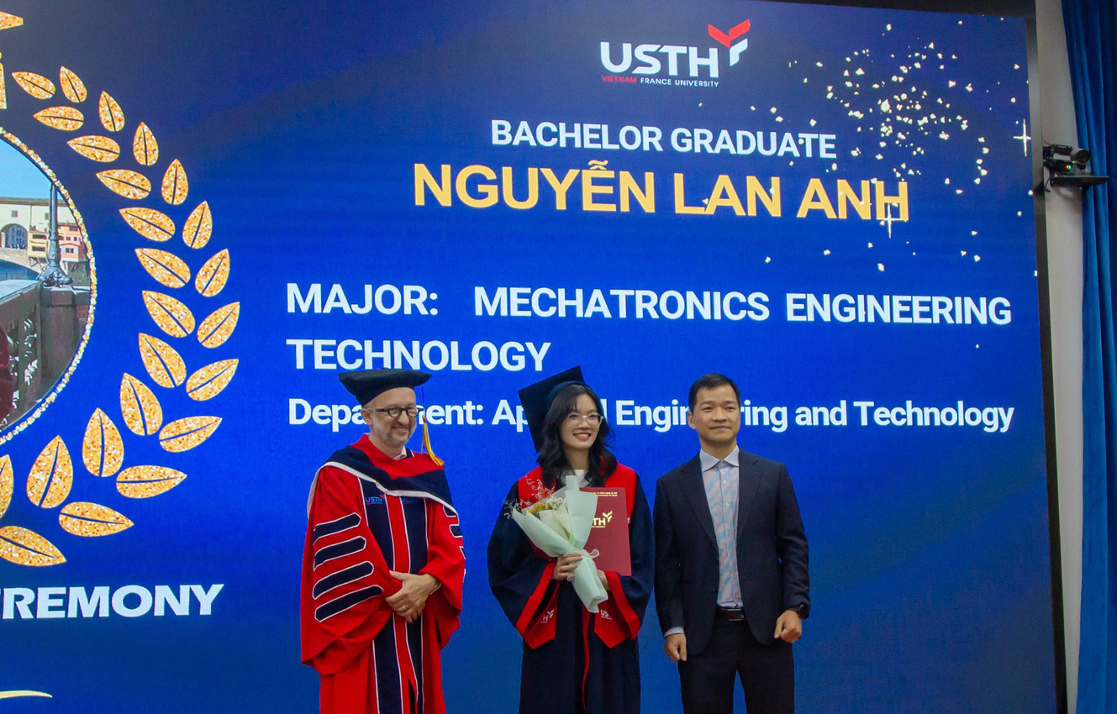
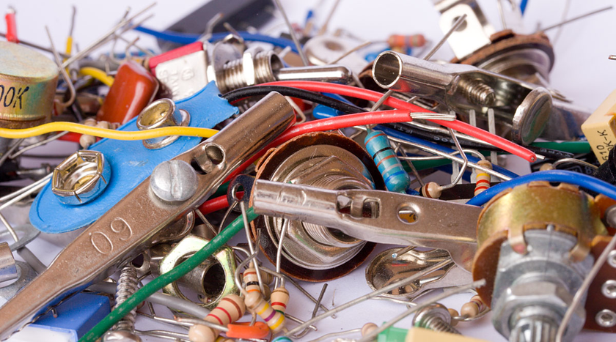
My background
Bachelor: Mechatronics Engineering Technology at USTH (2020 - 2024)

Slide 4
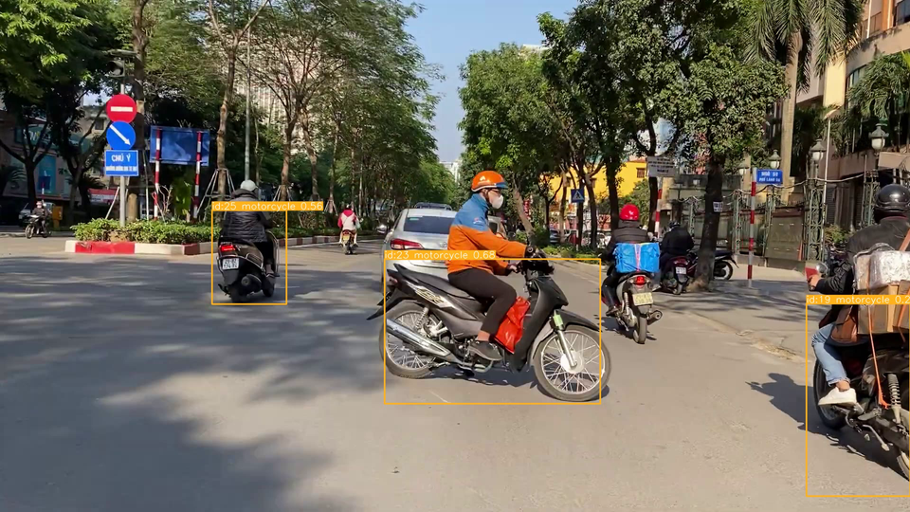
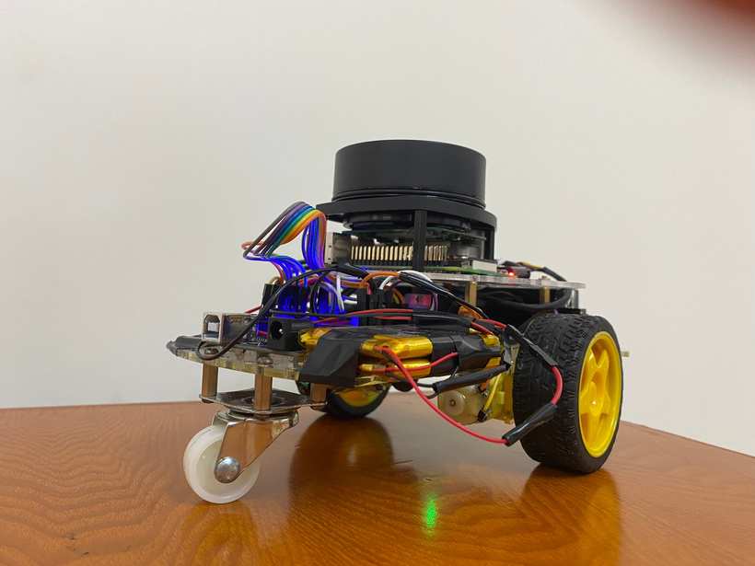
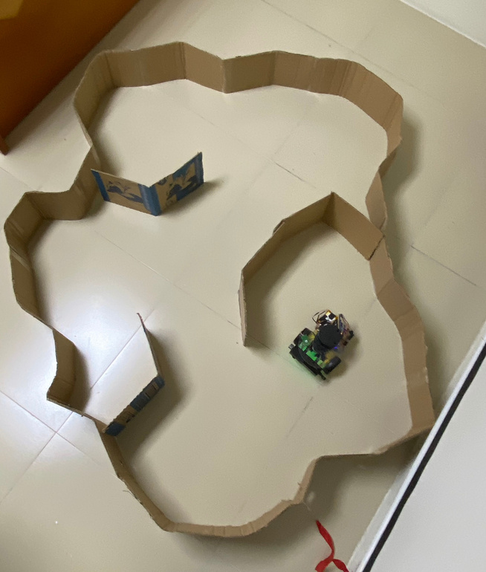
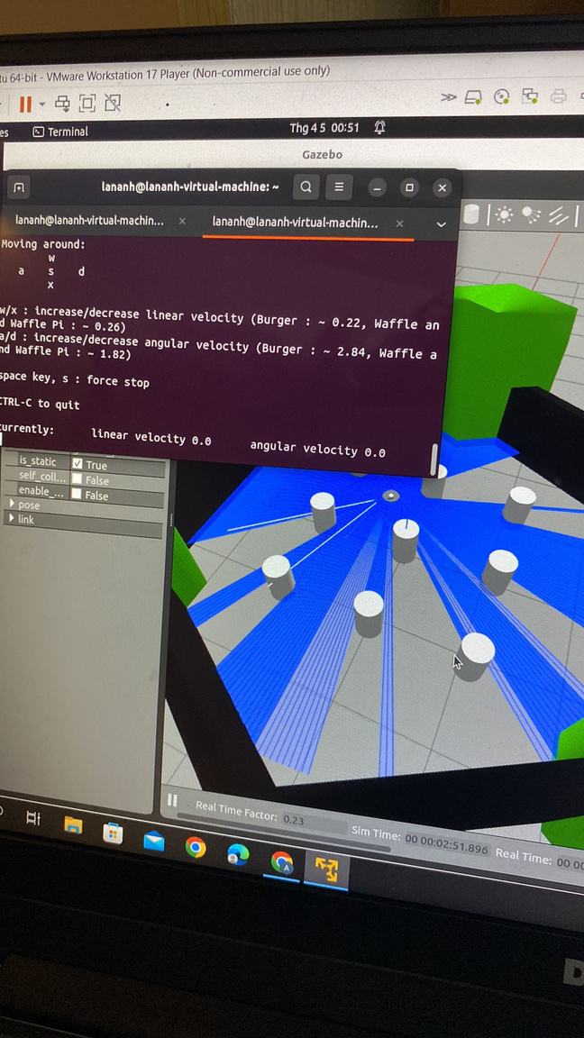
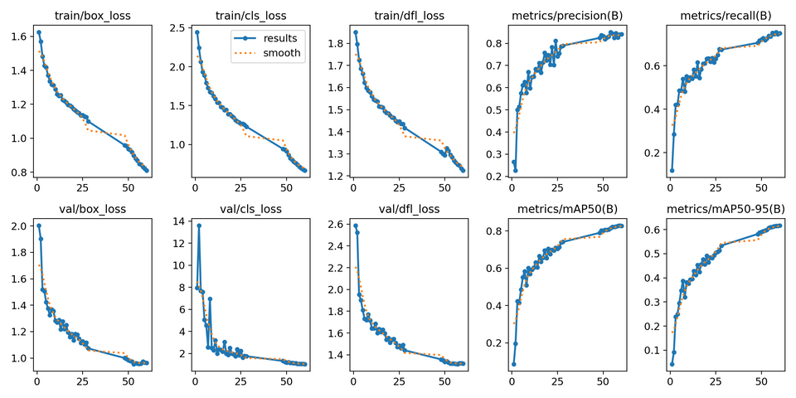
Bachelor Projects
Real-time detection and tracking of vehicles using Deep Learning
Mapping rover

Slide 5
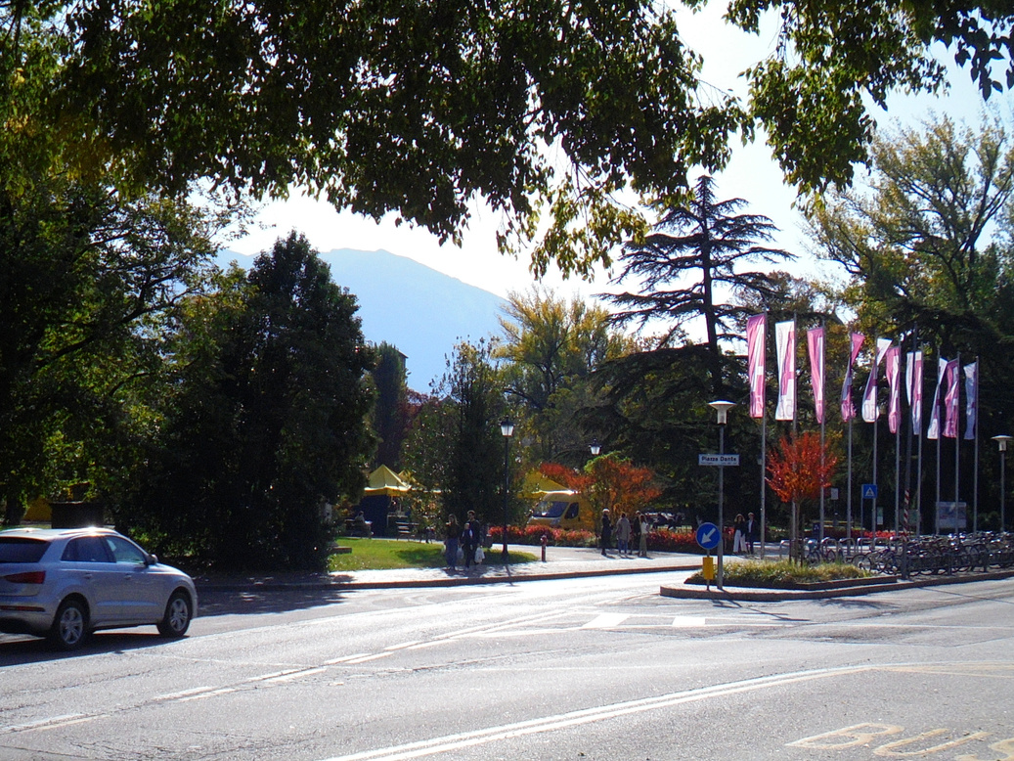
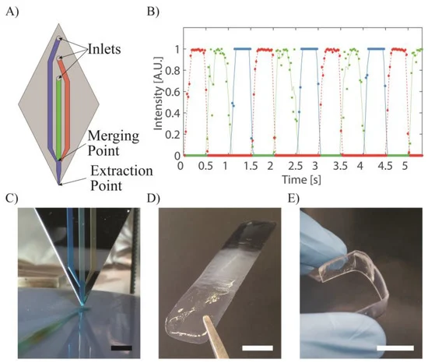
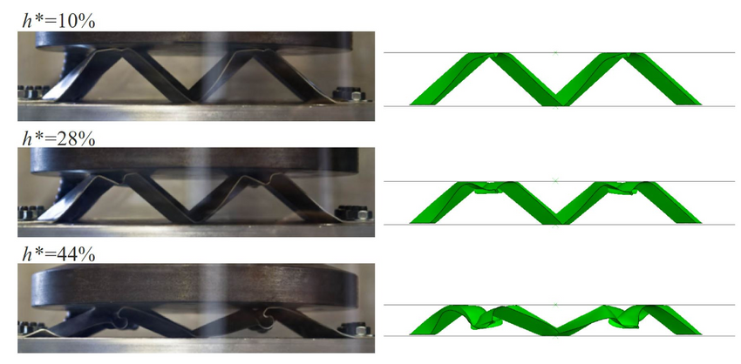
Exchange semester in Trento, Italy
Microfluidics
Origami materials
September, 2022

Slide 6
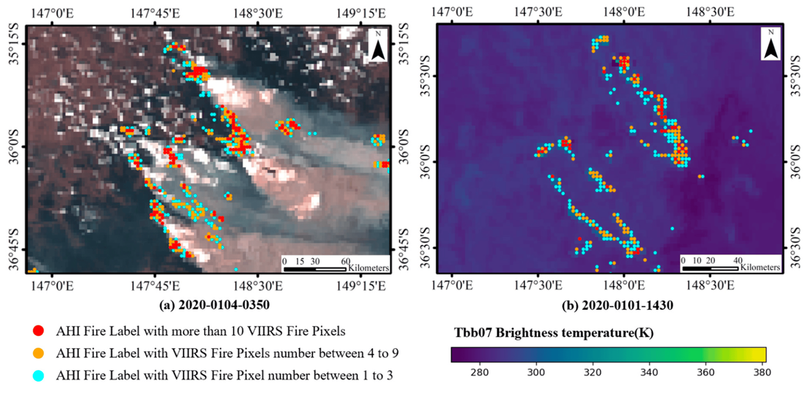
Master 1 - SPACE program - USTH
INTERESTS:
  Instrumentation
  Signal Processing
  Physics
Xu, H., Zhang, G., Zhou, Z., Zhou, X., & Zhou, C. (2022). Forest Fire Monitoring and Positioning Improvement at Subpixel Level: Application to Himawari-8 Fire Products. Remote Sensing, 14(10), 2460

Slide 7
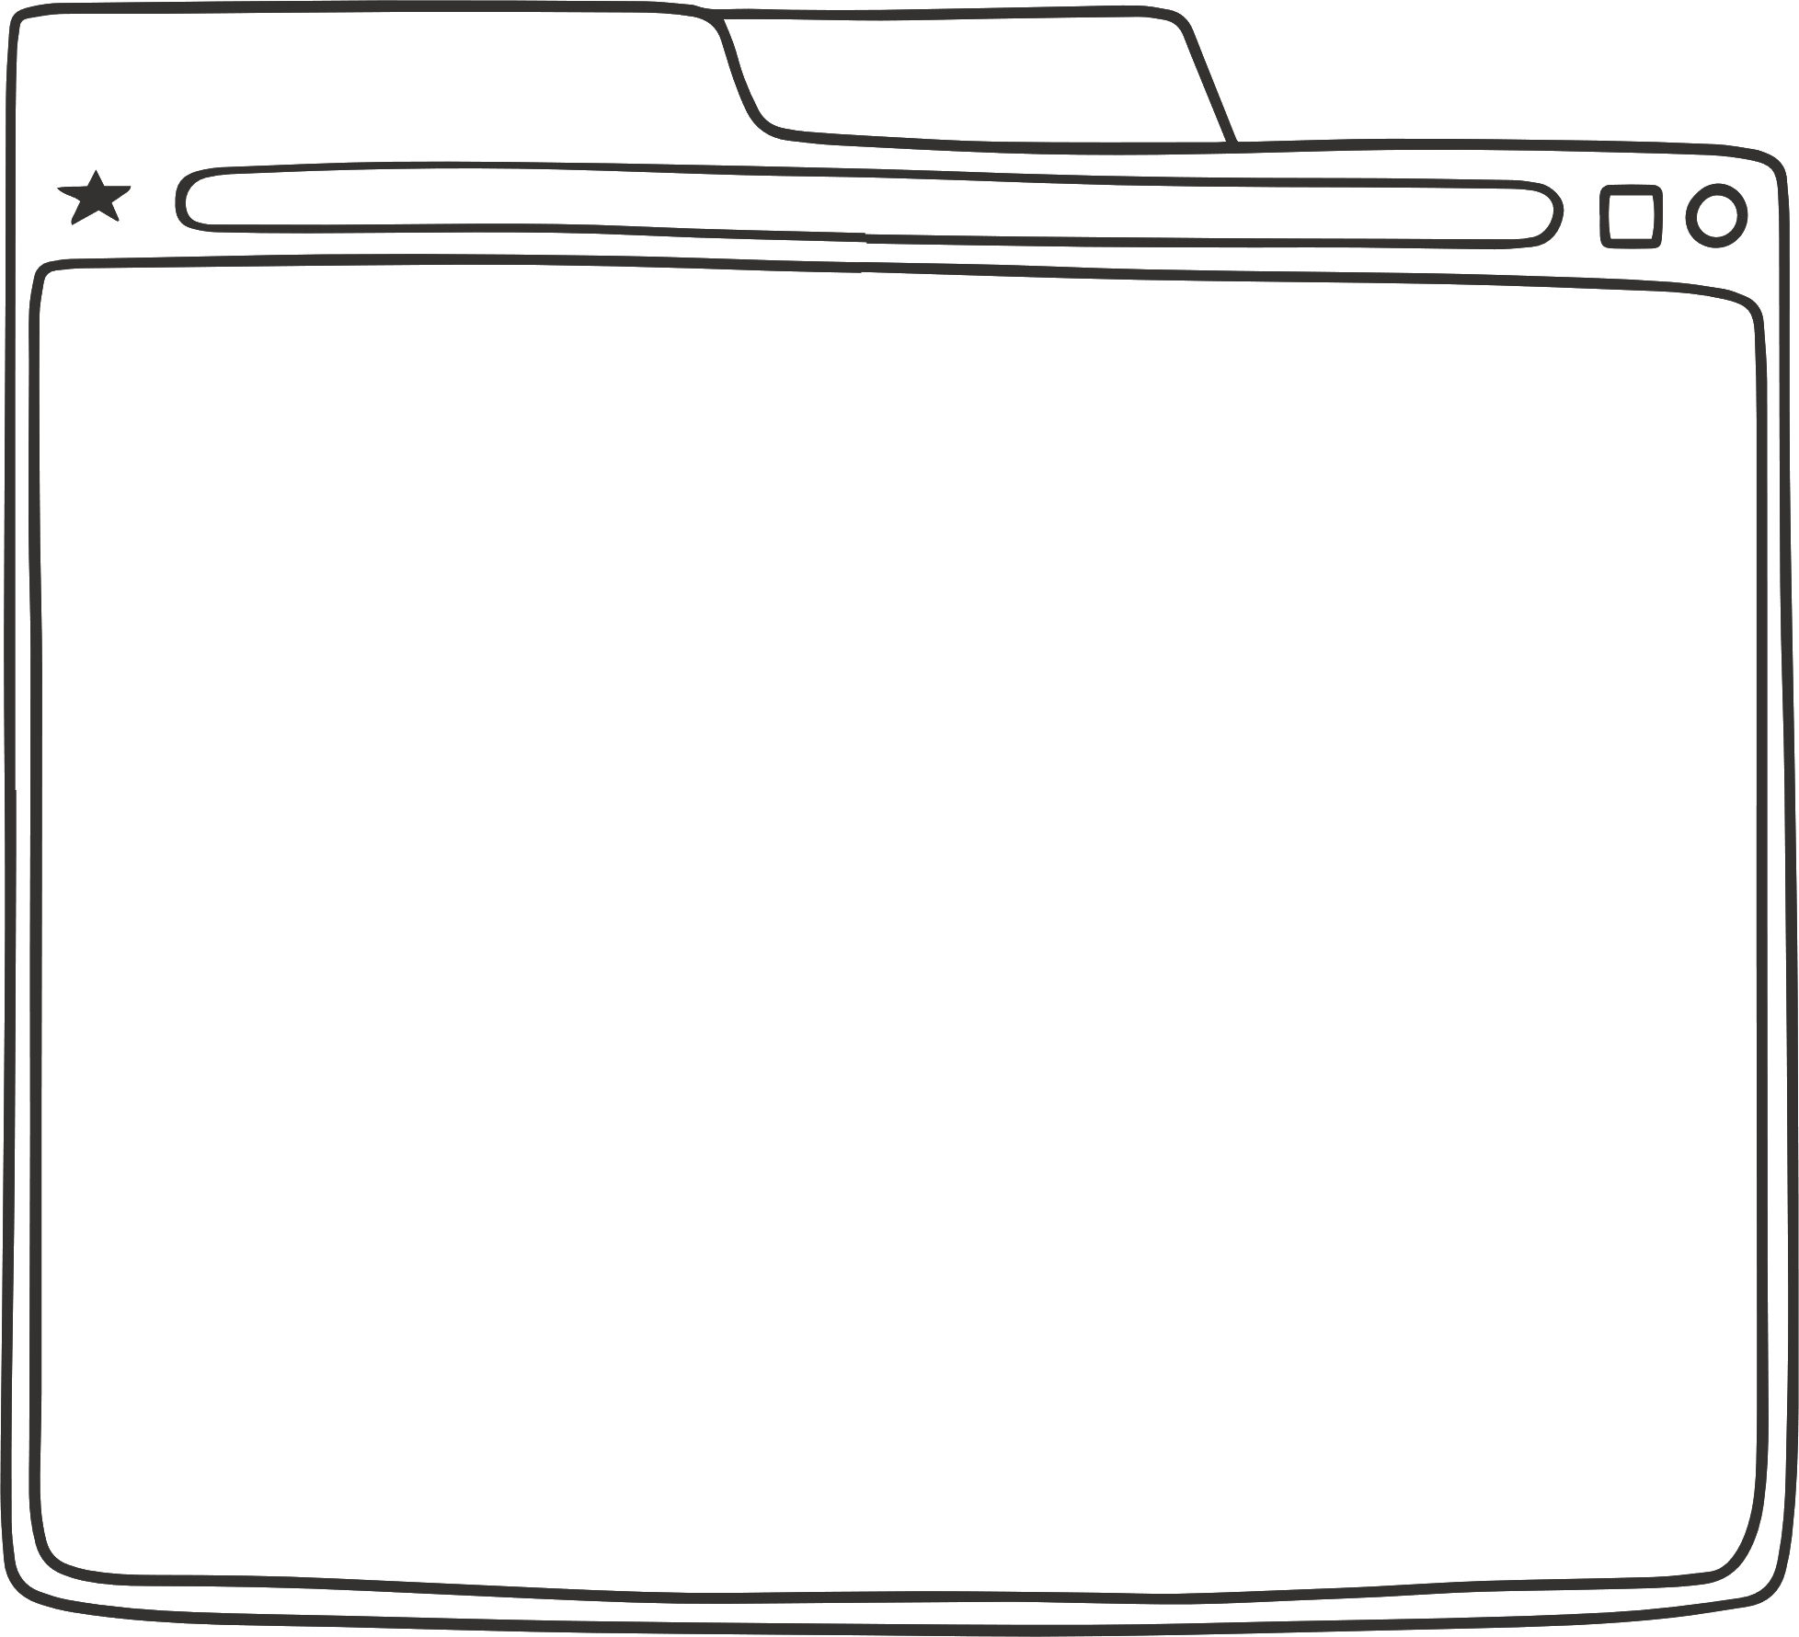

Thank you, everyone. I look forward to working with you!

