Slide 1
Introduction
About Me

Slide 2
Huynh Quoc Thang
From Ho Chi Minh City
2nd-year student
University of Science and Technology of Hanoi
Computational Astrophysics
Email: thanghq.bi12-400@st.usth.edu.vn

Slide 3
Why Astrophysics?

Slide 4
Experience
Coding
Photometry
Get used to different languages:
Pascal (3/5)
C++ (2/5)
C (3/5)
R (2/5)
Python (5/5)
Used IDL 8.5 to perform star photometry in detecting stars from JWST images.
However, just a practice with the tool.

Slide 5
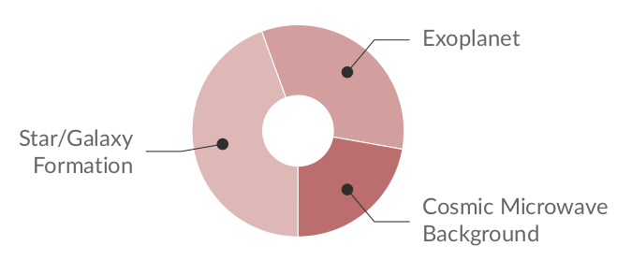
Research
Interest
Some topics that I really want to study about

Slide 6
Camp’s Expectation
Learning new things
Exposing to new equipments/tools
Expanding the relationship
Getting help from the others
Preparing for my future career

Slide 7
Thanks!
You can contact me via this email:
thanghq.bi12-400@st.usth.edu.vn
Please keep this slide as attribution

