Slide 1
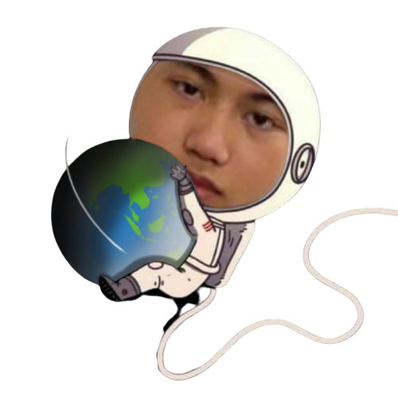
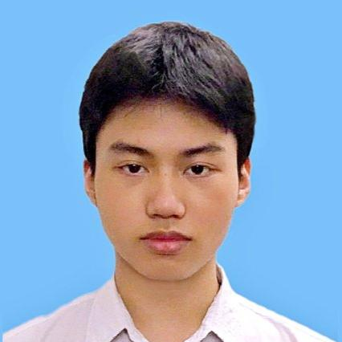
ABOUT MY SELF
Nguyen Phu
Huy

Slide 2
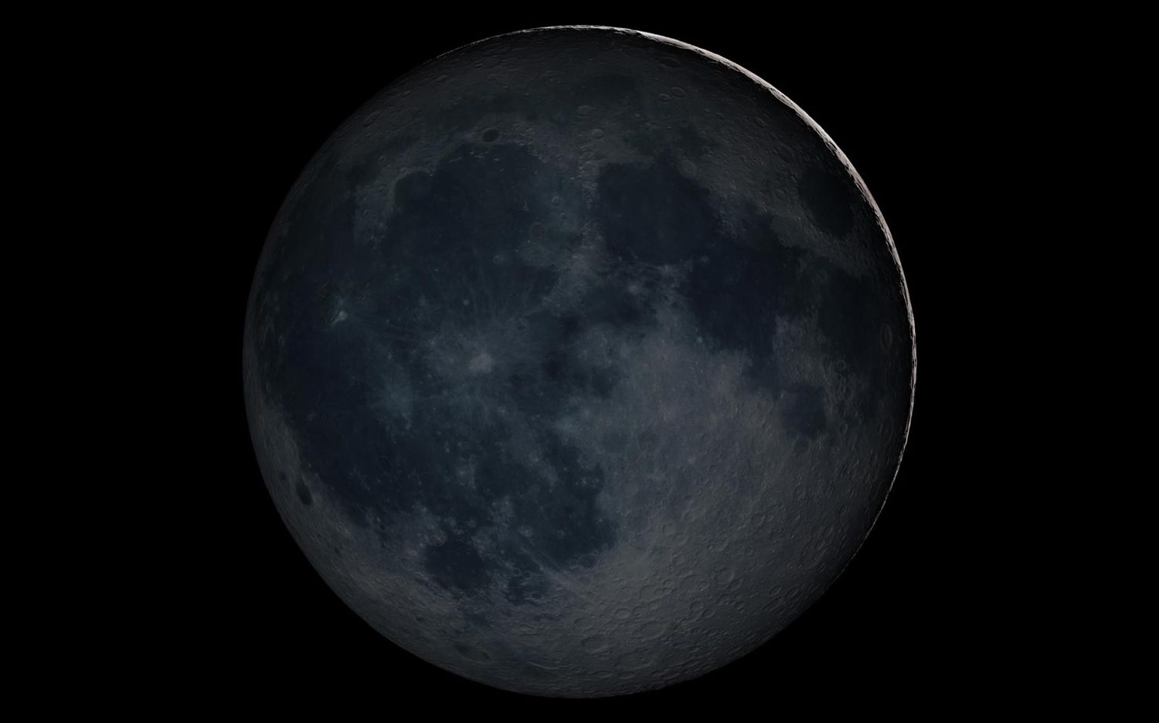
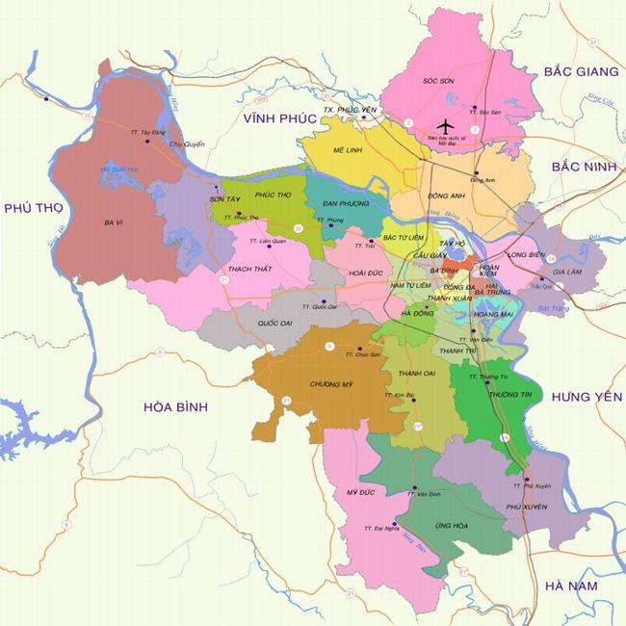
I was born on 28/08/2003
(It's 01/08/2003 according to Lunar calendar)
My hometown is Quoc Oai

Slide 3
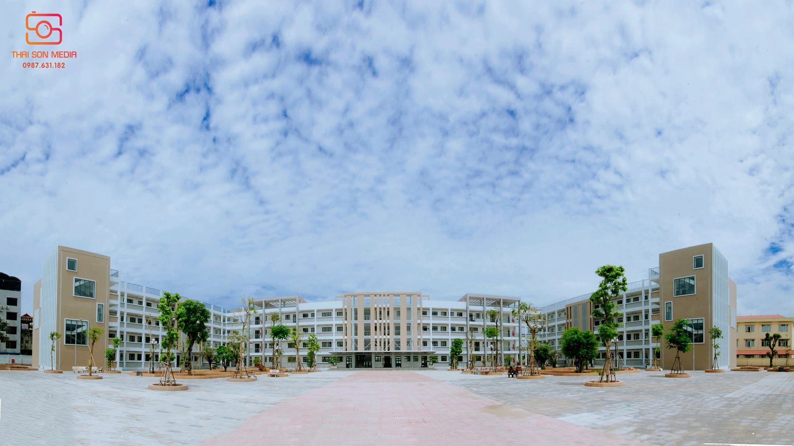
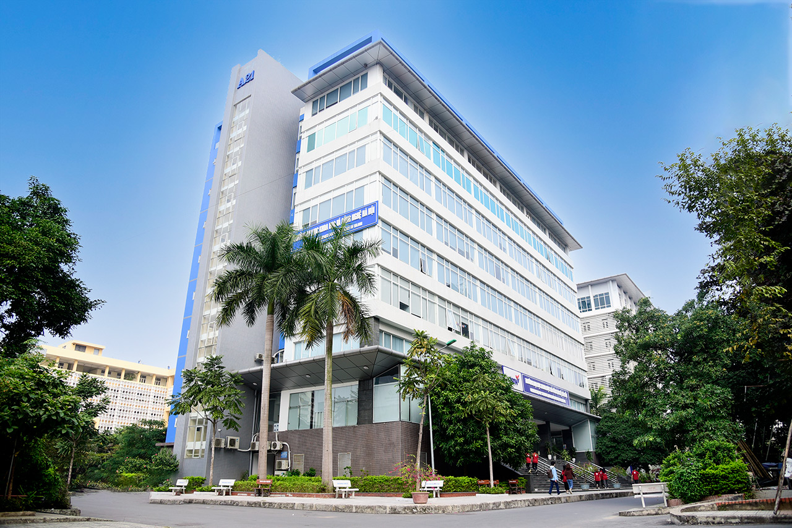
EEDUCATION:
Quoc Oai High School
University of Science and Technology of Hanoi
+ Major: Space Science and Satellite Technology
+ Research interest: Astrophysics, Cosmology

Slide 4
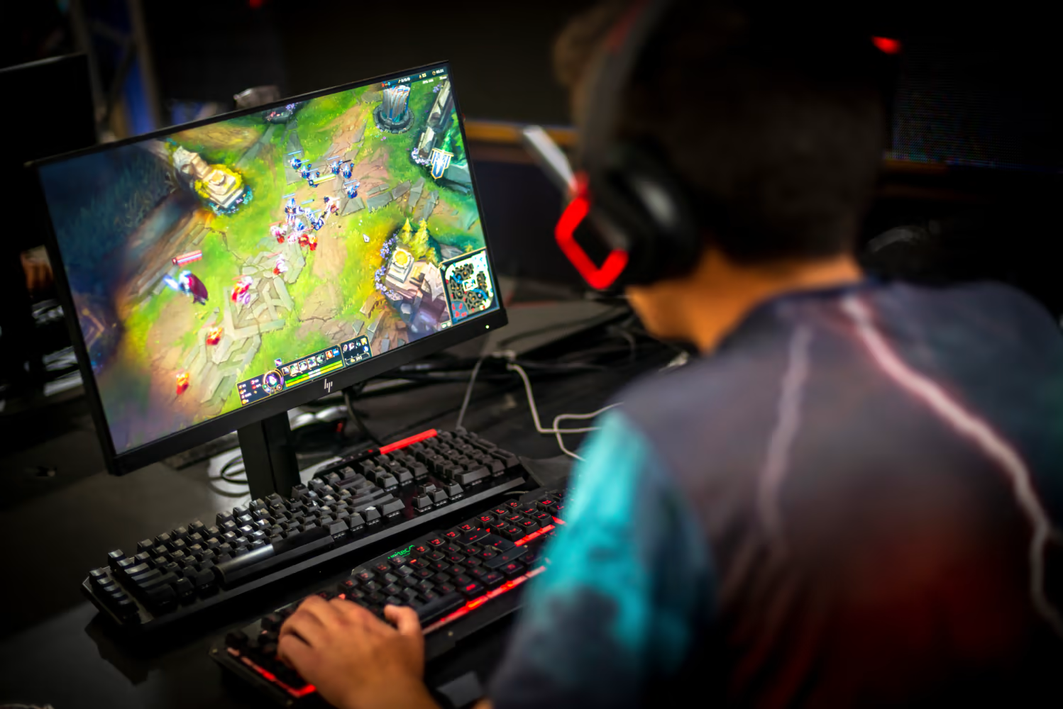
WHAT I LIKE TO DO:

Slide 5
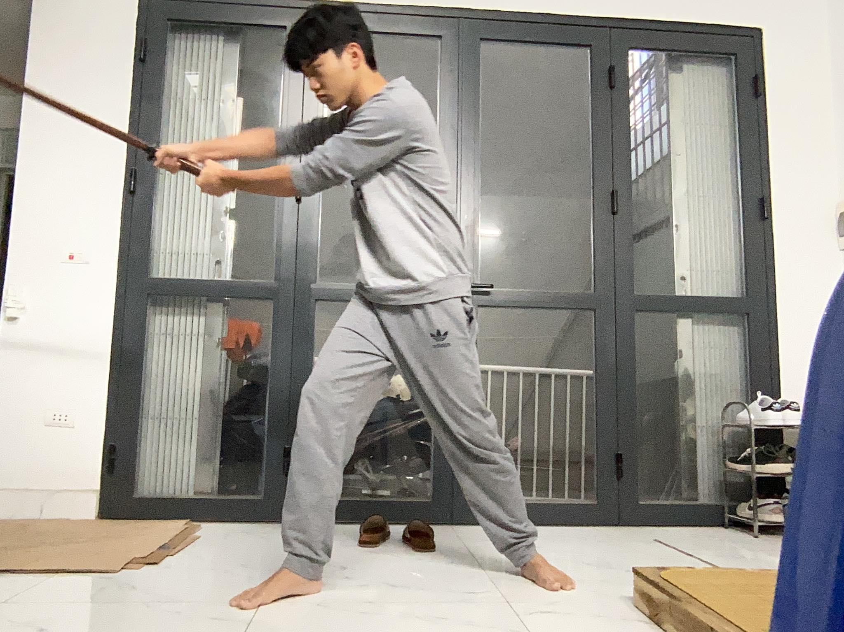
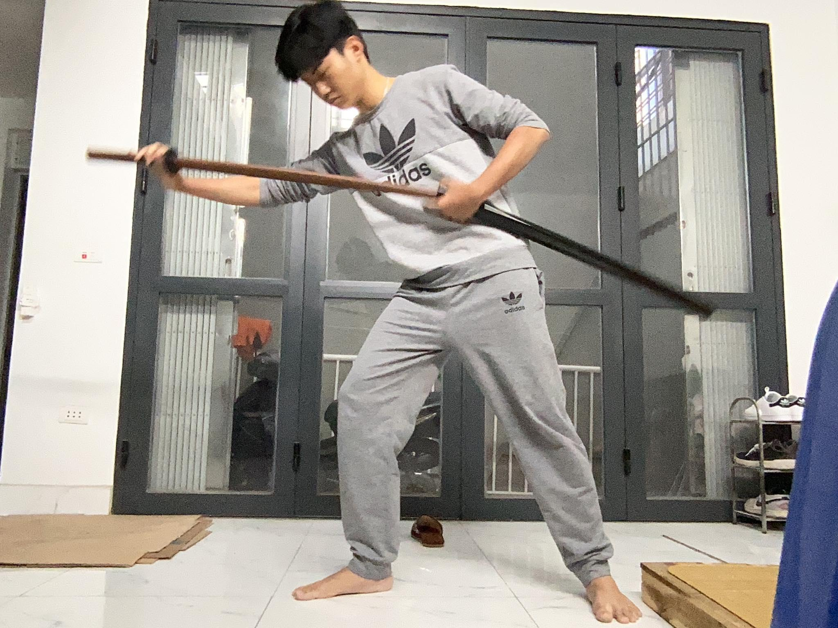
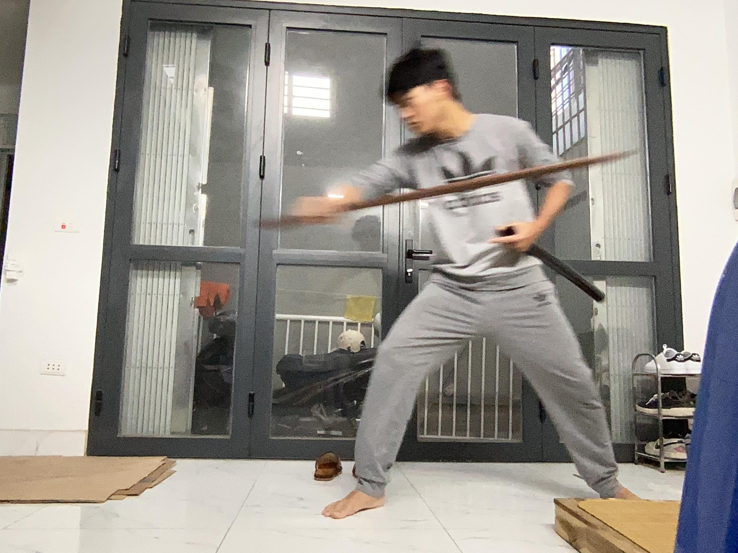
WHAT I LIKE TO DO:

Slide 6
MY GOAL

Slide 7
THANK YOU FOR LISTENING
ご聴取ありがとうございました

