Slide 1
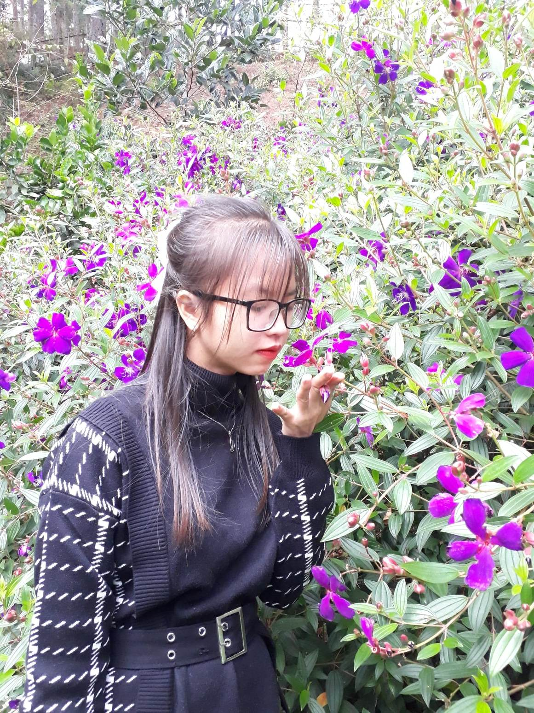
Introduction
Name,
Where,
Education,
Bachelor's Thesis,
Research interested,
Hobbies,
Purpose.
Nguyen Thi Nhung

Slide 2
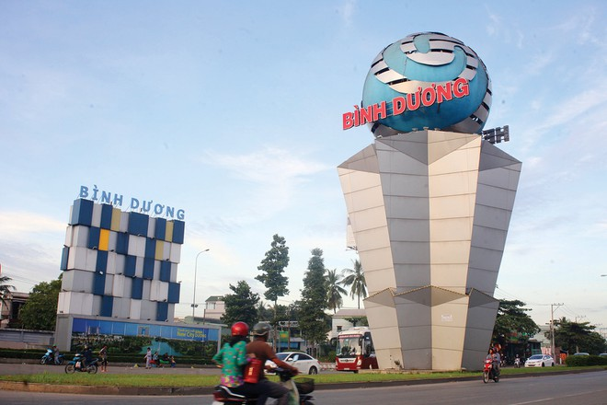
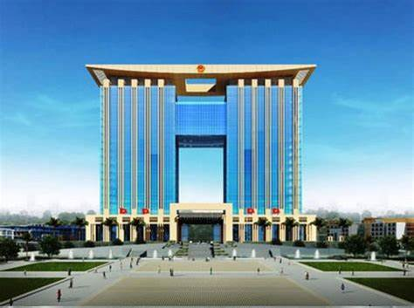
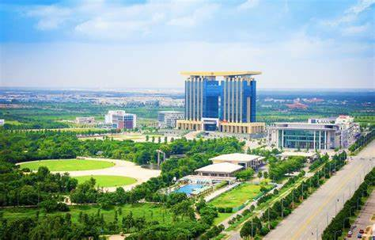
Binh Duong

Slide 3
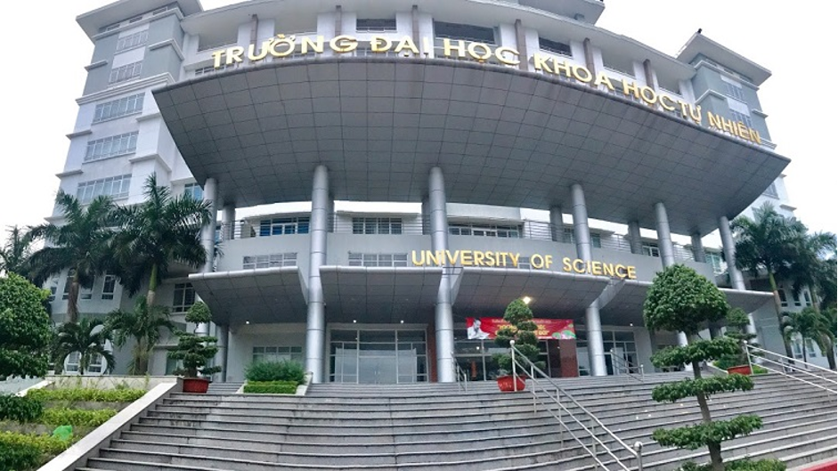
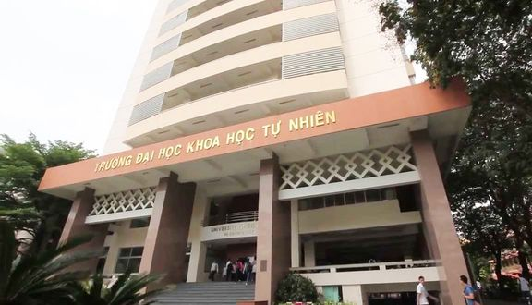
Education
VNUHCM_US

Slide 4
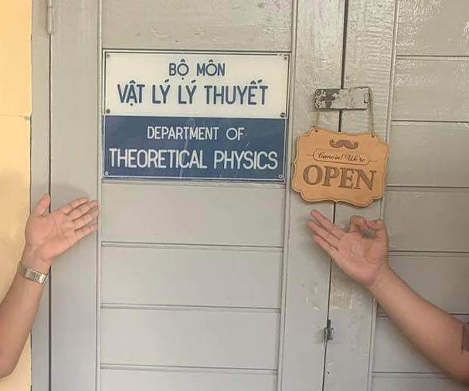
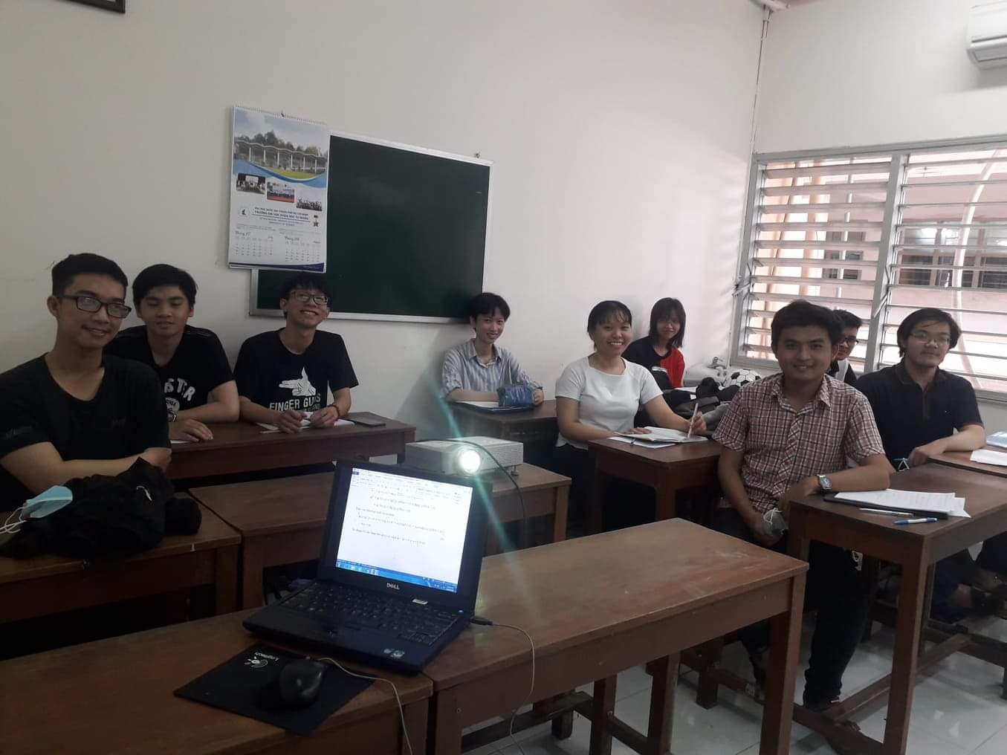
Education
Theoretical physics

Slide 5
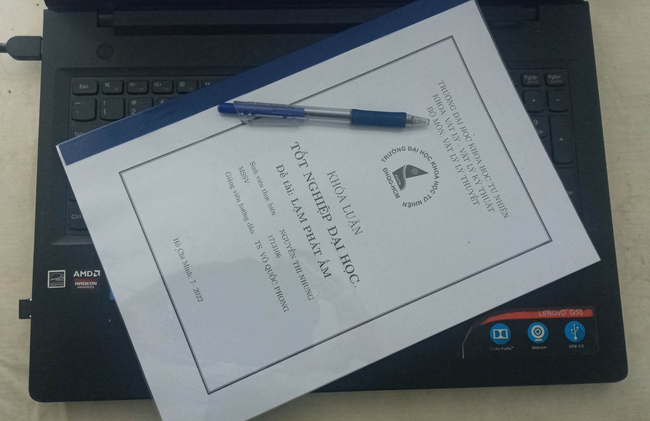
Bachelor's Thesis
Warm Inflation in Cosmology

Slide 6
Research interested
Astrophysics,
Neutrino Particle Physics,
Cosmology

Slide 7
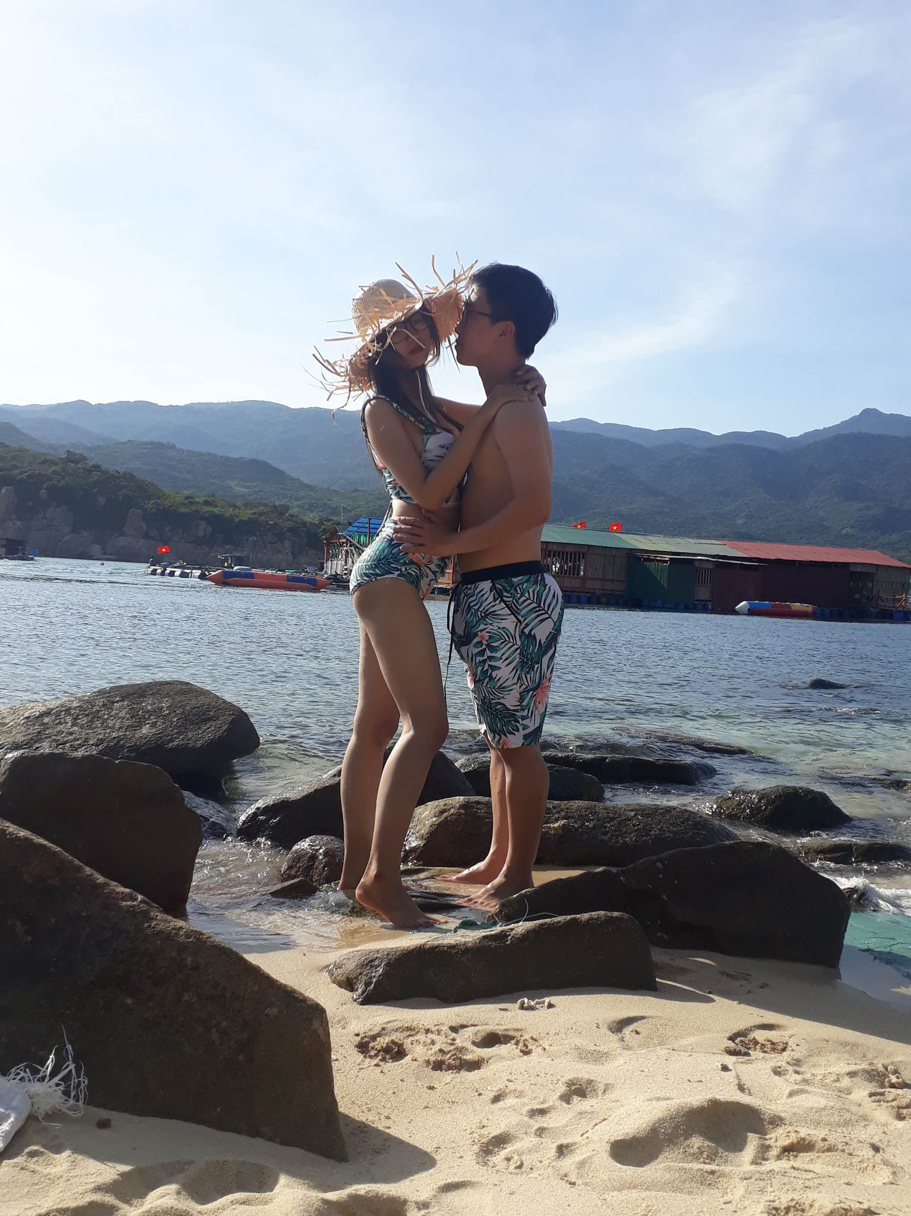
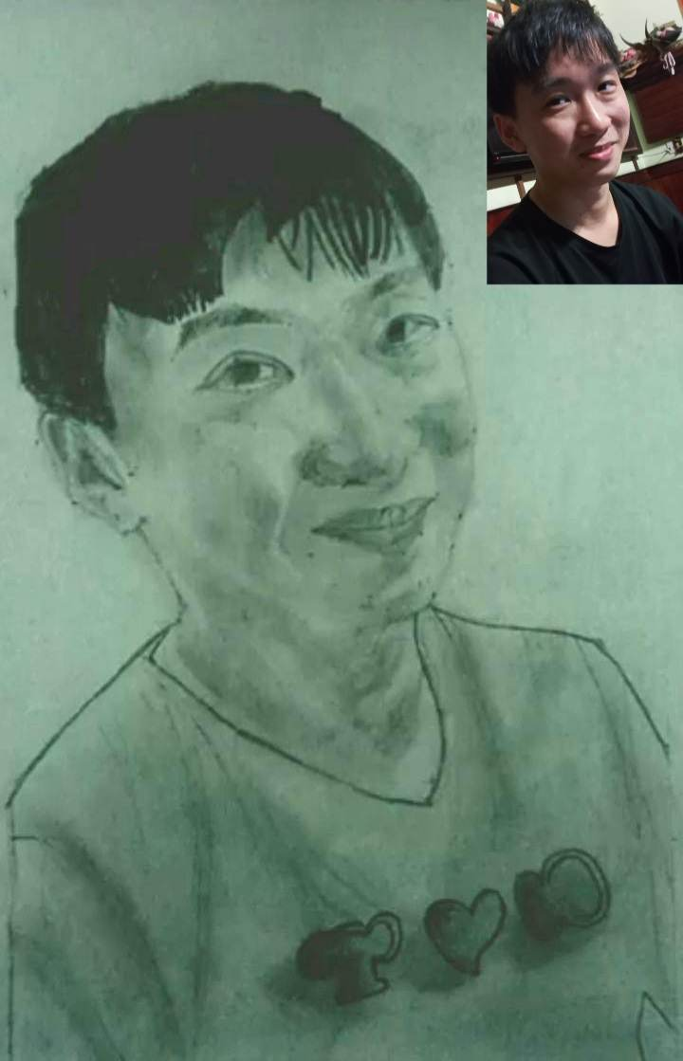
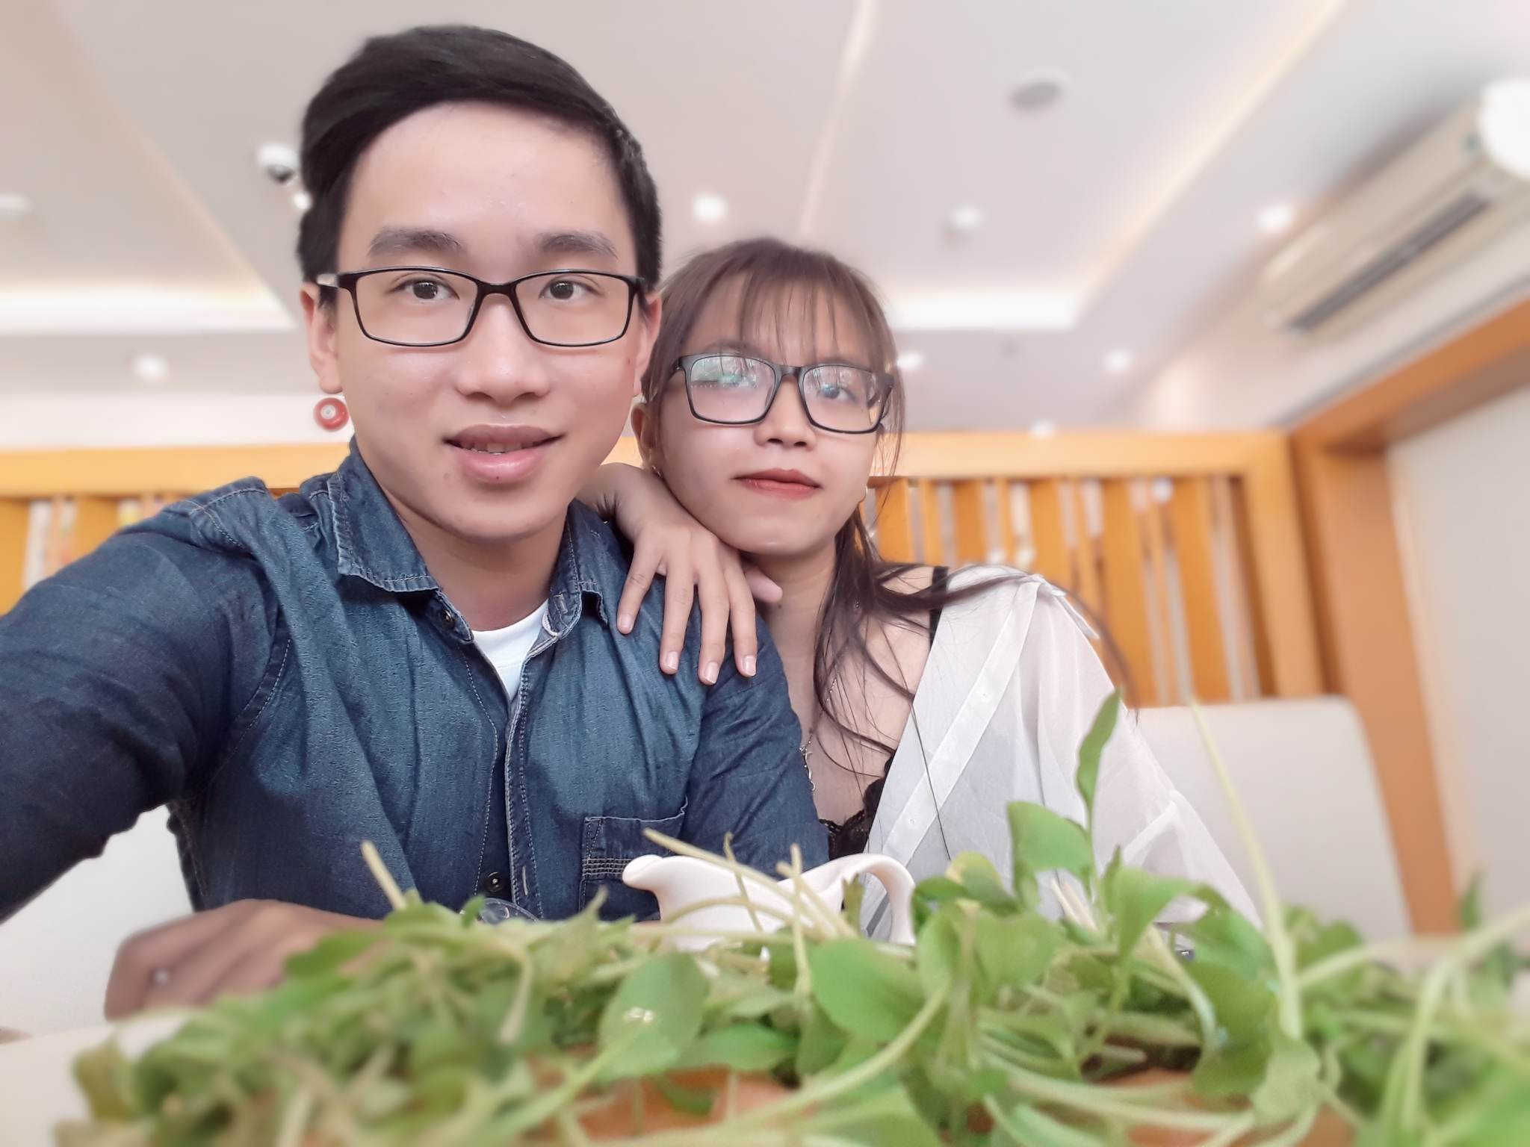
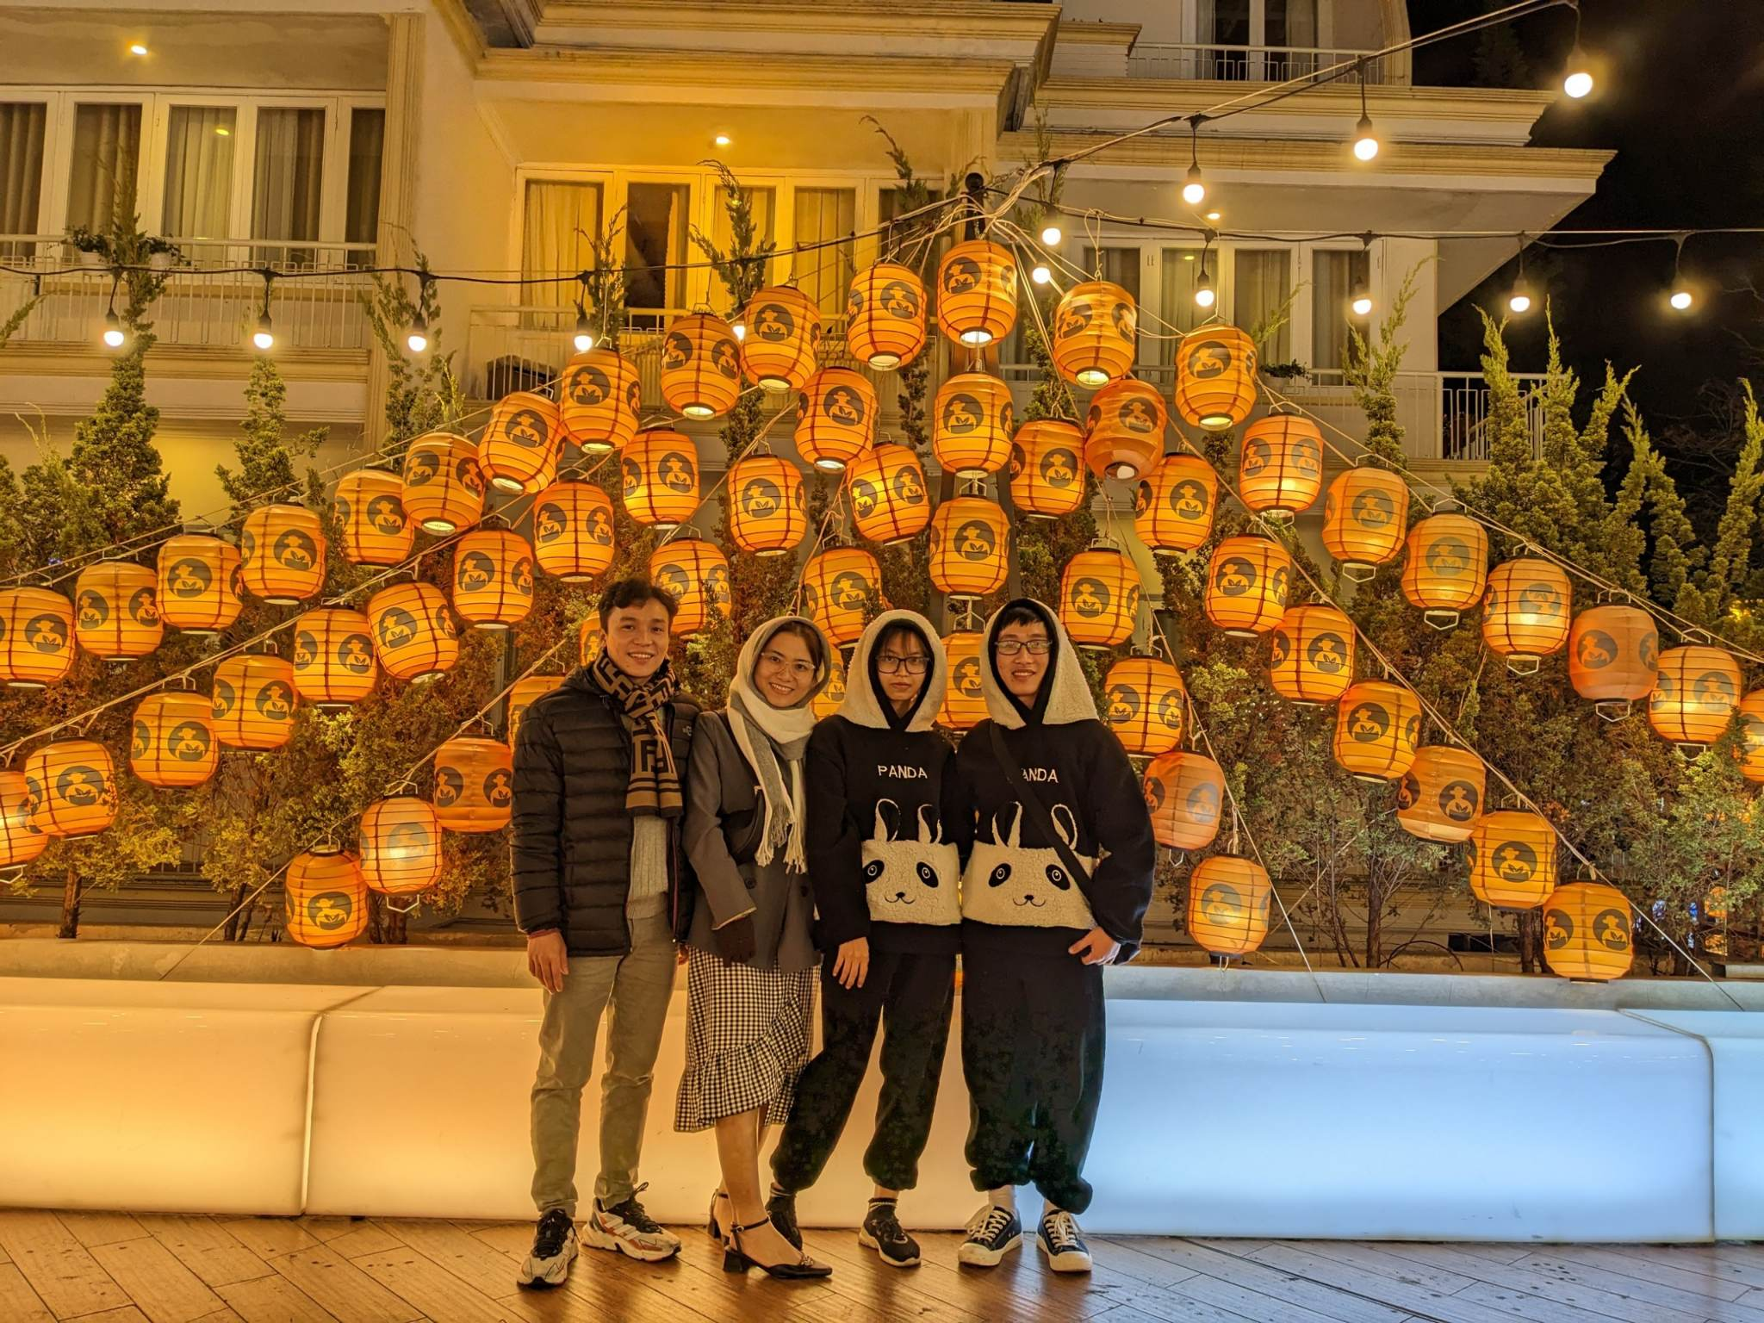
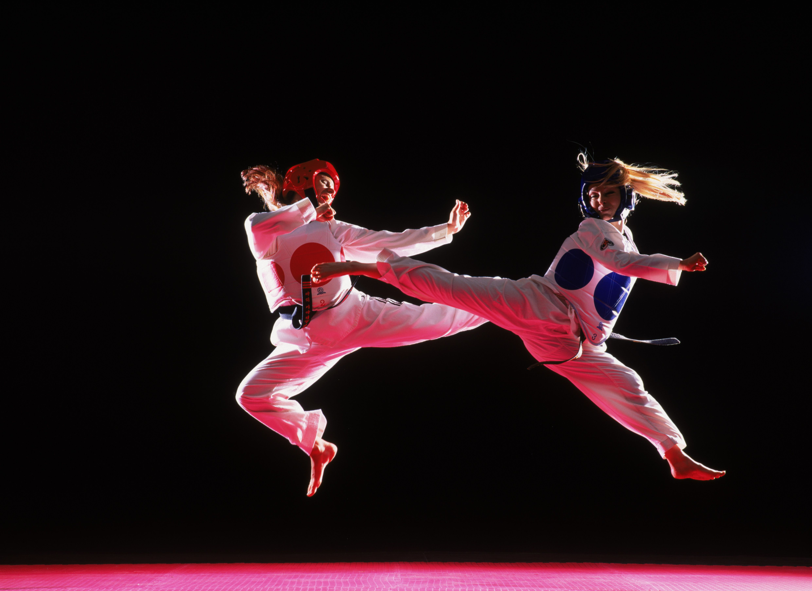
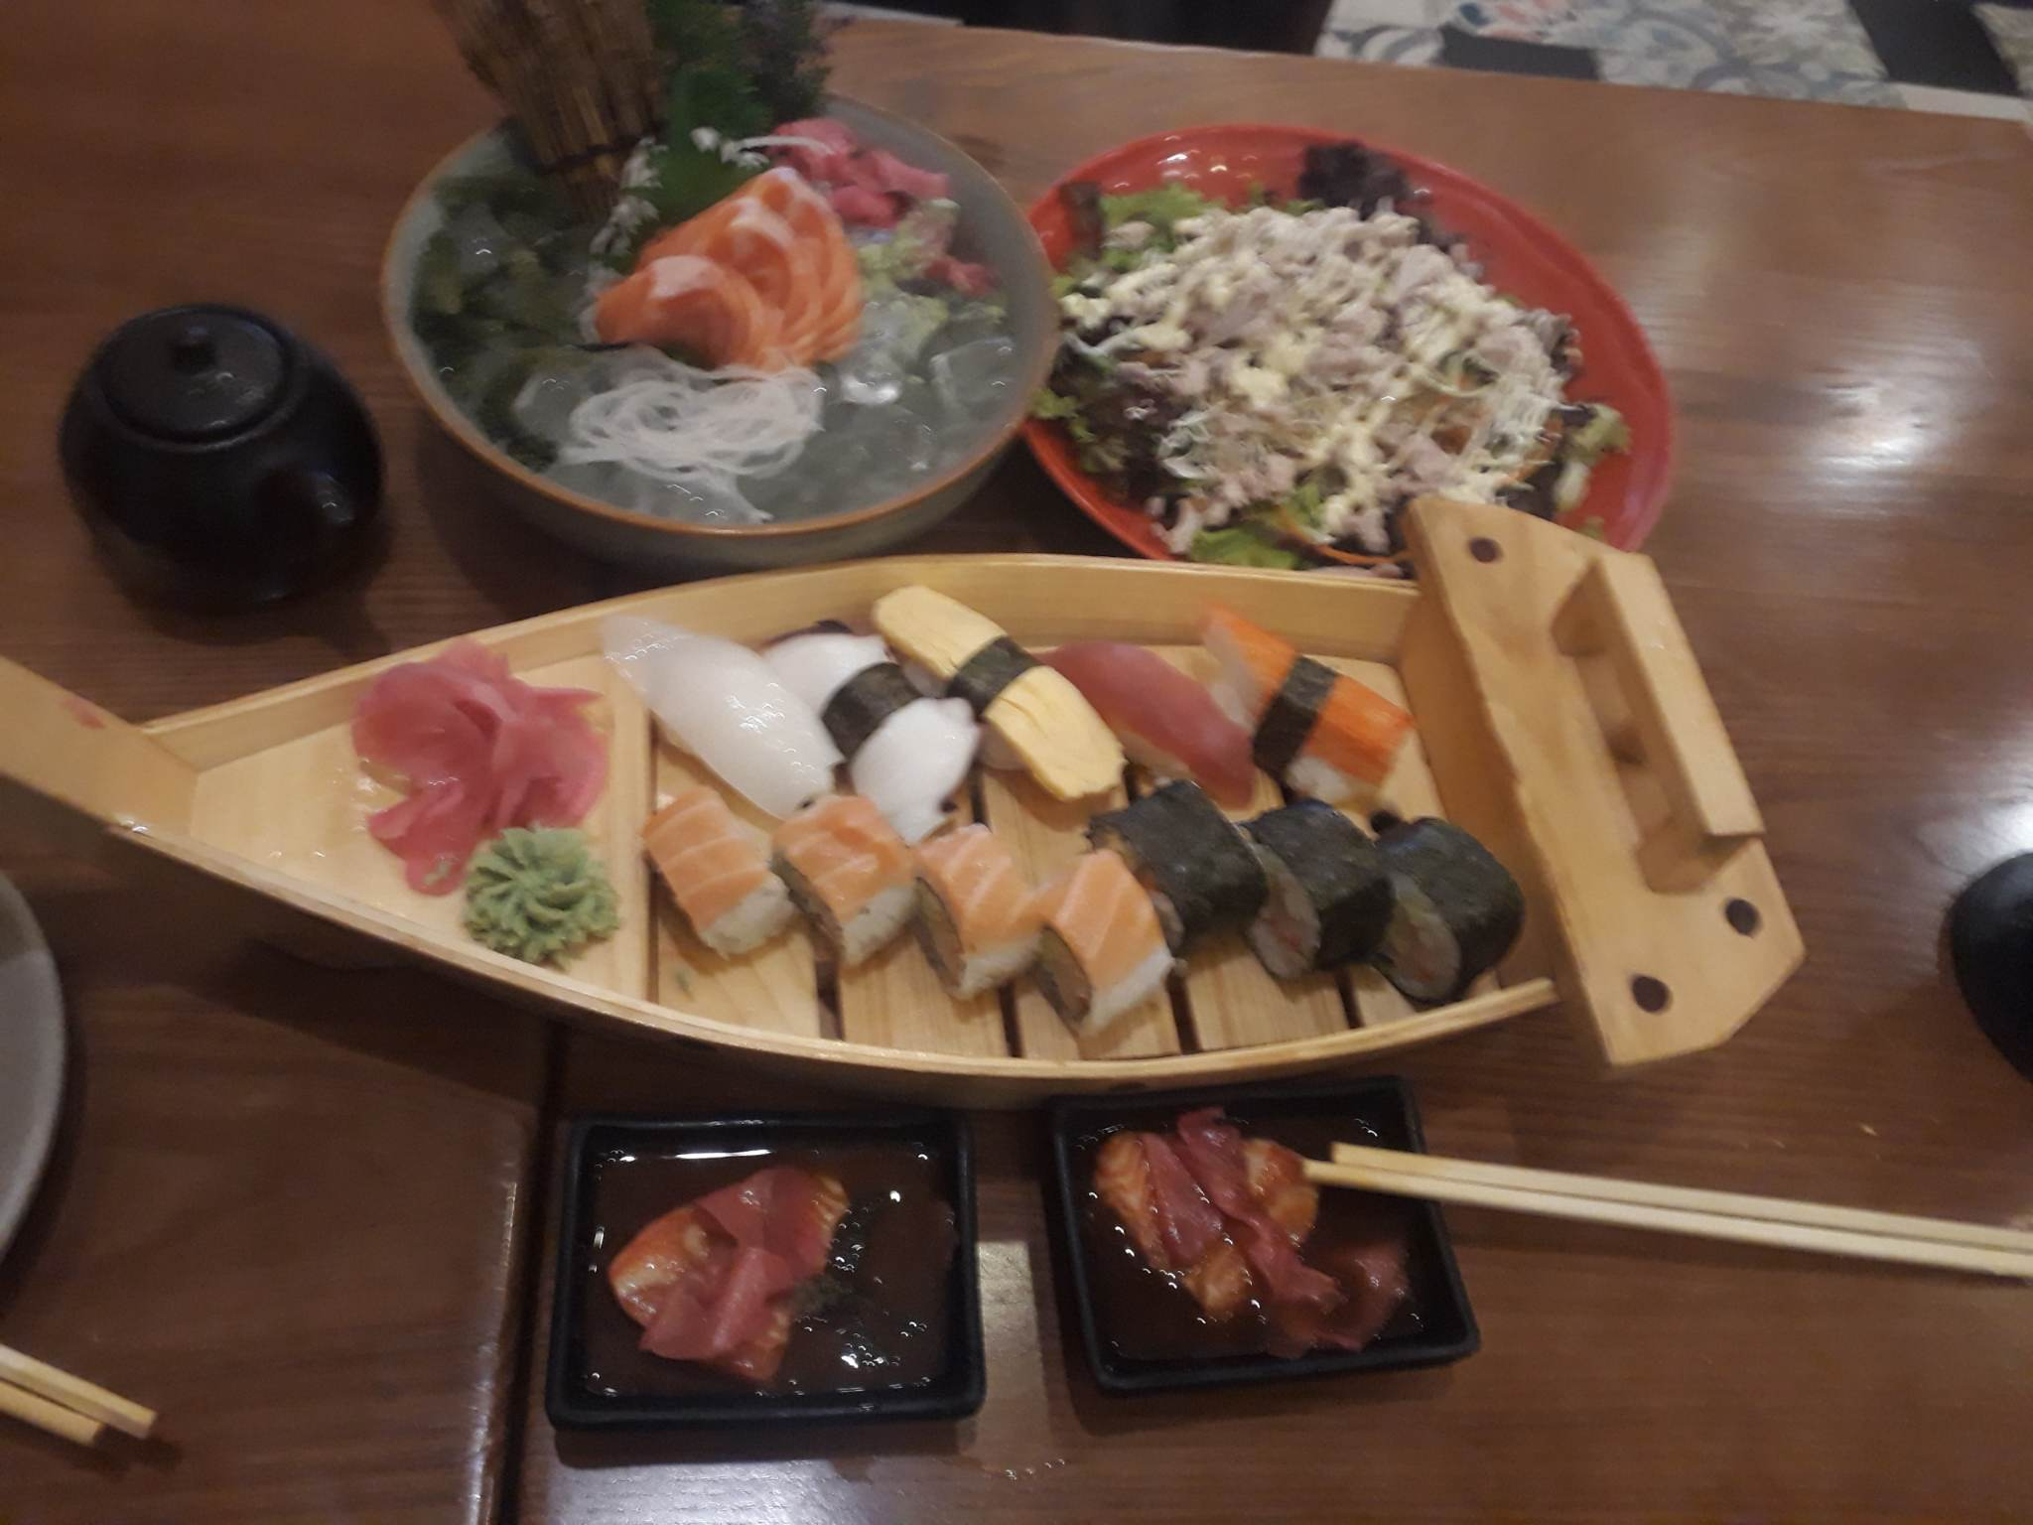
Hobbies

Slide 8
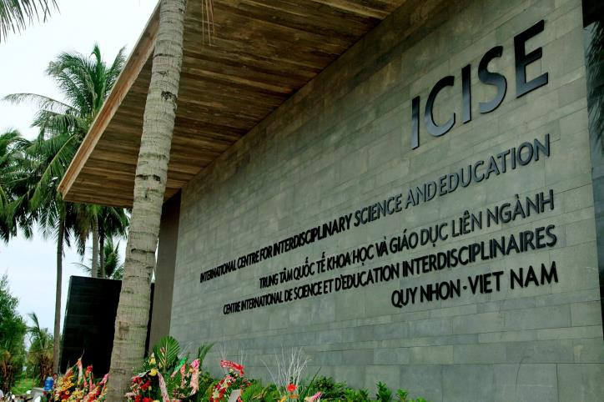
Purpose
Learn
Get in touch
Practice and apply
Challenge myself

Slide 9
Glad to know you all Thank you !

