Slide 1
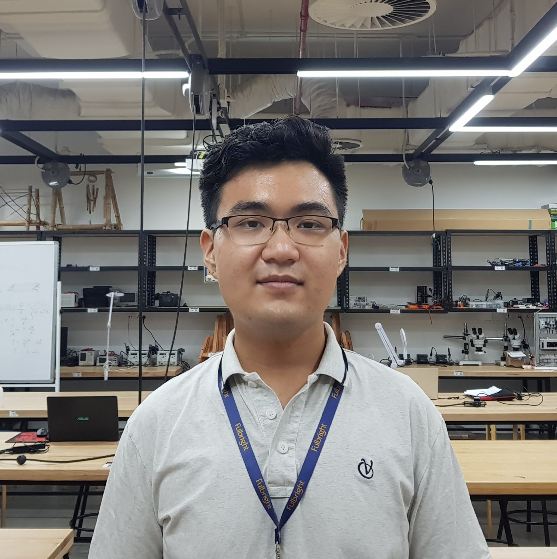
Nguyen Duc Phu
DOB: 28/12/2002
POB: An Giang
Engineering student at Fulbright University Vietnam

Slide 2
Experience
Liberal Art Education
Teaching Assistant for Introduction to Engineering and Sensor, Measurement, and Analysis courses.
Participate in a research project about material strength.

Slide 3
Objective
Learn and experience the research process
=> Assist my upcoming graduation thesis
Learn about the DAQ of the lab
Perform well in the lab

Slide 4
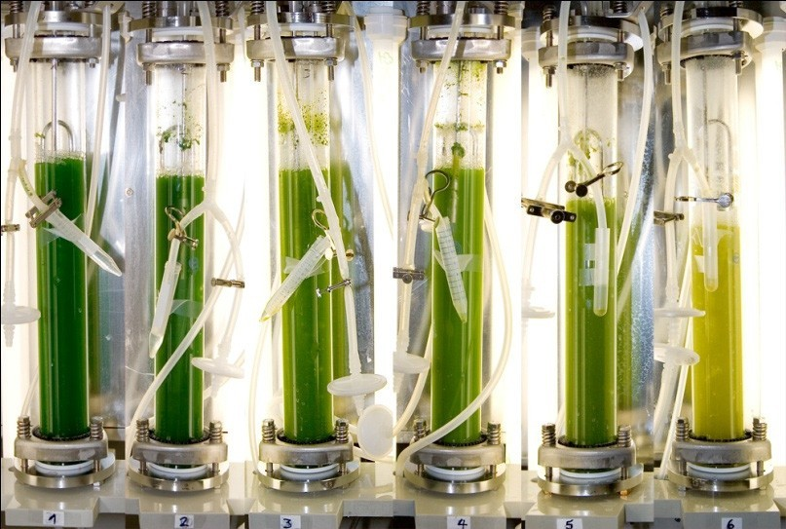
Interest

Slide 5
Others
Love cooking
Sports: Ultimate Frisbee, running, swimming,…

