Slide 1
VIETNAM NATIONAL UNIVERSITY HO CHI MINH
HO CHI MINH CITY UNIVERSITY OF TECHNOLOGY
FACULTY OF APPLIED SCIENCE
PERSONAL
INFORMATION

Slide 2
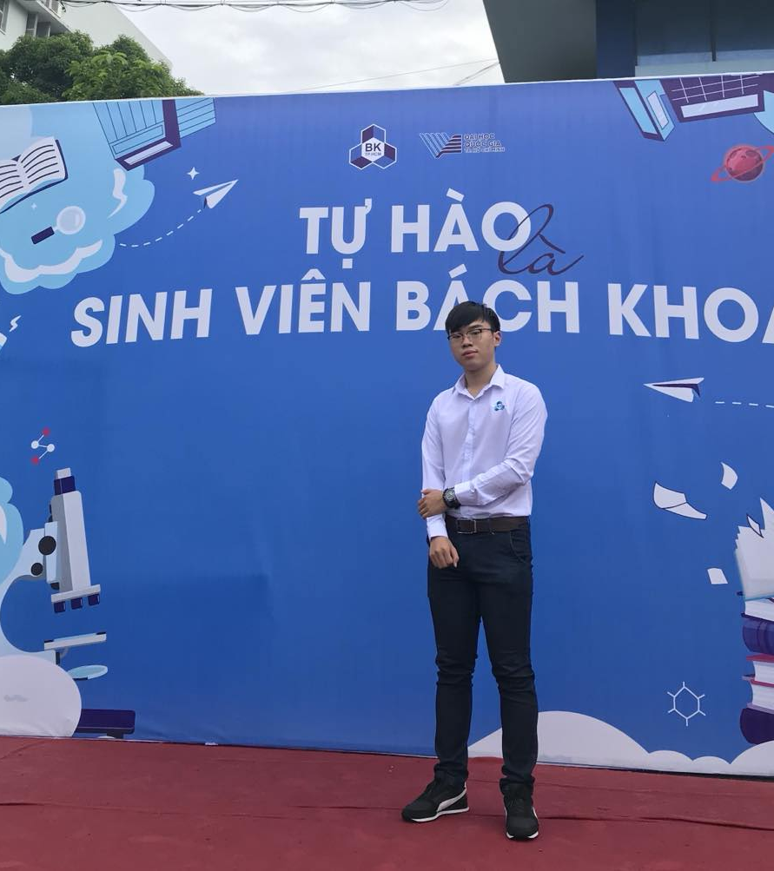
Cao Đình
Minh
Quân

Slide 3
About Me
• Full name: Cao Dinh Minh Quan
• Date of birth: 16/06/2002
• Place of birth: Nha Trang City, Khanh Hoa Province
• Major: Biomedical Engineering
• Ho Chi Minh City University of Technology, VNUHCM
• Research field: Electrical Impedance Tomography, Bioimpedance, Vital signs, Low-level Laser Therapy, Nuclear Detection
• Contact: +84.972083734
quan.caodinhminh@hcmut.edu.vn

Slide 4
Dr. Eng.
Trung Nghia Tran
PhD. Eng.
Anh Tu Tran
PhD. Eng.
Tran Hong
Duyen Trinh
MSc. Eng.
Diep Quoc
Tuan Nguyen
Stu. Thanh Ven
Huynh
Stu. Dinh Minh
Quan Cao
Eng. Hoang Nhut
Huynh

Slide 5
Research Field
ELECTRICAL IMPEDANCE TOMOGRAPHY, BIOIMPEDANCE

Slide 6
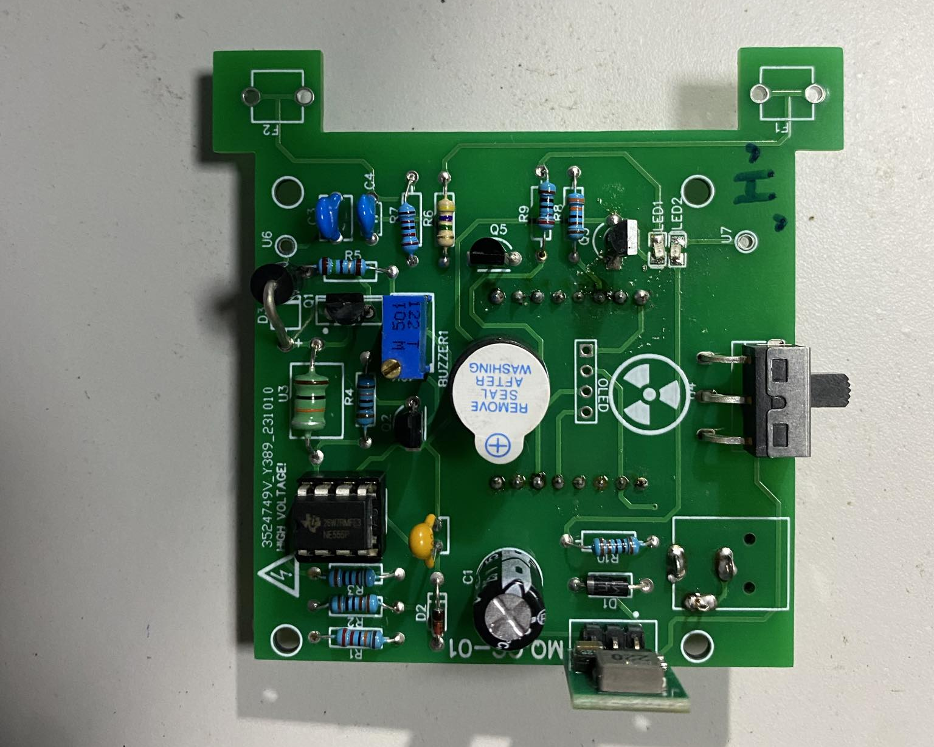
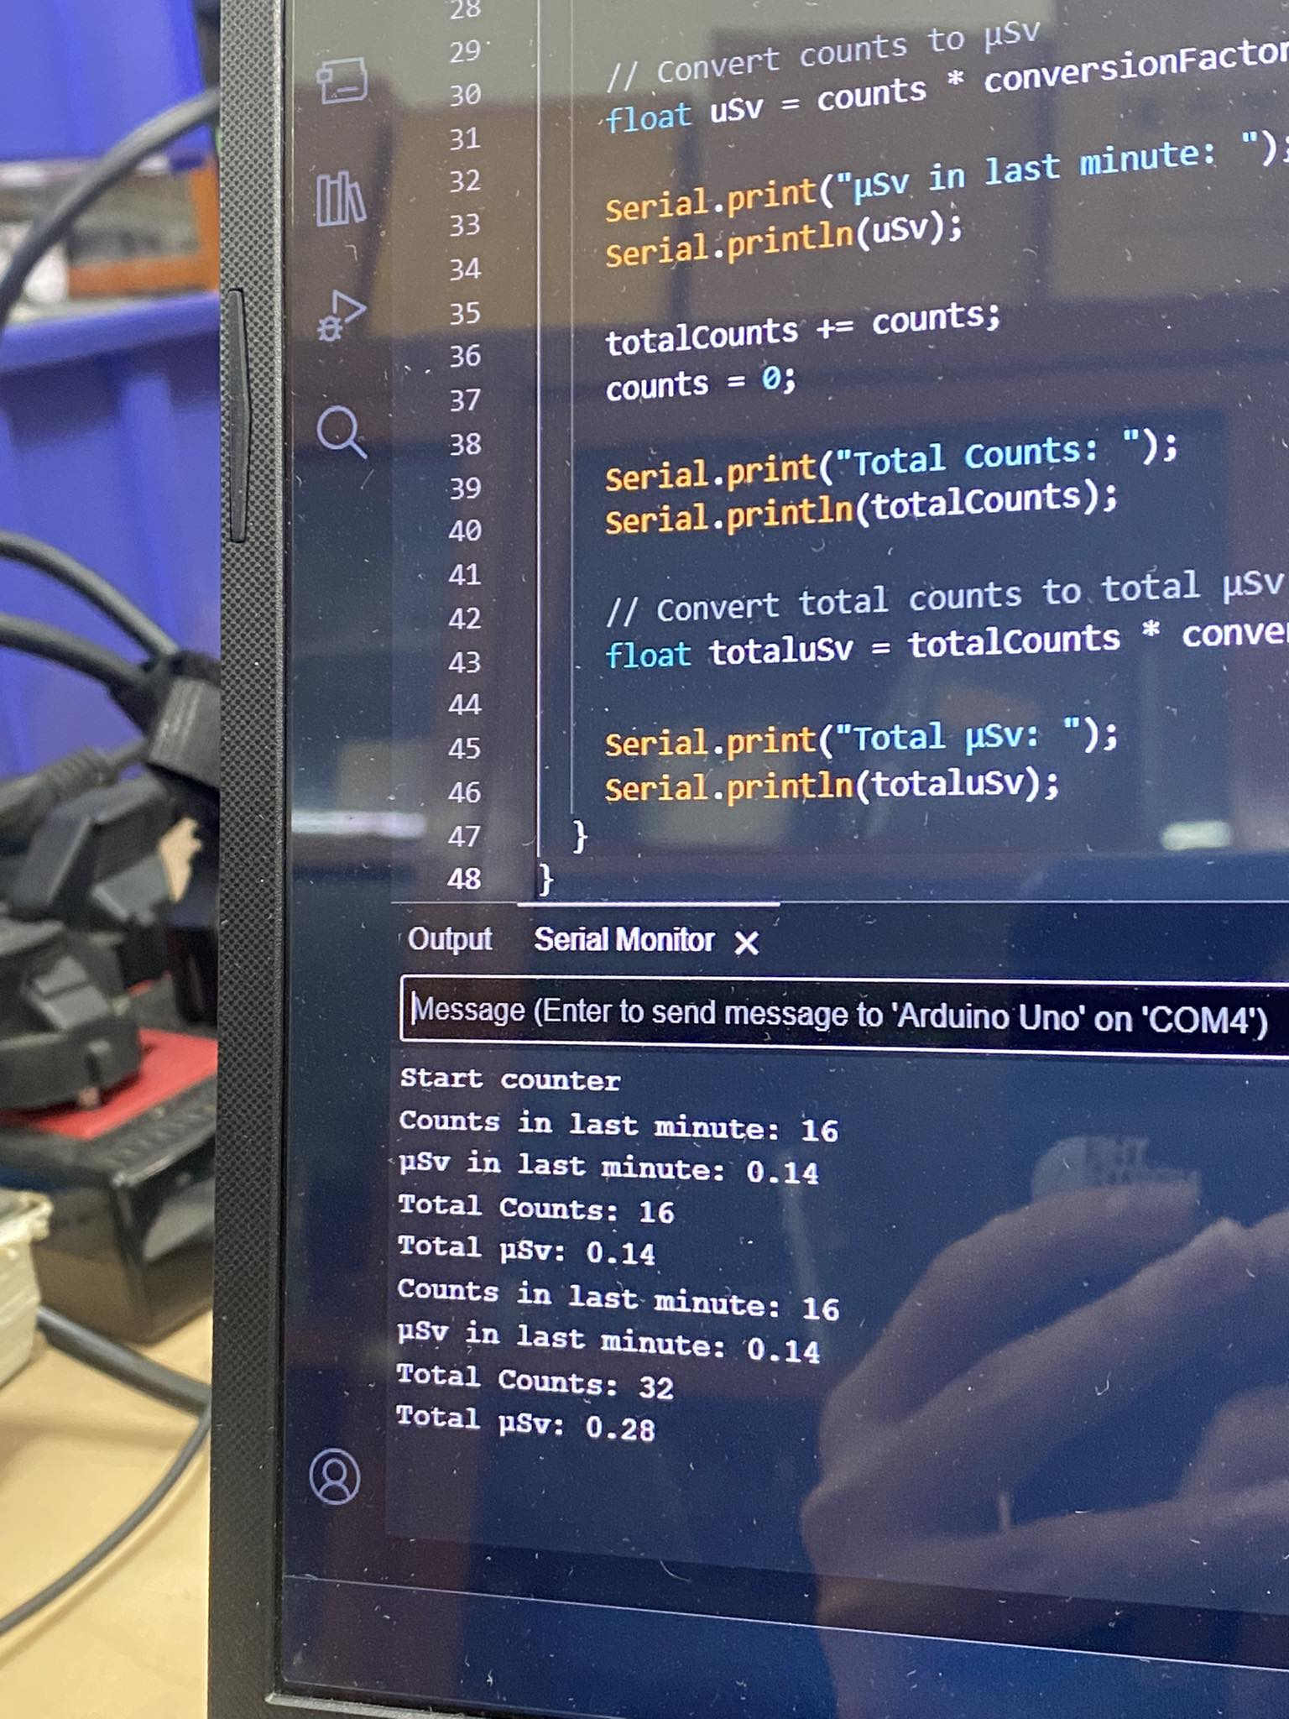
Research Field
NUCLEAR DETECTION

Slide 7
Thanks for your attention

