Slide 1
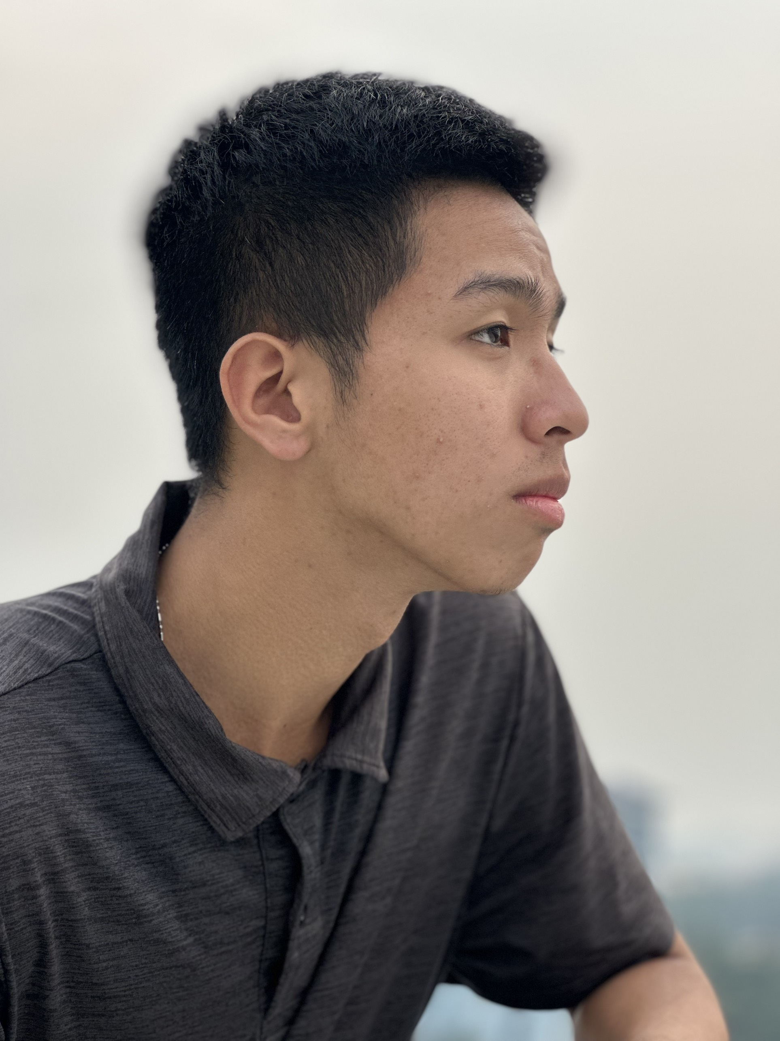
My name is Hien D. Luu

Slide 2
Basic index
Born: 12/4/2005
Education: Space Engineering major, Department of Physics, International University - Viet Nam National University Ho Chi Minh City.
Hobbies: Basketball, Nobel Prize,…

Slide 3
Interest
Theoretical physics (all undiscovered physics edges, as long as it help me get the Nobel Prize)
Astrophysics (black holes)
Astrophysical instrumentation (all-spectrum signal and few-photons detectors)
Beautiful girls

Slide 4
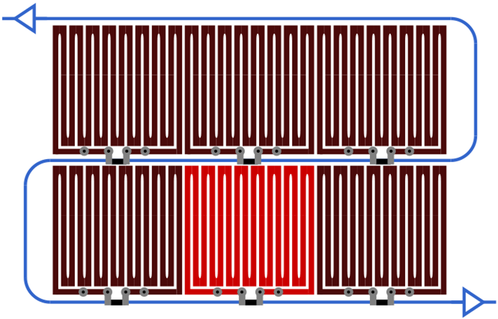
Reason I’m here
Intended to apply for an internship on SNSPD (superconducting nanowire single photon detectors) in Taiwan this summer.

