Slide 1
Good day !
Self - introduction
27/02/2023

Slide 2
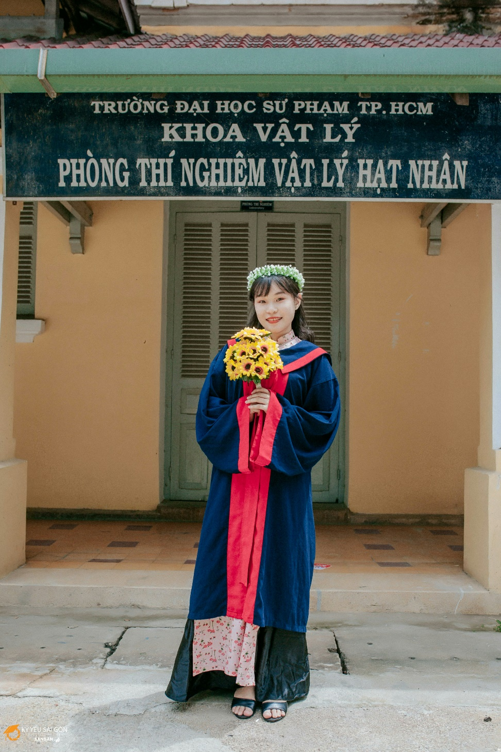
Name: Nguyen Thu Hang
Age: 25 (1998)
From: HCM City
Major: Nuclear Physics
HCM University of Education
Graduation: 2020

Slide 3
2019-2020 study non-destructive testing techniques with two methods of gamma transmission and gamma scattering
2021 graduate with two majors, passed the master’s entrance exam
and have my own scientific articles
2018 get acquainted with the laboratory and researching
From 2018 - 2021
Research focus period of time

Slide 4
Epidemic period
and giving up

Slide 5
Why am I here ?

Slide 6
Thanks for hearing my introduction

