Slide 1
Welcome to “3rd Hardware Camp for Fast and Low-Light detection”!
Yuichi Oyama Mar-4-2024
Organizers/Lecturers/Mentors of the hardware camp are:
My “welcome lecture” includes: -About the program of this hardware camp -Importance of experiment in physics, and importance of invention of detectors in experimental physics -Birth of Kamiokande
Tsuyoshi Nakaya (Kyoto Univ.)
Jennifer Thomas (UCL)
John Ceser (Univ. of Texas at Austin)
Nhan Tran (Fermilab)
Nam Tran (Boston Univ.)
Ken Sakashita (KEK/J-PARC)
Guillaume Pronost (ICRR/Kamioka)
Son Cao (IFIRSE)
Yuichi Oyama (KEK/J-PARC)
Atsumu Suzuki (Kobe Univ.)
Dong Van Thanh (Duy Tan Univ.)
Alex Snells (UCL)
Quyen Phan (IFIRSE)
Sang Truong (IFIRSE)
Shouvik Mondal (Univ. Calcutta)
Remote lecturers are shown in blue.
1

Slide 2
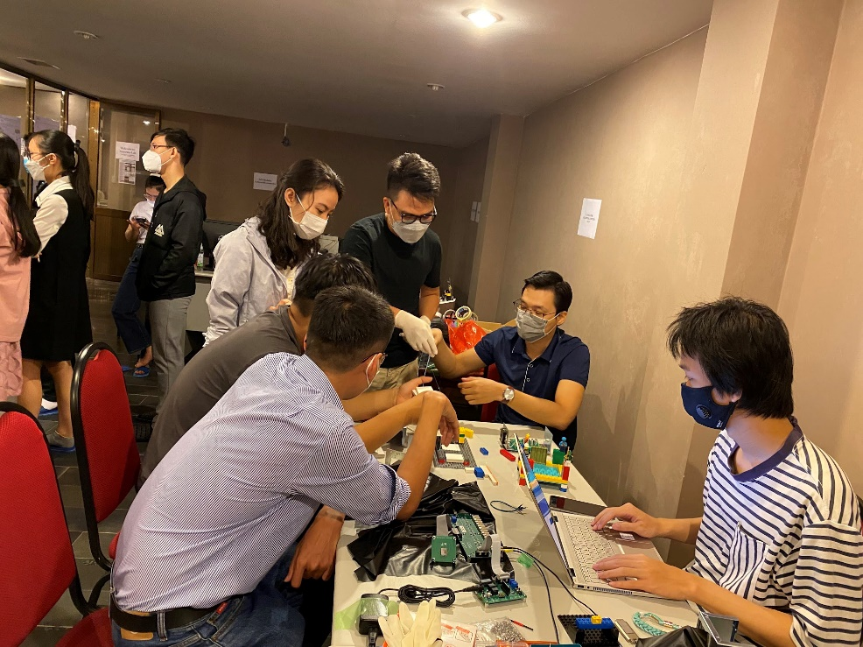
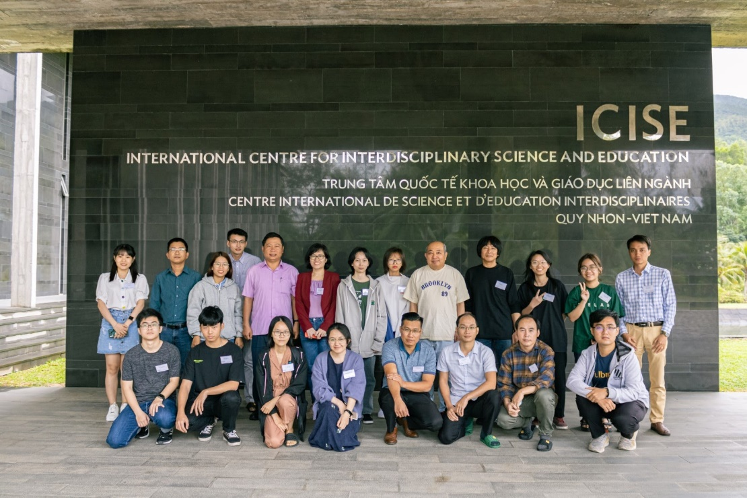
About this Hardware Camp
This hardware camp is planned as a supplementary exercise course of the Vietnam School on Neutrino 2023 (VSoN2023, Jul. 18 - Jul. 28, 2023).
VSoN has been organized by the Vietnam neutrino group and Japanese experimental physicists working in Super-Kamiokande and T2K. It started in 2017 and it has been held every year.
The hardware camp started from 2022, and this is the third camp. This time,14 students are invited to ICISE, Quy Nhon. Hand-on experiences of hardware will be provided.
The 1st hardware camp in 2022
2
The 2nd hardware camp in 2023

Slide 3
About the program of the hardware camp
The participants will study/experience many basic and common components of high energy experiments. They are; -photoproduction of charged particles in matter -photosensor with high voltage power supply -analog signal -trigger logic -digitization of analog signal by readout electronics -data acquisition (DAQ) by online computers -data analysis using offline computers -Monte Carlo simulation
The program focus on technology for high energy experiments. High energy physics itself is not the direct scope of this program.
Most of the participants might be studying theoretical physics. It would be the first hand-on experience to study a detector of high energy experiment for most of students.
This camp is an invitation to experimental high energy physics.
3

Slide 4
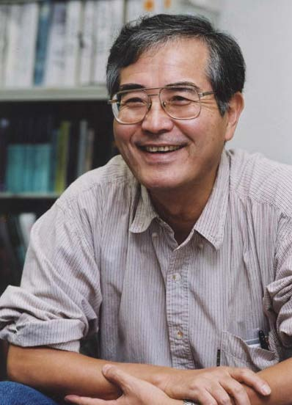
Experiments are important!
To invite students to experiments, let me introduce some words from Prof. Totsuka who was the first spokesperson of the Super-Kamiokande experiment.
Prof. Yoji Totsuka
(1942-2008)
Even though a great theorist propose a fantastic and beautiful theoretical model, we can easily reject it, saying “No! it does not agree with our experiment!”. In physics, the experimental result is everything.
Straightforwardly speaking, I am a detector physicist. I can make the best detector in the world, and I can explore the most advanced physics in the world.
4

Slide 5
Invention of detectors!
Experiment is important in physics. Invention of detectors is essential for experimental physics.
In fact, the Nobel Prize is awarded not only for discoveries, but also for invention of detectors. Let me show you examples ………..
5

Slide 6
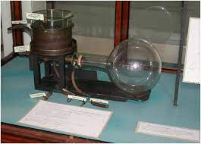
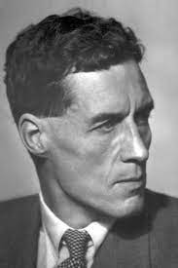
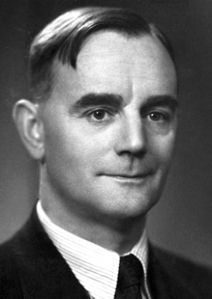
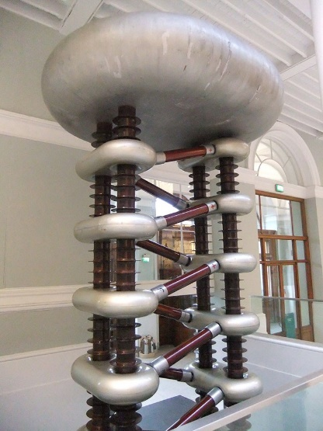
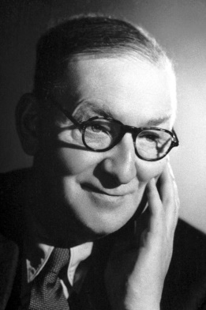
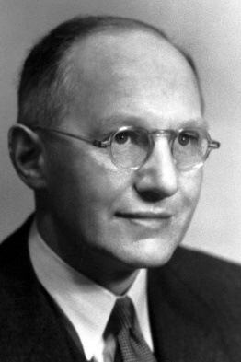
Nobel Prize for inventions in the field of high energy physics
1948 Patrick Maynard Stuart Blackett “for his development of the Wilson cloud chamber method, and his discoveries therewith in the fields of nuclear physics and cosmic radiation”
1950 Cecil Frank Powell “for his development of the photographic method of studying nuclear processes and his discoveries regarding mesons made with this method”
1951 Sir John Douglas Cockcroft and Ernest Thomas Sinton Walton “for their pioneer work on the transmutation of atomic nuclei by artificially accelerated atomic particles” -> Invention of Cockcroft-Walton Generator for particle acceleration
Blackett
Cloud chamber
π⁺ track by photographic method (emulsion)
Powell
Cockcroft
Walton
Cockcroft-Walton Generator
6
Reasons for the award are cited from the official website of the Nobel Foundation.

Slide 7
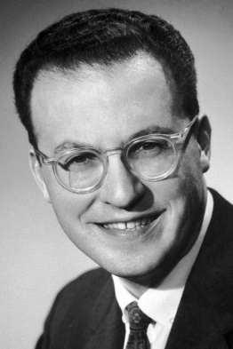
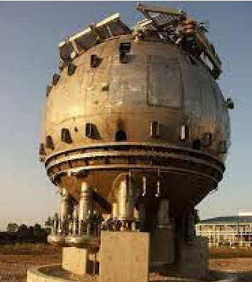
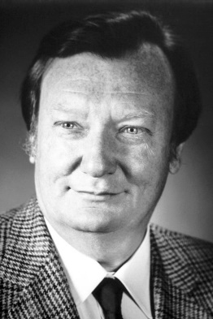
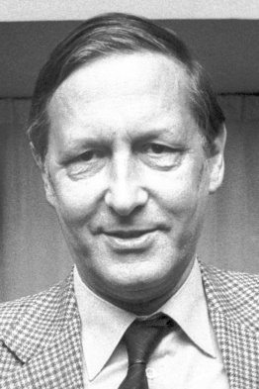
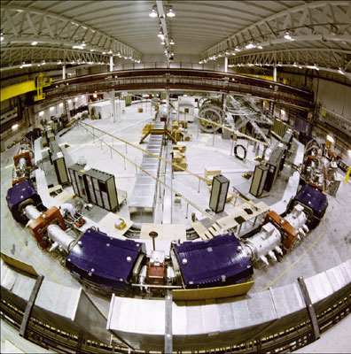
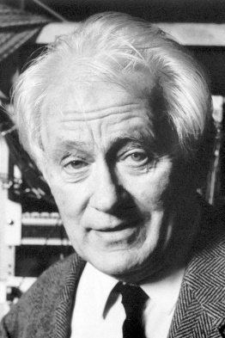
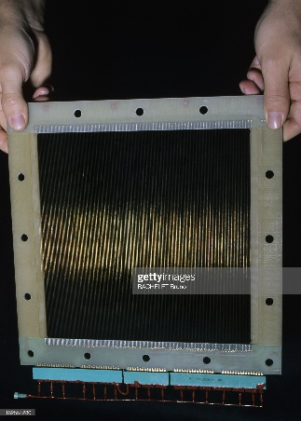
Nobel Prize for inventions in the field of high energy physics
1960 Donald Arthur Glaser “for the invention of the bubble chamber”
1984 Carlo Rubbia and Simon van der Meer “for their decisive contributions to the large project, which led to the discovery of the field particles W and Z, communicators of weak interaction” ->Simon van der Meer provided an idea of stochastic cooling. It was applied in the Antiproton Accumulator which supplied antiprotons to the Proton-Antiproton Collider.
1992 Georges Charpak “for his invention and development of particle detectors, in particular the multiwire proportional chamber”
Glaser
Bubble chamber
van der Meer
Antiproton Accumulator
Rubbia
Multiwire proportional chamber
Charpak
7

Slide 8
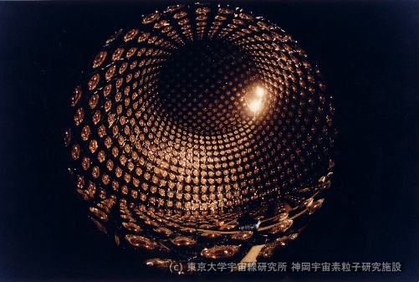
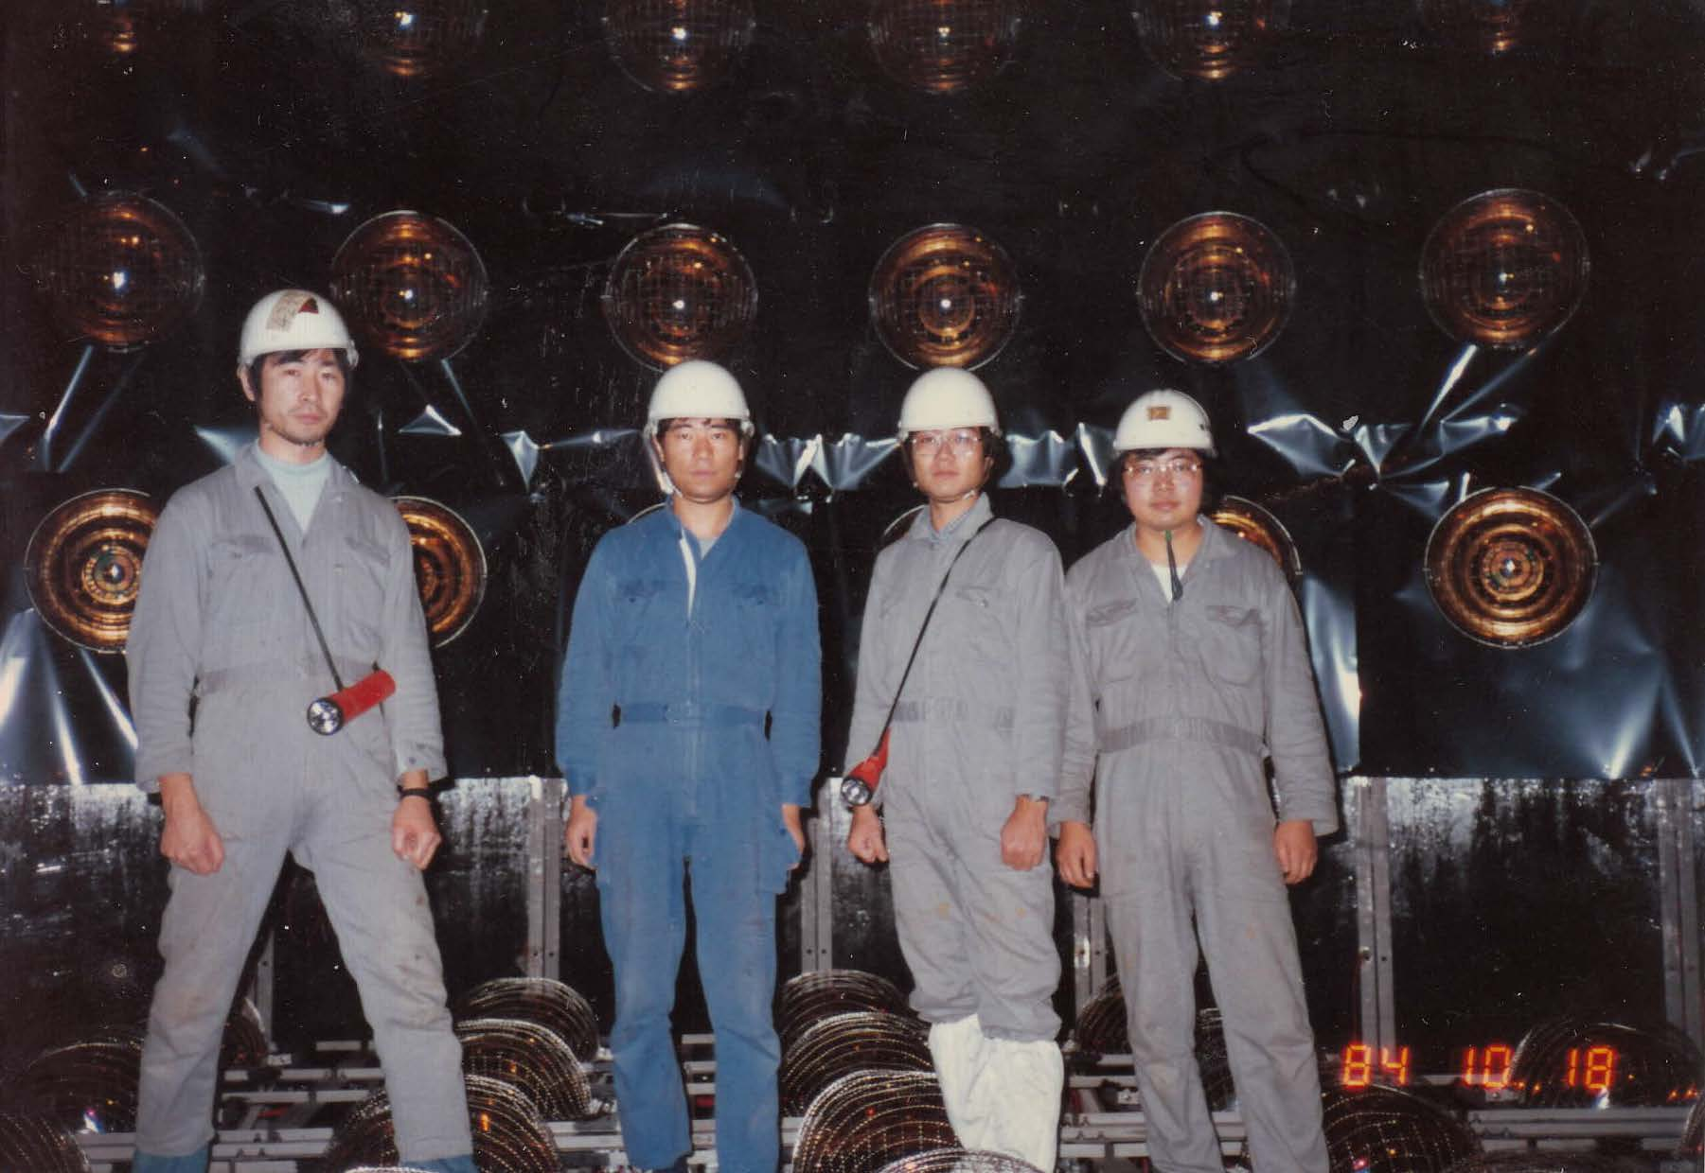
The birth of Kamiokande
Let's me present the efforts to construct the Kamiokande detector.
I have participated in the Kamiokande experiment since I was a master's student.
This story was requested by Dr. Son Cao, although it has been regularly presented in Vietnam School on neutrino in every summer. I am sorry if you hear this more than once…..
8

Slide 9
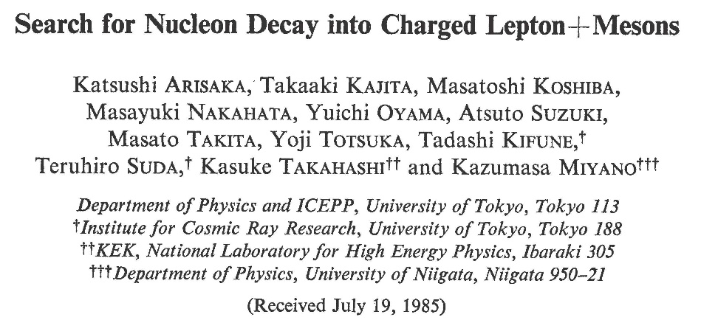
Introduction
Kamiokande (1983 - 1996) was the first Nobel Prize experiment outside of Europe and America in the field of high energy physics.
Kamiokande was small manpower / small budget experiment. In the first Kamiokande paper in 1985, only 12 authors. They are 7 staffs (about 5 Full Time Equivalent) and 5 graduate students.
The initial budget for the experiment was 5 Oku-yen and additional running cost was about 1 Oku-yen/year. It was quite small budget. (1 Oku-yen ~ 0.5 Million US dollars in early 1980s.)
Reporting why Kamiokande experiment succeeded with small manpower / small budget will be very instructive.
9

Slide 10
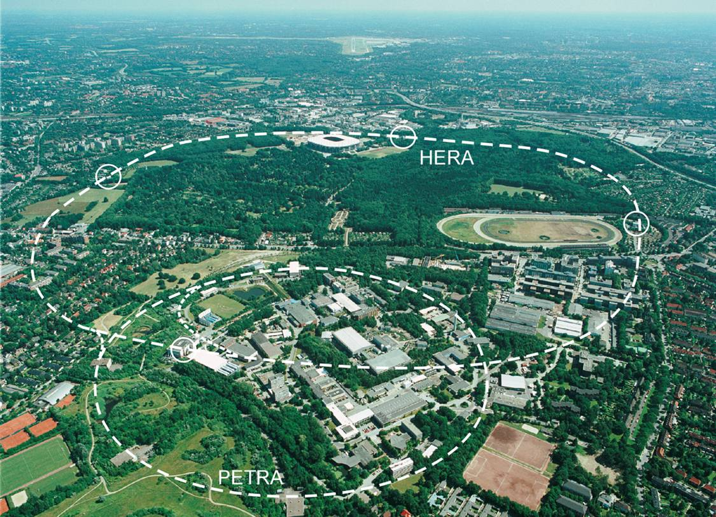
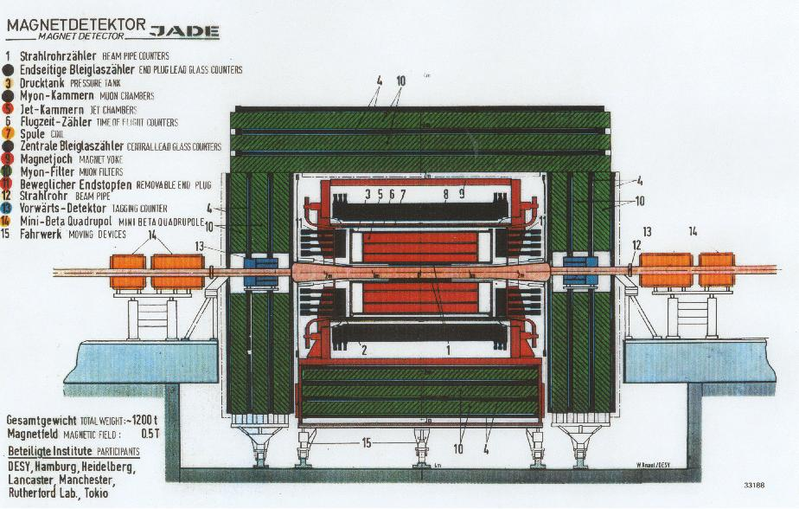
Before Kamiokande experiment…..
Before Kamiokande experiment, Koshiba's group in department of physics, University of Tokyo participated in JADE Experiment (1977-1986) in PETRA Ring in DESY, Hamburg.
Kamiokande was the second and local experiment of the group. It was planned just after the JADE experiment started successfully.
JADE detector
PETRA Ring in DESY
10

Slide 11
JADE experiment
JApan Deutschland England collaboration.
The main purpose of the experiment was observation of heavier new quarks. Unfortunately, it was not succeeded.
Instead, 3 jet events which directly show existence of gluons were discovered together with other 3 experiments in PETRA.
JADE detector
gluon event
11

Slide 12
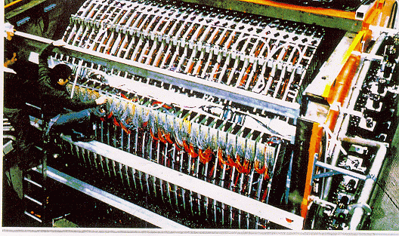
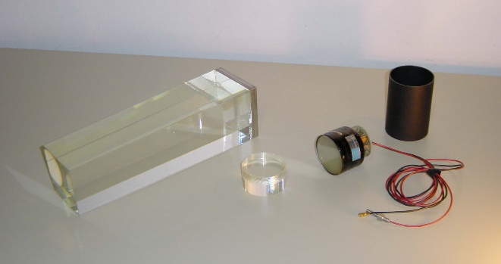
Lead glass counter and photomultiplier tubes (PMT)
In JADE experiment, Koshiba's group took charge of lead glass counters. It is a calorimeter to measure energy of electro-magnetic showers. Basically, it consists of a total of 2712 photomultiplier tubes (PMTs) and lead glasses.
At that time, the leading company of the PMTs was Philips in Nederland. PMTs made by Philips and made by Hamamatsu were compared and obviously Philips PMTs were much much better than Hamamatsu PMTs.
Assembling JADE Lead glass counter
Lead glass and PMT for OPAL experiment (sorry! I could not find that of JADE)
12

Slide 13
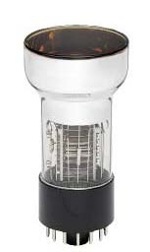
Hamamatsu PMTs !
Koshiba decided to use Hamamatsu PMTs although all other collaborators strongly opposed it. Koshiba said "Our research budget is funded by the Japanese government. For the critical and high-technology component of the detector, we must purchase Japanese products as much as possible.“
Hamamatsu developed new PMTs for JADE lead glass counters with cooperation of Japanese JADE members. Hamamatsu accumulated experience in the design of PMTs thanks to Koshiba's decision.
It was real “first step” for the Kamiokande experiment.
Hamamatsu R594 PMT for JADE experiment
13

Slide 14
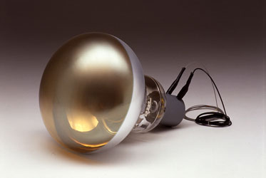
Development of 20-inchΦ PMT
When the planning of Kamiokande experiment started around 1979, IMB group have already started similar project independently in USA.
The IMB detector is larger and the start of the experiment is earlier. It seems there is no advantage in Kamiokande.
“Ask Hamamatsu to make new PMTs which have large diameter. They cannot reject my request. They succeeded as a PMT company after we selected Hamamatsu PMTs for JADE experiment!”
20-inchΦ PMT are developed, and precise measurement became possible with large photo collection. It led to the success of the experiment.
 | IMB | Kamiokande
Total (Fiducial) Volume | 8000 ton (3300 ton) | 3000 ton (1000 ton)
Start | 1982 | 1983
PMTs (size x number) | 8 inchΦ x 2048 | 20 inchΦ x 1000
14

Slide 15
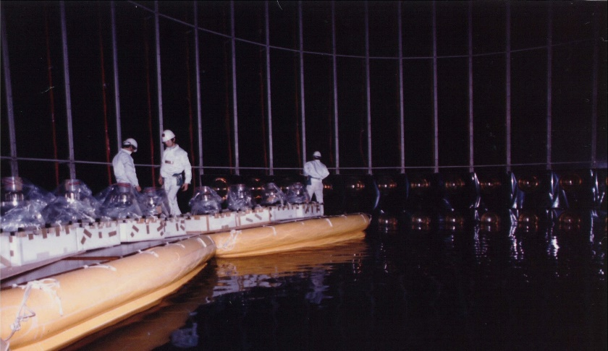
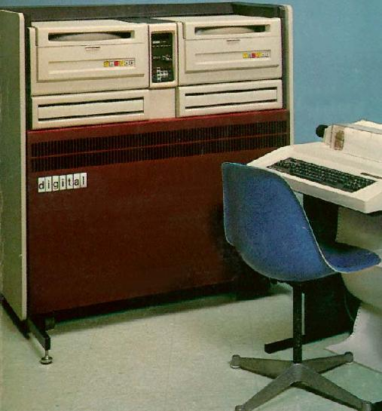
Use property of JADE experiment !
The tank including PMT support structure was designed and constructed by Mitsui Engineering and Shipbuilding Co.,Ltd. The company also designed structure of the JADE lead glass counter. The group had enough experience of communication with the company.
DEC PDP 11/60 was used as on-line data-taking computer. The group asked how to use it to a JADE member since PDP 11 series was used in JADE.
For readout electronics, high voltage power supplies and distributors, ready-made electronics were purchased. For some of the component, second-hand modules were used.
DEC PDP 11/60
15

Slide 16
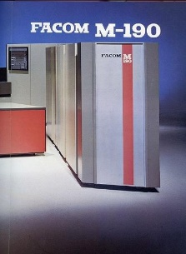
Use property of JADE experiment !
For off-line analysis computer, an IBM-type mainframe computer, FACOM M-190 for JADE experiment was used without any charge. Kamiokande members were just USERS of the computer, and did not care any maintenance and management.
In the analysis computer, all utility software for JADE experiment were used. They include data structure or event display.
For Monte Carlo simulation program, lead glasses were replaced with water, and only geometry was changed.
To summarize, Kamiokande borrow (or steal) almost everything from JADE experiment. In that sense, Kamiokande is (JADE)' at the first stage. That is one reason why Kamiokande started with small manpower and small budget.
16

Slide 17
What we can learn from the Kamiokande experience?
Vietnamese high energy experimental groups/physicists will join (or already joined) a large international collaboration. Keep in mind following…….
For critical and high-technology components of the detector, purchase your own national products. It would contribute to technology upgrade of your national companies, and would be the "first step" of your future experiments.
You should consider to imitate a detector component and start your own experiment in your own country. You can borrow (or steal) every property/experience/technology/software/hardware/ manpower from your international collaboration.
17

Slide 18
Finally……
Let me emphasize again. Experiment is important in physics. Inventions of detectors are essential for experimental physics.
Enjoy your first hand-on experience to study a detector of high energy experiment.
We hope that this experience become a trigger, and some of you will change your research field to high energy experiment, and become a pioneer of the Vietnamese high energy experiment, and construct the most advanced detector in Vietnam.
18

Slide 19
end
19

