Slide 1
About Quach Khanh Duc

Slide 2
Table of contents
1. Who is QKĐ
2. My hobby
3. My interest

Slide 3
Introduction

Slide 4
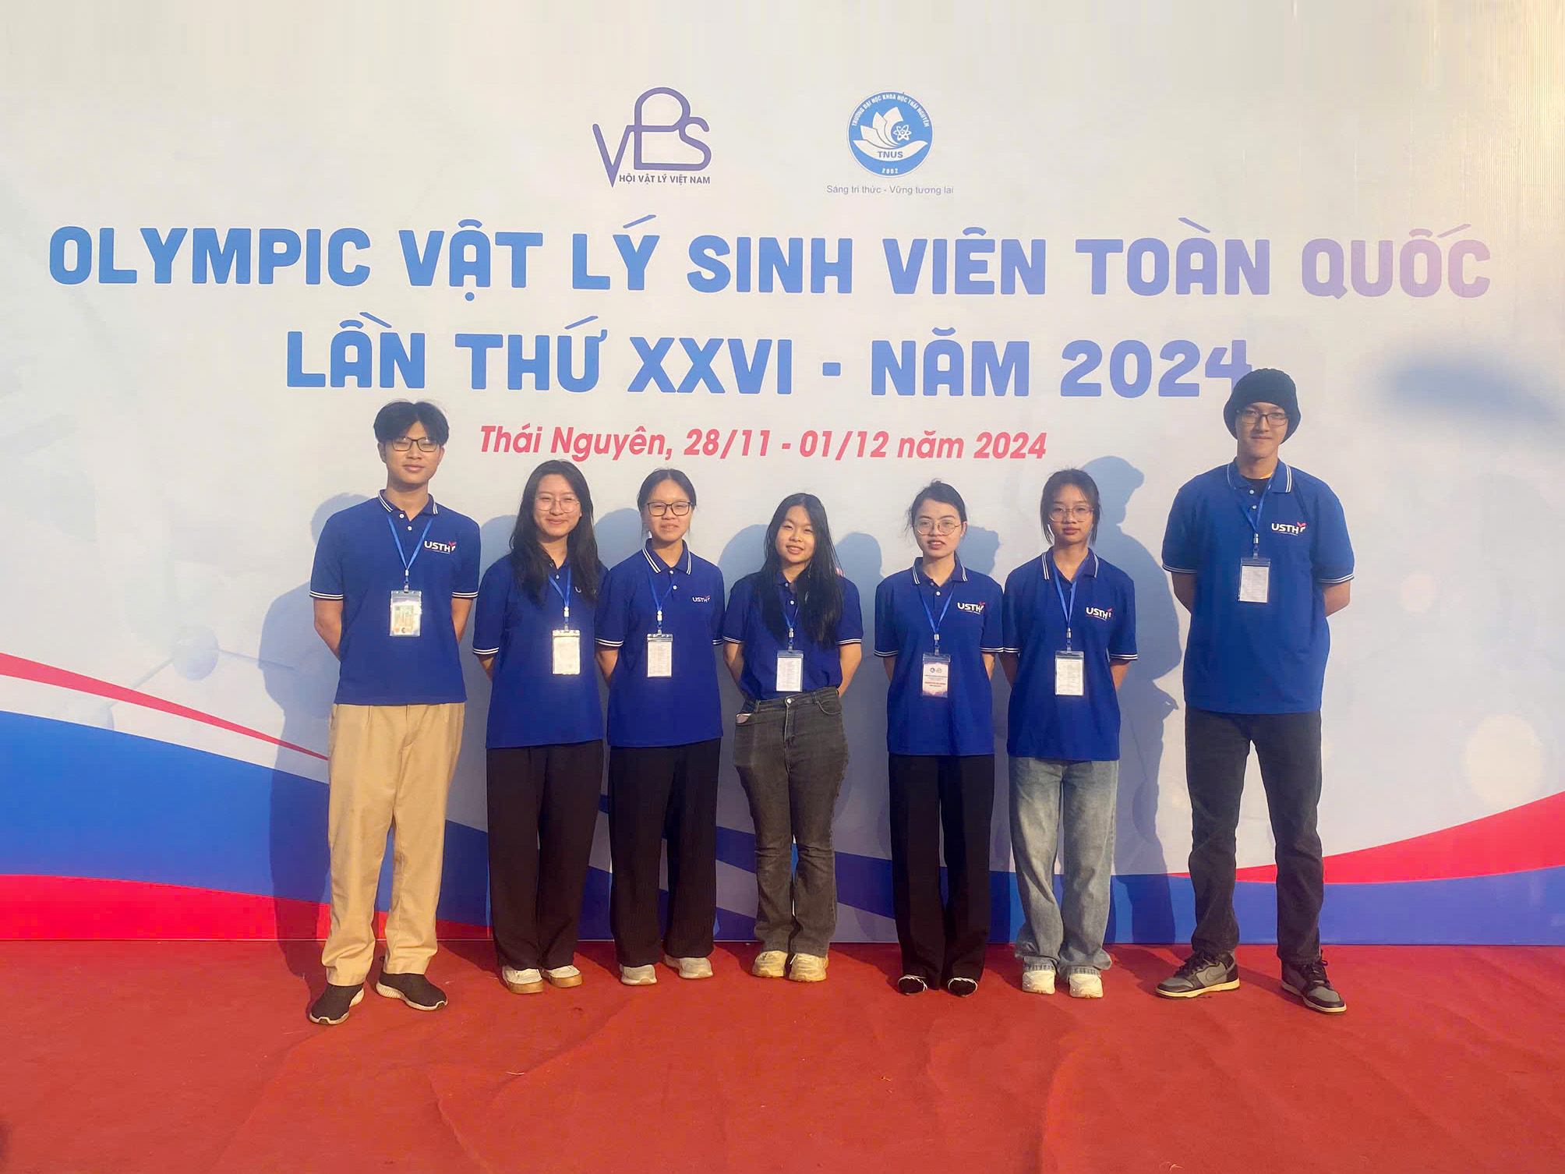
Name: Quach Khanh Duc
Age: 19 (Date: 05/12/2005)
School: USTH

Slide 5
2. Hobby

Slide 6
Anime, comics, and novels
Game and music (the old ones)
Charity works

Slide 7
3. Interest

Slide 8
My interest
High Energy Physics
General Relativity
Neutrino Physics
???

Slide 9
The end

