Slide 1
LET ME SHARE A LITTLE
ABOUT ME
NGUYEN T. MINH SANG
NICE TO MEET YOU!

Slide 2
The hills and mountains of Dalat are covered
with mist and drifting clouds

Slide 3
SOME OF MY KEY LIFE MOMENTS
Major
Physics
Dalat University
2012
Reseach
Physics, Monitirng environmental
2025

Slide 4
A FEW THINGS I REALLY LOVE
Springr is the best season
Chocolate is my favourite treat
Taking care of my indoor plants
Watching
Eating
Traveling

Slide 5
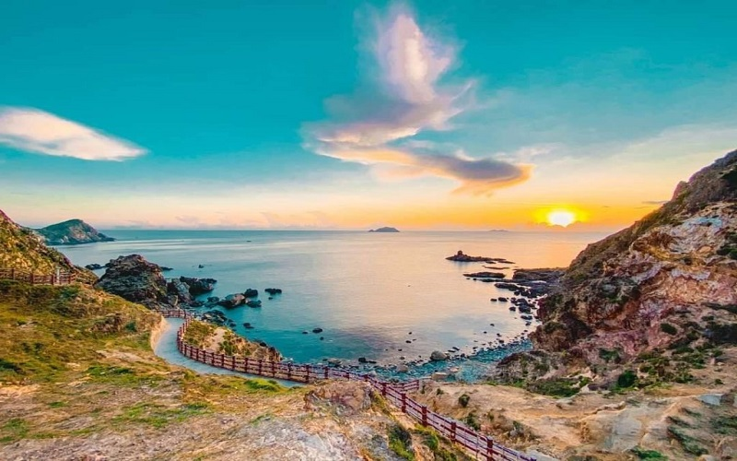
THANK YOU FOR GIVING
YOUR TIME!

