Slide 1
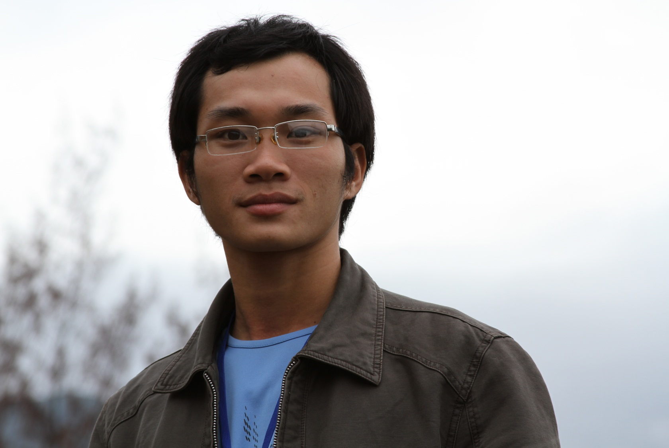
INTRODUCTION

Slide 2
Happiness does not depend on what you have or who you are. It solely relies on what you think
Full name: Tran Van Ngoc
Born: 1987
Hometown: Quang Binh
Marriage status: Single (don’t have girl friend yet :p )
Tel.: 0943636956
Email: tranngocapc06@gmail.com

Slide 3
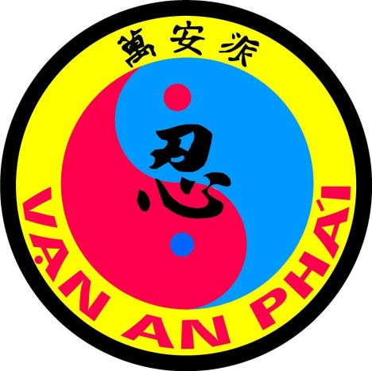
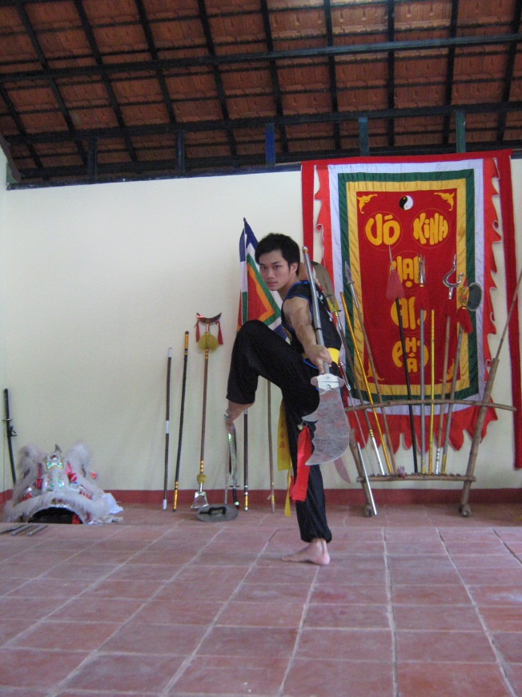
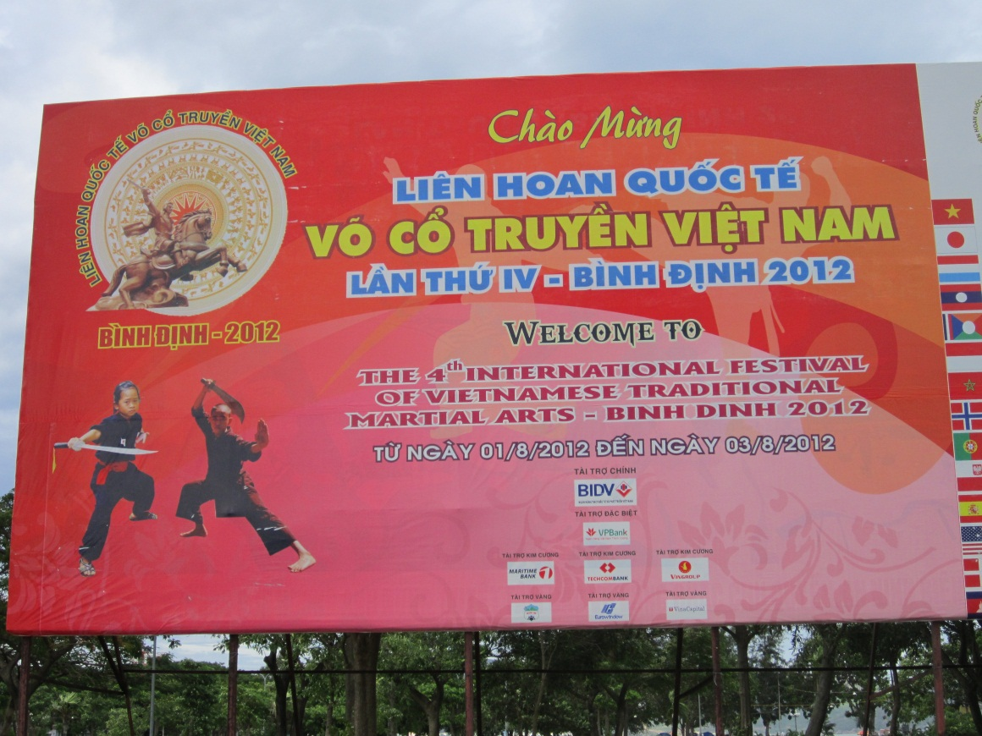
Passion: Martial art
Have practised martial art for more than 10 years
Participated in some martial art festivals

Slide 4
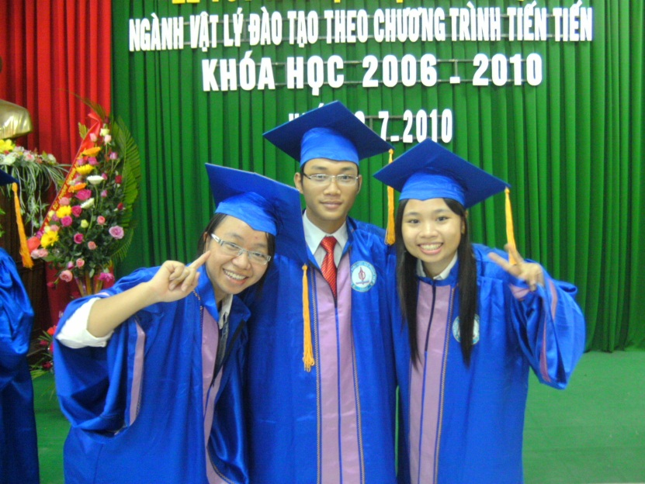
EDUCATION
Undergraduate: Advanced Physics Class, Hue University.
Master: Theoretical & Mathematical Physics, Hue University.
Career: Junior researcher, teacher

Slide 5
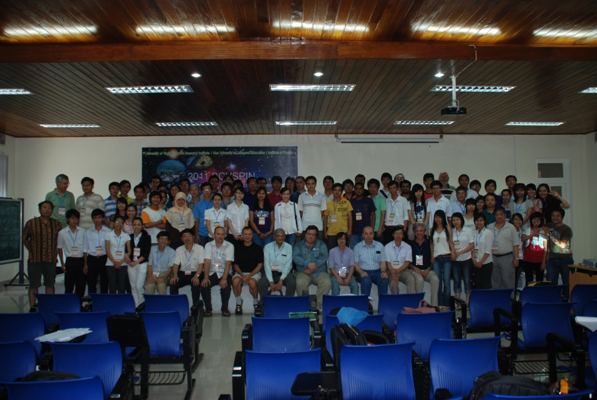
Activities participated
17th VSOP and 2011 BCVSPIN (Hue, 2011)
3rd School on Physics at LHC (Quy Nhon, 2011)
First Inha-Hue Winter School (Hue, 2011)
18th VSOP (Quy Nhon, 2012)
2013 BCVSPIN (China, 2013)

Slide 6
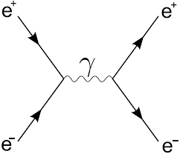
Fields of interest:
High Energy Physics
Quantum Physics
Future plan:
+ Apply and get PhD in next 3-4 years
+ Participate in Neutrino group activities

