Slide 1
Flipped U(1) extended Standard Model and Majorana dark matter
Cao Hoang Nam
Phenikaa University
Based on arXiv: 2007.xxx
ICISE - Quy Nhon, July 2020

Slide 2
Plan of the talk
GR+SM and motivations for beyond
Flipped U(1) extended Standard Model and Majorana dark matter

Slide 3
Part 1: Standard Model and Motivations for beyond

Slide 4
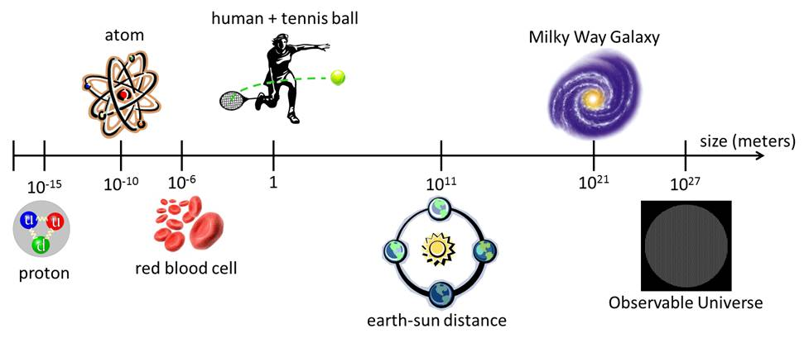
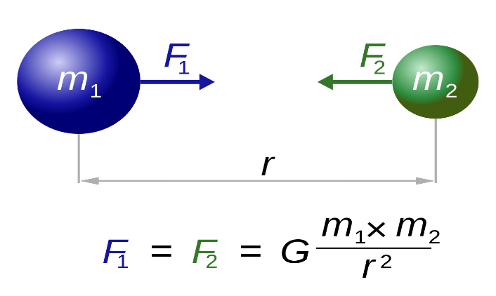
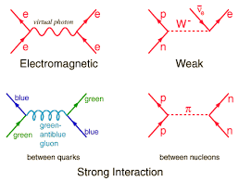
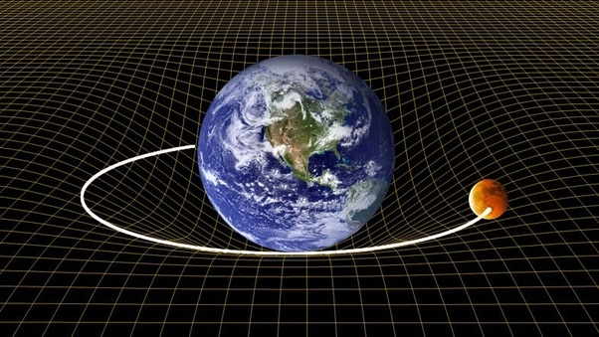
GR+SM

Slide 5
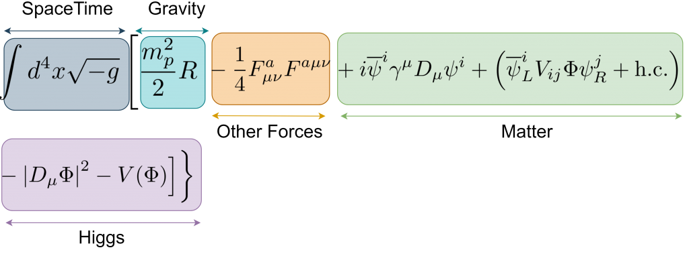
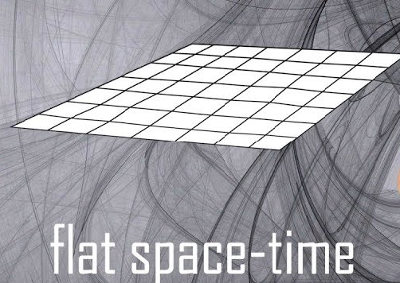
In the world of elementary particles with energy scales much lower than Planck energy scale (about ${10}^{19}$ GeV), the gravity effects are ignored.

Slide 6
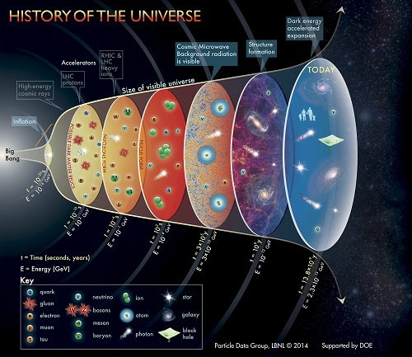
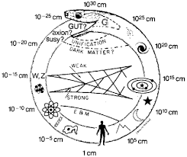

Slide 7
Standard Model
Gauge symmetry:
Fermion content:
$$Q=T_{3}+Y$$

Slide 8
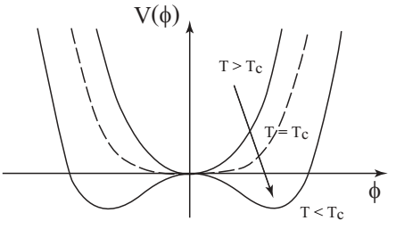
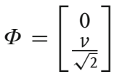
Spontaneous symmetry breaking:

Slide 9
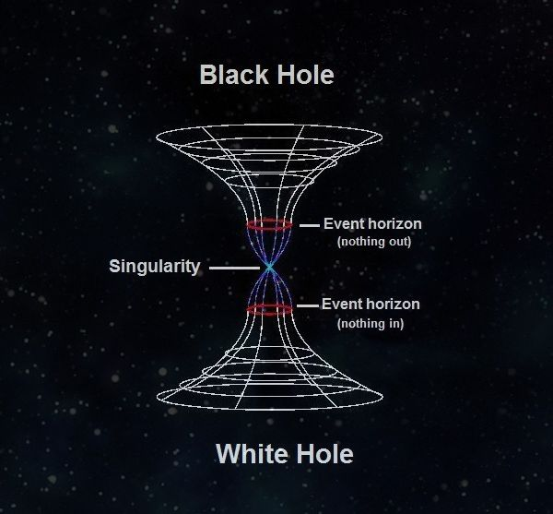
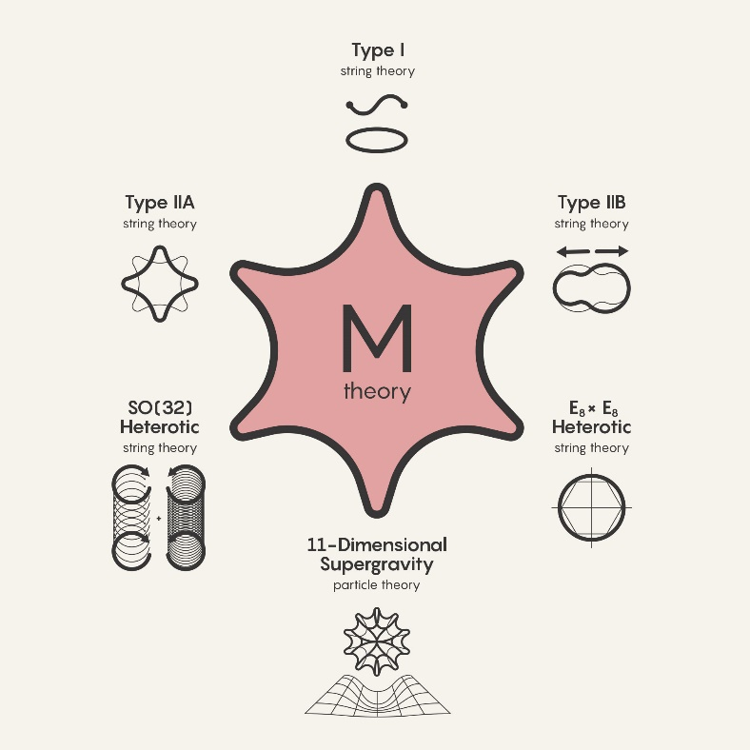
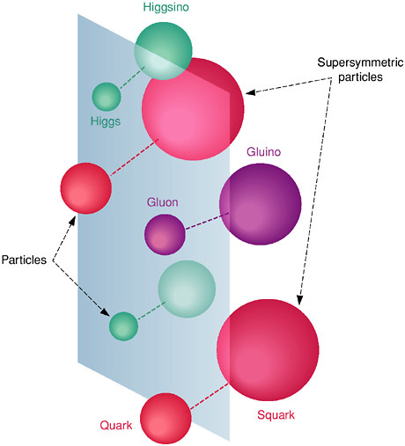
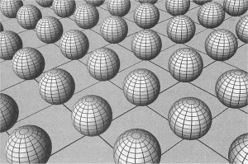
What is spacetime at short distances?

Slide 10
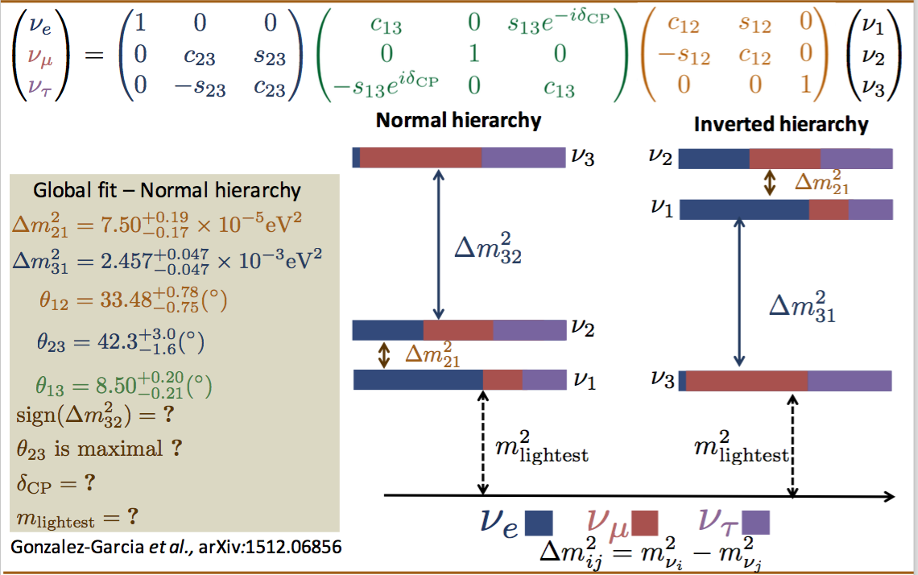
Neutrino masses and oscillations
In the Standard Model, the neutrinos are massless because the right-handed neutrinos are absent and the lepton number is conserved.

Slide 11
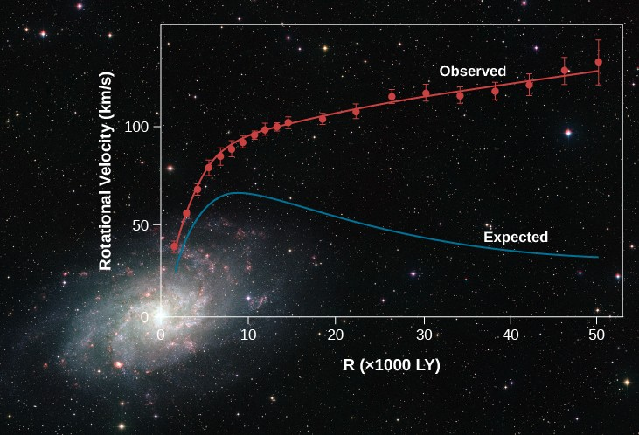
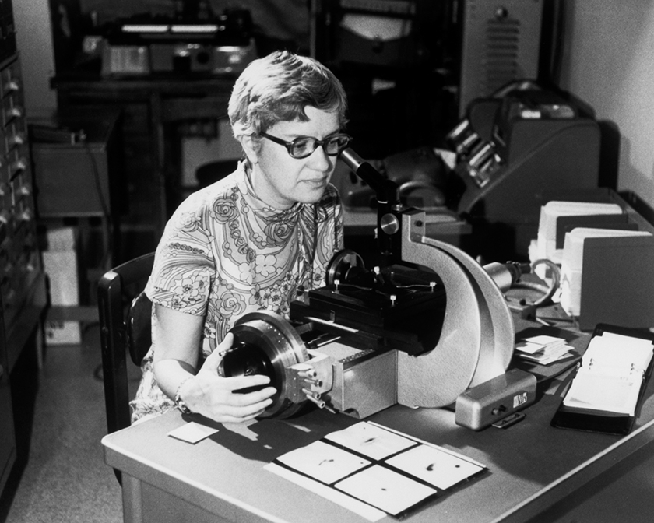
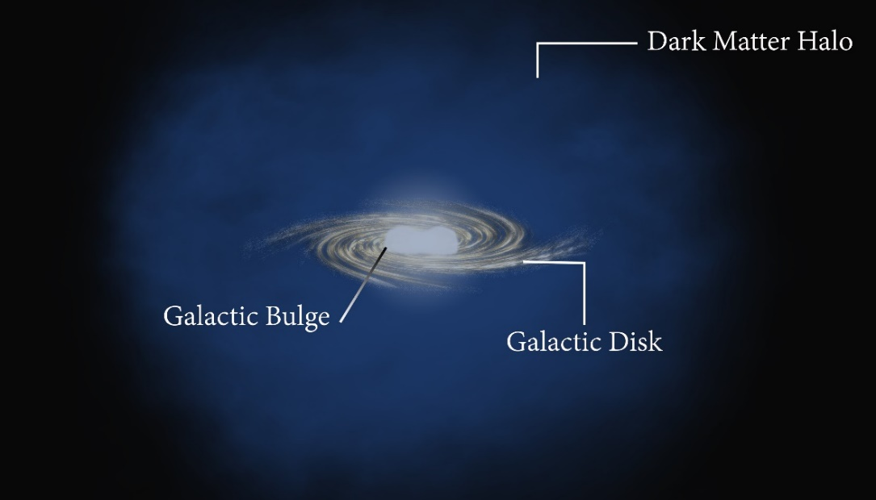
Dark Matter
Vera C. Rubin

Slide 12
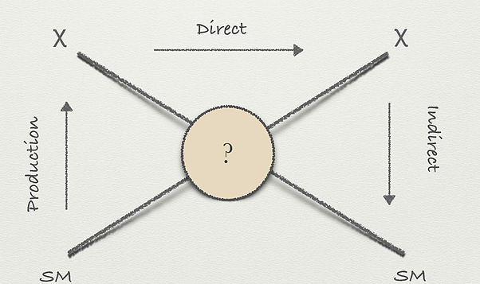
DM Classification
DM properties
Hot Dark Matter: Particles moving relativistically
Cold Dark Matter: Particles moving at sub-relativistic velocities
Warm Dark Matter: Particles with properties intermediate between those of hot dark matter and cold dark matter (maybe source of the XENON1T anomaly)
Electric neutral
Nonbaryonic
Stable (lifetime larger than Universe’s age)

Slide 13
Matter-antimatter asymmetry
No SM mechanism generating a large enough baryon asymmetry has been found
Leptogenesis

Slide 14
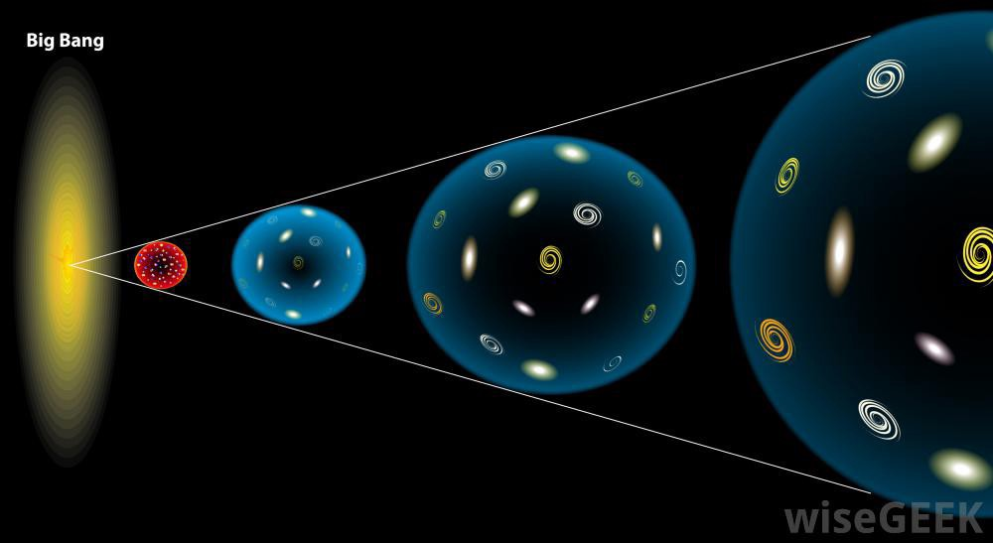
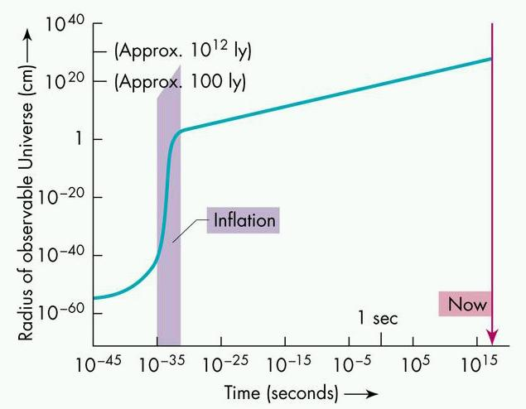
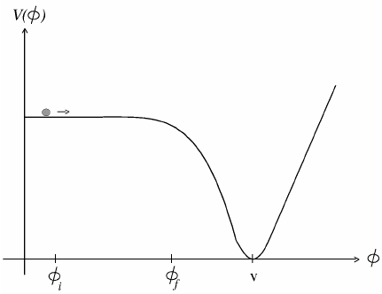
Cosmic Inflation
Horizon problem: CMB is almost isotropic
Our universe is flat nearly
No magnetic monopoles have been observed

Slide 15
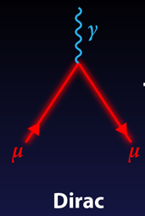
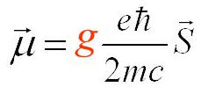
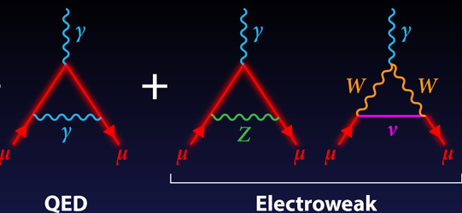
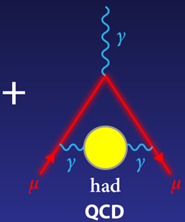
Anomalous Magnetic Moment of Muon
New Physics

Slide 16
In summary, in order to introduce the physics beyond GR+SM, one may at least extend
Spacetime
SM gauge symmetry

Slide 17
Part 2: Flipped U(1) extended Standard Model and Majorana dark matter

Slide 18
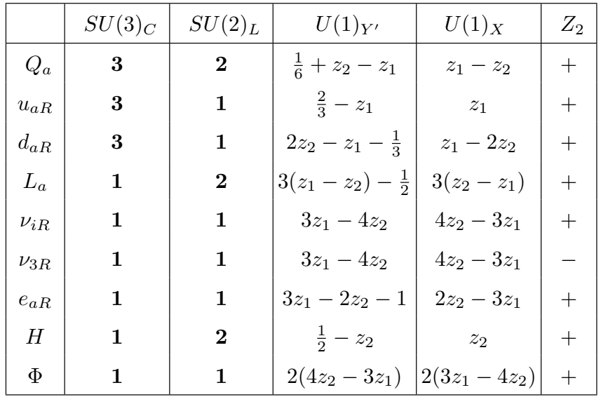
Model
Gauge symmetry
Particle content

Slide 19
Lagrangian
Covariant derivative
Higgs potential
Yukawa couplings

Slide 20
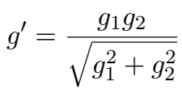
U(1)_Y gauge coupling
Anomaly cancellations

Slide 22
VEVs of the scalar fields
Neutrino masses

Slide 23
Neutral gauge boson sector

Slide 24
Z couplings to fermions
Z’ couplings to fermions

Slide 25
Constraints
The precise measurement of the mass of the SM gauge boson Z
The precision measurement of the Z decay width

Slide 26
The weak nuclear charge of Cesium
LEP constraint on

Slide 27
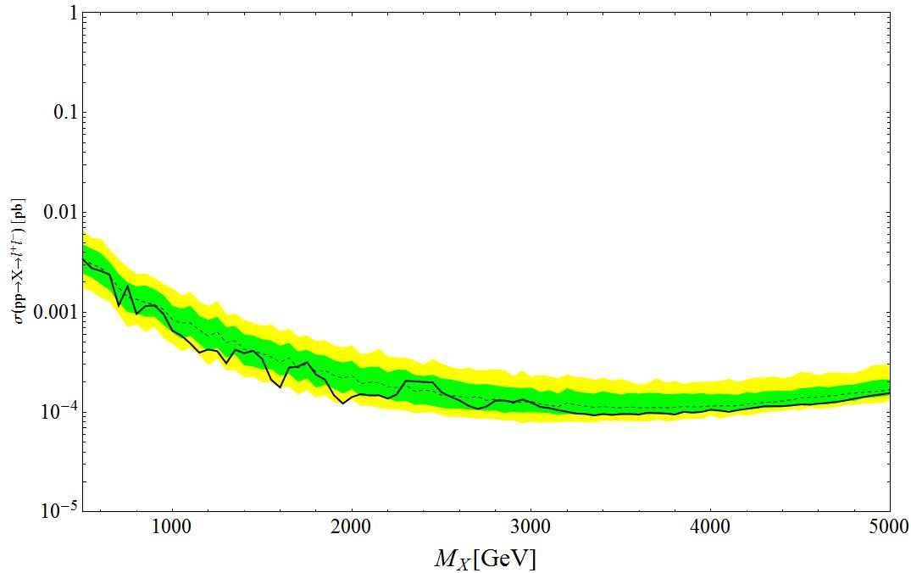
The current LHC limits on new gauge boson

Slide 28
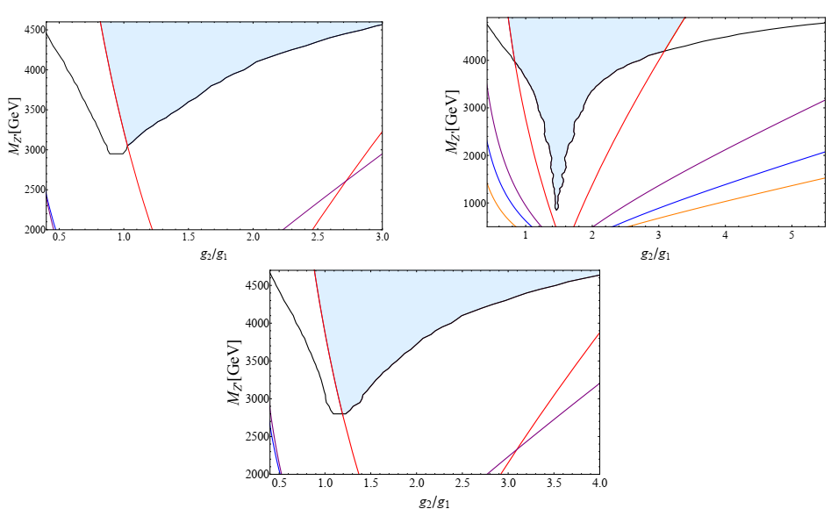

Slide 29
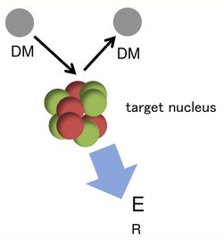
Dark matter phenomenology
Direct detection

Slide 30
Indirect detection
The thermal average annihilation cross-section times the relative velocity
The dark matter pair annihilation into the standard model particles

Slide 31
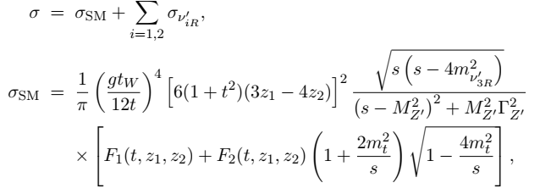

Slide 34
THANK YOU FOR YOUR ATTENTION

