Slide 1
Neutrino Beam Profile Measurement
Nguyen Thi Hong Van

Slide 2
From Megan Friend

Slide 3
Monitor neutrino beam direction at T2K
PROTON BEAM MONITORS
To monitor proton beams before hitting the target
MUON MONITOR (MUMON)
118m from target
Measure muon profile
Monitor neutrino beam direction indirectly
INTERACTIVE NEUTRINO GRID (INGRID)
280m from target
Measure on-axis neutrino beam profile
Monitor neutrino beam direction

Slide 5
Beam profile stability from proton beam monitor (SSEM)

Slide 6
Beam profile from INGRID

Slide 8
Beam Profile center from INGRID in days
X
Date
Date
Y
Date

Slide 9
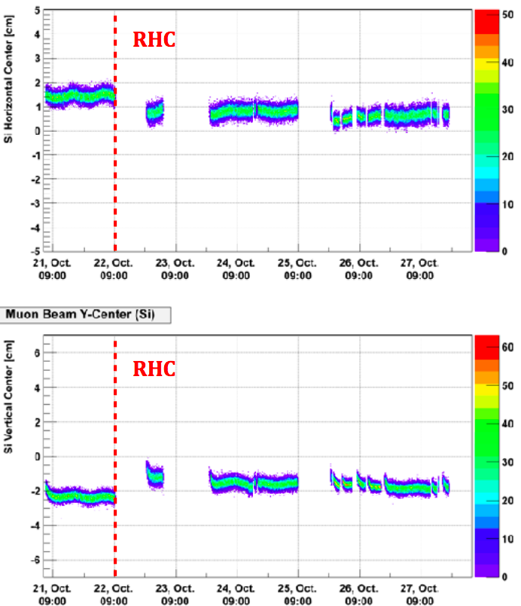
Beam Profile center from MUMON

