Slide 1
S – matrix in the interaction representation
Lagrangian Formalism

Slide 2
S – matrix in the interaction representation

Slide 3
Definition
The S-matrix or scattering matrix relates the initial state and the final state of a physical system undergoing a scattering process.
The S-matrix is defined as the unitary matrix connecting sets of asymptotically free particle states (the in-states and the out-states)
Asymptotically free then means that the state has this appearance in either the distant past or the distant future.

Slide 4
Let the Hamiltonian H be split into the free part H₀ and the interaction H_{I}, H = H₀ + H_{I}
The operators behave as free field operators and the state vectors have dynamics according to the interaction H_{I}
$$|\left.Φ\left(t\right)\right\rangle =U\left(t,t_{o}\right)|\left.Φ(t_{o})\right\rangle$$
$|\left.Φ\left(t\right)\right\rangle$is a state that has evolved from a free initial state $|\left.{Φ(t}_{o})\right\rangle$
Initial state: $t_{o}→−∞$
State vector: t $→∞$
$$|\left.Φ\left(∞\right)\right\rangle =U\left(∞,−∞ \right)|\left.Φ(−∞)\right\rangle$$
The operator S = U$\left(−∞,∞\right)$ is the S-matrix
$S=\sum_{−∞}^{∞}{\frac{{(−i)}^{n}}{n!}\int_{−∞}^{∞}{dt_{1}}}$ $\int_{−∞}^{∞}{dt_{2}}$… $\int_{−∞}^{∞}{dt_{n}}.P(H_{I}(t_{1})$ $H_{I}(t_{2})$… $H_{I}(t_{n})$)
With Dyson chronological operator
$P(H_{I}(t_{1})$ $H_{I}(t_{2})$… $H_{I}(t_{n})$) = $H_{I}(t_{i1})$ $H_{I}(t_{i2})$… $H_{I}\left(t_{in}\right), t_{i1 }≥$ $t_{i2 }≥$… $≥$ $t_{in }$

Slide 5
Lagrangian Formalism
Field Equations of Motion
Conservation of Energy
Charge Conservation

Slide 6
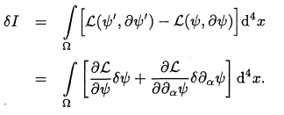
1. Field Equations of Motion
Lagrangian equations of motion
$\frac{∂ℒ}{∂x_{p}^{i}}−\frac{d}{dt}\frac{∂ℒ}{∂x_{p}^{i}}=0, i=1,2,3$is the coordinates of the particles
The field equations whose field are relativistic systems can be invariant under Lorentz transformations, only if spatial and time Lagrangian depends on $ψ\left(x\right), ∂_{α}ψ\left(x\right), α=0,1,2,3$
Let us determine the variation of the action

Slide 7
In this formula:
where $δψ(x)$ is an arbitrary infinitesimal function of x. We have
Substituting such result into equation of $δI$ and combining Gauss theorem:
where $Σ$ is the surface surrounding the volume $Ω, {dσ}_{α}$is the infinitesimal surface elements. We shall assume
$δI=0, δψ\left|Σ\right.$ = 0
$$→Euler−Lagrange equation$$
If the field depends on an additional variable which can take discrete values, the variational principle implies
$$\frac{∂ℒ}{∂ψ_{σ}}−∂_{α}\frac{∂ℒ}{∂∂_{α}ψ_{σ}}=0$$

Slide 8
2. Conservation of Energy
Translations the coordinates of points are transformaed as follows
where $a^{i}$is a constant vector, i=1,2,3
The condition for translational invariance has the form:
$a^{i}$ is an inifinitesimal vector. Keeping pnly the linear terms in the power expansion in $a^{i}$:
$$→$$
Equation of motion:
Besides, we have: = const

Slide 9
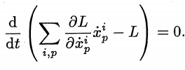
We have:
$$⟺$$
$$→$$
The energy conservation law is a consequence

Slide 10
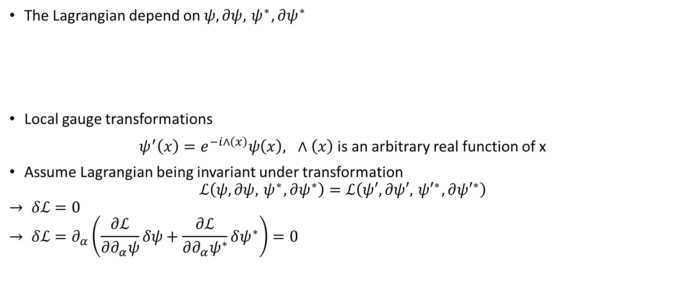
3. Charge Conservation
The Lagrangian depend on $ψ,∂ψ,{ ψ}^{∗}, ∂ψ^{∗}$
Local gauge transformations
$ψ^{′}\left(x\right)=e^{−i∧\left(x\right)}ψ\left(x\right), ∧\left(x\right)$ is an arbitrary real function of x
Assume Lagrangian being invariant under transformation
$$ℒ\left(ψ,∂ψ,{ ψ}^{∗}, ∂ψ^{∗}\right)=ℒ\left(ψ′,∂ψ′,{ ψ′}^{∗}, ∂{ψ′}^{∗}\right)$$
$$→ δℒ=0$$
$$→ δℒ=∂_{α}\left(\frac{∂ℒ}{∂∂_{α}ψ}δψ+\frac{∂ℒ}{∂∂_{α}ψ^{∗}}δψ^{∗}\right)=0$$

Slide 11
In order to current and charge are conservation, considering infinitesimal gauge transformations
$ψ^{′}=ψ+δψ= ψ+i∧ψ$ $∧$ is an infinitesimal quantity
$ψ^{′∗}=ψ^{∗}+{δψ}^{∗}=ψ^{∗}+i∧ψ^{∗}$
$→$ $δℒ=∂_{α}(−i)\left(\frac{∂ℒ}{∂∂_{α}ψ}∧ψ^{∗}+\frac{∂ℒ}{∂∂_{α}ψ}∧ψ\right)=0$
$$→∂_{α}j^{α}=0$$
$$j^{o}=ρ:denstity of charge$$
$$Q=\int{j^{0}d^{3}x}$$
$$→\frac{∂Q}{∂x^{0}}=0:charge conversation$$

